Slide 1
MODULE 3: The Basics of Logic Design
Computer Organization (CS220)
Semester 2021-22-II
Urbi Chatterjee
CSE, IIT Kanpur

Slide 2
Field Programmable Gate Array (FPGA)
Application-specific integrated circuits (ASICs) and Field Programmable Gate Arrays (FPGAs)
Advantages of FPGA
Low cost
High performance
parallelism
Re-programmability
No sophisticated equipment for production
No third party involved, increasing trust in hardware circuits.
Need to be designed carefully
Realisation of basic operations using Look-Up-Tables
Enhanced utilization
Meeting the timing constraints.

Slide 3
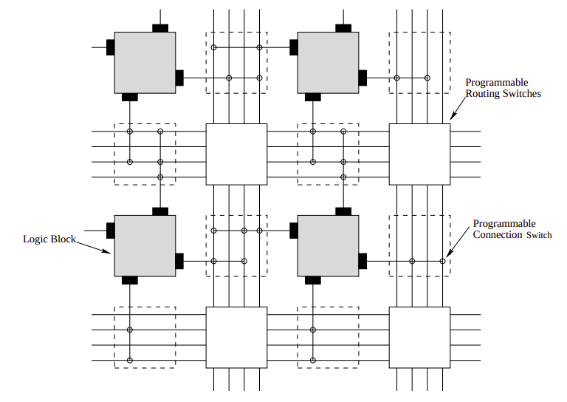
FPGA Island-Style Architecture
Input/output (I/O) blocks and the core
Programmable Logic Blocks:
Logic circuitry for implementing logic.
Surrounded by routing channels connected through switch blocks and connection blocks.
Programmable Routing Architectures
Switch block: adjacent channels through programmable switches
Connection block: logic block to its inputs and outputs through programmable switches.

Slide 4
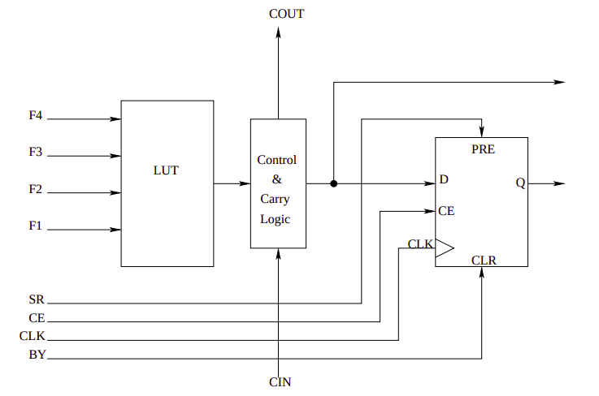
FPGA Logic Block
The Look-Up Table or LUT is a RAM-based function generator and is the main resource for implementing logicfunctions.

Slide 5
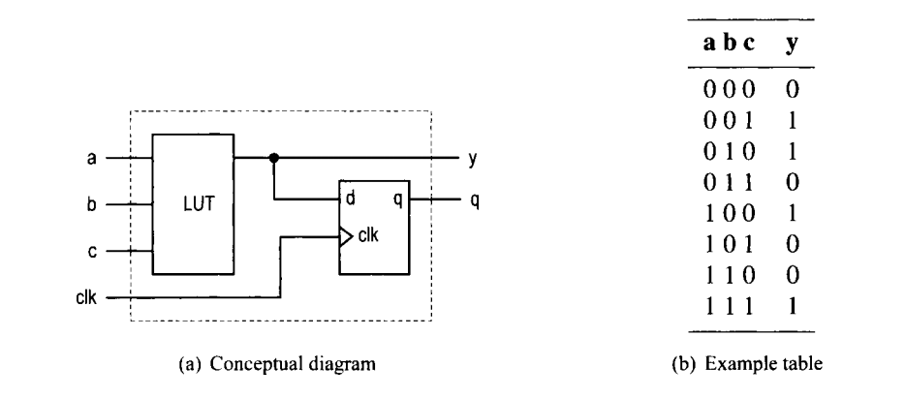
Three-input LUT-based logic cell

Slide 6
Macro cell
Designed and fabricated at the transistor level, and their functionalities complement the general logic cells.
Commonly used macro cells include memory blocks, combinational multipliers, clock management circuits, and interface circuits.
Advanced FPGA devices may even contain one or more prefabricated processor cores.

Slide 7
Spartan-3E Family Architecture
Configurable Logic Blocks (CLBs) contain flexible Look-Up Tables (LUTs) that implement logic plus storage elements used as flip-flops or latches. CLBs perform a wide variety of logical functions as well as store data.
Input/Output Blocks (IOBs) control the flow of data between the I/O pins and the internal logic of the device. Each IOB supports bidirectional data flow plus 3-state operation.
Block RAM provides data storage in the form of 18-Kbit dual-port blocks.
Multiplier Blocks accept two 18-bit binary numbers as inputs and calculate the product.
Digital Clock Manager (DCM) Blocks provide self-calibrating, fully digital solutions for distributing, delaying, multiplying, dividing, and phase-shifting clock signals.

Slide 8
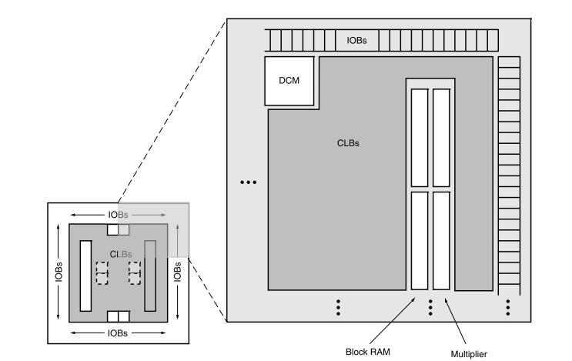
Spartan-3E Family Architecture
Slide Credits: Xilinx and Prof. Mainak Chaudhuri, CSE, IITK.

Slide 9
CLBs
A 2D array of configurable logic blocks (CLBs)
Each CLB has four logic/memory slices.
Each of the two logic slices (SLICEL) has
Two four-input 16-entry look-up table (LUT) function generators (can store any four-input function)
Two registers
Two multiplexors
Arithmetic logic and carry (two full adders)
Each of the two memory slices (SLICEM) has
Everything of a logic slice
Two 16-bit memory blocks (RAM16)
Two 16-bit shift registers (SRL16)
Slide Credits: Xilinx and Prof. Mainak Chaudhuri, CSE, IITK.

Slide 10
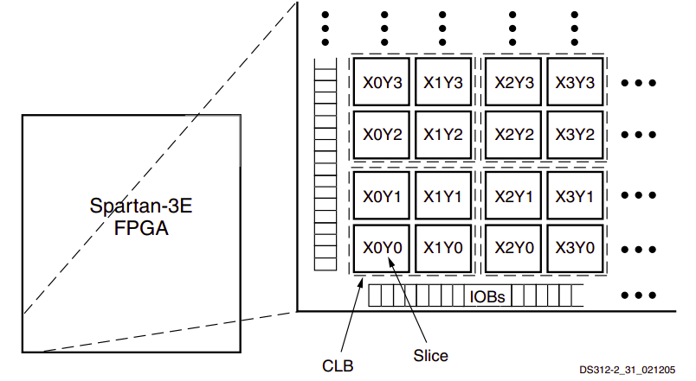
CLB Locations
Slide Credits: Xilinx and Prof. Mainak Chaudhuri, CSE, IITK.

Slide 11
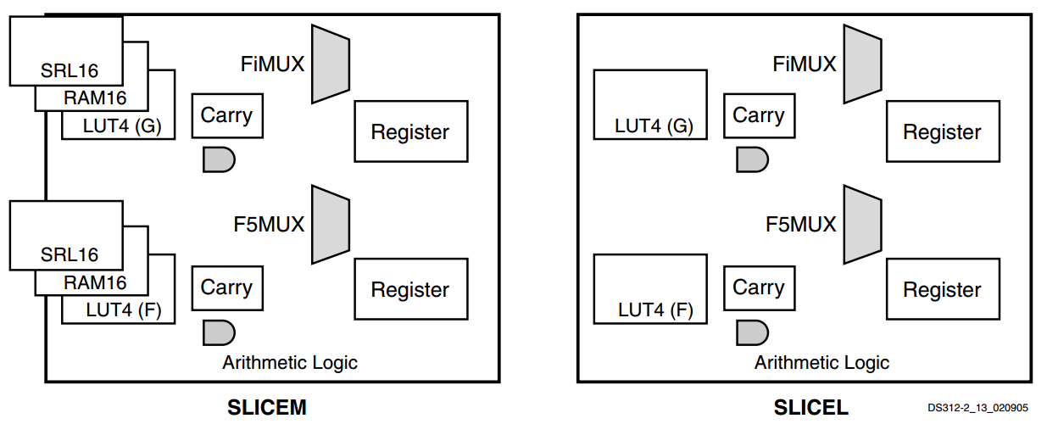
Resources in a Slice
Slide Credits: Xilinx and Prof. Mainak Chaudhuri, CSE, IITK.

Slide 12
LUT Resources in a Slice
The LUTs in each SLICEM pair can be configured as Distributed RAM or a 16-bit shift register.
Each of the two LUTs (F and G) in a slice have four logic inputs (A1-A4) and a single output (D).
Any four-variable Boolean logic operation can be implemented in one LUT.
Functions with more inputs can be implemented by cascading LUTs or by using the wide function multiplexers that are described later.
The output of the LUT can connect to the wide multiplexer logic, the carry and arithmetic logic, or directly to a CLB output or to the CLB storage element.

Slide 13
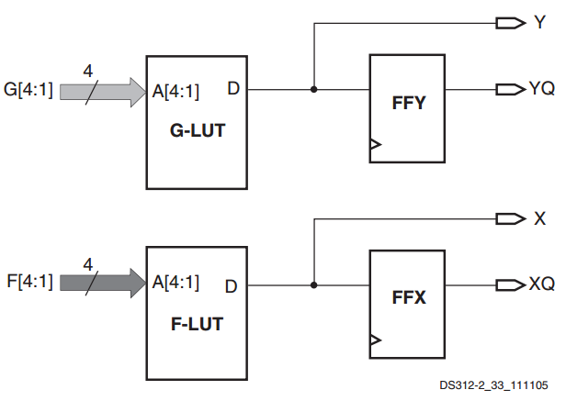
LUT Resources in a Slice
Slide Credits: Xilinx and Prof. Mainak Chaudhuri, CSE, IITK.

Slide 14
Spartan 3 Families
Five family members
100K, 250K, 500K, 1200K, and 1600K logic gates
Specs of XC3S500E
500K gates
1164 CLBs (4656 slices); 46 rows, 34 columns
Some CLB rows and columns are taken up by block RAM, multiplier blocks, DCM
360K-bit block RAM (20 RAM blocks, each 18K bits)
20 multiplier blocks
4 DCMs
Slide Credits: Xilinx and Prof. Mainak Chaudhuri, CSE, IITK.

Slide 15
The FPGA Design Flow
The design flow is a semi-automated or automated sequence of steps that translates the conception of the design to an actual hardware realisation on a target platform.
The sequence of steps starts with the hardware description of the design using a HDL.
Input: HDL Description
Verilog and VHDL.
SystemC, Matlab, Simulink.
Register Transfer Level (RTL): Flow of signals or data between hardware registers and operations that are performed on them.
Behavioural and structural designs .
Hiererchy of modules.
Root node consists of sub-modules, terminates at the leaf nodes (shifters, flip-flops).
Leaf node is behavioural, top levels are structural.
Increases the programmability, readability and testability.

Slide 16
The FPGA Design Flow
Input : Constraints
Input Delay: This delay is from the input pad to the register, which holds the input signals.
Register to Register Delay: The synthesis tool assumes that all combinational paths are to be prformed in a single clock period. This delay computes the critical path of the design.
Setup time: The minimum time that the synchrounous data must arrive before the active clock edge in a sequential circuit.
Hold time: The minimum time that the synchrounous data should be stable after the active clock edge.
False Path: Identify the paths which are never activated.
Multi-cycle Path: Some paths are designed to require more than one clock cycles to become stable. Hence setup and hold time violation analysis for the overall circuit should be done by taking care of such paths.

Slide 17
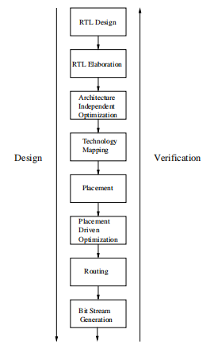
RTL Design: Description of the deisgn in HDL. planning architecture and understanding data-path and control-path, developing RTL codes for sub-modules.
RTL Elaboration: inferring of data-path to be realized by special components internal to the FPGA. and elaborating control-paths into state-machines or Boolean equations.
Architectural Independent Optimization: Not related to to the architecture. Constant propagation, strength reduction, operation sharing for data-path and FSM encoding and state minimization for control paths.
Technology Mapping: Elements of the design optimally assigned to resouces of the FPGAs. IT is FPGA device specific.
Placement: Decides the physical locations and interconnections of each logical blocks. Bad design leads to increase in interconnects, hence performance can degrade.
Placement Driven Optimization: Updated through logic restructuring, rewiring, duplication.
Routing: Global and detailed routing are done to connect the signal nets using restricted routing resources that are pre-designed using programmable switches, wire segments and multiplexers.
Bit Stream Generation: Takes routed design as input and produces the bit-stream to program the logic and interconnects to implement the design the FPGA.

Slide 18
Reference
https://www.xilinx.com/support/documentation/data_sheets/ds312.pdf

Slide 19
Thank you.

