Slide 1

Nowcasting Cryptocurrency Price Changes with Twitter Sentiment Analysis
November, 2017
Ongoing MSFE Student Research Project
Notes:
Yuan
We are first year graduate students from the U of I MSFE program. During the past four weeks, we have been working on this project about….

Slide 2


Leadership Introduction
Dr. Morton Lane
Director, MSFE
Matthew Murphy
Financial Data & Information Specialist, MSFE
Project Supervisor
Notes:
Yuan First of all, we wanna express our thanks to Dr. Lane, who suggested this project, and Mattew who is supervising our team.

Slide 3





Team Introduction
Tengxiao (Andrew) Yan
Class of 2018
MSFE
UIUC
ty8@illinois.edu
Lijun (LJ) Huang
Class of 2018
MSFE
UIUC
lhuang70@illinois.edu
Yuan (Zoe) Liu
Class of 2018
MSFE
UIUC
yuanl5@illinois.edu
Yixiao (Alex) Xu
Class of 2018
MSFE
UIUC
yixiaox2@illinois.edu
Lingbo (Erin) Lu
Class of 2018
MSFE
UIUC
lingbol2@illinois.edu
Notes:
Yuan and self intro

Slide 4
Goal
Use Twitter data to develop advantageous crypto currency trading strategies
Data Analysis
Algorithm Development
Sentiment Analysis
Supervised Learning Algorithms
Turn Twitter crypto currency relating data into valuable indicator, including multiple factors such as volume and ID along with the polarity score
Machine Learning Algorithm to identify crypto currency market movement
Future potential: Expand to the use of Chinese social media data (e.g. Wechat & Weibo)
“Algorithmic Trading of Cryptocurrency Based on Twitter Sentiment Analysis”
Notes:
llb

Slide 5
Method
Turning Tweets into Market Insights
Data Collection & Data Processing
Use the Python library “Tweepy” to access the Twitter API
Set up Amazon Cloud server for data extracting
Data cleaning & Sentiment scoring
Group score vectors by time span to match with price data
Additional efforts in plan: Distinguish between institutional/private IDs; Consider volume
Core Algorithm
Supervised learning algorithms
Naïve Bayes & Random Forest
Train with 1 million tweets data for testing purpose
In the process of: obtaining recent market data for training
Additional efforts in plan: Develop Nero Network model
Optimization
Statistic analysis
Model evaluation & improvement
Notes:
llb

Slide 6
Data Collection & Processing

Slide 7
Twitter Dataset and Feature
Use “Tweepy” to access Twitter API; Further cleaned and bundled into files
Comprehensive data for the time span
Capture all related data
200,000 tweets/day
Error exception
Robust algorithm to deal with multiple potential errors in data extracting process
Keep multiple features for future screening
“ID”, “Source”, “Retweet Count”, “Location”, “Followers count”
Amazon cloud server to constantly extract data; Use API to process and bundle
Source: tweepy.org
Notes:
lijun

Slide 8
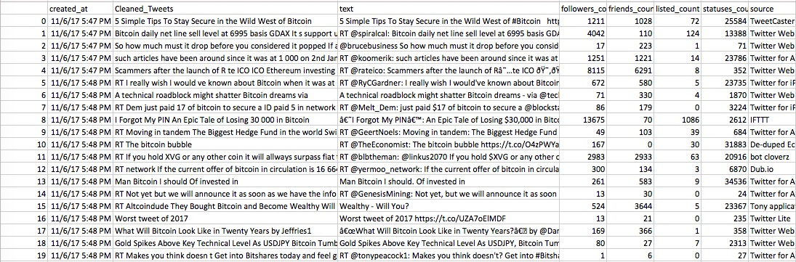
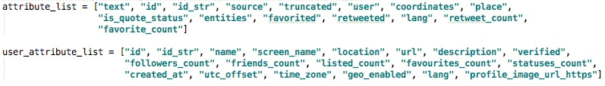
Data Sample
Time
Cleaned Text
Raw Text
Additional efforts in the future: Distinguish between institutional/private IDs; Consider volume; Include degree of influence manifested in retweet count
Notes:
lijun

Slide 9
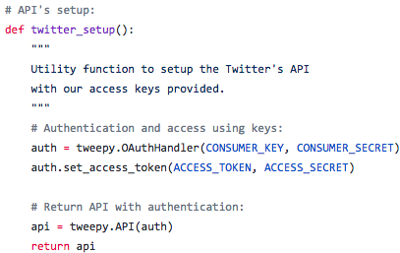
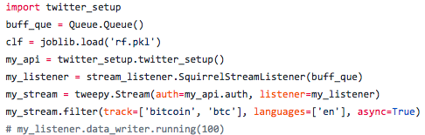
Code Sample – Data Extracting
Notes:
dalao

Slide 10
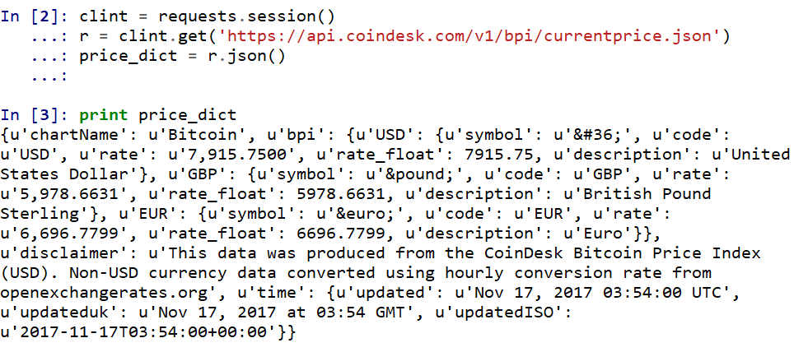
Code Sample – Extracting Price
Notes:
dalao

Slide 11
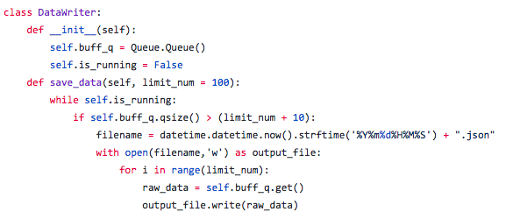
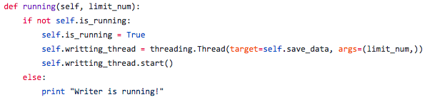
Code Sample – Streaming to File
Writing file in the background to separate from the data extracting process, avoid interference
Notes:
dalao

Slide 12
Data Processing and Format
Data Clean
Remove “non-English” with API
Sentiment Score
Score polarity with language processing API
Data Group
Group score vectors by time span
Price Match
Extract crypto currency (bitcoin) price data & match with sentiments by time
Notes:
yixiao

Slide 13
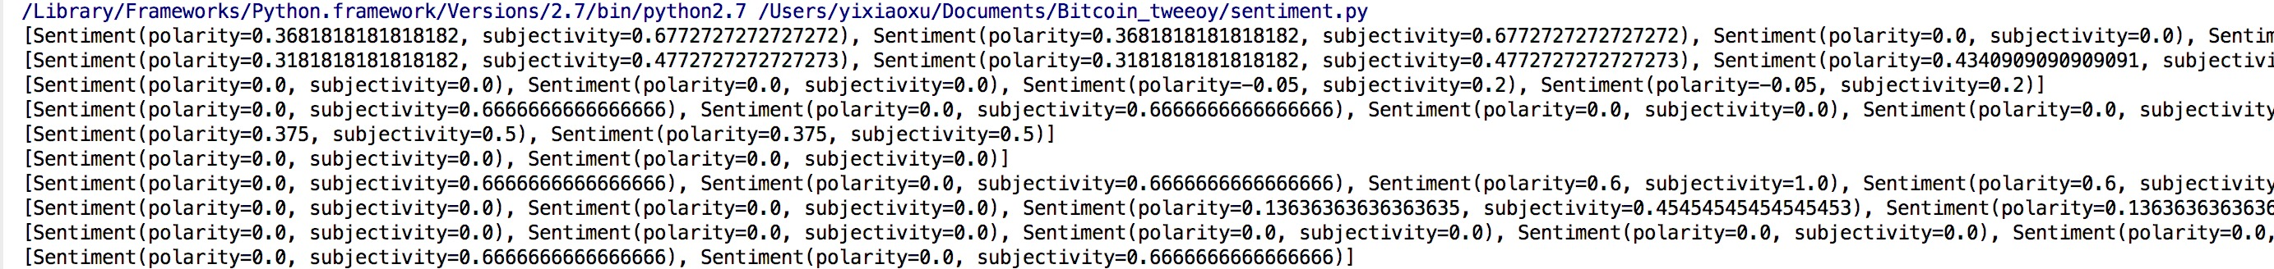
Data Processing and Format
Label
0
1
0
0
1
1
0
Feature 1 | Feature 2 | Feature 3 | Feature 4
-0.34 | 0.12 | -.02 | -0.31
0.67 | 0.58 | 0.72 | 0.69
-0.26 | 0.01 | 0.21 | 0.21
-0.73 | -0.52 | -0.45 | 0.11
0.94 | 0.81 | 0.78 | 0.78
0.86 | 0.83 | 0.98 | 0.92
-0.22 | 0.0 | 0.05 | -0.03
NLTK produces sentiment object that has a “polarity” score and “subjectivity” score
We focus on the polarity score that measures the positivity/negativity of tweets
Using “TextBlob” and “NLTK(Natual Language Toolkit)” APIs for scoring
Notes:
yixiao

Slide 14
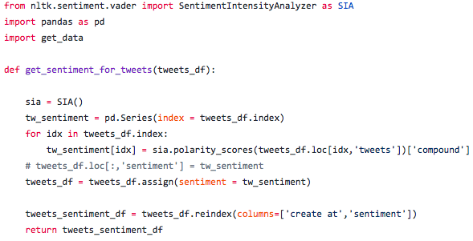
Code Sample – Sentiment Scoring
Natural Language Toolkit Processor
Using “TextBlob” and “NLTK(Natual Language Toolkit)” APIs for scoring
Notes:
dalao

Slide 15
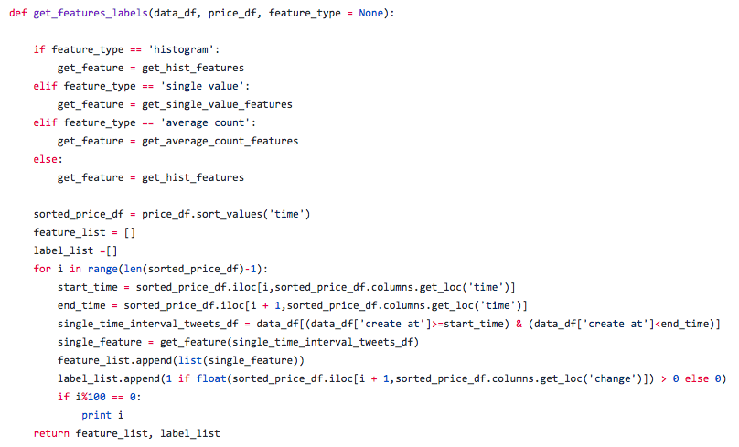
Code Sample – Grouping by Time
Sort and get the start and end time from the price data to determine time intervals
group tweet data features by each time interval
Sort the feature read from data file by time
Notes:
dalao

Slide 16
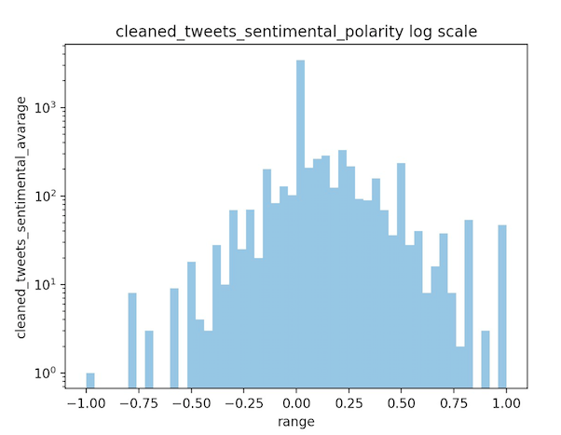
Data Primary Analysis
0-centered, slightly positive scores
Notes:
Sentiment score histogram on 2667 tweets

Slide 17
Machine Learning Algorithm

Slide 18
Naïve Bayes Classifier
The representation for naive Bayes is probabilities.
Includes:
Class Probabilities: The probabilities of each class in the training dataset.
P(class=1) = count(class=1) / (count(class=0) + count(class=1))
Conditional Probabilities: The conditional probabilities of each input value given each class value.
P(weather=sunny|class=go-out) = count(instances with weather=sunny and class=go-out) / count(instances with class=go-out)
Notes:
lijun

Slide 19

Naïve Bayes Process
Summarize data
Separate Data By Class
Calculate Mean
Calculate Standard Deviation
Summarize Dataset
Summarize Attributes By Class
Make prediction
Calculate Gaussian Probability Density Function
Calculate Class Probabilities
Make a Prediction
Estimate Accuracy
Notes:
Lijun https://machinelearningmastery.com/naive-bayes-classifier-scratch-python/

Slide 20
Naïve Bayes
Pros
Cons
Easy and Fast
Unrealistic assumption of conditional independence
Performs good in categorical inputs
The method assumes conditional independence among attributes
P(d1,d2,d3|h) = P(d1|h)*P(d2|h)*P(d3|h)

Slide 21
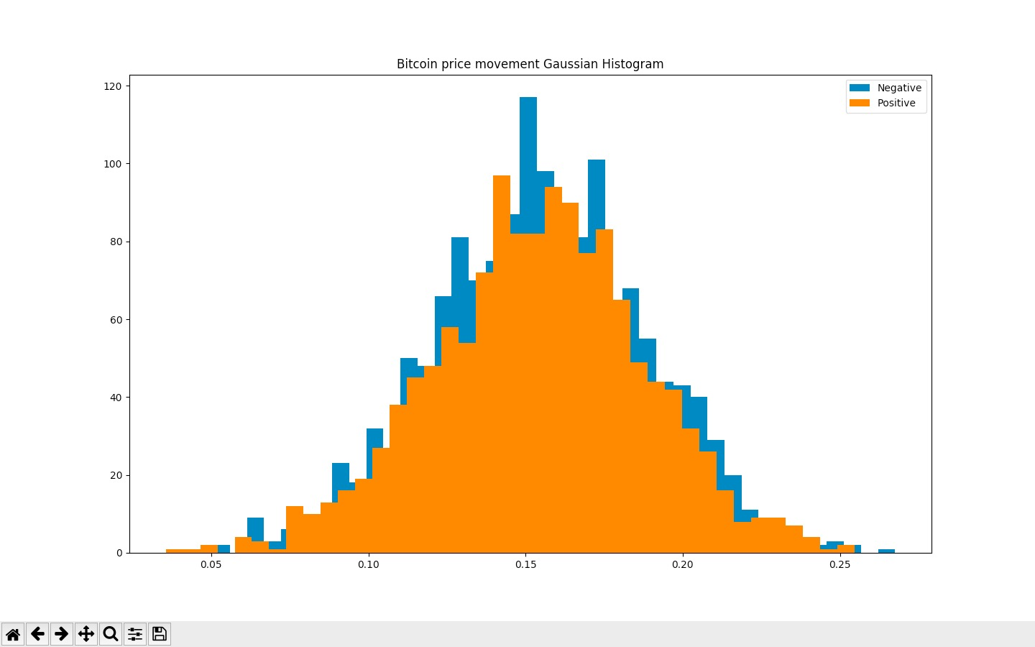
Naïve Bayes First Attempt Result
Both positive and negative price movements exhibit Gaussian distribution, with major overlap
Notes:
lijun

Slide 22

Problems with the Scoring API
While the first example obviously is more positive than the second one, it gets a bad score
Our next step is to investigate into the sentiment scoring APIs, and develop a scoring system that better serves our research needs
Notes:
yuan

Slide 23
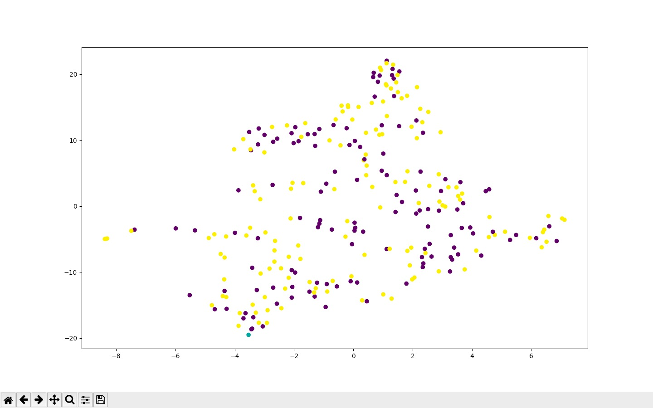
Visualize Feature Data for Validity Check
Dimensional reduction graph for the Positivity and negativity feature, suggesting small differentiate power
Notes:
lijun

Slide 24
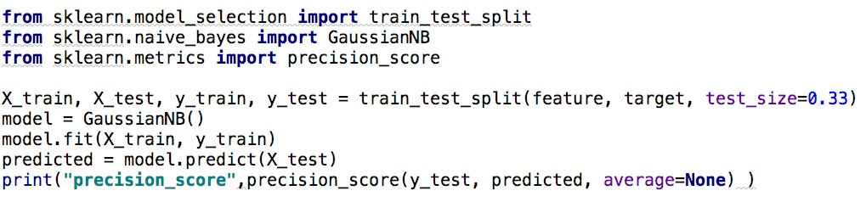
Naïve Bayes Code Sample
Source: scikit-learn.org
Notes:
Lijun https://machinelearningmastery.com/naive-bayes-classifier-scratch-python/

Slide 25

Random Forest
Decision Tree
ID3 Decision Tree
Random Forest
“Best A” – maximize Gain(D,a)
Randomly choose d features and samples with these features
Feature 1
Feature 2
Pure set
Pure set
Feature 2
Pure set
Train and get many decision trees
Combine them and use the vote result
Notes:
dalao

Slide 26
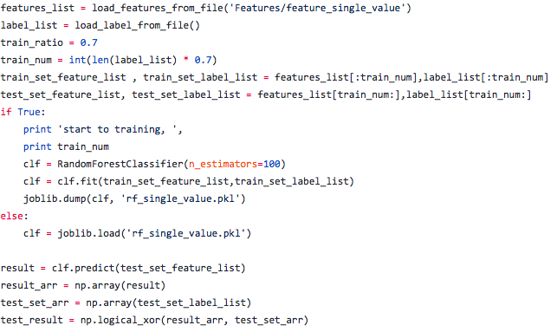
Random Forest Code Sample
Notes:
dalao

Slide 27
Future Plans
Feature Engineering
Additional Models
Other Applications
Customized Keywords Frequency
SVM
Stocks
Assign Weights
Neural Network
Indices
Info other than Tweet Text
Deep Learning
Other Social Media Platforms
Notes:
yixiao

Slide 28
Thank You!
Please follow up with the project on GitHub.
github.com/flios/SquirrelX

