Slide 1
Obfusicating bytes/LayerProx
By Filip

Slide 2
Whoami?
Filip, nick flipchan
gymnasie elev/<morestuff>
Sometimes does pentests,Opensource Programmer, Duckduckgo etc

Slide 3
About one/two years ago
irl email from isp, meh just doin something
Sits in the Basement ->
Friend of my phonecall from his isp(called his mom), Asshole takes my pc

Slide 4
Back 2 the basement
Idea gets in to my head
What if I could encrypt and make my data look like im visiting site B while am really on site A
Could be some next level Trolling with my isp

Slide 5
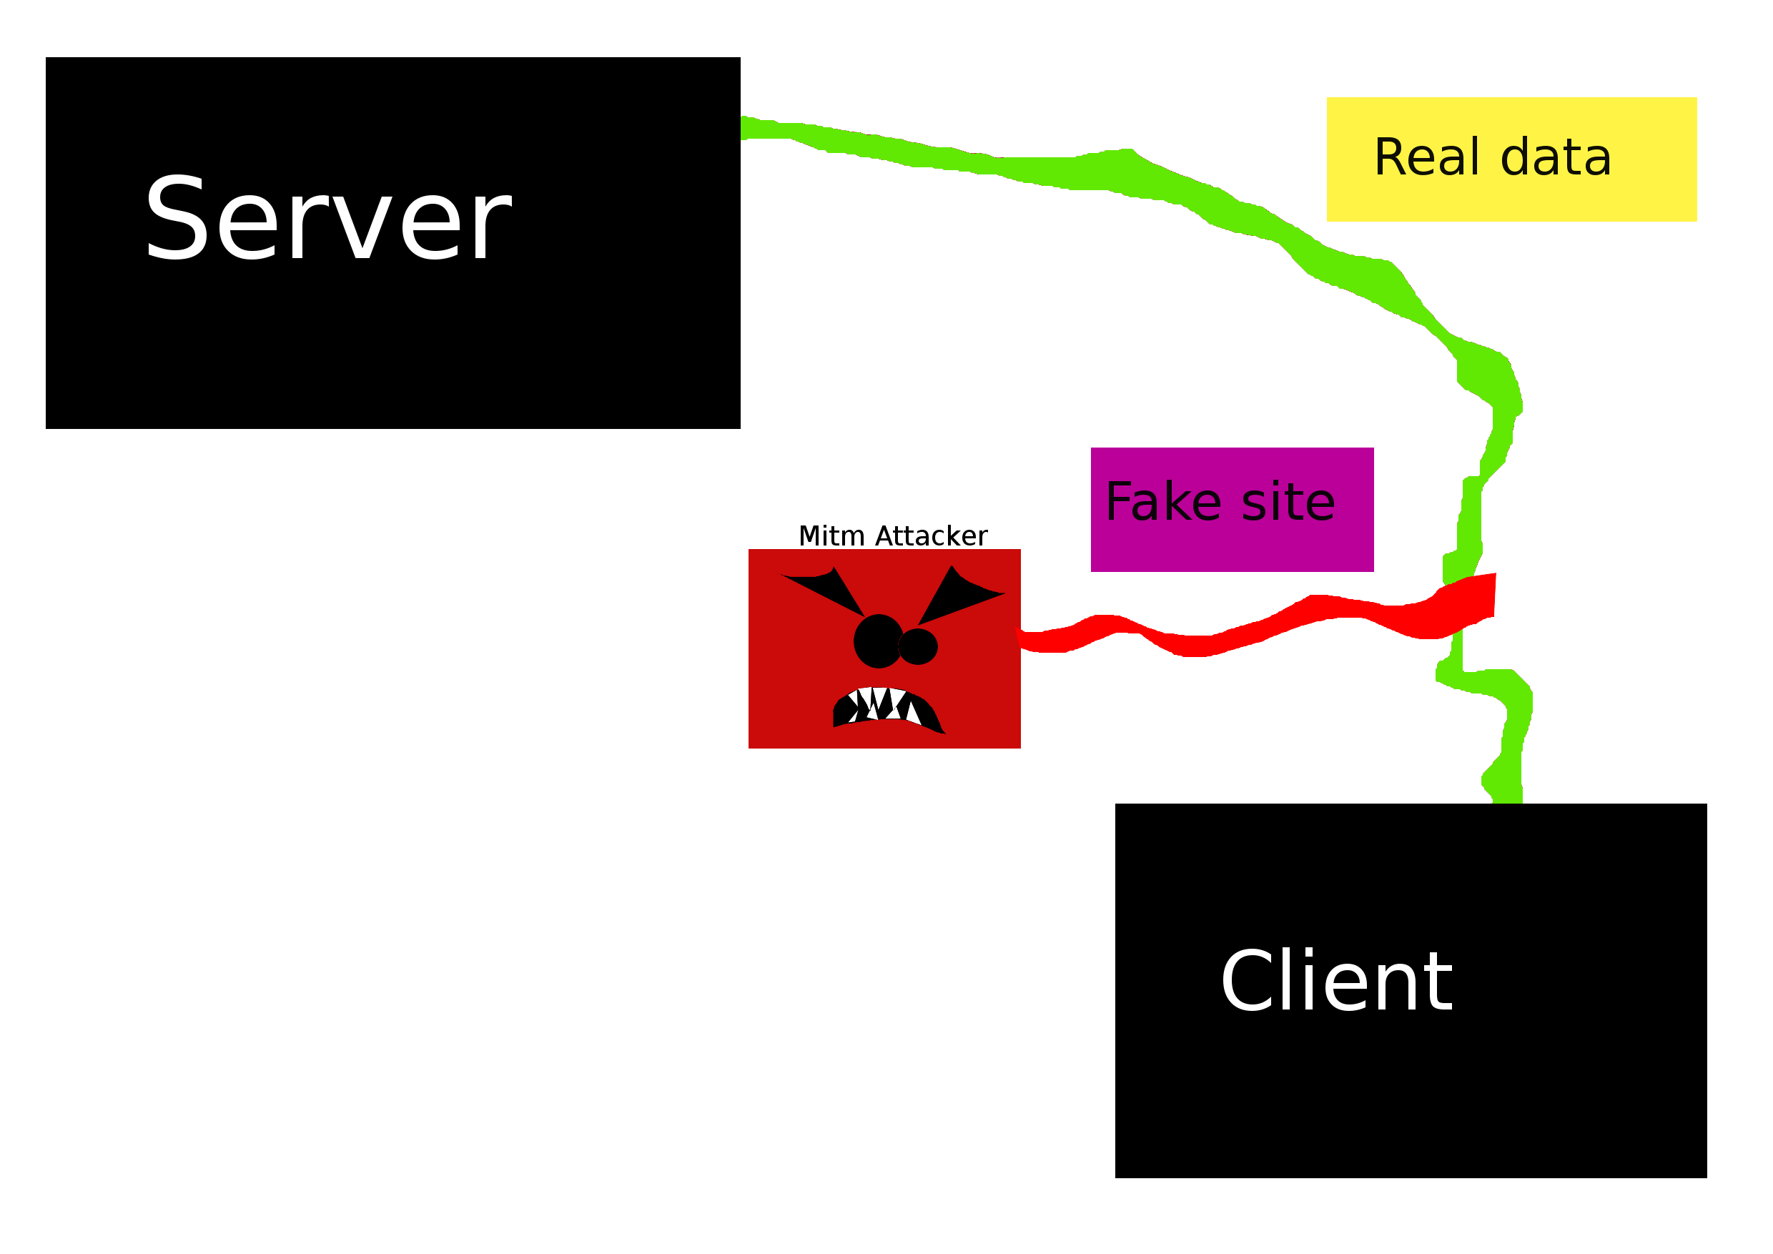

Slide 6
Noone has done this?
Does a ton research, nothin nothin
Traffic obfusication, closes thing

Slide 7
Crash Course in traffic obfusication
Meaning of Traffic obfusication: making it look like something else
4 Categories:
1:Randomization, 2:Mimic, 3:Tunneling and 4:Programmable Systems
Tor = pluggable transports/obfs,scramblesuit,fte
ScrambleSuit, obfs2-4, FTE , Freewave
CensorSpoofer, SkypeMorph, StegoTorus, uProxy
seprate channels for one for upstream and one for downstream
Fteproxy, Marionette(ultimate Programmable Systems)
Protocol Misidentification
Lantern etc etc..

Slide 8
Talks with people
Talks with Kevin p dyer who is the dev/inventor
of file transformation encryption (/FTE)
Kevin: allmost take a look at this
Marionette

Slide 9
After a million errors
Gets some code working !!

Slide 10
Http Gen thats what I want
Failing of Http generation is current state of other systems
GET /snsjlvreoraviorrvneoerjrveieejasvjjsavnsdjasvnruvn HTTP1.0
What http data can be spoofed?
Goal:
Look legit, be legit , alexa top rated

Slide 11
Dev Goes on
Starts to write regex'es to gen legit looking http-data
Source/Dst ip spoofing? Not any real luck
Fake webproxy(/web-ui)? Hell yeah!
/webproxy/<myurl>

Slide 12
After some time ..
Gets more regex'es working
Mods n tweaks Marionette
LayerProx is born

Slide 13
Spoofing the average user
What I use everyday(ish): ebay, cxsecurity, youtube, amazon, packetstorm
rtm.ebay.com/clk?RtmClk&u=1H4sIAAAAAAAAAEXMT2uDMBzG8bvgexBGd0vNLzF%2FLIThag8De2phDI
QSY1pDW5U0rmyvfhYGvTyXz5fnZT%2FZpJhOCfAEixWIFYNku9snBAOPIz%2BpLoSxXqXp%2FX5f2kb%2FLM1wT
V24pmsX3K%2Ft0cYM qPTu26L3y2RR0Z%2Fs5YY%2BB39p0brzQz%2BcvB47VFkdOuvR1vYz62A6VOwl
JhhhWqEUBHDJWUaogLdD8OdR%2B%2But VgvC%2FTgejGsXtGSctpRk2GYN5lJCbnPL2TH%2Fj9yzItrwR2WO
NM8aIYwB9vq4vbm2VnGkB4Xnda0qi4%2Fqq9wU1S6OmlZBLrIckzhyswkmiZBYcGCCQiaBzeDPCuLoD0z0BGU6AQAA
&ch=3&g=93b72e521560a624b0e5b7bdfff9fa8d&aii=75827807615731
48152&lid=1974902&m=650405&pi=2057337%0A%09%09%09%09%09%09&%0A%09%09%09%09%09%09_ trksid=e100084.m1843
https://www.youtube.com/watch?v=H0g3Z77synI - 11 watch id bytes
https://cxsecurity.com/issue/WLB-2016080149 - cve id
https://www.amazon.com/b/?_encoding=UTF8&node=6669702011 - node id
https://packetstormsecurity.com/files/favorite/138347/ - favorite id (/thinks its cool)
Tinyurl, pastebin, beefhook, funny msgs in pcaps/header etc, sites Use Mysql ids to much... easy 2 spoof

Slide 14
Regex Based dsl spofing
Syntax GET /webbproxy/<theurl>
GET / http://rtm.ebay.com/clkRtmClk&u=1H4sIAAAAAAAAAEXMT2uDMBzG8bvgexBGd0vNLzF%2FLIThag8De2phDSCVIQSY1pDW5U0rmyvfhYGvTyXz5fnZT%2FZpJhOCfAEixWIFYNku9snBAOPIz%2BpLoSxXqXp%2FX5f2kb%2FLM1wTV24pmsX3K%2Ft0cYM qPTu26L3y2RR0Z%2Fs5YY%2BB39p0brzQz%2BcvB47VFkdOuvR1vYz62A6VOwlJhhhWqEUBHDJWUaogLdD8OdR%2B%2But VgvC%2FTgejGsXtGSctpRk2GYN5lJCbnPL2%2Fj9yzItrwR2WONM8aIYwB9vq4vbm2VnGkB4Xnda0qi4%2Fqq9wU1S6OmlZBLrIckzhyswkmiZBYcGCCQiaBzeDPCuLoD0z0BGU6AQAA&ch=3&g=93b72e521560a624b0e5b7bdfff9fa8d&aii=7 582780761573148152&lid=1974902&m=650405&pi=2057337%0A%09%09%09%09%09%09&%0A%09%09%09%09%09%09_ trksid=e100084.m1843
GET/webbproxy/http://rtm.ebay.com/clkRtmClk&u=hrDCNnJnuWxAxBzg5/TLtqsyGrier22ThGzAdNPGyU/TsO0kW+MGXbymRJx/w%R42lahdasJ7u1y/Uk2zhOywg16zNuNdWIUqwpCQ%bHuf8EA3+SZgvatqGf11+qH+1x4%68WE1DHSNqoD35ixb93uICfxQMMxywFrMhmQA5aWzi3DtBcj3GtOA7Ry8UWG2APpq6xo/ry/vmim+jQ=XQfXk0pAe5JozhJYOO0zBEeCTE+tlpPuZE3TgDKc/94BiEyJmSsRtBxkF8dkznrloVlL%2B%2But VgvC%DPVIomh79+A5Y07JQoeb2W9MNxgI/vm+/SMry62QDu0q7ZAc1g%vn3HQca/RZJNyI5ZFEhjGo+J7g4gpha7cb6n+of39rY37fuZwXDS8fyBEZ8WuLnS7sUjdOUxRDiRVXY&ch=W&g=EXyFRanUmSLwNhjDi+nGSFsazvwUm2cCcMX0go/QJGY&aii=hx1/o8/cfgDsXUi6BWkxdwgfQA&lid=HSP0W56&m=G52KXM&pi=JSBFRTLOW%GC%HA%8X%5I%OQ%DA%CC%7L%3M%93%4C%FW%LV%T1_trksid=e100084.m1843

Slide 15
LayerProx? What is this?
Started as a idea/wanted it to become a PoC
Make data look like something else
User X visits site A, mitm person looks at traffic
and thinks he visits site B

Slide 16
How it works
Think → Steganography
Traffic Route:
[1] proxy listens, socks4a, socks5 added
[2] grabs data
[3] --encrypts it and runs it throw fte with regex2dfa -> gets converted to binary data
[4] a format gets chosen
[5] binary data gets injected in to the next mimic data layer
[6] layer of mimic http data(our spoofed urls)

Slide 17
LayerProx whois involved
Me(lead dev, does stuff)
Kevin(sometimes helps/inventor of FTE n marionette)
Mr b(protector of the bytes/isp)
Some other ppl/crypto etc..

Slide 18
Why build a Traffic obfs system?
OpenVPN meh(not build for anonymization, lack of good vpn providers, autolog)
Whats out on the net needs a facelift
Tor is good(anyone can set up an exit node../HiddenServices are great doe)
Privacy (implement uptodate-crypto make it resist modern computers/techniques, even utah datacenter)
Customization build what fits you

Slide 19
Webui
Auto changes server headers to avoid fingerprinting
#root@box:~# curl -I http://127.0.0.1:80/
#HTTP/1.0 200 OK
#Content-Type: text/html; charset=utf-8
#Content-Length: 198
#Server: Apache
#root@box:~# curl -I http://127.0.0.1:80/
#HTTP/1.0 200 OK
#Content-Type: text/html; charset=utf-8
#Content-Length: 198
#Server: Nginx

Slide 20
Analyst resistance(ish/allmost)
With fte easy to make the pcaps look legit/Protocol Misidentification
Autoshift formats – coming in new version(ML/v2)
Correlations very hard, the (regex-based)”dummy traffic PoC” implemented,
DUMMY-implementations with delays!

Slide 21
Crypto
Started with ChaCha20Poly1305 AEAD + aes
Then moved on to scrypt n pgp
Scrypt sucks
Off the wire/improved off the record
Pgp sign n crypt + Aes-ctr + blake2
Sometimes I just run it with pgp
ML new stuff based on crypt node
Dont rly like diffie hellman, microsofts
Supersingular isogeny Diffie-Hellman against quantum computing maybe..

Slide 22
Real data vs spoofed
Ebay
Built on the idea to hide in plainsight

Slide 23
Protecting users
Combine with a tor relay/Note traffic may get throttled
No ip logging
Encrypted traffic

Slide 24
Backup by Mr b
OpenBSD
OpenSourceBased - ISP
No dmca

Slide 25
ML(in the future)
DHT
Based on Gnutella, Bittorrent and Crypto Node(alot of )
New feauters

Slide 26
dpi
Checks whats blocked
Deep package injection / Deep package inspection
Signatured based/i guess
Great research → the ppl @ ooni(ooni.torproject.org)

Slide 27
Internet Traffic
15 exa bytes enligt bruce schneider
Hide it in plainsight

Slide 28
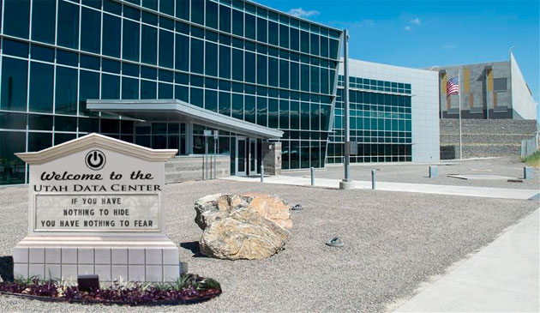
Where do “they” store all data?
Private data center

Slide 29
Obfusciating Torrent traffic
Spridnings kollen
Udp socks5

Slide 30
Whats Next?
More dev
New version yey
Checksum checkings – with blake maybe
Public servers, should be out, lazy dev zZz

Slide 31
Sum up/Thanks to/Big up
Kevin p dyer, 2600(n bernie), wingware, mr b, *
Opensource hackit/breakit/rebuildit, Pub Servs(throttled)
Git clone https://github.com/flipchan/layerprox,
Encrypt your traffic, Dont use isp's Telenor or DG-access
Some whitepapers I recommend:
. - kevins/marionette(Marionette: A Programmable Network-Traffic Obfuscation System) – philipp winters (chinese firewall) -CensorSpoofer (CensorSpoofer: Asymmetric Communication using IP Spoofing for Censorship-Resistant Web Browsing(No PoC.../no email response/noone knows em))

Slide 32
The End
Questions?
Other stuff?

