Slide 1
Pgp End to end encryption with spoofed http data
By:
Filip Kälebo

Slide 2
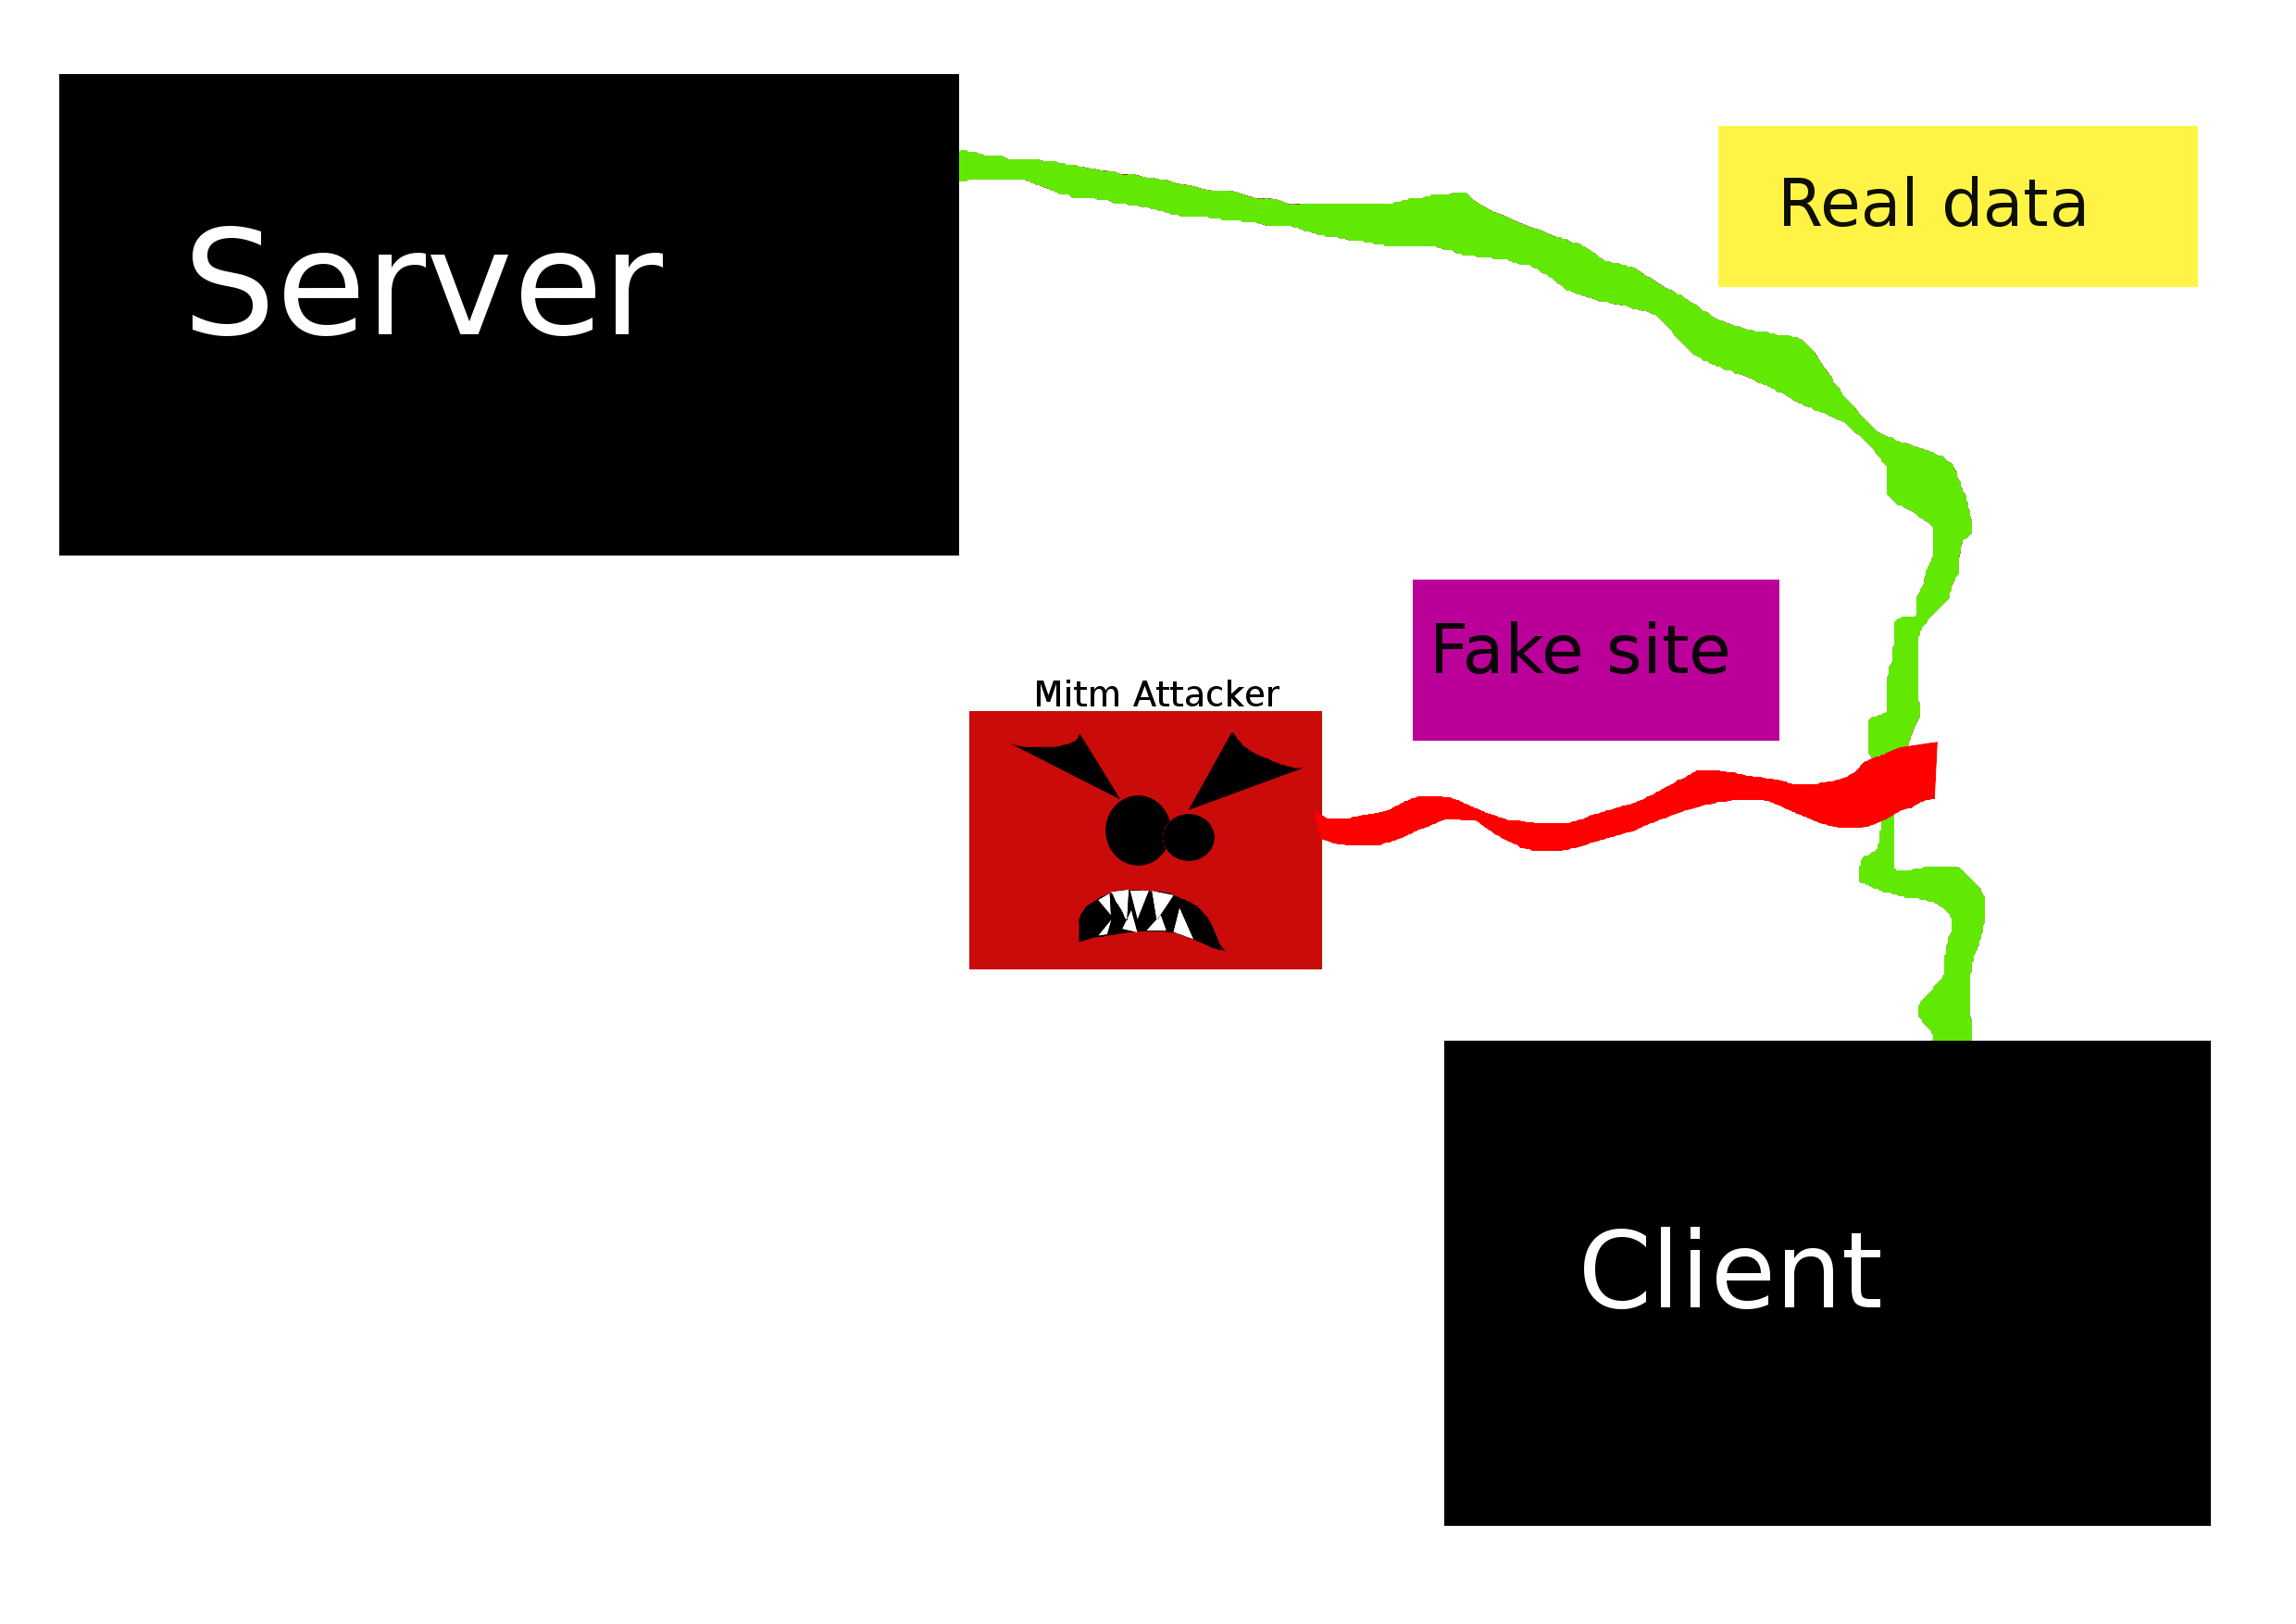

Slide 3
Obfuscation Systems
Tor
ScrambleSuit, obfs2-4,FTE , Freewave
CensorSpoofer, SkypeMorph, StegoTorus
Randomization, Mimic, Tunneling and Programmable Systems
Fteproxy, Marionette
Protocol Misidentification

Slide 4
Failing of Http generation
GET /snsjlvreoraviorrvneoerjrveieejasvjjsavnsdjasvnruvn HTTP1.0

Slide 5
What http data can be spoofed
Look legit, be legit
Top rated sites

Slide 6
ebay, cxsecurity, youtube, amazon, packetstorm
rtm.ebay.com/clk?RtmClk&u=1H4sIAAAAAAAAAEXMT2uDMBzG8bvgexBGd0vNLzF%2FLIThag8De2phDI
QSY1pDW5U0rmyvfhYGvTyXz5fnZT%2FZpJhOCfAEixWIFYNku9snBAOPIz%2BpLoSxXqXp%2FX5f2kb%2FLM1wT
V24pmsX3K%2Ft0cYM qPTu26L3y2RR0Z%2Fs5YY%2BB39p0brzQz%2BcvB47VFkdOuvR1vYz62A6VOwl
JhhhWqEUBHDJWUaogLdD8OdR%2B%2But VgvC%2FTgejGsXtGSctpRk2GYN5lJCbnPL2TH%2Fj9yzItrwR2WO
NM8aIYwB9vq4vbm2VnGkB4Xnda0qi4%2Fqq9wU1S6OmlZBLrIckzhyswkmiZBYcGCCQiaBzeDPCuLoD0z0BGU6AQAA
&ch=3&g=93b72e521560a624b0e5b7bdfff9fa8d&aii=75827807615731
48152&lid=1974902&m=650405&pi=2057337%0A%09%09%09%09%09%09&%0A%09%09%09%09%09%09_ trksid=e100084.m1843
https://www.youtube.com/watch?v=H0g3Z77synI - 11 watch id bytes
https://cxsecurity.com/issue/WLB-2016080149 - cve id
https://www.amazon.com/b/?_encoding=UTF8&node=6669702011 - node id
https://packetstormsecurity.com/files/favorite/138347/ - favorite id
Tinyurl, pastebin, beefhook etc..

Slide 7
http packages
Fake a Proxywebui
GET /webbproxy/proxyurl?=fakeurlhere
Ebay
"192.168.1.3","192.168.1.5","HTTP","1514","
GET
/webbproxy/proxyurl?=/http://rtm.ebay.com/clRtmClk&u=GwuJHVKr4DopIA
CnbgcgcnxVJq6O8l91pr9Injskfvbskdvbjskvdjsbb0fYC7ipND8UjcLLRPaXlblki8mTclRtmClk&u=TCIGrizzocM023liZtr HTTP/1.1
See everything @
https://github.com/flipchan/LayerProx/blob/master/whitepaper/fullyworking_all_plugins.pcapng

Slide 8
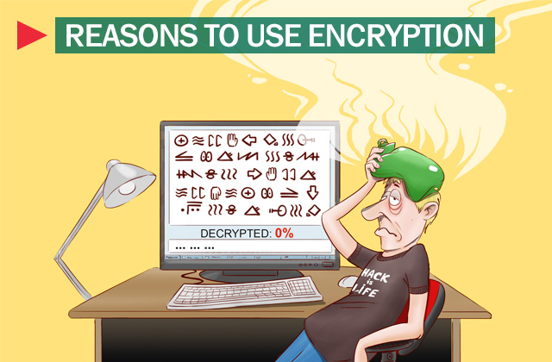
Crypto
PGP, Scrypt

Slide 9
Key storage
Plaintext
Use Steganography?
Solution? Encrypt swap?

Slide 10
Ip-address Logging
Aquman edition
Replace the ip addresses that are being loged

Slide 11
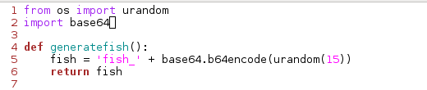
6 line script
Cat fish.py

Slide 12
What can it be used with?
Proxychains, irc, ssh, browser, voip etc..
Tcp Socks4a Proxy

Slide 13
Demo time

Slide 14
Next step?
Gui
Patch, update, deploy
Release version 2
All code: github.com/flipchan/LayerProx
Hack it, break it, rebuild it
Get in touch with me?
tweet me @filipsweet (FLIPCHAN)

