Slide 1
期中试题分析
2022.4.14 Shuang Song

Slide 2
名词解释 (1)
(1) CMOS Complementary Metal Oxide Semiconductor 互补金属氧化物半导体
(2) DSP Digital Signal Processor 数字信号处理器
(3) FPGA Field Programmable Gate Array 现场可编程逻辑门阵列
(4) ASIC Application Specific Integrated Circuit 专用集成电路
(5) CVD Chemical Vapor Deposition 气相沉积法
(6) SOI Silicon on Insulator 绝缘体上硅
(7) DRC/LVS Design Rule Check 设计规则检测
/Layout Versus Schematics 验证版图和逻辑图
(8) C_{GS} / C_{BD} gate-source capacitance/ Bulk drain capacitance 栅-源/衬底-漏电容
(9) Cascode/Cascade (中文) 共源共栅(垂直级联)/水平级联
(10) BGR Bandgap Voltage Reference 带隙基准电压

Slide 3
名词解释 (2)
(11) PTAT Proportional to Absolute Temperature 与绝对温度成正比
(12) ZTC Zero Temperature Coefficient 零温度系数
(13) OTA operational transconductance amplifier 跨导运算放大器
(14) SiP System In a Package 系统级封装
(15) ISSCC/JSSC IEEE International Solid-State Circuits Conference 国际固态电路会议/ IEEE Journal of Solid-State Circuits IEEE固态电路学报

Slide 4
填空 (1)
(1) Moore's Law refers to Gordon Moore's perception that the number of _transistors_ (what) on a microchip _doubles_ (change how many times) every 18-24 month, though the cost of computers is halved.
(2) _Analog_ (Analog/Digital) IC design differs greatly from digital IC design. Where _digital_ (analog/digital) IC design is mostly done at an abstracted level with HDL (Hardware Description Language), _analog_ (analog/digital) IC design generally involves more personalized focus into each transistor, determining the sizing of each.
(3) Modern CMOS technologies involve roughly the following operations: (1) Wafer Preparation: produce the proper type of substrate; (2) _lithography : (step name) precisely define each region by light; (3) Oxidation, deposition and _ion_ (what) implantation: add materials to the wafer; (4) Etching: remove materials from the wafer
(4) The type of transistors in the following figure.1 is _FinFET_ (Planar MOS/FinFET), which is invented for _advanced_ (conventional/advanced) technology node like 14nm CMOS.

Slide 5
填空 (2)
(5) An NMOS transistor with a _ higher _ (lower/higher) Vds tends to work in saturation region. In saturation region, it usually has a _higher_ (higher/lower) small signal resistance (r_{o}) compared to linear region.
(6) An NMOS transistor (working at saturation region) at FF corner has a _lower_ (lower/higher) threshold voltage (Vth) than at TT corner. The same transistor at SS corner has a _higher_ (lower/higher) trans-conductance (gm) than at TT corner.
(7) An NMOS transistor working as a switch has _lower_ (higher/lower) resistance than a PMOS based switch. That is the reason why a transmission gate (consisting of a PMOS and an NMOS transistor) use a larger W/L ratio for _ PMOS _ (NMOS/PMOS).
(8) The Vbe is the following figure has a _ negative _ (positive/negative) temperature coefficient(TC), the KVt has a _ positive _ (positive/negative) TC. A bandgap reference provides a stable output voltage at both temperature and _ voltage _ (what) range.

Slide 6
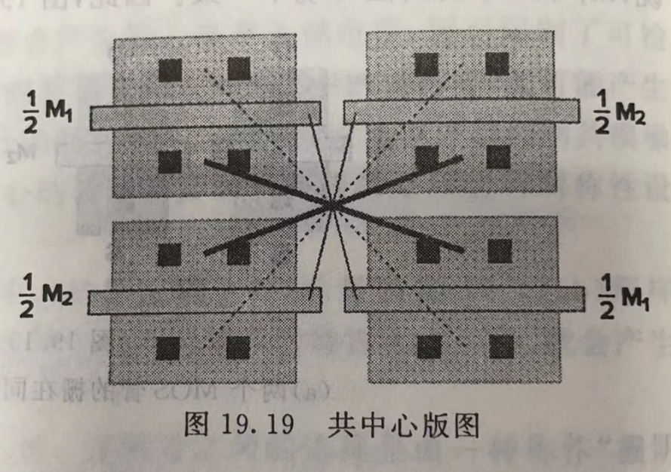
问答题 1
(a) Give the corresponding circuits schematics and mark the W/L sizes of each transistor. Assume λ=0.4μm.
M1,M4,M5:2/3 M2:5/1 M3:5/1
(2)把M1和M2都分为两个宽度为原来一半的晶体管，沿对角放置且并联连接构成二维匹配。
（或者）每个拆分为两个，水平放置，交替连接1/3管 2/4管栅极，构成一维匹配。

Slide 7
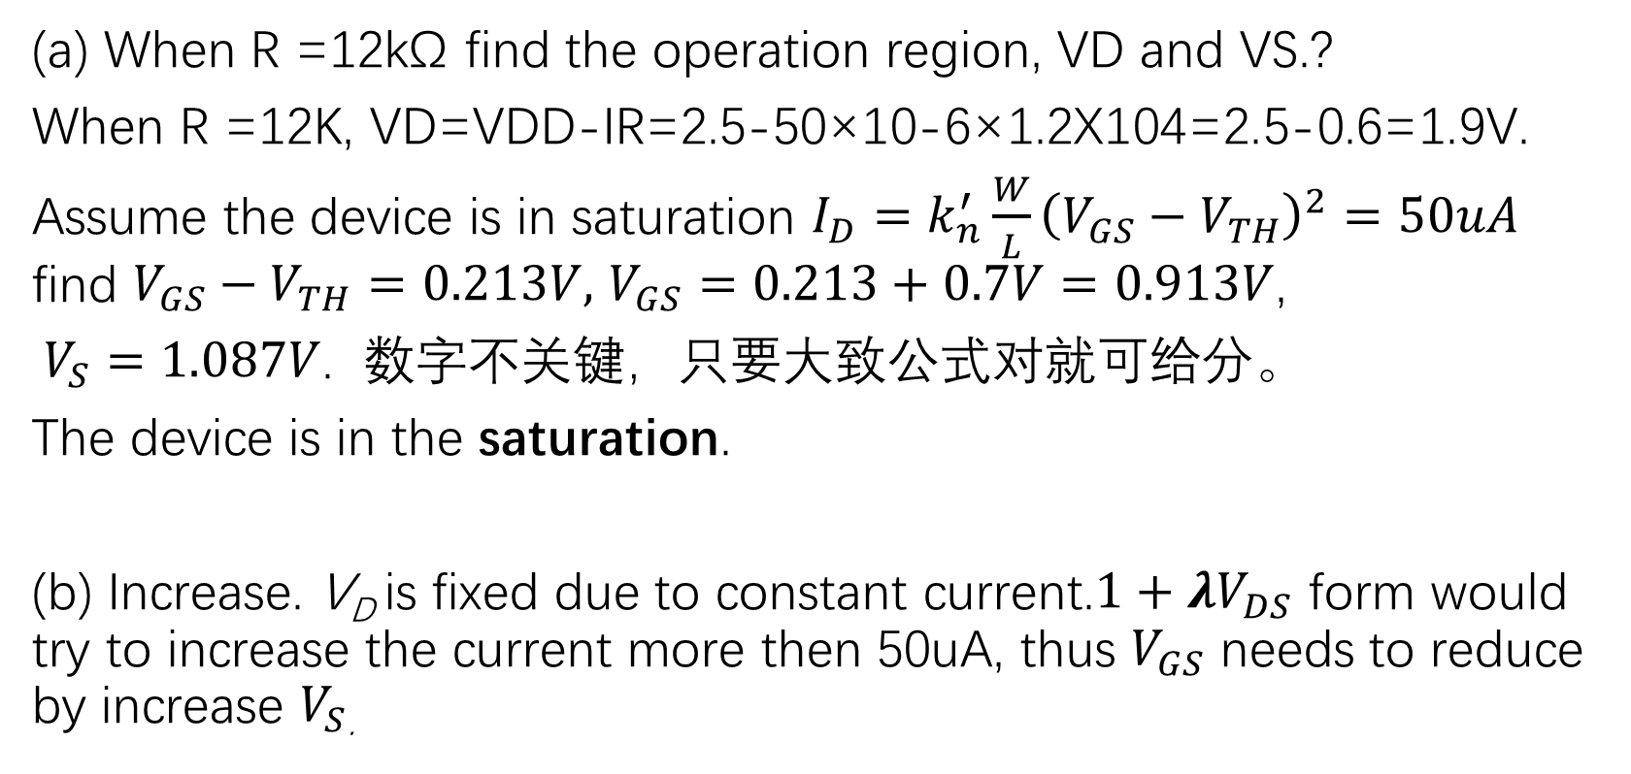
问答题 2
(a) When R =12kΩ find the operation region, VD and VS.?
When R =12K, VD=VDD-IR=2.5-50×10-6×1.2X104=2.5-0.6=1.9V.
Assume the device is in saturation $I_{D}=k_{n}^{′}\frac{W}{L}{\left(V_{GS}−V_{TH}\right)}^{2}=50uA$ find $V_{GS}−V_{TH}=0.213V,$ $V_{GS}=0.213+0.7V=0.913V$,
$V_{S}=1.087V$. 数字不关键，只要大致公式对就可给分。
The device is in the saturation.
(b) Increase. V_{D} is fixed due to constant current.$1+λV_{DS}$ form would try to increase the current more then 50uA, thus $V_{GS}$ needs to reduce by increase $V_{S}$.

Slide 8
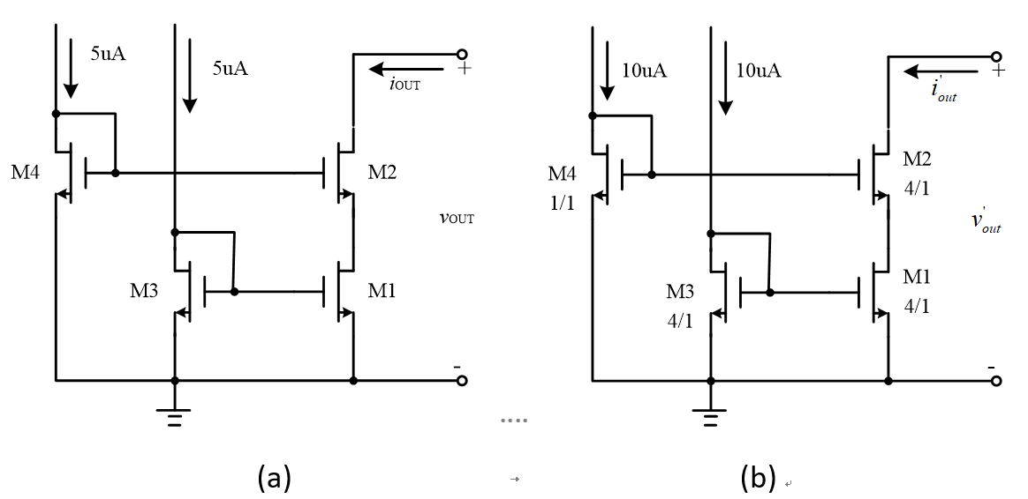
问答题 3
M4 0.5/1
M3 2/1

Slide 9
问答题 3
(b) Derive a symbolic expression for Vds of M1 in Fig. (b)
（已知各管处于饱和区且各管阈值电压为VTH）
Vds1 = Vgs4 – Vgs2
I4 = I1 -> (K/2)*(W/L)₄*(Vgs4-Vth)² = (K/2)*(W/L)₂*(Vgs2-Vth)²
-> Vgs4-Vth = 2*(Vgs2-Vth) -> Vds1 = Vgs4-Vgs2 = Vgs2-Vth
Considering that Vgs1 = Vgs2 because M3 and M2 are with the same size and current.
Transistor M1 is working in saturation with its Vds = Vgs - Vth

Slide 10
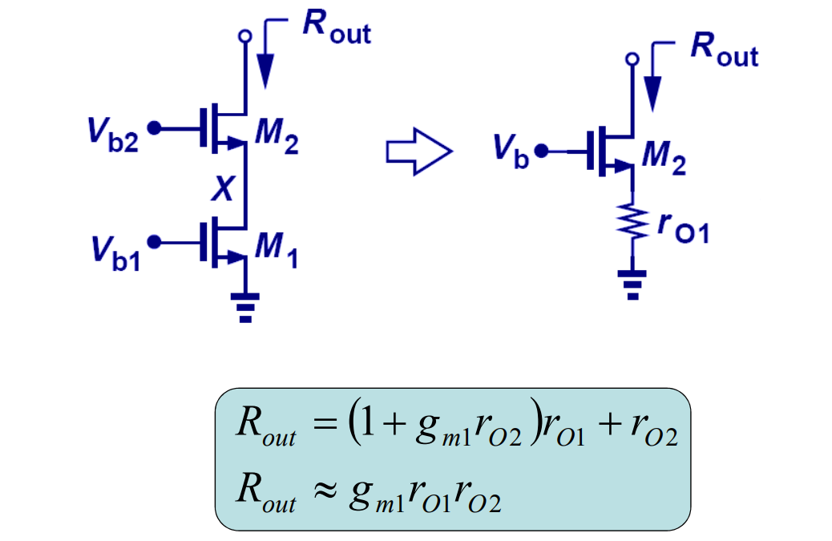
问答题 3
(c) Derive of the small signal model of cascode current mirror
ro1 = 1/(10uA*0.1) = 1Mohm
ro2 = 1/(10uA*0.1) = 1Mohm
Gm2 = (2I*K*(W/L))^0.5 = 103.5uS
Ro = ~103.5Mohm

