Slide 1
Parallelizing K-means for Image Segmentation
Chris Jordan
Victor Janmey
Raymond Ko

Slide 2
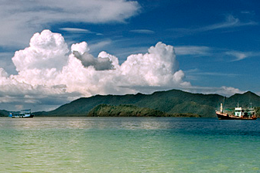
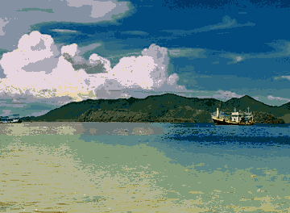
Problems and Applications
Group points to clusters
Fixed number of clusters (k)
Machine learning
Unsupervised learning methods
Dividing data for more specific classifiers
Selection of examples for k-nearest neighbors
Computer vision
Image segmentation
Estimating object boundaries
Cue for object recognition
Network Analysis
Finding communities

Slide 3
K-means Algorithm
Step 1: Initialization
Choose initial centers
Naïve approach
K-means++ (Significant speedup)
Step 2: Iteration
Assign particle to centers (distance measure)
Re-compute cluster centers (means of points)
Terminate when assignments converge

Slide 4
Implementation
C++ and OpenCV image library
Required for TBB, OpenCV has easy image manipulation, input, and output
Parallel: Add TBB constructs to serial
Parallel cluster assignment: parallel_for
Parallel cluster center calculation: parallel_reduce

Slide 5
Preliminary results
Sample run: 1,024,000 pixels, 3 dimensions (HSV)
50 Iteration, 50 clusters
Speedup: 4.4, Grain Size: 64,000
Step 1 speedup: 4.42, grain size: 64,000
Step 2 speedup: 2.89 grain size: 8,192
Step 1 dominates since is it is (k*n) vs. O(n) for Step 2
Similarly for k-means++ initial cluster selection, Step 1 (min distance to a cluster) is the dominating factor since it is also O(n)

Slide 6
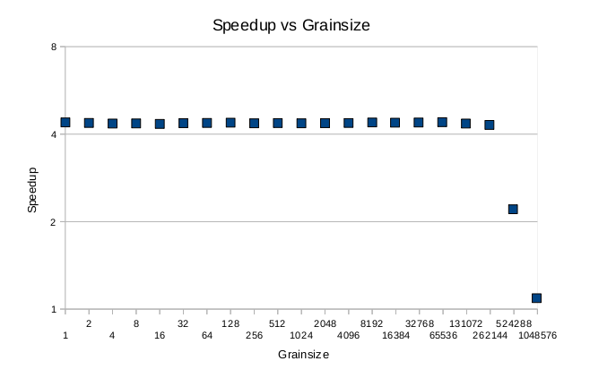
Speedup vs. Grainsize

Slide 7
Next steps
Investigate if similar performance is achievable with OpenMP
Experiments
Speedup vs. Number of Particles
Is there an optimal image size given today’s technology that balances speed and benefits?
Speedup vs. Number of Cores
Does it scale well? When will performance gains be apparent?
Speedup vs. Number of Clusters
At what point does it become inefficient to use the algorithm, if any?
Algorithm improvements
K-means++
Triangle inequality

