Slide 1
How to predict the outcome of a soccer game
And Profiting From It

Slide 2
Industries affected
Professional Sport Leagues
Gambling Organizations
Regulatory Bodies
Game-Related Entertainment

Slide 3
Betting houses & gambling websites
Business model is based on odds
Effects are immediate
A better model means higher profits
Where to start?

Slide 4
The data
player | team | league | country
playerattributes | teamattributes | match* | sqlitesequence
Base data | Player data | XML data | Betting House Odds
country_id | league_id
season | stage
date | match_api_id
home_team_api_id | away_team_api_id
home_team_goal | away_team_goal
goalDiff* | points*
goal | HTgoalDiff* | ATgoalDiff*
shoton | HTshoton* | AThoton*
shotoff | HTshotoff* | ATShotoff*
foulcommit | HTfouls* | ATfouls*
card | htYcard* | atYcard*
 | htRcard* | atRcard*
cross | HTcross* | ATCross*
corner | HTcorners* | ATcorners*
possession | homePoss* | awayPoss*

Slide 5
Pulling the Base data
statsMB3 <-
matchMB3 %>%
group_by(team, season, league_id) %>% # if add "season" here, it affects the ggplot (and we probably want to)
summarise(sgoals = sum(goals), soppgoals = sum(opponent_goals), swins = sum(win),
slosses = sum(loss), sdraws = sum(draw), sgdiff = sum(goal_dif),
spoints = sum(points), maxStage = (ifelse(max(stage) < 31, '30 matches',
ifelse(max(stage) > 30 & max(stage) < 35, '34 matches',
ifelse(max(stage) > 34 & max(stage) < 37, '36 matches', ‘38 matches')))))

Slide 6
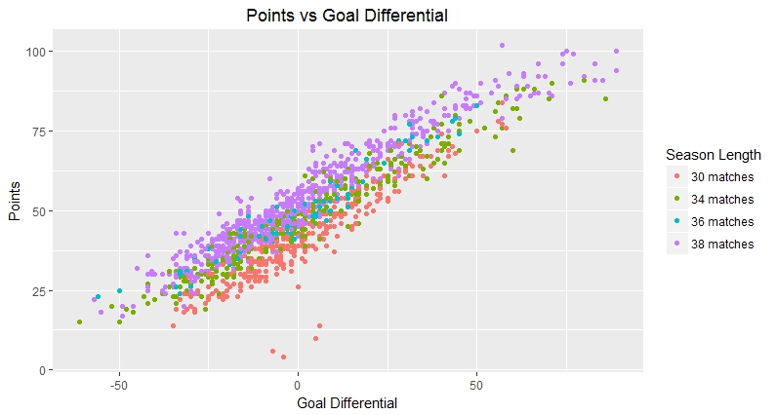
selecting a dependent variable

Slide 7
Parsing the xml data
1. Select desired columns using dplyr
2. Remove incomplete data using base R
Extract XML data:
For-loop
XML package
dplyr package
magrittr package
conditional statements

Slide 8
Parsing the xml data
for (i in 1: length(testALL$foulcommit)){
temp <- as.data.frame(do.call(rbind, xmlToList(as.character(testALL$foulcommit[i]))))
if('player1' %in% colnames(temp)) {
temp %<>%
filter(player1 == testALL$home_team_api_id[i] |
sortorder == testALL$home_team_api_id[i] |
team == testALL$home_team_api_id[i] |
n == testALL$home_team_api_id[i]) } else {
temp %<>%
filter(sortorder == testALL$home_team_api_id[i] |
team == testALL$home_team_api_id[i] |
n == testALL$home_team_api_id[i])}
testALL$HTfouls[i] <- nrow(temp)}
EXAMPLE:
Home team fouls
(HTfouls)

Slide 9
Viewing independent variables
 | Match | Home | Away | Ycard | Rcard | Fouls | Goals | Cross | C-kick | ShOn | ShOff
Wins | 6070 | 3741 | 2329 | 10706 | 185 | 73779 | 14610 | 96495 | 32558 | 35851 | 35483
% of T | 74.7% | 46.0% | 28.7% | 33.9% | 19.6% | 36.2% | 65.9% | 36.1% | 38.7% | 39.8% | 38.8%
Draw | 2054 | 2054 | 2054 | 8317 | 202 | 52918 | 4104 | 69993 | 21657 | 22909 | 23442
% of T | 25.3% | 25.3% | 25.3% | 26.3% | 21.4% | 26.0% | 18.5% | 26.2% | 25.7% | 25.4% | 25.6%
Loss | 6070 | 2329 | 3741 | 12568 | 558 | 77178 | 3454 | 100543 | 29978 | 31263 | 32476
% of T | 74.7% | 28.7% | 46.0% | 39.8% | 59.0% | 37.9% | 15.6% | 37.7% | 35.6% | 34.7% | 35.5%
Total | 8124 | 8124 | 8124 | 31591 | 945 | 203875 | 22168 | 267031 | 84193 | 90023 | 91401

Slide 10
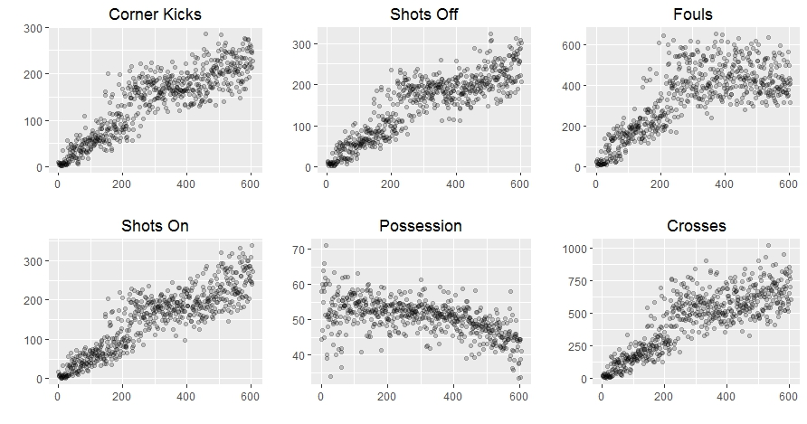
Viewing independent variables

Slide 11
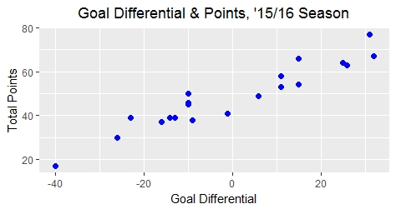
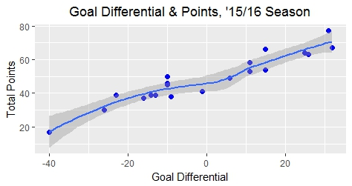
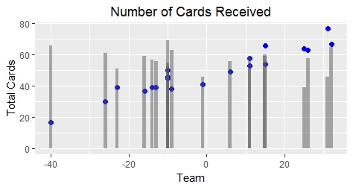
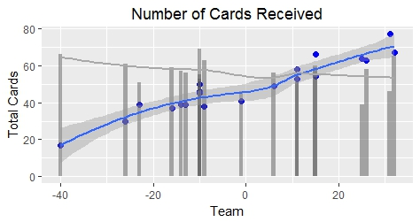
Viewing independent variables
(English Premier League)

Slide 12
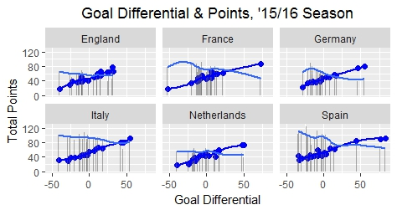
Viewing independent variables
(All Leagues, ‘15/16 season)

Slide 13
Baseline models
Wins | Draws | Losses | Total
6,070 | 4,108 | 6.070 | 16,248
.3736 | .2528 | .3736 | 1
Baseline Model 1 W: 37% D: 25%
H Wins | A Wins | Draws | H Losses | A Losses | Draws | Total
3741 | 2329 | 2054 | 2329 | 3741 | 2054 | 8.124
.4605 | .2867 | .2528 | .2867 | .4605 | .2528 | 1
Baseline Model 2 W: 46% D: 29%

Slide 14
Beating the baseline models: logistic regression
 | Model 1 | Model 2 | Model 3 | Model 4
HTshoton | Y
HTshotoff | Y
HTcross | Y | Y | Y
HTcorners | Y
ATshoton | Y
ATshotoff | Y
ATcross | Y | Y | Y
Atcorners | Y
HTfouls | Y | Y
htYcard | Y | Y | Y | Y
htRcard | Y | Y | Y | Y
ATfouls | Y | Y
atYcard | Y | Y | Y | Y
atRcard | Y | Y | Y | Y
Dependent Variable:
Home Team Win
Home Team Draw
4 MODEL PAIRS (8 MODELS TOTAL)

Slide 15
Beating the baseline models
 | B1 | L1 | L2 | B2 | M1 | M2
Win | .3736 | .4427 | .4295 | .4605 | .5170 | .4994 | (in-sample)
 |  |  |  |  | .5164 | .5021 | (out-of-sample)
Draw | .2528 | .2486 | .2476 | .2528 | .2529 | .2581 | (in-sample)
 |  |  |  |  | .2585 | .2597 | (out-of-sample)
AIC |  | 14683 13573 | 14810 13553 |  | 7810.3 6773.1 | 8011.5 6770 | (win AIC) (draw (AIC)
PROBABILITY OF ACCURATELY PREDICTING A WIN OR DRAW
Baseline Models: B1 and B2
Initial logistic regressions: L1 and L2 (Not shown in previous slide)
Secondary logistic regressions: M3 and M4 (Shown in previous slide)

Slide 16
recommendation
Games of simple match outcome (win/draw/loss)
Any secondary logistic regression is more accurate
Select Model 1 or Model 2
Model Complexity
Betting on game details
Linear Regression
Rearranged Logistic Regression

