Slide 1
How to predict the outcome of a soccer game
Predictive Models for Betting Houses

Slide 2
Industries affected
Professional Sport Leagues
Gambling Organizations
Regulatory Bodies
Game-Related Entertainment

Slide 3
Betting houses & gambling websites
Business model is based on odds
Effects are immediate
A better model means higher profits
Where to start?

Slide 4
The data
player | team | league | country
playerattributes | teamattributes | match* | sqlitesequence
Base data | Player data | XML data | Betting House Odds
country_id | league_id
season | stage
date | match_api_id
home_team_api_id | away_team_api_id
home_team_goal | away_team_goal
goalDiff* | points*
goal | goalDiff*
shoton | shotson* | oppShotson*
shotoff | shotsoff* | oppShotsoff*
foulcommit | fouls* | oppFouls*
card | Ycards* | oppYcards*
 | Rcards* | oppRcards*
cross | crosses* | oppCrosses*
corner | corners* | oppCorners*
possession | poss* | oppPoss*

Slide 5
Pulling the Base data
statsMB3 <-
matchMB3 %>%
group_by(team, season, league_id) %>% # if add "season" here, it affects the ggplot (and we probably want to)
summarise(sgoals = sum(goals), soppgoals = sum(opponent_goals), swins = sum(win),
slosses = sum(loss), sdraws = sum(draw), sgdiff = sum(goal_dif),
spoints = sum(points), maxStage = (ifelse(max(stage) < 31, '30 matches',
ifelse(max(stage) > 30 & max(stage) < 35, '34 matches',
ifelse(max(stage) > 34 & max(stage) < 37, '36 matches', ‘38 matches')))))

Slide 6
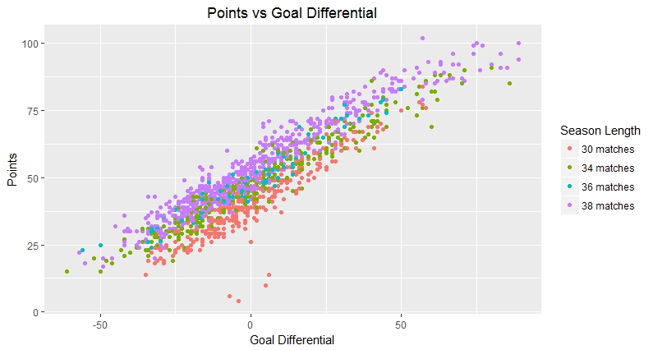
selecting a dependent variable

Slide 7
Parsing the xml data
1. Select desired columns using dplyr
2. Remove incomplete data using base R
Extract XML data:
For-loop
XML package
dplyr package
magrittr package
conditional statements

Slide 8
Parsing the xml data
for (i in 1: length(testALL$foulcommit)){
temp <- as.data.frame(do.call(rbind, xmlToList(as.character(testALL$foulcommit[i]))))
if('player1' %in% colnames(temp)) {
temp %<>%
filter(player1 == testALL$home_team_api_id[i] |
sortorder == testALL$home_team_api_id[i] |
team == testALL$home_team_api_id[i] |
n == testALL$home_team_api_id[i]) } else {
temp %<>%
filter(sortorder == testALL$home_team_api_id[i] |
team == testALL$home_team_api_id[i] |
n == testALL$home_team_api_id[i])}
testALL$HTfouls[i] <- nrow(temp)}
EXAMPLE:
Home team fouls
(foulcommit)

Slide 9
Viewing independent variables
 | Match | Home | Away | Ycard | Rcard | Fouls | Goals | Cross | C-kick | ShOn | ShOff
Wins | 6070 | 3741 | 2329 | 10706 | 185 | 73779 | 14610 | 96495 | 32558 | 35851 | 35483
% of T | 74.7% | 46.0% | 28.7% | 33.9% | 19.6% | 36.2% | 65.9% | 36.1% | 38.7% | 39.8% | 38.8%
Draw | 2054 | 2054 | 2054 | 8317 | 202 | 52918 | 4104 | 69993 | 21657 | 22909 | 23442
% of T | 25.3% | 25.3% | 25.3% | 26.3% | 21.4% | 26.0% | 18.5% | 26.2% | 25.7% | 25.4% | 25.6%
Loss | 6070 | 2329 | 3741 | 12568 | 558 | 77178 | 3454 | 100543 | 29978 | 31263 | 32476
% of T | 74.7% | 28.7% | 46.0% | 39.8% | 59.0% | 37.9% | 15.6% | 37.7% | 35.6% | 34.7% | 35.5%
Total | 8124 | 8124 | 8124 | 31591 | 945 | 203875 | 22168 | 267031 | 84193 | 90023 | 91401

Slide 10
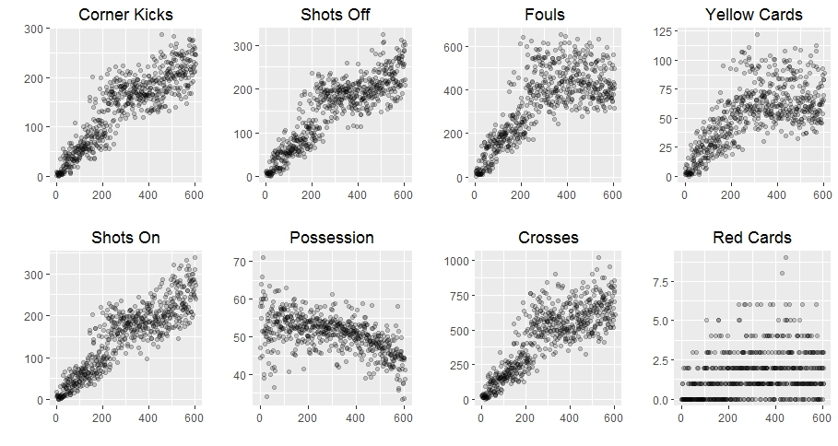
Viewing independent variables

Slide 11
Viewing independent variables

Slide 12
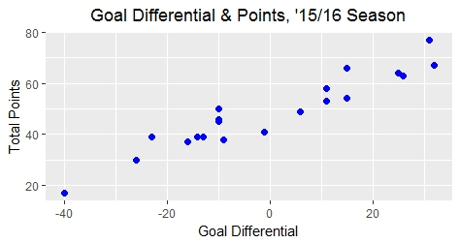
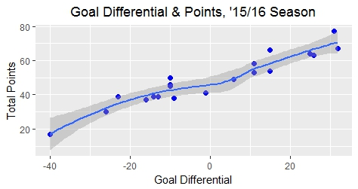
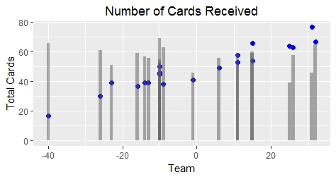
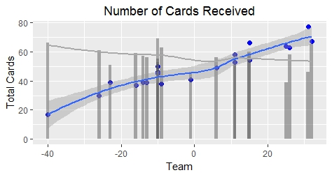
Viewing independent variables
(English Premier League)

Slide 13
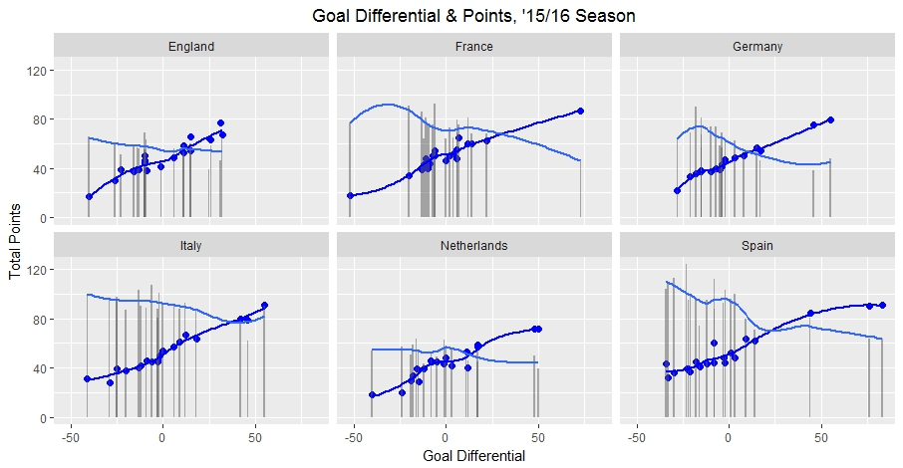
Viewing independent variables
(All Leagues, ‘15/16 season)

Slide 14
Baseline models
Wins | Draws | Losses | Total
6,070 | 4,108 | 6.070 | 16,248
.3736 | .2528 | .3736 | 1
Baseline Model 1 W: 37% D: 25%
H Wins | A Wins | Draws | H Losses | A Losses | Draws | Total
3741 | 2329 | 2054 | 2329 | 3741 | 2054 | 8.124
.4605 | .2867 | .2528 | .2867 | .4605 | .2528 | 1
Baseline Model 2 W: 46% D: 29%

Slide 15
Beating the baseline models: logistic regression
 | Model 1/2 | Model 3/4 | Model 5/6 | Model 7/8
shotson | Y |  | Y
shotsoff | Y |  | Y
crosses | Y | Y | Y | Y
corners | Y
oppShotson | Y |  | Y
oppShotsoff | Y |  | Y
oppCrosses | Y | Y | Y | Y
oppCorners | Y
fouls | Y | Y
Ycards | Y | Y | Y | Y
Rcards | Y | Y | Y | Y
oppYcards | Y | Y | Y | Y
oppRcards | Y | Y | Y | Y
home_or_away |  |  | Y | Y
Dependent Variable:
Home Team Win
Home Team Draw
4 MODEL PAIRS (8 MODELS TOTAL)

Slide 16
Beating the baseline models: logistic regression
 | Model 9/10 | Model 11/12 | Model 13/14 | Model 15/16
HTshoton | Y
HTshotoff | Y
HTcross | Y | Y | Y
HTcorners | Y
ATshoton | Y
ATshotoff | Y
ATcross | Y | Y | Y
Atcorners | Y
HTfouls | Y | Y
htYcard | Y | Y | Y | Y
htRcard | Y | Y | Y | Y
ATfouls | Y | Y
atYcard | Y | Y | Y | Y
atRcard | Y | Y | Y | Y
Dependent Variable:
Home Team Win
Home Team Draw
4 MODEL PAIRS (8 MODELS TOTAL)

Slide 17
Beating the baseline models
Model 5 | Outcome | Predicted |  | Model 6 | Outcome | Predicted
(Win/Not) | Actual | FALSE | TRUE | (Draw/Not) | Actual | FALSE | TRUE
 | 0 | 2,220 | 385 |  | 0 | 9,082 | 0
 | 1 | 986 | 543 |  | 1 | 3,032 | 0
 |  | in sample | out |  |  | in sample | out
 | _{Accuracy} | _{.6691} | _{.6684} |  | _{Accuracy} | .7497 | .7397
 | Misclass R | _{.3309} | _{.3316} |  | Misclass R | .2503 | .2603
 | _{Sensitivity} | _{.3614} | _{.3551} |  | _{Sensitivity} | -- | ₋₋
PROBABILITY OF ACCURATELY PREDICTING A WIN OR DRAW
Baseline Models: B1 and B2 – Overall Accuracy:
B1 win: 0.3736 /// B1 draw: 0.2528
B2 win: 0.4605 /// B1 draw: 0.2528

Slide 18
recommendation
Games of simple match outcome (win/draw/loss)
Any secondary logistic regression is more accurate
Select the Model 5/6 Pair
Model Complexity
Betting on game details
Linear Regression
Rearranged Logistic Regression

