Slide 1

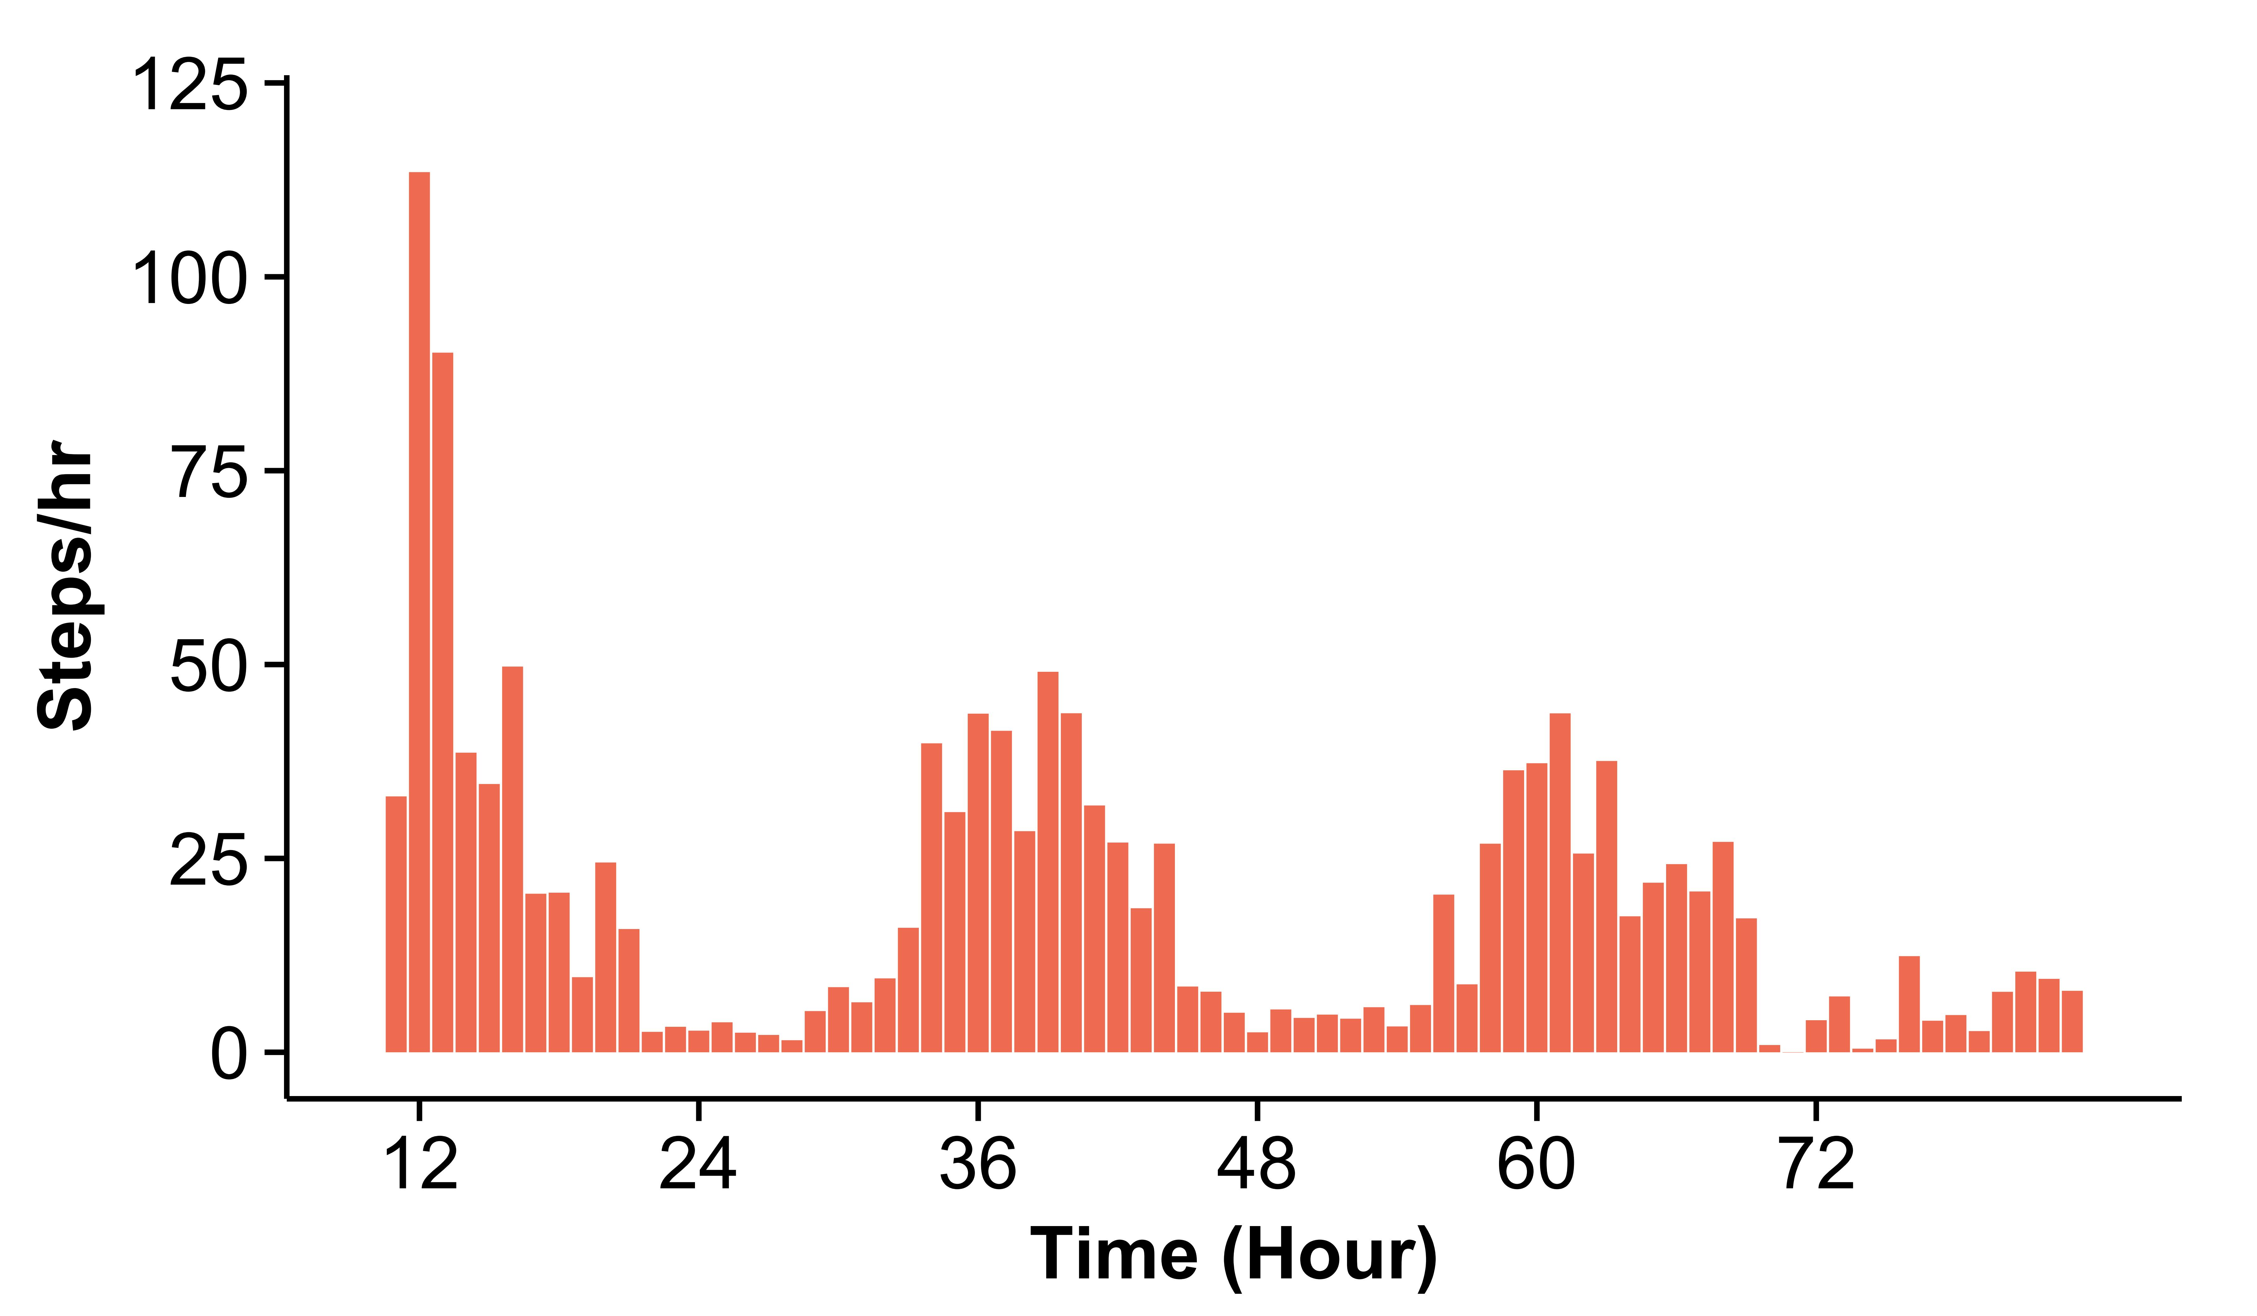
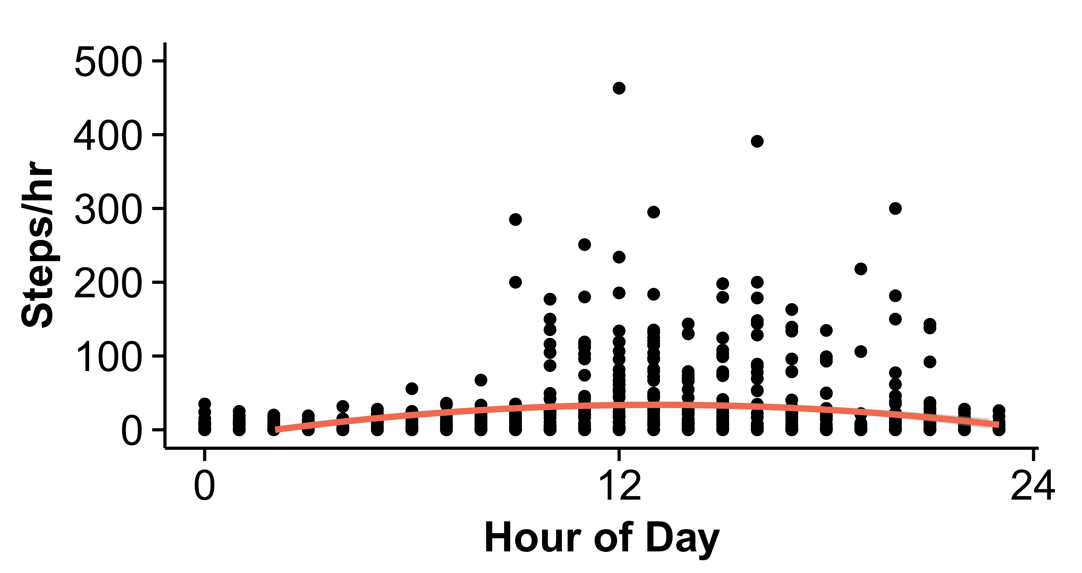
Ambulation of Hospitalized Older Adult Patients
Fanglin Kuo, PhD(c); Barbara J. King, PhD, RN; & Linsey Steege, PhD
Background
Results
About 17% of hospitalized older adults will lose their ability to independently ambulate during their hospital stay.
Loss of independent ambulation is associated with increased length of stay, falls, new nursing home placement, and higher mortality rates.
Research has demonstrated that hospitalized older adults spend 83-95% of their time in bed.
Sample Characteristics (N=38)
Comparison in Weekdays/Weekends
Of 15 patients who included both weekdays and weekends, 5 had significantly decreased steps during weekends compared to weekdays (p=0.00 - 0.027).
 | Mean (SD) | Range | Frequency | %
Age | 81 (8.93) | 65-94
BMI | 28.45 (7.74) | 15.4-49.6
Gender (Female) |  |  | 23 | 60
Length of stay (Day) | 2.52 (1.88) | 1-6.99
Walking device use |  |  | 24 | 63
Person assistive walking |  |  | 29 | 76
Resided home prior admission |  |  | 30 | 79
Discharge to home |  |  | 27 | 71
Patient Ambulation
Daily steps decreased during hospitalization from 505 steps (1st 24-hour stay) to 472 (2nd ) and 351 (3rd ) (Figure 1).
The mean steps had a quadratic hour effect during the day (Figure 2).
Peak time periods for ambulation were 12-1pm (113.5 steps/hr) and 1-2pm (90.217 steps/hr).
The highest gait speed among participants was 58 steps/minute.
Purpose
To describe the frequency of ambulation in hospitalized older adults.
Methods
Figure 1
Figure 2
Design
A descriptive, correlational study
Eligibility Criteria
Aged 65 or older
Able to walk with or without assistance
At least 24 hour hospital stay
Procedure
Monitored patients’ steps using research-grade accelerometers during hospitalization
EMR review for demographic and clinical information
Data analyzed using regression and t-test
Conclusion and Implication
Compared to prior research, patients in this study displayed lower step counts.
Certain time periods during shifts may indicate increased opportunity for patient ambulation during hospitalization.
A substantial decrease in ambulation during weekends may be related to staffing ratios.
Additional research is needed to identify factors within hospitals which may impact frequency of patient ambulation during their hospital stay.

