Slide 1
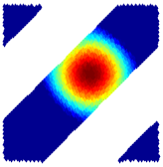
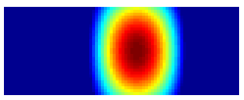
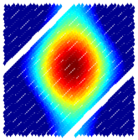
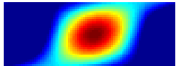
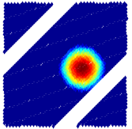





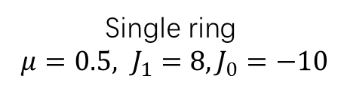





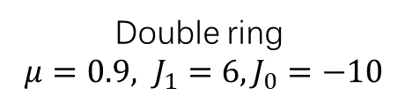



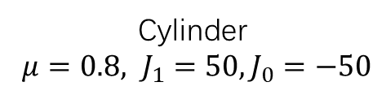
$$2π$$
$$π/2$$
$$r$$
$$θ_{B}$$
$$−π/2$$
$$0$$
$$2π$$
$$θ$$
$$0$$
$$0$$
$$2π$$
Single ring
$μ=0.5, J_{1}=8, J_{0}=−10$
$$θ_{A}$$
Double ring
$μ=0.9, J_{1}=6, J_{0}=−10$
Cylinder
$μ=0.8, J_{1}=50, J_{0}=−50$

Slide 2
Cylinder
Single ring
Double ring

Slide 3
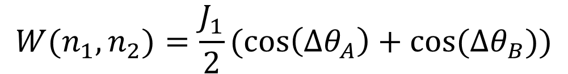
Neuron1
Neuron2
Map A
Map B
$$W(n_{1},n_{2})=\frac{J_{1}}{2}(\cos\left(Δθ_{A}\right)+cos⁡(Δθ_{B}))$$

Slide 4
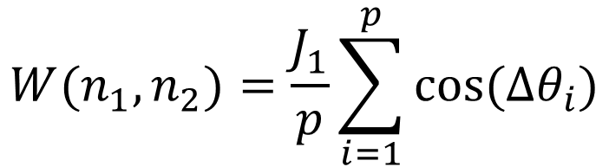
Neuron1
Neuron2
Map -1
Map 1
$$W(n_{1},n_{2})=\frac{J_{1}}{p}\sum_{i=1}^{p}{cos⁡(Δθ_{i})}$$

