Slide 1

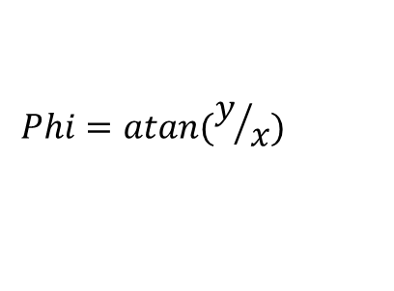

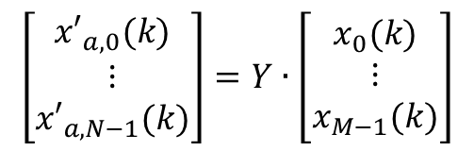




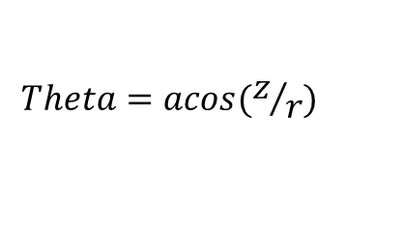

$$x_{0}(k)$$
$${x′}_{a,0}(k)$$
$$\left[\begin{matrix}{x′}_{a,0}(k) \\ ⋮ \\ {x′}_{a,N−1}(k)\end{matrix}\right]=Y∙\left[\begin{matrix}x_{0}(k) \\ ⋮ \\ x_{M−1}(k)\end{matrix}\right]$$
$$x_{1}(k)$$
$${x′}_{a,1}(k)$$
$$x_{M−1}(k)$$
$${x′}_{a,N−1}(k)$$
$$Phi=atan(y/x)$$
$$Theta=acos(z/r)$$
$$x_{a,N−1}(k)$$

