Slide 1
P++
Designing our Own Programming Language
Florian fink & Ashley Daniel Ulumben

Slide 2
Why P++
We decided to implement a language that is a slightly more lenient version of C++
It gives the programmer a safety net if they make mistakes, and also the option to use an easier syntax.
Even implement a few functions that are not available in statically type languages.
By Combining the Execution Time of C++ and the syntax of Python we intend to create a faster, shorter and an easier language to implement.

Slide 3
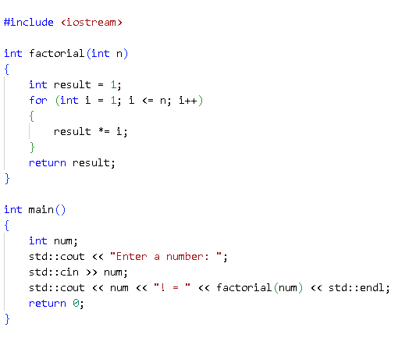
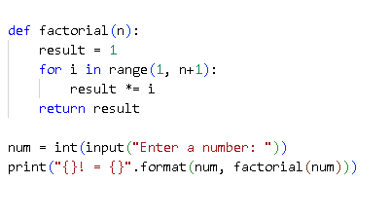
Syntax of C++ and Python

Slide 4
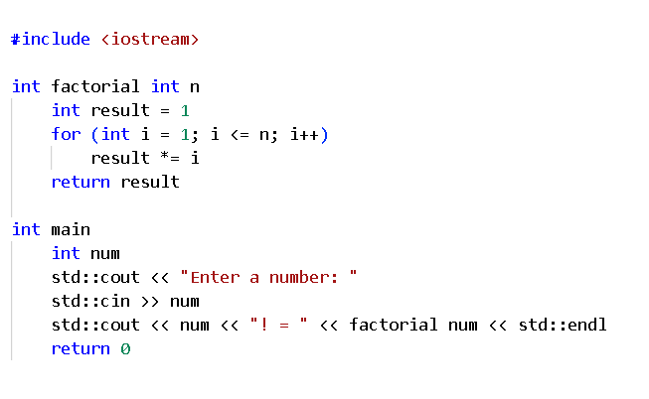
How our Implementation Looks

Slide 5
Language Specifications
The Bane of all programmers, the missing semicolon
We decided to implement line/statement terminations as optional
Semicolons
Curly Brackets
Parentheses
A way to implement format strings in a statically typed language like C++
The Choice to write Infix Notations for Functions with two parameters

Slide 6
Examples of the optional Syntax
Semicolon
If ( condition )
{
Block-statement
} else {
Block-statement
}
Curly Brackets
If ( condition )
Block-statement
else
Block-statement
Parentheses
If condition
Block-statement
else
Block-statement

Slide 7
Example of Format Strings
Syntax for Format Strings in P++
print f” Hello { var }”
The above statement gets converted to
std::string name = “Hello” + var + “\n”;
cout << name;

Slide 8
Example of Infix Notation
Infix Notation
isIn a, b
It can also be written as
a `isIn` b
Which are sometimes easier to read

Slide 9
Grammar for the Language
program = (statement)*
statement = (labeled-statement | block-statement | declaration-statement
| selection-statement | iteration-statement | jump-statement |
| expression | try-statement) [";"]
labeled-statement = label statement
block-statement = ("\t" (statement)*)* | "{" (statement)* "}"
declaration-statement = type identifier ["=" expression] [";"] | function-declaration
| class-declaration

Slide 10
Grammar
selection-statement = if-statement | switch-statement
iteration-statement = while-loop | do-while-loop | for-loop
jump-statement = "break" | "continue" | "return" [expression] | "goto" label
expression = assignment-expression | increment-decrement | arithmetic-expression
| logical-expression | comparison-expression | member-access | other-expressions
try-statement = "try" statement "catch" (expression | "(" expression ")" ) statement
label = identifier ":" | "case" constexpr ":" | "default" ":"
type = ["unsigned"] ( "int" | "bool" | "char" | "float" | "double" | identifier) ("*" | "&")*

Slide 11
Grammar
identifier = letter | identifier letter | identifier digit
function-declaration = type identifier [ "(" parameters ")" | parameters ] [block-statement | ";"]
class-declaration = "class" Identifier [":" [access-specifiers] Identifier] class-body
if-statement = "if" ( expression | "(" expression ")" ) statement [ "else" statement ]
switch-statement = "switch" ( expression | "(" expression ")" ) block-statement
while-loop = "while" ( expression | "(" expression ")" ) statement
for-loop = "for" ( "(" (statement | ";" ) expression ";" expression ")" | (statement | ";") expression ";" expression ) statement
The complete Grammar is in the Grammar.txt file

Slide 12
Prototype of the Language
The zip folder contains the Prototype implementation “pplusplus.py”
It also contains the complete Grammar of the Language
Running the test file “test.ppp” it will add semicolons and curly Brackets in all the valid places to the code
It will create a new file “test.cpp” which can then be compiled in C/C++ compilers
(The Logic for adding Semicolons are not perfect at the moment.)

