Slide 1
Check 24 GenDev
Technical Concept Challenge

Slide 2
Problem & SDUI Concept
Problem:
UI change requires app releases
User must download updates
Friction and delays
Solution:
Server-Driven UI
+ faster & flexible UI updates
+ consistent across multi-platform
+ robust UI (rendering focus)
+ personalization (in real-time)
Performance relies on server (internet connection of user)
Offline support of App
Server infrastructure
Difficulty through flexibility

Slide 3
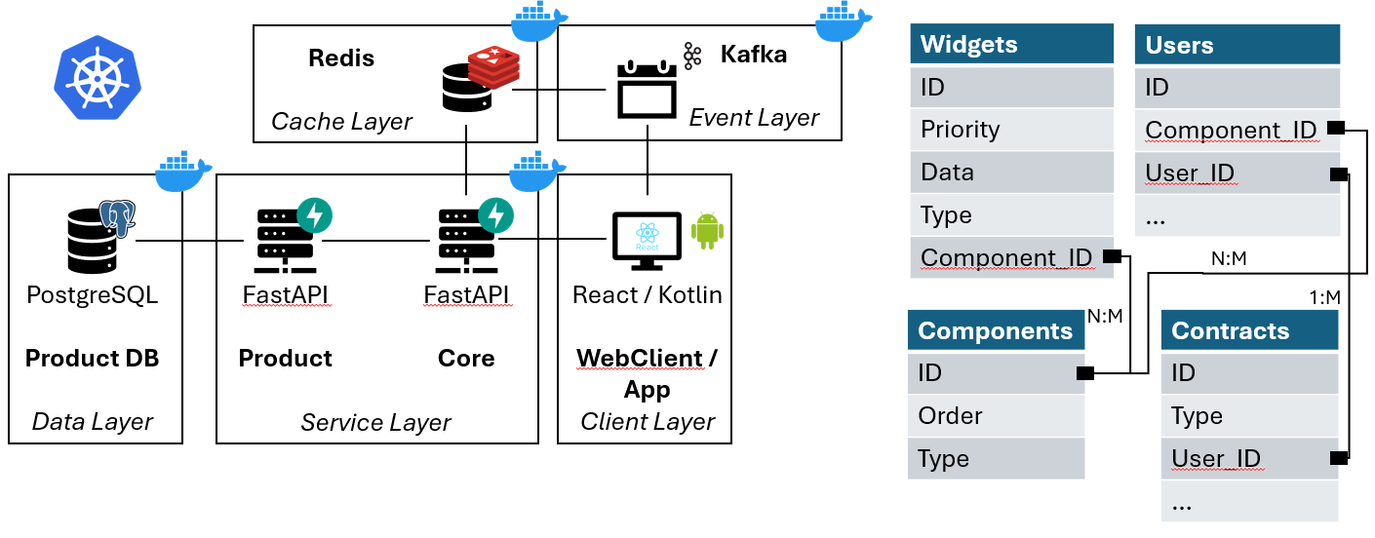
Architecture

Slide 4
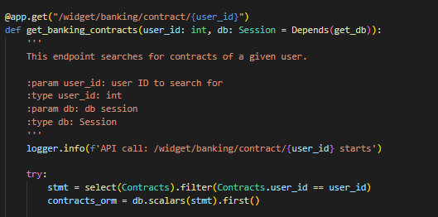
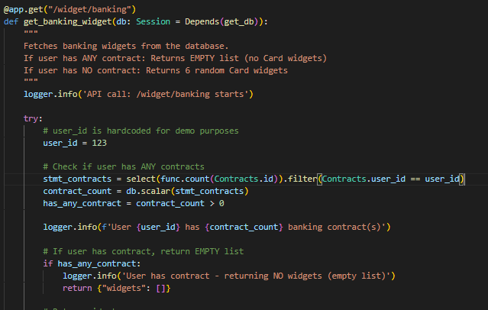
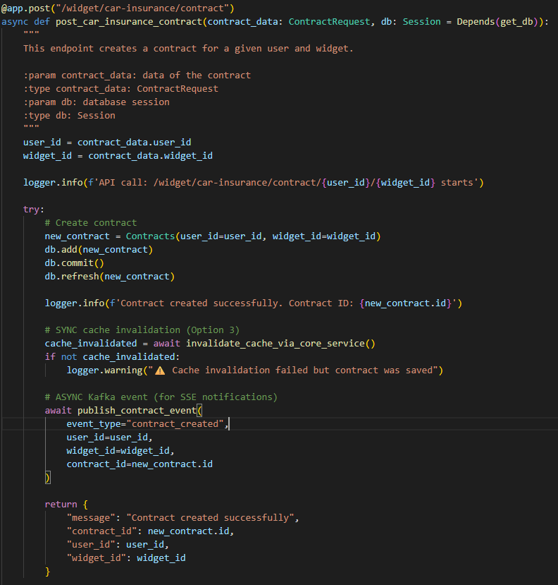
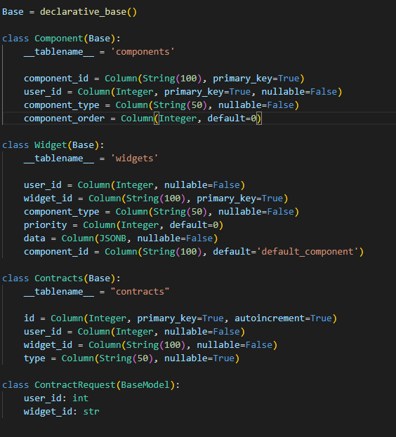
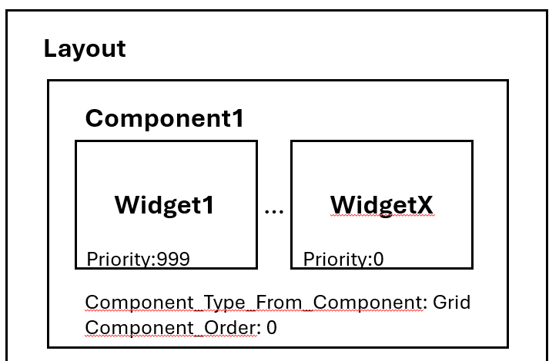
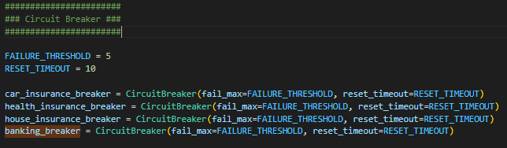
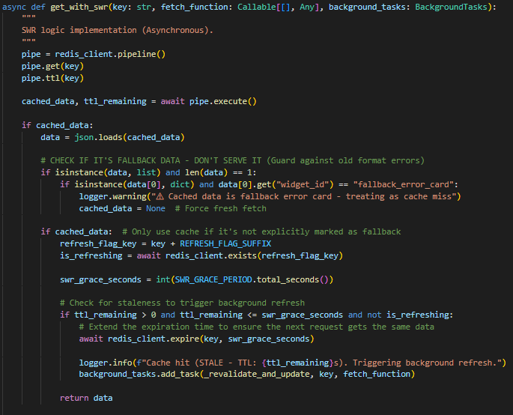
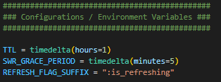
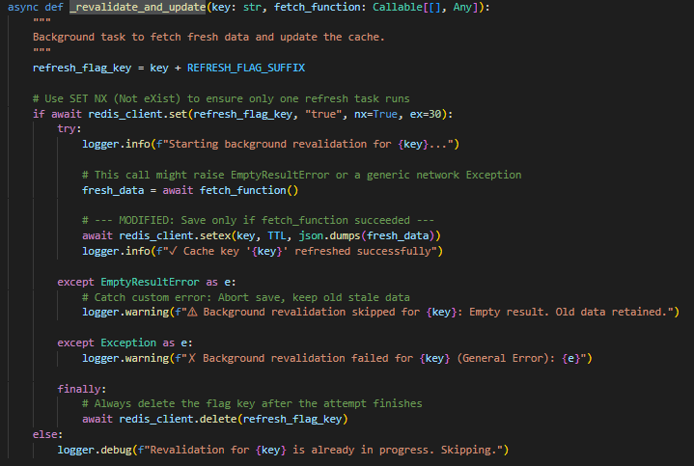
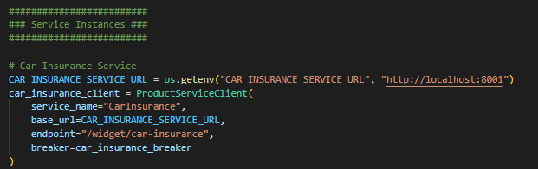
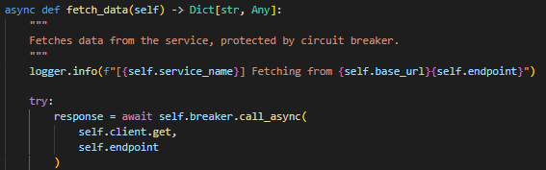
Key Technical Decisions
Performance & Scalability
    Stale-While-Revalidate Caching (Redis)
Circuit Breaker
High Availability
Dual Cache Invalidation
Personalization
Widgets assigned to users
Insurance Centre (Contracts)
Widget Design
Multi-Platform Consistency
JSON Contract

Slide 5
—Florian Korn
“Let’s Demo”

