Slide 1












Redis
Cache Layer
Kafka
Event Layer
Widgets
ID
Priority
Data
Type
Component_ID
Users
ID
Component_ID
User_ID
…
N:M
PostgreSQL
Product DB
Data Layer
FastAPI
Product
FastAPI
Core
React / Kotlin
WebClient / App
Client Layer
1:M
Components
ID
Order
Type
N:M
Contracts
ID
Type
User_ID
…
Service Layer

Slide 2
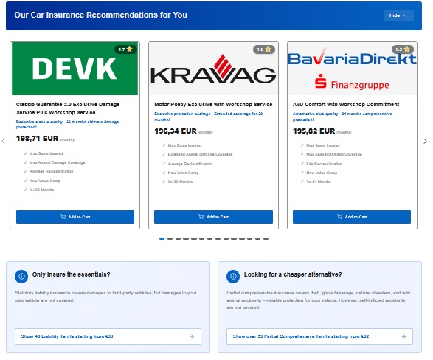
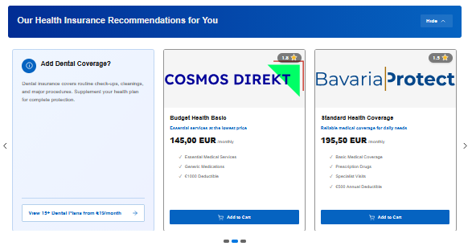
Layout
Component1
Component_Type_From_Component: Grid
Component_Order: 0
Widget1
Priority:999
…
WidgetX
Priority:0
…
ComponentX
Component_Type_From_Component: Grid
Component_Order: X
Widget1
Priority:999
…
WidgetX
Priority:0

