Slide 1
Inversion oF Control
Prezentare Fii Practic

Slide 2
Introduction
Recap
Definition of Done
Microservices
Web API
DIP, IoC, DI
Manually Ioc
Unity
Use in MVC

Slide 3
DIP, Ioc, DI
Dependency Inversion Principle (DIP)
Principle used in architecture of software
Inversion of Control (IoC)
Pattern used to invert interfaces, flow, dependencies
Dependency Injection
Implementation of IoC used to invert dependencies
Inversion of Control Container
Framework to implement IoC
Interface
Externally exposed way to interact with something

Slide 4
Dependency Inversion
Instead of low level modules defined an interface that high level modules depend on, high level modules define an interface that low levels modules implement.
Portable chargeable devices.

Slide 5
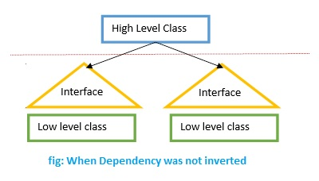
Dependency Inversion
http://www.codeproject.com/script/Membership/Uploads/3723168/DIP2.jpg

Slide 6
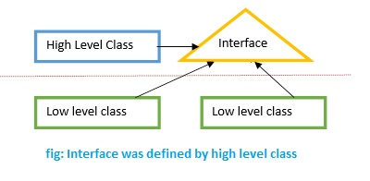
Dependency Inversion
http://www.codeproject.com/script/Membership/Uploads/3723168/DIP3.jpg

Slide 7
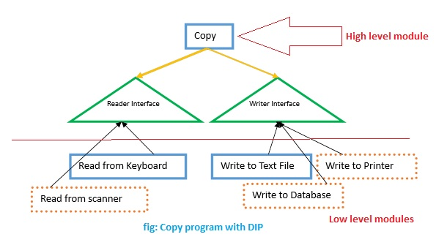
DIP COPY PROGRAM

Slide 8
Inversion of Control
Pattern to imprement DIP
IoC
for interfaces
For flows
For dependencies

Slide 9
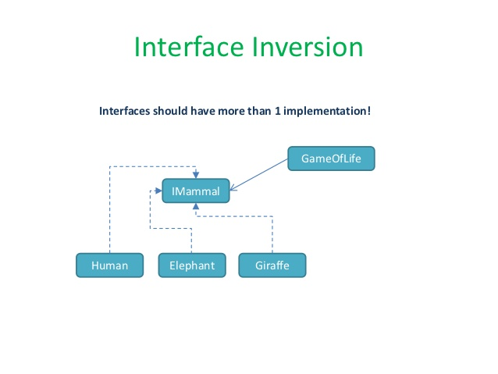
Ioc for Interfaces

Slide 10
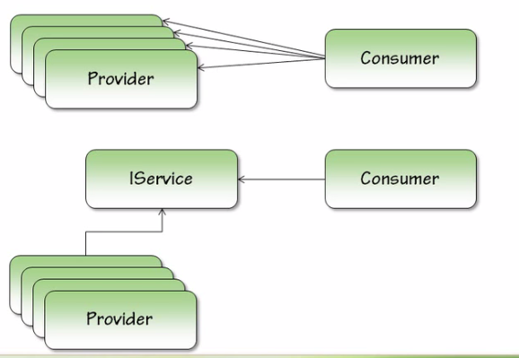
Provider Model

Slide 11
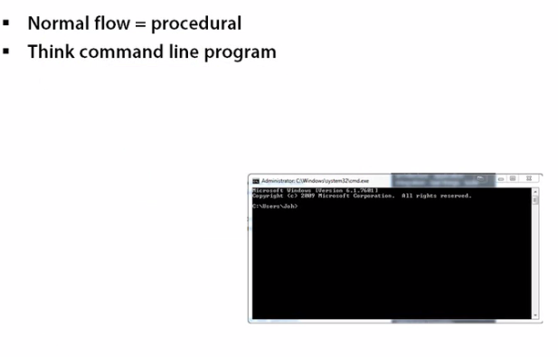
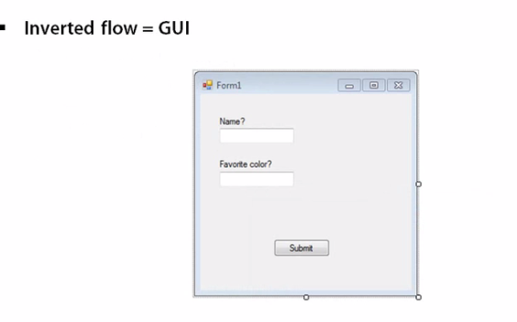
FLOW inversion
Do not call us, we will call you.

Slide 12
Creation Inversion
Normal creation of object is in class where they are used.
Inversion of Creation:
Create objects outside the class they are used.

Slide 13
Patterns For Creation INversion
Factory pattern
Button button = ButtonFactory.CreateButton();
Service Locator
Ibutton button = ServiceLocator.Create(IButton)
Dependency Injection
IButton button = new Button()
View v = new View(button);

Slide 14
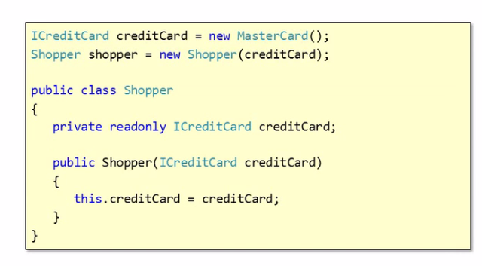
Dependency Injection
A type of IoC that we move creation and binding outside class is used.
Constructor Injection
Pass dependency using constructor

Slide 15
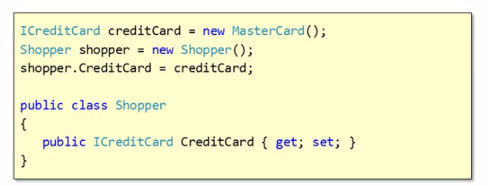
DI
Setter Injection
Create setter in dependent class

Slide 16
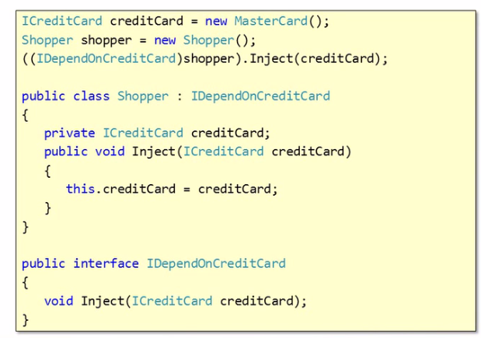
Di – Interface Injection
Dependent class use a interface
Injector will use interface to inject object

Slide 17
Unity
Demo

Slide 18
One Common Goal

