Slide 1
Predicting Retail Food Prices
in Ugandan Markets
Project at a glance
Regression model
Retail food prices
43 markets
38 commodities
Jan 2006 – Jun 2026
Final model: Random Forest
Using WFP market price data to forecast next-month retail food prices
Data Engineering & Analytics Final Project
Florence Kemigisha • 13 August 2026
GitHub: github.com/floCarlee/Uganda_Food_Price_Prediction

Slide 2
PROBLEM STATEMENT
PROBLEM STATEMENT
The challenge
Project objective
Retail food prices in Uganda change over time because of market conditions, seasonality, inflation, supply factors and location differences.
These changes affect household purchasing power, food security and planning decisions.
Build a machine learning regression model that predicts the next month retail price of food commodity in the Ugandan market.
This model uses commodity, market, location, time and historical price features.
Framed as a regression task: predicting a numerical target variable, next_month_price.

Slide 3
DATA SOURCE
Dataset description
Source: “https://data.humdata.org/dataset/wfp-food-prices-for-Uganda”
Dataset used: wfp_food_prices_uga.csv
32,171
16
43
38
2006–2026
UGX
raw rows
raw columns
markets
commodities
period
currency
Raw fields used
After preparation
date, region, district, market, latitude, longitude, category, commodity, unit, price type, currency, price and USD price.
The modelling dataset contains 20,872 rows and 21 columns after filtering retail food records and creating lag, moving-average and target features.

Slide 4
PIPELINE
Data engineering workflow
Raw CSV
Data understanding
Cleaning & filtering
Feature engineering
EDA & visualization
Model training
Evaluation & demo
Original WFP file
shape, types, missing values
retail food records only
lags + moving averages
patterns and relationships
baseline, RF, neural net
metrics + Gradio app
What makes this a data engineering project?
The work is not only model training. It includes data ingestion, quality checks, filtering, feature engineering, train-test preparation, model packaging and a demo interface.

Slide 5
ETL PIPELINE
ETL pipeline architecture
How the raw WFP file becomes the ML-ready dataset used by the models and demo
1. Extract
2. Transform
3. Engineer
4. Load
Raw source
Cleaning + filters
Features + target
Outputs
Load raw WFP CSV
Inspect 32,171 rows and 16 columns
Check data types, duplicates and missing values
Convert date to datetime and prices to numeric
Keep retail food records only
Remove invalid prices and duplicate rows
Create year, month and quarter
Create previous price and price-change features
Create 3-month/6-month averages and next_month_price
Save ML-ready CSV
Save predictions and final Random Forest model
Use model and reference data in the Gradio demo
Pipeline reliability checks
Automation plan
The pipeline keeps the raw file unchanged, documents row reductions, validates the target column, and produces a reproducible ML-ready CSV.
For production, the same notebook/script can be scheduled monthly using GitHub Actions or cron whenever new WFP price data is available.
Uganda Retail Food Price Prediction
5

Slide 6
PREPARATION
Cleaning and feature engineering
Cleaning decisions
New features
Target variable
• Converted date to datetime
• Converted prices to numeric
• Removed non-food items
• Kept retail prices only
• Checked duplicates and invalid prices
• Removed rows with missing lag/target values
• year
• month
• quarter
• previous_price
• price_change
• price_pct_change
• price_3_month_avg
• price_6_month_avg
next_month_price
This is the next recorded retail price for the same commodity in the same market.
It turns the dataset into a supervised regression problem.

Slide 7
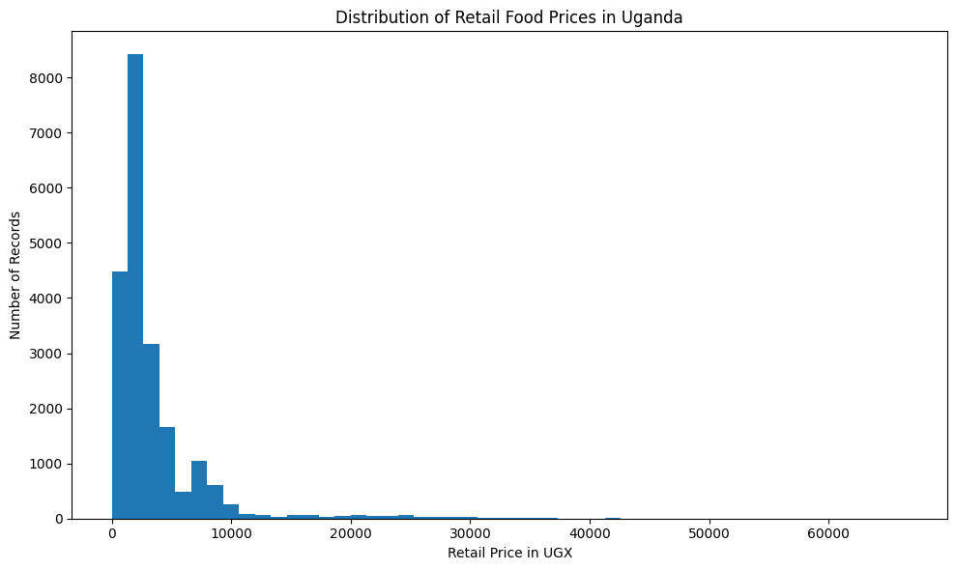
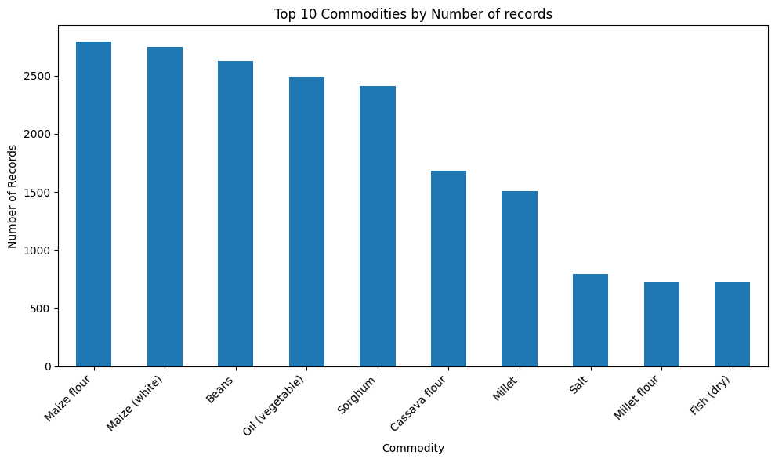
Exploratory data analysis: distribution and coverage
Price distribution
Commodity coverage
Most retail food prices are concentrated at lower values, with a few high-price outliers.
Maize flour, maize, beans, vegetable oil and sorghum have the most records, giving the model strong historical coverage.

Slide 8
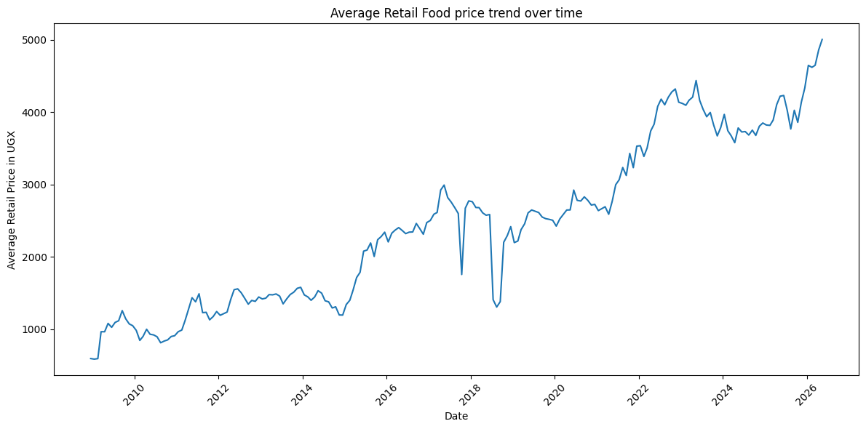
Average retail food price trend over time
Average retail food prices generally rise over the period, with visible dips and spikes that may reflect seasonality, market shocks or changes in food supply conditions.

Slide 9
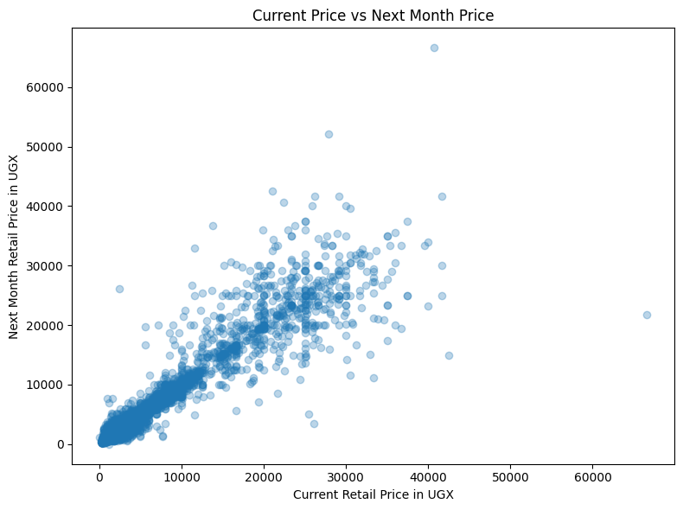
REGRESSION SIGNAL
Relationship with the prediction target
Why regression is feasible
The scatter plot shows a strong positive relationship between the current price and the next month price.
Modelling implication
Historical price features such as current price, previous price and moving averages should be useful predictors.
Extreme points indicate that sudden price spikes may still be difficult to predict.

Slide 10
APPROACH
Machine learning models
Baseline
Random Forest Regressor
Neural Network
Assumption:
next month price = current price
Used as a benchmark to test whether machine learning adds value.
Classical ML model.
Handles non-linear patterns and mixed features well after preprocessing.
Feedforward regression model.
Used to satisfy the deep learning comparison requirement.
Evaluation metrics: MAE, RMSE and R²

Slide 11
RESULTS
Model evaluation
Model
MAE
RMSE
R²
Best model
Baseline
557.70
1975.42
0.8586
Random Forest
Lowest MAE
Lowest RMSE
Highest R²
Random Forest
533.20
1697.70
0.8955
Neural Network
691.14
1760.43
0.8877
Interpretation
The Random Forest model outperformed the baseline and neural network. It explained approximately 89.6% of the variation in next-month retail food prices.

Slide 12
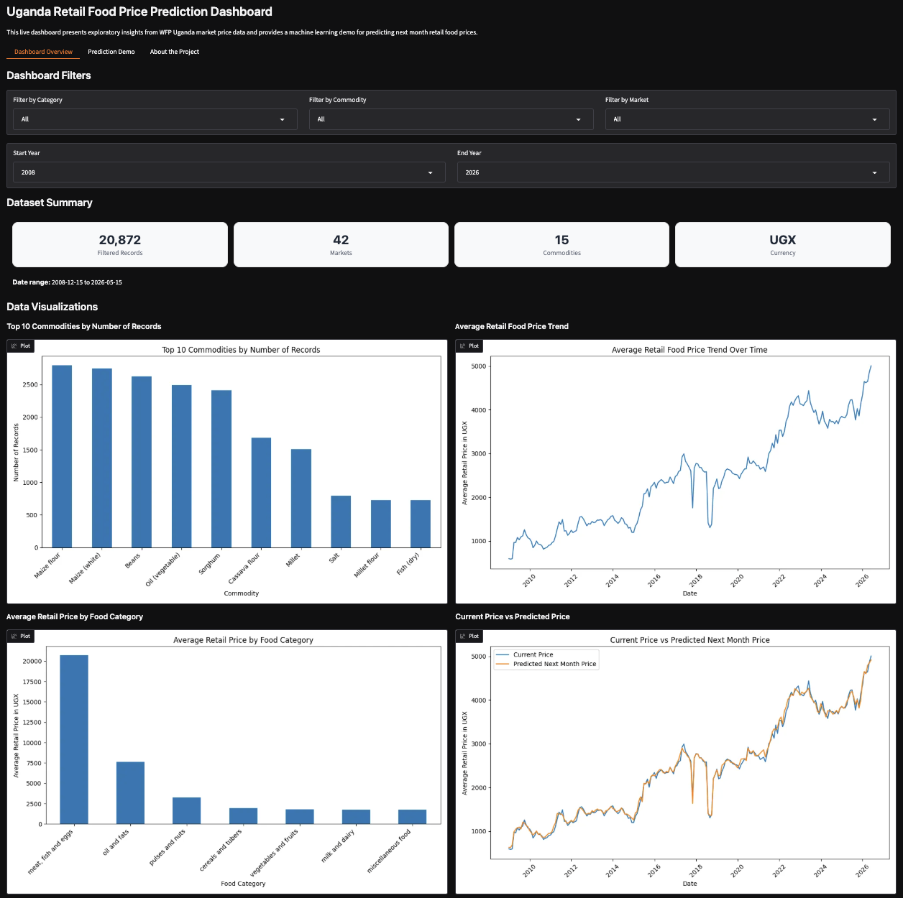
Demo Dashboard
This Dashboard demonstrates the relationship between the current price vs Predicted price and visualizations. It has filters and it auto refreshes every 1 minute.
The graphs show that food prices vary by commodity, category and time.

Slide 13
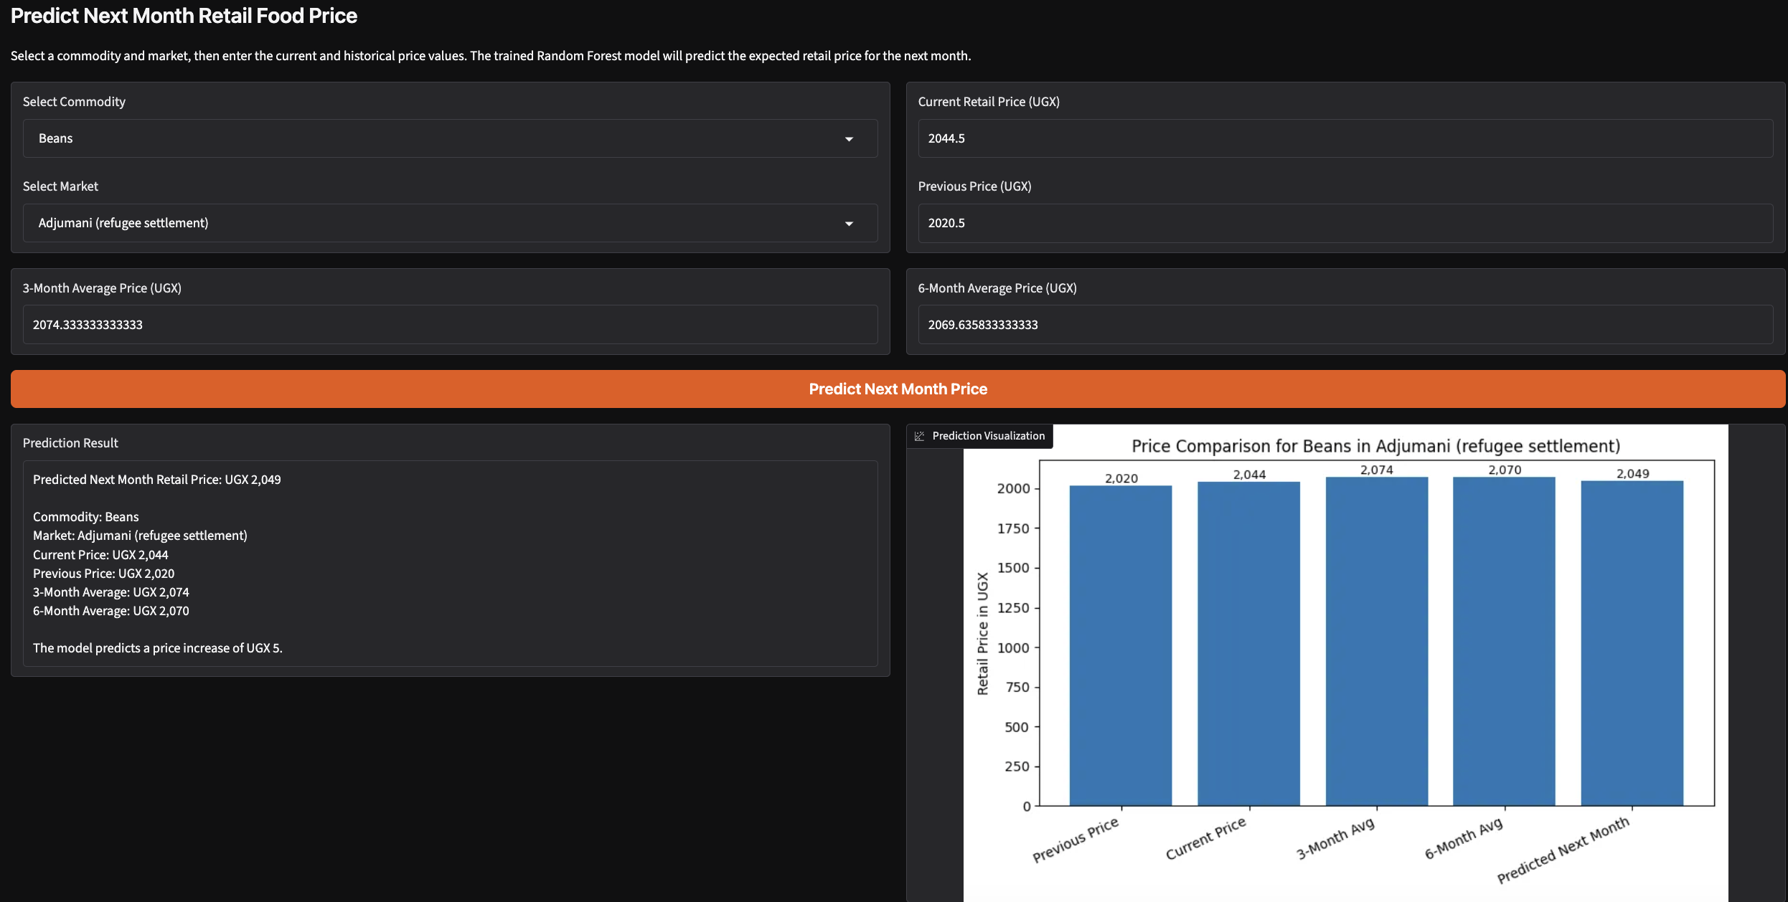
Demo interface and project repository
Demo function
The app lets a user select a commodity and market, enter price values, and receive a next-month retail price prediction.
Repository
github.com/floCarlee/Uganda_Food_Price_Prediction
Includes notebooks, data, model, app, figures and presentation.

Slide 14
Limitations and conclusion
Limitations
Conclusion
This model does not include external drivers such as rainfall, fuel prices, exchange rates, inflation, transport costs, harvest seasons, conflict or supply disruptions.
These factors may explain sudden price movements that the model cannot fully capture.
This project successfully built an end-to-end ML pipeline for Uganda retail food price prediction.
Random Forest was selected as the final model with an R² score of 0.8955.
The project demonstrates cleaning, feature engineering, EDA, modelling, evaluation, GitHub documentation and a working demo.
Future Work: combine price data with weather, fuel, inflation and exchange-rate data.

