Slide 1
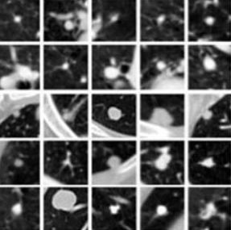
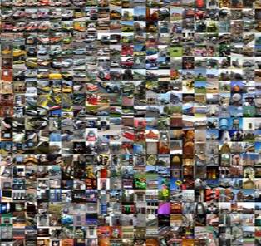
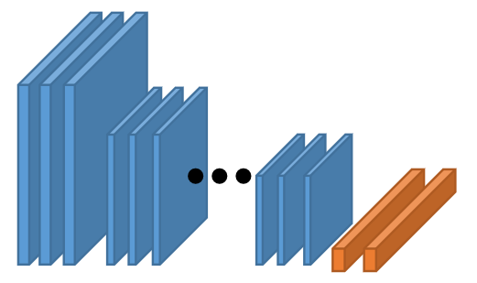
ImageNet
Base-Learner
Pre-trained:
ResNet152
Fine-tuned:
ResNet152
Pre training on ImageNet
Fine tuning on all
training sample

Slide 2

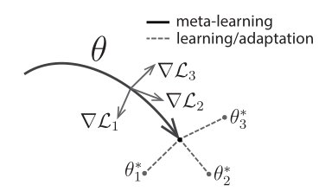



Meta-testing Stage
Meta-training Stage
Training Classes
Classifier fine tunning
Final evaluation
Meta-learner: MAML
Meta-learner: MAML
Training on
Hark Task strategy
Unseen task
(training samples)
Unseen task
(testing samples)
Base-leaner: ResNet152
Base-leaner: ResNet152

