Slide 1
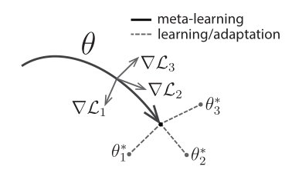
Meta-Training
ResNet152
Meta-learner: MAML with HT
ImageNet
Base-learner:
CT- Pre-tained:
ResNet152
CT dataset
Pre-tained:
ResNet152

