Slide 1
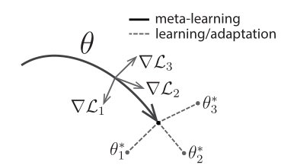
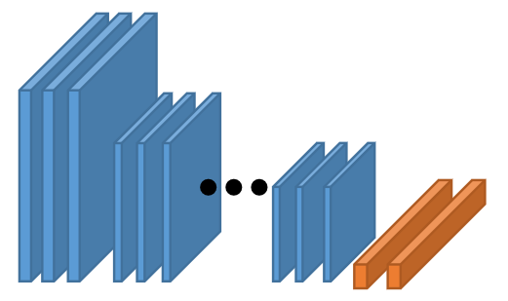
Meta-Training
ImageNet
ResNet152
Meta-learner: MAML with HT
Base-learner:
CT- Pre-tained:
ResNet152
CT dataset
Pre-tained:
ResNet152

