Slide 1
CV infrastructure: idet
Internal Project
Yang, Wei Intel SMG AI-TSS

Slide 2
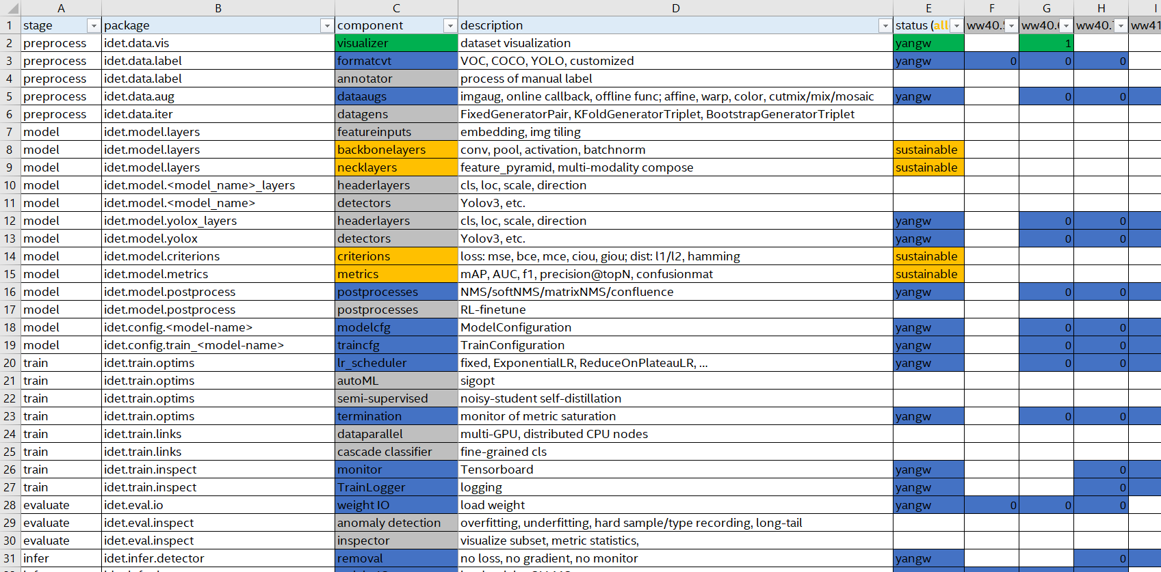
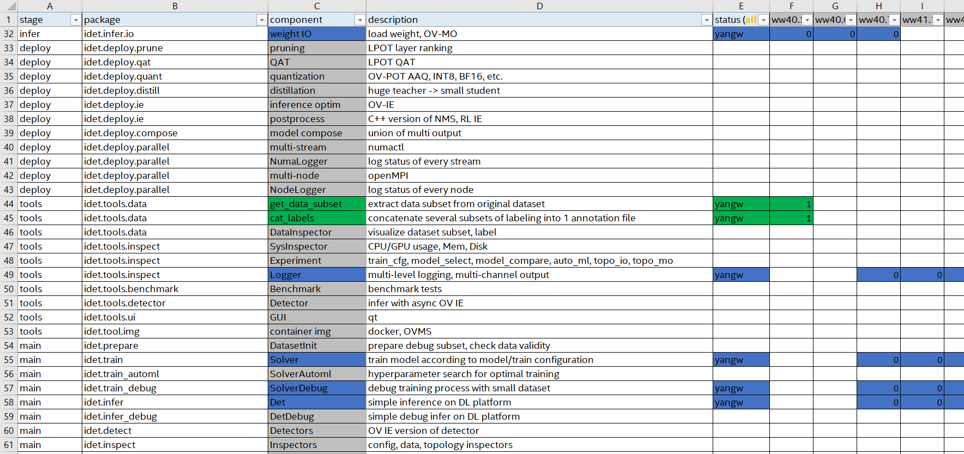
What are the Core Components of CV DL model?
Open Discuz
Label, Augment, EDA
baseline
Data
compare model
model
modify modules
DL
tools
autoML
deploy
prune, qat …
OV TRT …
Qt, OVMS ...

Slide 3
Architect: How do you focus on current work?
CAT rule
Comprehensive
- multiple choices for potential demands
- project is beyond code.
Aim-driven
- Integrate other’s tools
- Proto first, optim next.
Teamwork

Slide 4
Comprehensive: Why need Multiple Choices?
CAT rule
Comprehensive
- multiple choices for potential demands
- project is beyond code.
Aim-driven
- Integrate other’s tools
- Proto first, optim next.
Teamwork

Slide 5
Comprehensive: How do we show ourselves?
CAT rule
Comprehensive
- multiple choices for potential demands
- project is beyond code.
Aim-driven
- Integrate other’s tools
- Proto first, optim next.
Teamwork

Slide 6
Comprehensive.beyondcode: idea, design, doc, demo, code, ann
Everything starts from scratch

Slide 7
Comprehensive.beyondcode: idea, design, doc, demo, code, ann
Keep your trials on blueprint

Slide 8
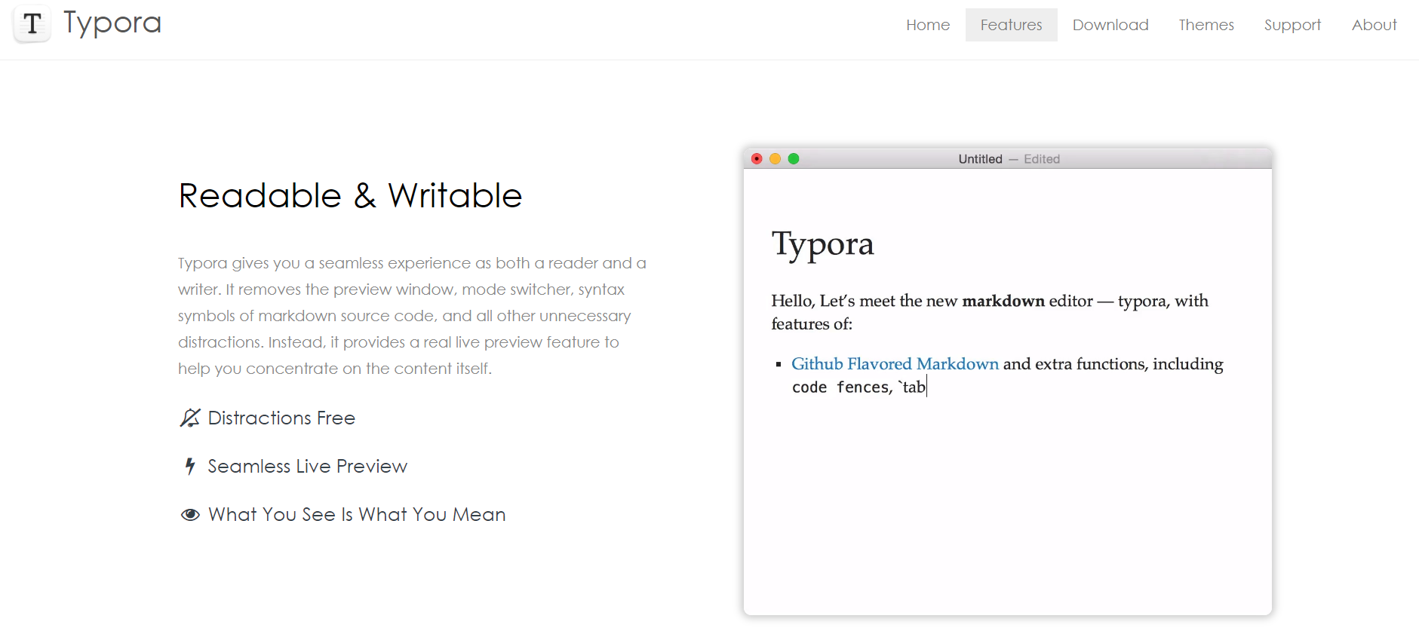
Comprehensive.beyondcode: idea, design, doc, demo, code, ann
Write API.md with powerful App
typora.io

Slide 9
Comprehensive.beyondcode: idea, design, doc, demo, code, ann
Unfamiliar -> Attracted

Slide 10
Comprehensive.beyondcode: idea, design, doc, demo, code, ann
Dummy -> Productive

Slide 11
Aim-driven: architect v.s. wheel-building
CAT rule
Comprehensive
- multiple choices for potential demands
- project is beyond code.
Aim-driven
- Integrate other’s tools
- Proto first, optim next.
Teamwork

Slide 12


Aim_driven.integration: License issues
License
Known source w/o Commercial limits:
- APL2.0
- MIT
- no license
- ?
Never use sources from GPL/LGPL

Slide 13
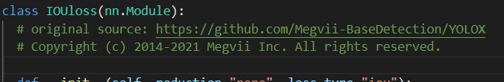
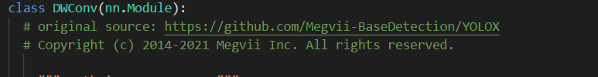
Aim_driven.integration: License issues
Always label code source
Label at very beginning of each func/class:
Convert codes if necessary:
- cross-platform translation
- change code logic

Slide 14
Aim-driven: optimization is always the next
CAT rule
Comprehensive
- multiple choices for potential demands
- project is beyond code.
Aim-driven
- Integrate other’s tools
- Proto first, optim next.
Teamwork

Slide 15
Teamwork: How do we manage a project?
Comprehensive
- multiple choices for potential demands
project is beyond code.
Aim-driven
- Integrate other’s tools
- Proto first, optim next.
Teamwork
- Project Mgmt

Slide 16
Teamwork: Your 1st journey on GitLab
Teamwork
- Project Mgmt
- cooperation on GitLab

Slide 17
Teamwork: routine plan & summary
Teamwork
- Project Mgmt
- cooperation on GitLab
- plan day & summary day

Slide 18
Teamwork: Divide info into different levels
Teamwork
- Project Mgmt
- cooperation on GitLab
- plan day & summary day
- Intel confidential level

Slide 19
AI Engineer v.s. Data Scientist
phenomenon
model
Analyze module
train metrics

Slide 20
Obj-det task
labeling
K-Fold, bootstrap
cleansing
data
augment
preprocess
modules
model
Subnet: backbone…..
training process

Slide 21
Obj-det task
Setup baseline
comparison
Switch modules
Speed-up
Compose
distillation
Pruning (LPOT)
AAQ:INT8 quant
QAT
Multi-modality
union

Slide 22
Obj-det task
NMS & thresh
visualization
model
metrics
deploy & optim
OVMS
service
docker & K8s
API interfaces
Design for debug

Slide 23
Obj-det task
Setup baseline
AAQ:INT8 quant
comparison
QAT
Switch modules
Pruning (LPOT)
distillation
Speed-up
Multi-modality
Compose
union

Slide 24
Obj-det task
Img cls / obj-det
backbone
neck
head
softmax
vector
Extract features (local in map)
Pyramid
SIFT / SURF

Slide 25
env
vs code
gitee
Anaconda & labelImg & pytorch openCV
MobaXterm
OpenCV C++, VS

