Slide 1
Post Processing- NMS

Slide 2
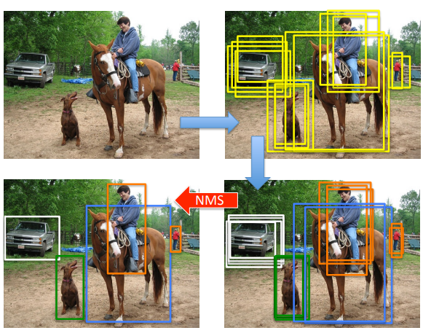
NMS & soft-NMS
Purpose: 解决单目标多检测框
Pipeline

Slide 3
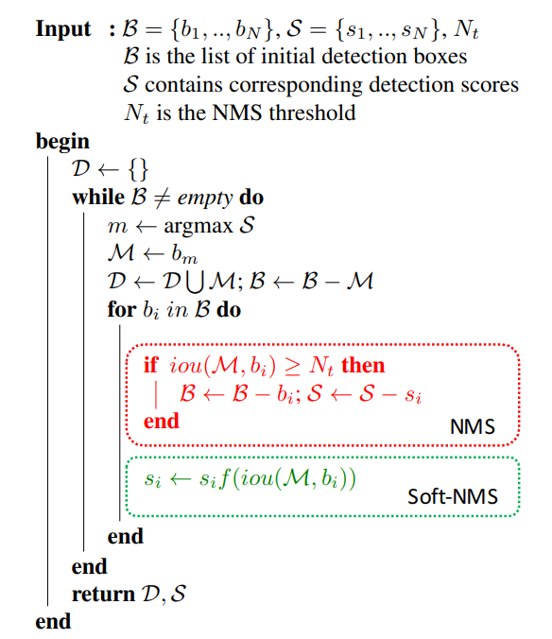
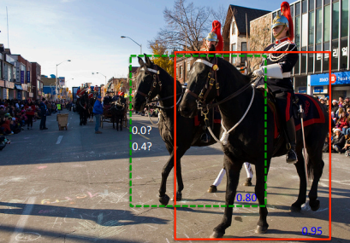
NMS & soft-NMS
Purpose: 临近同类目标检测错误
Pipeline
Algorithm

Slide 4
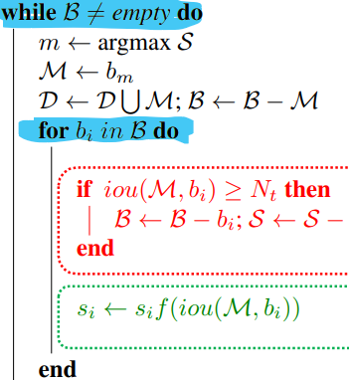
NMS & soft-NMS
Serial
Purpose: 临近同类目标检测错误
Pipeline
Algorithm
Defect

Slide 5
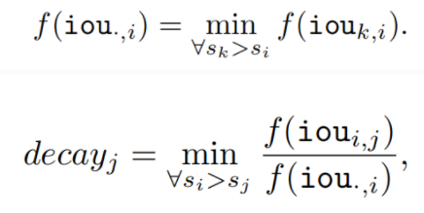
Matrix – NMS
Analysis : What Influence Decay factor
Purpose: NMS并行运算
The penalty of each prediction mi on mj (si > sj ) {mi=mask_i, si=scores_i}
the probability of mi being suppressed. （输入敏感）
Analysis & Solution
Solution
approximate the probability by the most overlapped prediction on mi as
Q: What is difference between Mask(看文章，instance分割) and Detection – BOX ?

Slide 6
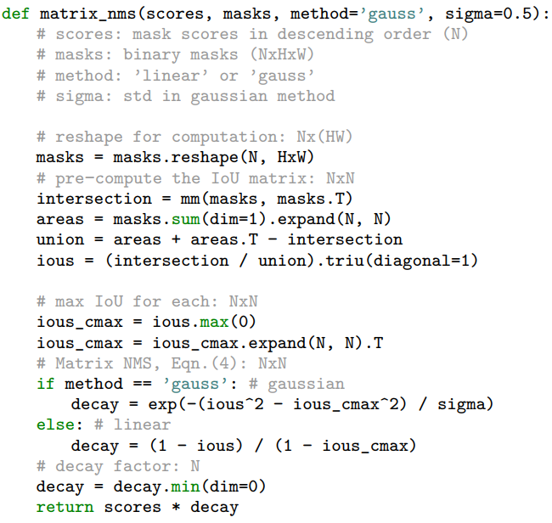
Matrix – NMS
Purpose: NMS并行运算
compute a N × N pairwise IoU matrix for the top N predictions sorted descending by score
get the most overlapping IoUs by column-wise max on the IoU matrix
decay factors are computed, and the decay factor for each prediction is selected as the most effect one by column-wise min
the scores are updated by the decay factors
Analysis & Solution
Algorithm

Slide 7


DIoU – NMS
Purpose:用更好的标准衡量阈值
Distance-IOU

Slide 8
Confluence NO – NMS
Purpose:
Distance-IOU

