Slide 1
Forecasting at scale
Sean J. Taylor and Benjamin Letham
Facebook, Menlo Park, CA

Slide 2
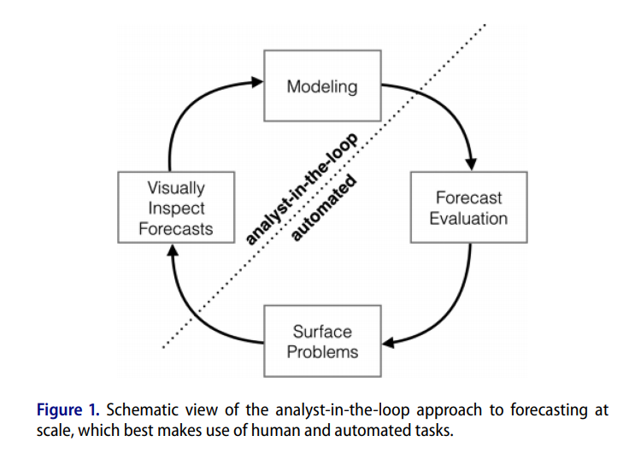
Introduction
Forecasting is a data science task that is central to many activities within an organization
1, completely automatic forecasting techniques can be hard to tune
2, analysts with deep expertise about the specific products or services, but often do not have training in time series forecasting
We summarize our analyst-in-the-loop approach to business forecasting at scale

Slide 3
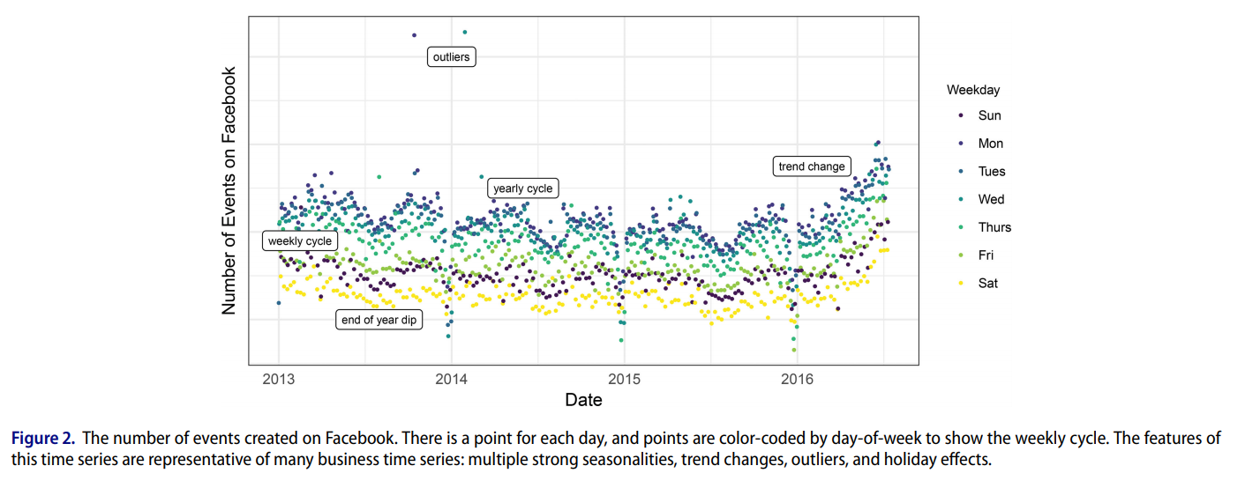
Features of Business Time Series
Facebook users are able to use the Events platform to create pages for events,
invite others, and interact with events in a variety of ways.

Slide 4
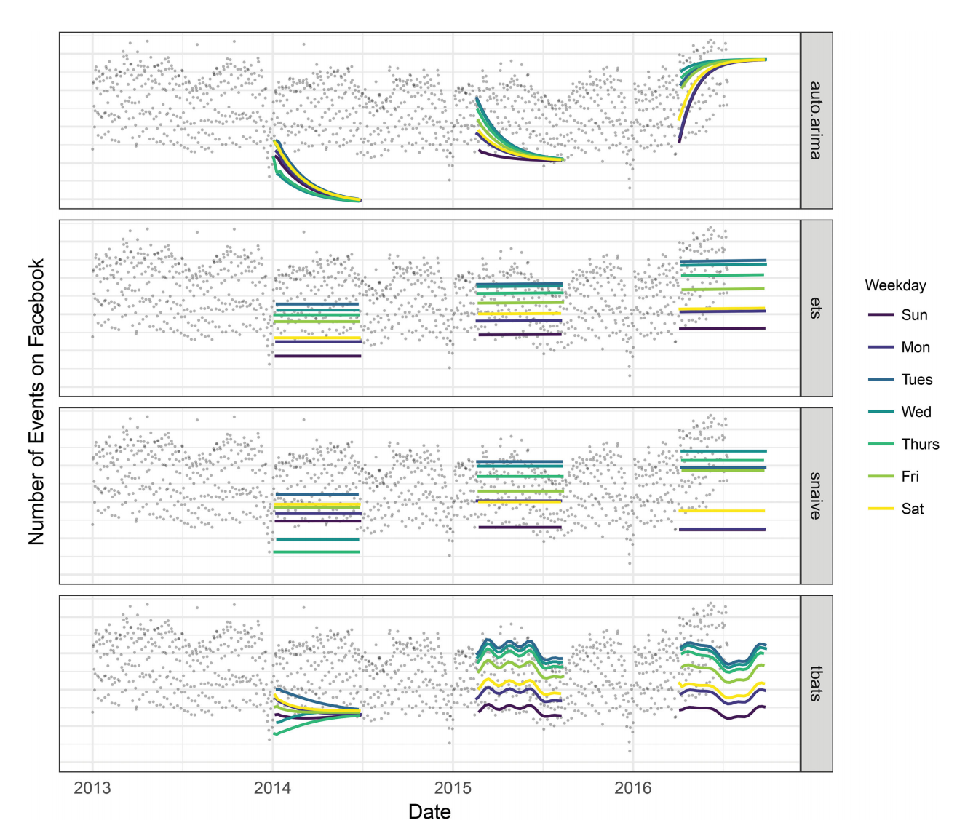
Features of Business Time Series
1,It’s difficult to producing reasonable forecasts with fully automated methods
2,Hard to tune parameters when forecast is poor

Slide 5

The Prophet Forecasting Model
Prophet模型(加法模型) = 趋势模型 + 周期模型 + 特殊节日模型 + 误差
g(t) is the trend function which models nonperiodic changes in the value of the time series,
s(t) represents periodic changes (e.g., weekly and yearly seasonality)
h(t) represents the effects of holidays which occur on potentially irregular schedules over one or more days.
error term t represents any idiosyncratic changes which are not accommodated by the model;
later we will make the parametric assumption that t is normally distributed

Slide 6
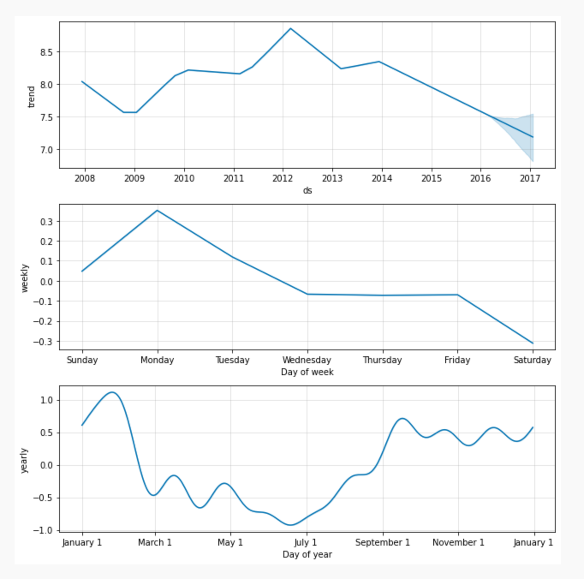
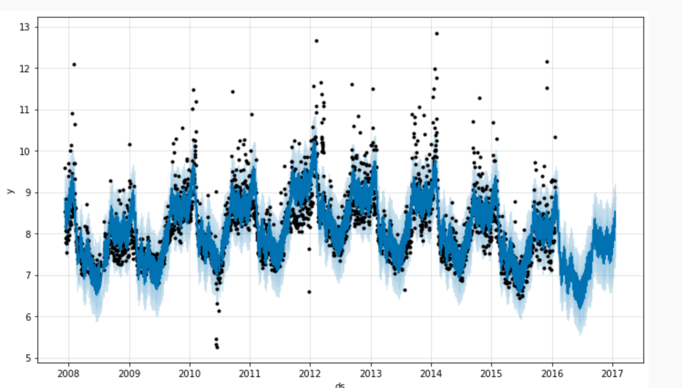
The Prophet Forecasting Model

Slide 7



The Trend Model
1,Nonlinear, Saturating Growth
Problems:
(1),carrying capacity is not constant
(2),the growth rate is not constant
Analysts often have insight into market sizes and can set these accordingly
There may also be external data sources that can provide carrying capacities

Slide 8
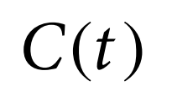
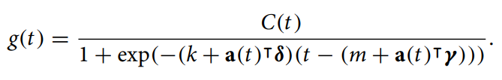
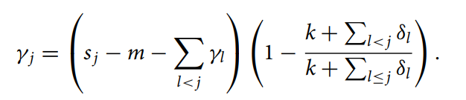
The Trend Model
1,Nonlinear, Saturating Growth
Problems:
(1),carrying capacity is not constant
(2),the growth rate is not constant
Rate change at Changepoints
引入y保证函数在changepoints前后连续

Slide 9

The Trend Model
2, Linear Trend With Changepoints
Same as nonlinear

Slide 10
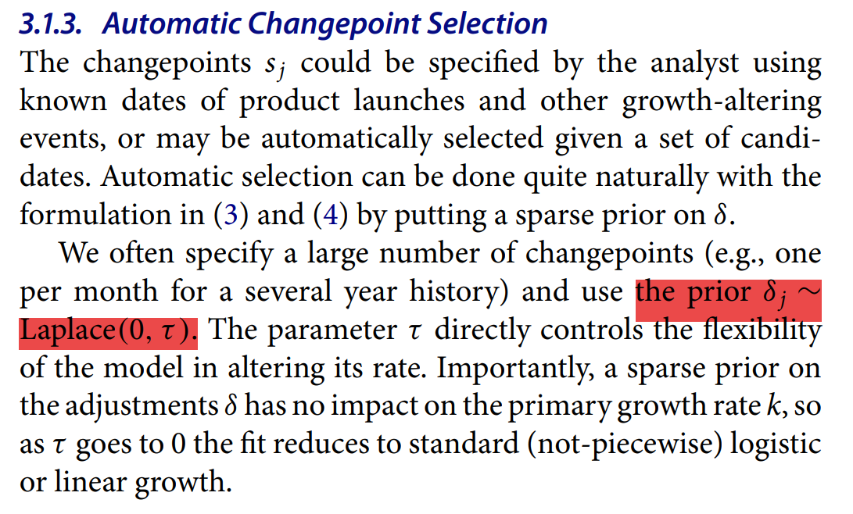
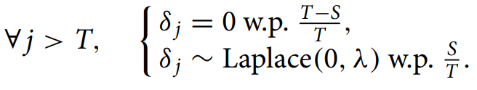
The Trend Model
Automatic Changepoint Selection
Trend Forecast Uncertainty
Future changepoints are randomly sampled in such a way that the average frequency of changepoints matches that in the history:
The generative model for the trend is that there are S changepoints over a history of T points, each of which has a rate change δj ∼ Laplace(0, τ ). We simulate future rate changes that emulate those of the past by replacing τ with a variance inferred from data.

Slide 11
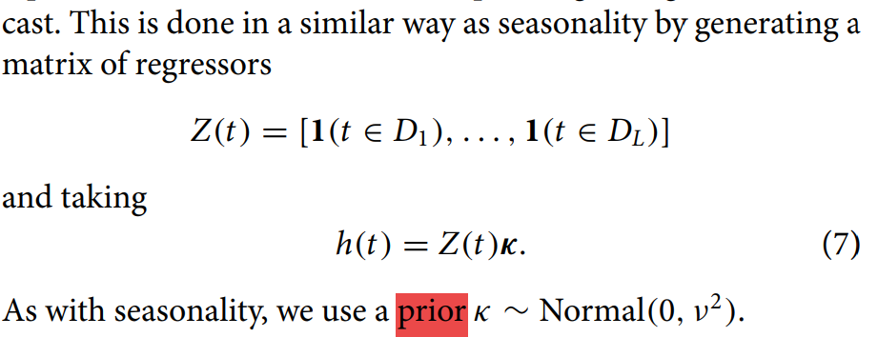
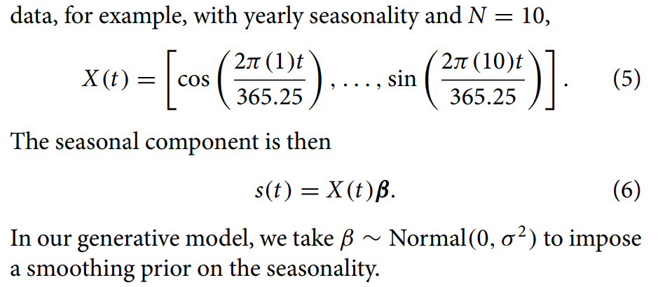
Seasonality
Holidays and Events
用傅里叶级数模拟
For example, with yearly seasonality and N = 10,

Slide 12
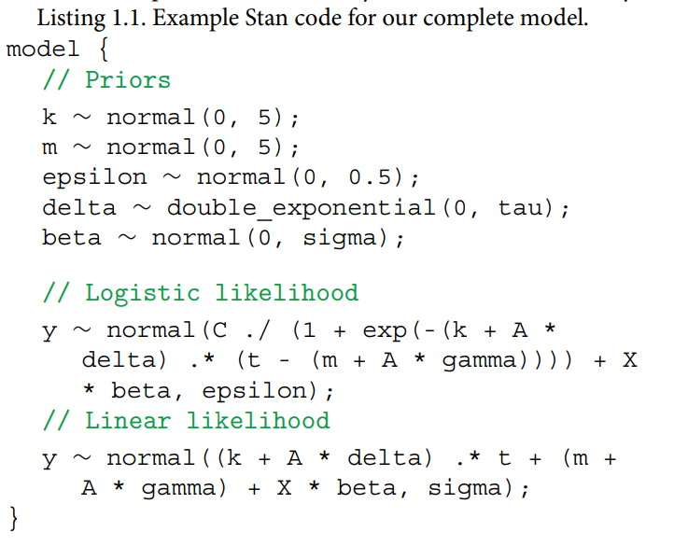
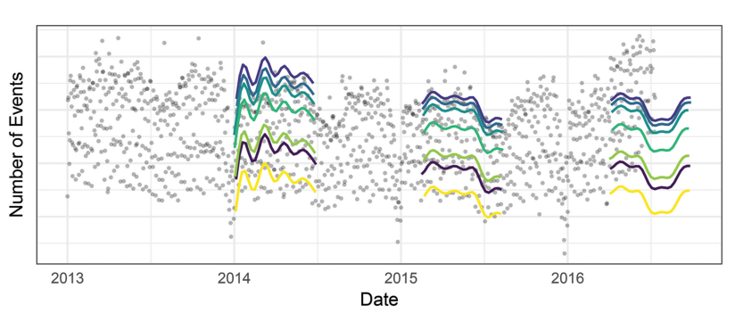
Model Fitting
Stan’s L-BFGS to find a maximum a posteriori estimate

Slide 13
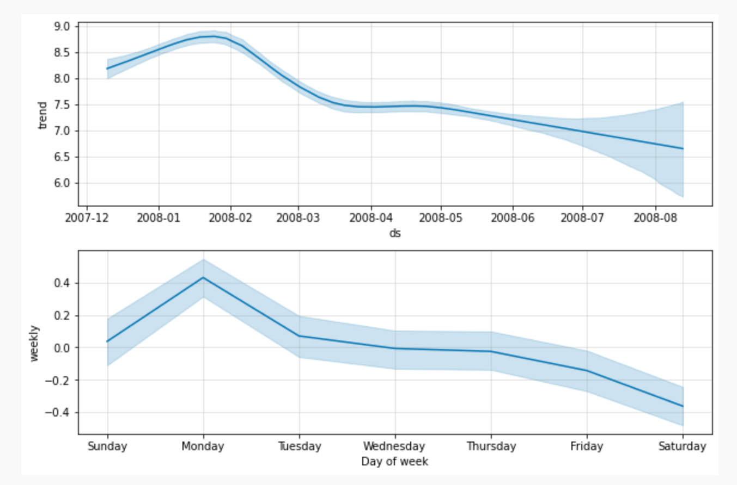
Analyst-in-the-Loop Modeling
可调参数
Capacities
Changepoints
Holidays and seasonality
Smoothing parameters

Slide 14
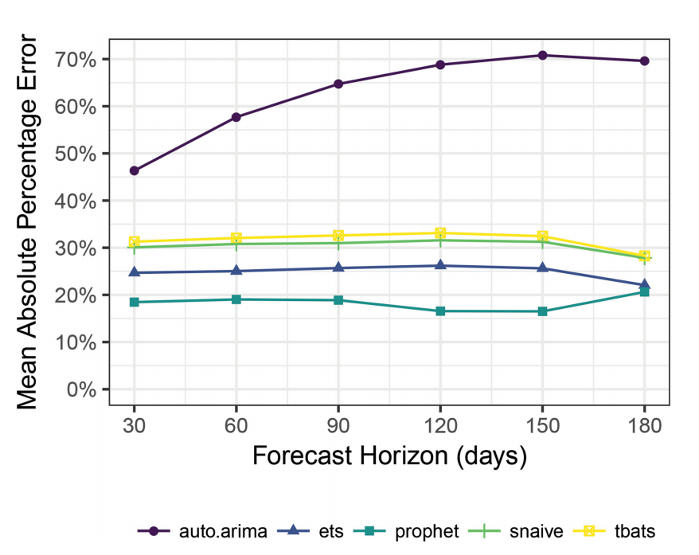


Modeling Forecast Accuracy
Absolute percentage error between
Forecast for time T+h with historical information T and
The real T+h
simulated historical forecasts (SHFs)
by producing K forecasts at various cutoff points in the history, chosen such that the horizons lie within the history and the total error can be evaluated.

