Slide 1
Movie Success Prediction Using Social Media Data
Presented By : Aniruddha Das

Slide 2
Putting Film Industry into Perspective
Film Industry – a multi-million dollar business
In India alone, it generated a revenue of 10, 498 crore in box office and web traffic, (2019).
A movie’s success depends on a lot of factors
The hype surrounding the movie
The positive buzz it generates on social media
Marketing budget
Actors working on the movie and their number of followers
Predicting based on this parameters will help us know that a movie is successful of not
However, movie prediction can never be highly accurate, as human behaviour plays a key role in the success of a movie,
If humans cannot always predict the outcome of a movie’s success, neither can machines

Slide 3
Determining success of a movie
Success of a movie can be interpreted in many ways
The amount of awards it has won
The amount of revenue it has generated
The ratings from review outlets
etc…
For the sake of simplicity we will consider the amount of revenue generated to be prime parameter for success
Shareholders will likely see this metric to be the determining factor of a movie ballooning into a franchise.

Slide 4
LiBraries & DataSet used for This Task
Python libraries :
Sklearn : features pre-made functions for various classification, regression and clustering that will be used to make a model.
Matplotlib : features various graphical exploratory data analysis tools which will help us better understand relationships between featuresets.
XGBoost : brings XGBoost algorithm, so that it can be used to make a model.
CatBoost : brings CatBoost algorithm, so that it can be used to make a model.
Numpy & pandas : feature several data and matrix manipulation tools that are used to store data in a specific way so that it can be used for training & evaluation.
The dataset that we are going to use for this task was downloaded from UCI called
movieDetails.csv , it is a raw dataset from IMDB, so it contains null values, incompatible data types etc, that I needed to clean…

Slide 5
Methodology
The entire project was completed in three phases:
Model Extraction
Data preprocessing & feature engineering
Model Evaluation & conclusion
Libraries imported in the first phase…

Slide 6
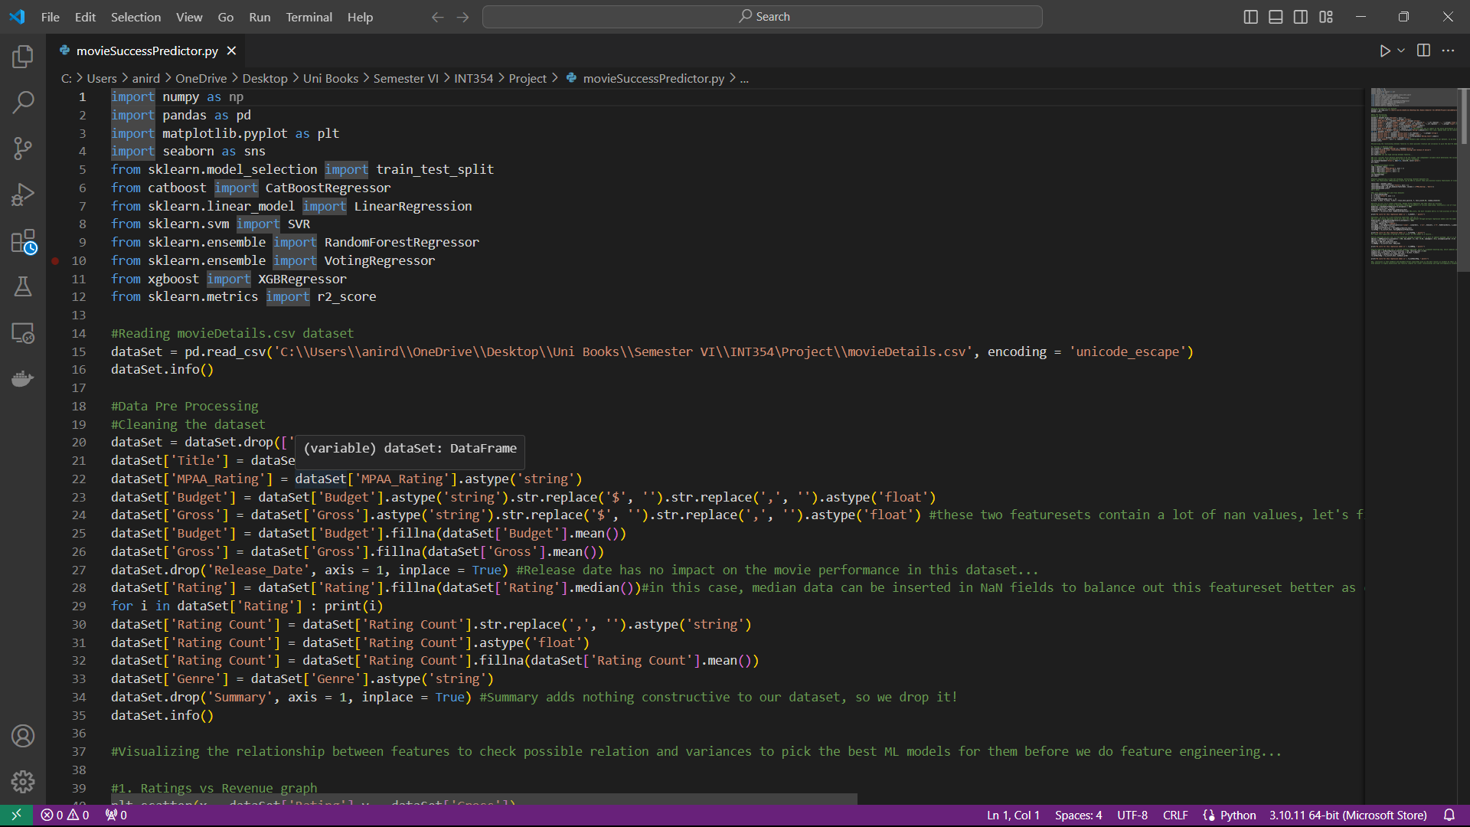
Feature Extraction

Slide 7
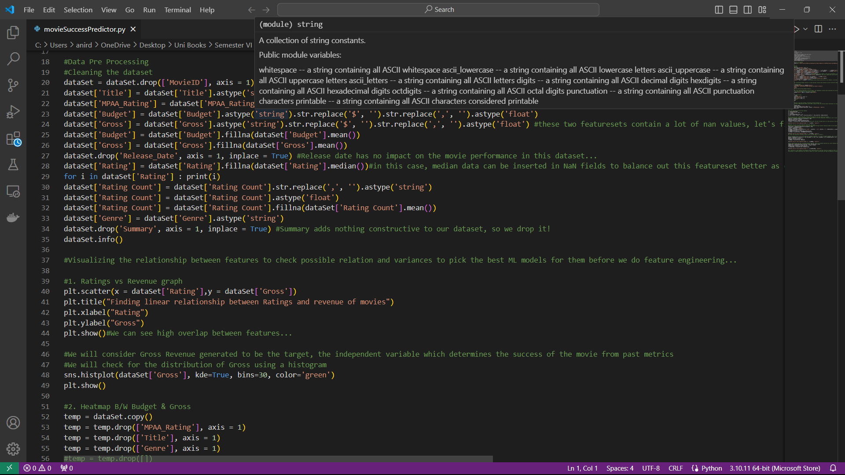
Data Pre-Processing

Slide 8
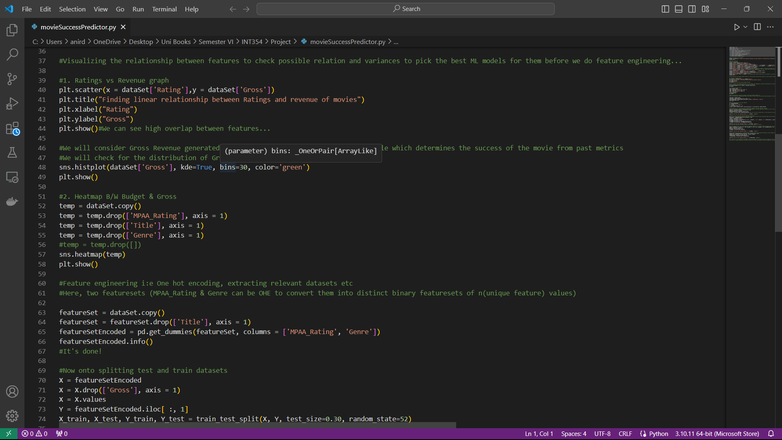
Graphical E.D.A.

Slide 9
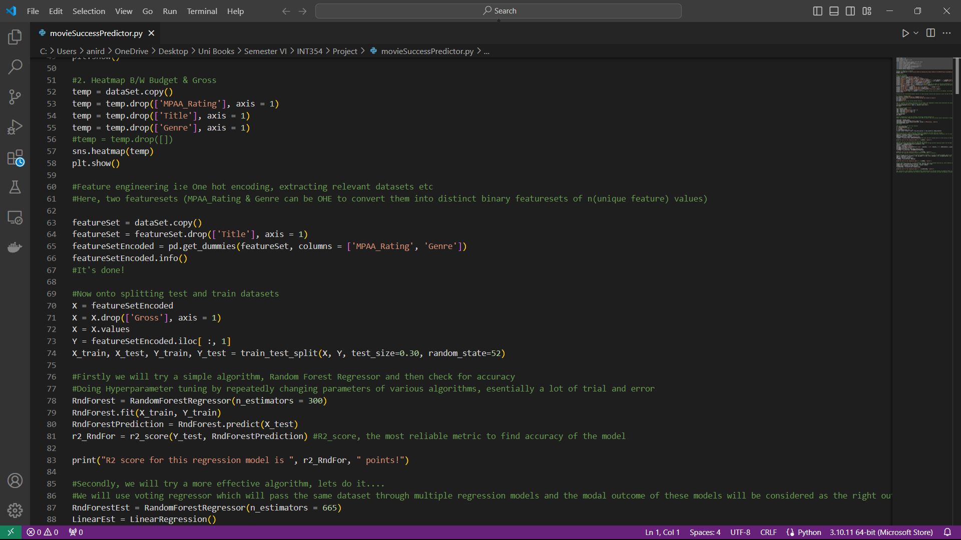
Feature Engineering

Slide 10
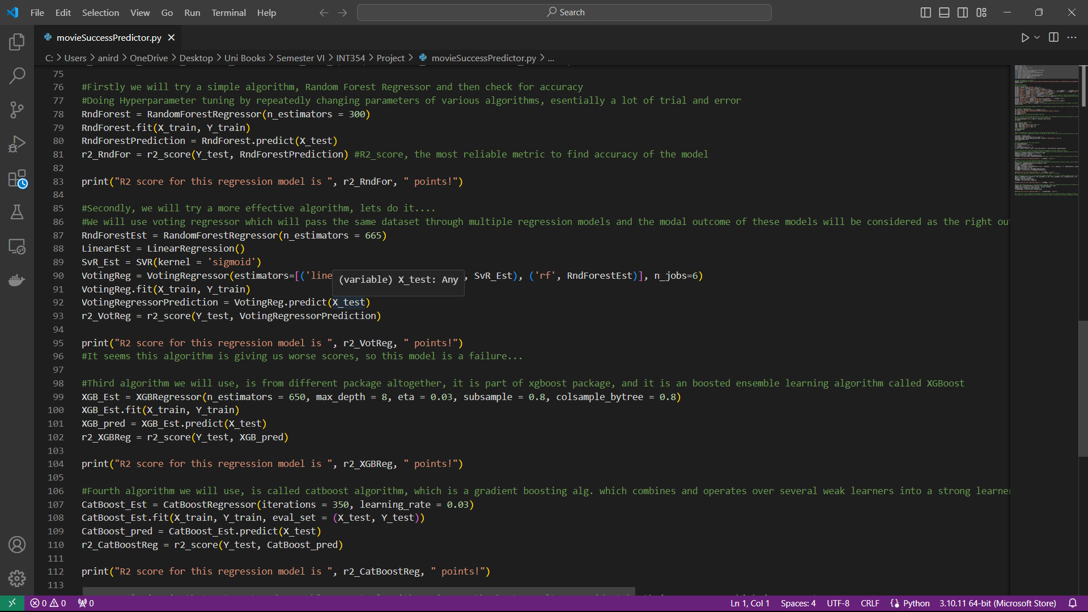
Algorithms used & Models Made + Hyper-Parameter Tuning

Slide 11
Conclusion
For this kind of task, consisting of a dataset containing complex and sometimes unnecessary relationships between various feature-sets
Linear Regression& SVM model will perform worse as is shown by the outcomes of the project previously…
It is better to use Ensemble Random Forest and Catboost algorithm which give us an r2 score of 0.59 which means they explained 59% of the variance property of the testing dataset.

