Slide 1
Piccolo esperimento IoT
LINUX DAY 2018

Slide 2
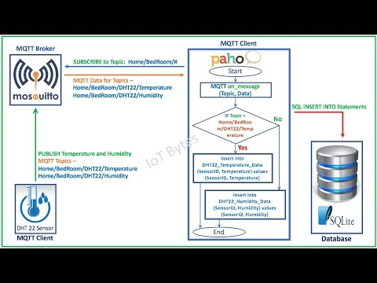
MQTT
http://mqtt.org/

Slide 3

MQTT
MQTT stands for Message Queuing Telemetry Transport. It is a publish/subscribe, extremely simple and lightweight messaging protocol, designed for constrained devices and low-bandwidth, high-latency or unreliable networks. The design principles are to minimise network bandwidth and device resource requirements whilst also attempting to ensure reliability and some degree of assurance of delivery. These principles also turn out to make the protocol ideal of the emerging “machine-to-machine” (M2M) or “Internet of Things” world of connected devices, and for mobile applications where bandwidth and battery power are at a premium.
http://mqtt.org/

Slide 4
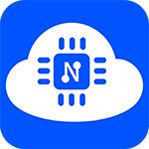
NodeMCU
NodeMCU is an open source Lua based firmware for the ESP8266 WiFi SOC from Espressif and uses an on-module flash-based SPIFFS file system. NodeMCU is implemented in C and is layered on the Espressif NON-OS SDK.
The firmware was initially developed as is a companion project to the popular ESP8266-based NodeMCU development modules, but the project is now community-supported, and the firmware can now be run on any ESP module.
Arduino-like hardware IO
Advanced API for hardware IO, which can dramatically reduce the redundant work for configuring and manipulating hardware. Code like arduino, but interactively in Lua script.
https://nodemcu.readthedocs.io/en/master/

Slide 5
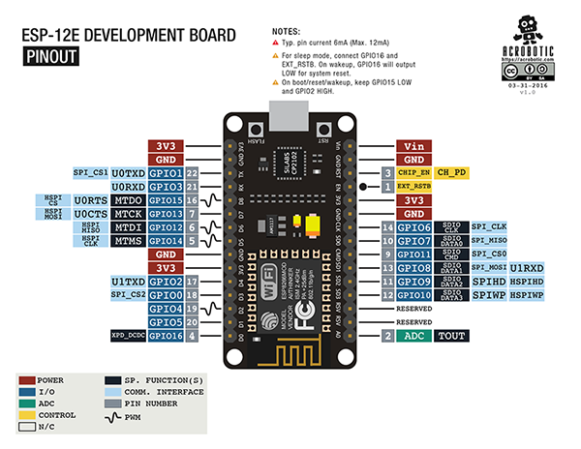
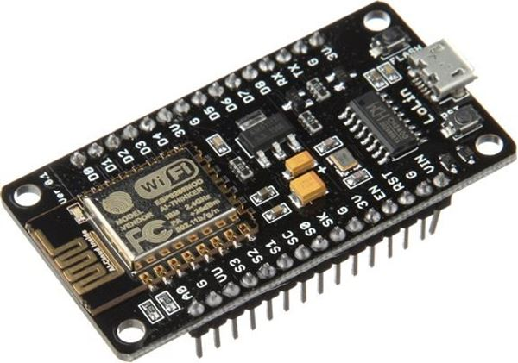
NodeMCU
The Development Kit based on ESP8266,
integates GPIO, PWM, IIC,
1-Wire and ADC
all in one board
https://nodemcu.readthedocs.io/en/master/
https://github.com/nodemcu

Slide 6
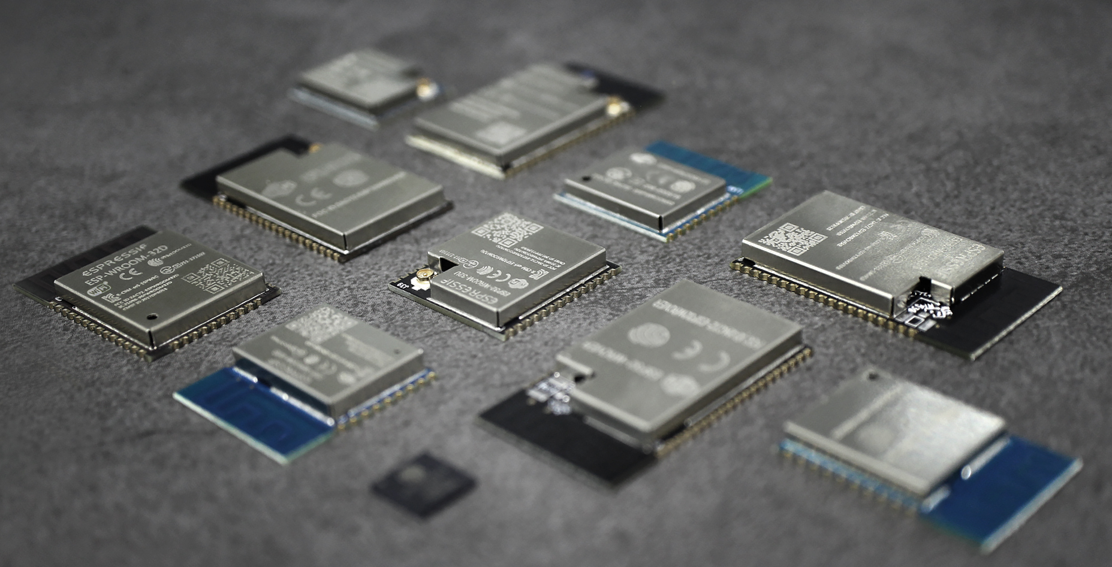
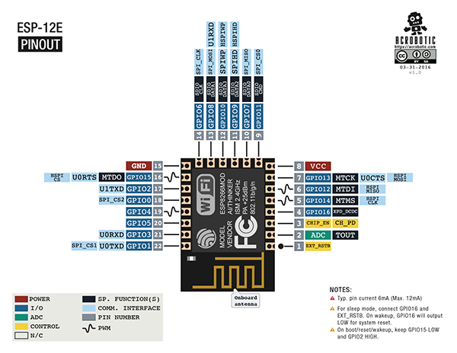
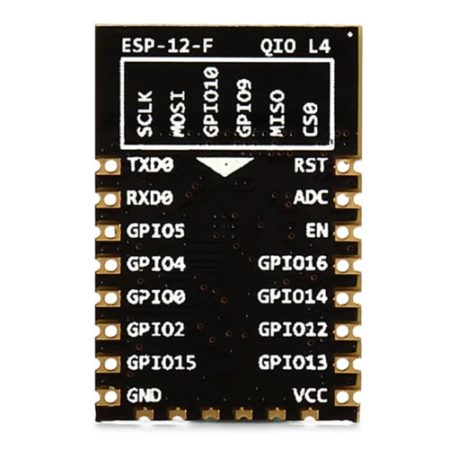
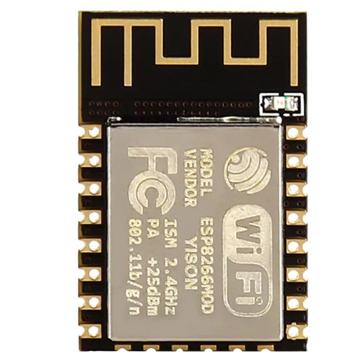
ESP8266
https://www.espressif.com/

Slide 7
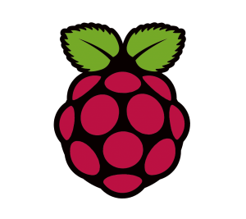
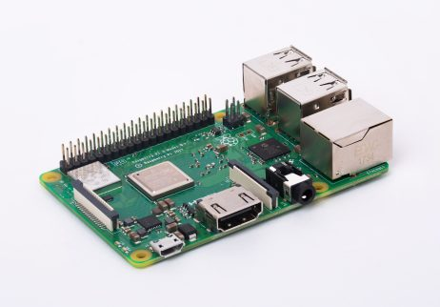
Raspberry Pi
Raspberry Pi 3 Model B+
1.4GHz 64-bit quad-core processor, dual-band wireless LAN, Bluetooth 4.2/BLE, faster Ethernet.
https://www.raspberrypi.org/

Slide 8


Raspbian is a free operating system based on Debian optimized for the Raspberry Pi hardware. An operating system is the set of basic programs and utilities that make your Raspberry Pi run. However, Raspbian provides more than a pure OS: it comes with over 35,000 packages, pre-compiled software bundled in a nice format for easy installation on your Raspberry Pi.
The initial build of over 35,000 Raspbian packages, optimized for best performance on the Raspberry Pi, was completed in June of 2012. However, Raspbian is still under active development with an emphasis on improving the stability and performance of as many Debian packages as possible.
Note: Raspbian is not affiliated with the Raspberry Pi Foundation. Raspbian was created by a small, dedicated team of developers that are fans of the Raspberry Pi hardware, the educational goals of the Raspberry Pi Foundation and, of course, the Debian Project.
https://www.raspbian.org/

Slide 9

Eclipse Mosquitto™
An open source MQTT broker
Eclipse Mosquitto is an open source (EPL/EDL licensed) message broker that implements the MQTT protocol versions 3.1 and 3.1.1. Mosquitto is lightweight and is suitable for use on all devices from low power single board computers to full servers.
The MQTT protocol provides a lightweight method of carrying out messaging using a publish/subscribe model. This makes it suitable for Internet of Things messaging such as with low power sensors or mobile devices such as phones, embedded computers or microcontrollers.
The Mosquitto project also provides a C library for implementing MQTT clients, and the very popular mosquitto_pub and mosquitto_sub command line MQTT clients.
Mosquitto is part of the Eclipse Foundation and is an iot.eclipse.org project.
https://projects.eclipse.org/projects/technology.mosquitto

Slide 10

Python™
Python is an interpreted high-level programming language for general-purpose programming.
https://www.python.org/

Slide 11

MariaDB®
MariaDB Server is one of the most popular database servers in the world. It’s made by the original developers of MySQL and guaranteed to stay open source. Notable users include Wikipedia, WordPress.com and Google.
MariaDB is developed as open source software and as a relational database it provides an SQL interface for accessing data. The latest versions of MariaDB also include GIS and JSON features.
https://mariadb.org/

Slide 12

LIGHTTPD
Security, speed, compliance, and flexibility -- all of these describe lighttpd (pron. lighty) which is rapidly redefining efficiency of a webserver; as it is designed and optimized for high performance environments. With a small memory footprint compared to other web-servers, effective management of the cpu-load, and advanced feature set (FastCGI, SCGI, Auth, Output-Compression, URL-Rewriting and many more) lighttpd is the perfect solution for every server that is suffering load problems. And best of all it's Open Source licensed under the revised BSD license.
https://www.lighttpd.net/

Slide 13

PHP©
PHP is a popular general-purpose scripting language that is especially suited to web development.
Fast, flexible and pragmatic, PHP powers everything from your blog to the most popular websites in the world.
https://secure.php.net/

Slide 14
SQL
SQL (Structured Query Language) è un linguaggio standardizzato per database basati sul modello relazionale (RDBMS) progettato per:
creare e modificare schemi di database (DDL - Data Definition Language);
inserire, modificare e gestire dati memorizzati (DML - Data Manipulation Language);
interrogare i dati memorizzati (DQL - Data Query Language);
creare e gestire strumenti di controllo e accesso ai dati (DCL - Data Control Language).

