Slide 1
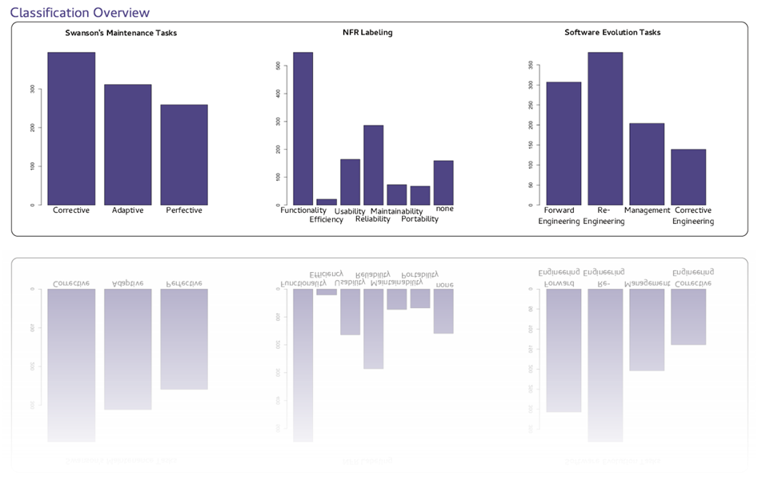


Andreas Mauczka, Florian Brosch, Christian Schanes, Thomas Grechenig
Research Group for Industrial Software (INSO)
Vienna University of Technology, Austria
www.inso.tuwien.ac.at

Slide 2
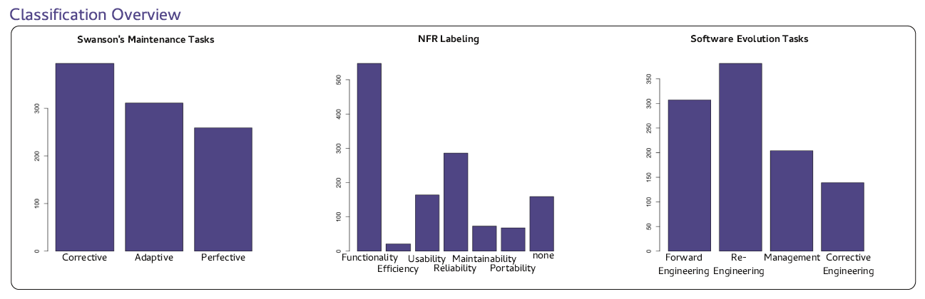
Topic
Labeling of commits according to three classification schemes
  Adapted Swanson’s, Hindle’s, Lanza’s
Manual labeling by the authors of the change – meta-information of the nature of a change
Meta-Information and results are available as an SQLite Database file

Slide 3
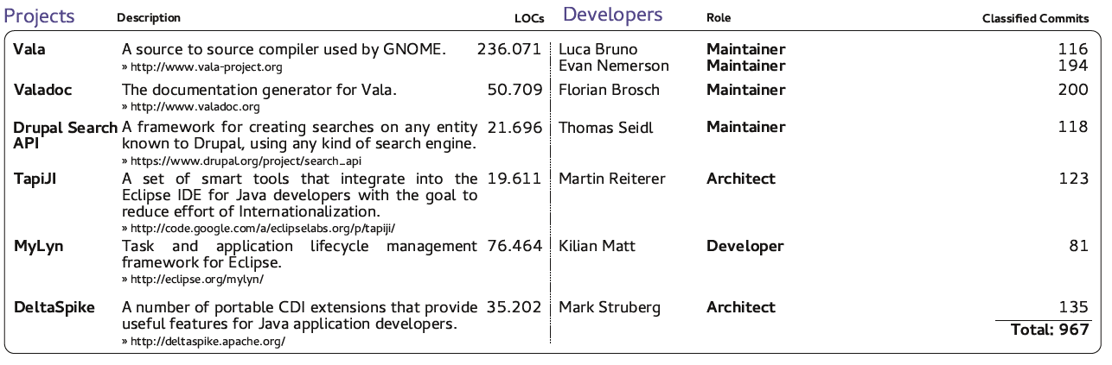
Survey

Slide 4
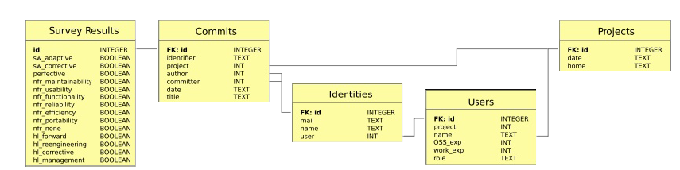
Dataset Model

