Slide 1
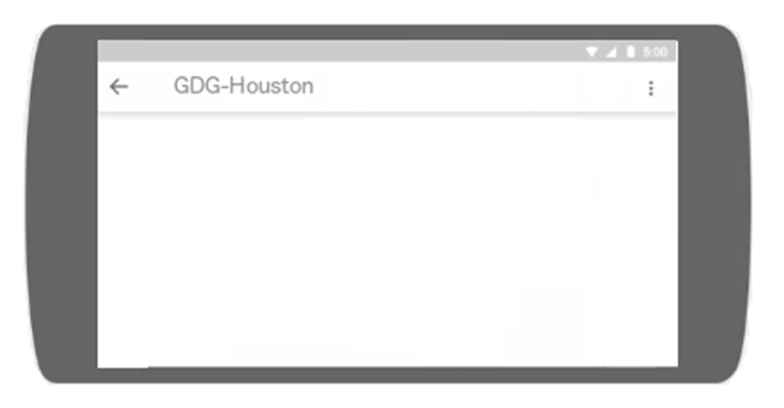
Threads
Inside
Fragments
Inside
Activities
by Flo Maldonado

Slide 2
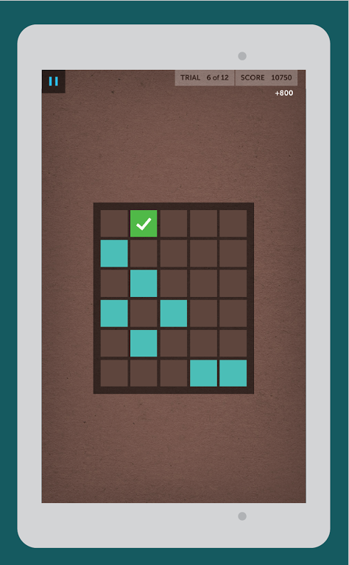

Some Activities are
Made Up of Fragments
Notes:
Fragment connection to Activity is gone.
Trying to connect to not attached Activity will result in a crash.

Slide 3
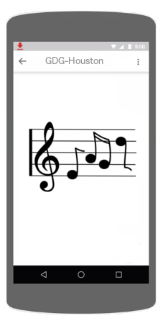
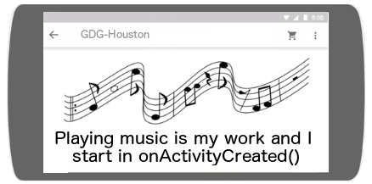
Activity and Thread are
Destroyed When Phone is Flipped
Activity A
Activity B
Music Playing
Thread A
Music Playing
Thread B
Notes:
Fragment connection to Activity is gone.
Trying to connect to not attached Activity will result in a crash.

Slide 4
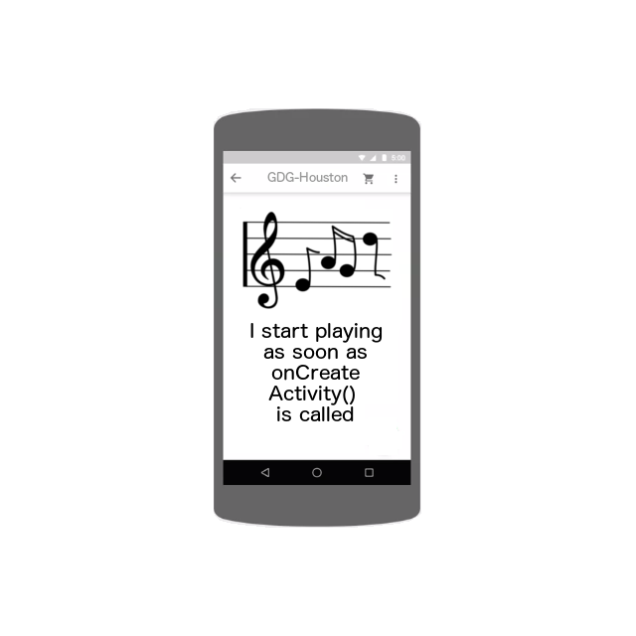
A Naively Adding a Non-Retained Fragment
Fragment 1
Music Playing Thread 1

Slide 5
A Naively Adding a Non-Retained Fragment
Fragment 1
Music Playing Thread 1

Slide 6
A Naively Adding a Non-Retained Fragment
Fragment 1
Music Playing Thread 1

Slide 7
A Naively Adding a Non-Retained Fragment
Fragment 1
Fragment 2
Music Playing Thread 1
Music Playing Thread 2

Slide 8
Adding a Retained Fragment
Fragment 1
Music Playing Thread 1

Slide 9
Adding a Retained Fragment
Fragment 1
Music Playing Thread 1

Slide 10
Adding a Retained Fragment
Fragment 1
Music Playing Thread 1

Slide 11
Adding a Retained Fragment
Fragment 1
Music Playing Thread 1

Slide 12
No Synchronization
Working Thread
UI Thread
Fragment
Activity
onCreate () {
initializations
frag = new Fragment();
commit fragment
}
Fragment () {
mThread = new mThread();
}
onCreate () {
mThread.start();
}
run {
for (letter: A thru Z) {
activity = getActivity();
activity.notify(letter);
}
}
onActivityCreated () {
}
onDestroy () {
super.onDestroy();
clean up
}
onDestroy () {
}
onDetach () {
}

Slide 13
Using mReady To Avoid Crashes
Working Thread
UI Thread
Fragment
Activity
onCreate () {
initializations
frag = new Fragment();
commit fragment
}
Fragment () {
mThread = new mThread();
mReady = false;
}
onCreate () {
mThread.start();
}
run {
for (letter: A thru Z) {
synchronized(self) {
if (mReady){
activity = getActivity();
activity.notify(letter);
}
}
}
}
onActivityCreated () {
synchronized(mThread) {
mReady = true;
mThread.notify();
}
}
onDestroy () {
super.onDestroy();
clean up
}
onDestroy () {
synchronized(mThread) {
mReady = false;
mThread.notify();
}
}
onDetach () {
synchronized(mThread) {
mReady = false;
mThread.notify();
}
}

Slide 14
Retained Fragment Using mReady and mQuitting
Working Thread
UI Thread
Fragment
Activity
onCreate () {
initializations
frag = new Fragment();
commit fragment
}
Fragment () {
mThread = new mThread();
mReady = false;
mQuitting = false;
}
onCreate () {
mThread.start();
}
run {
for (letter: A thru Z) {
synchronized(self) {
while (!mReady && !mQuitting){
wait();
}
if (mQuitting) {
return;
}
activity = getActivity();
activity.notify(letter);
}
}
onActivityCreated () {
synchronized(mThread) {
mReady = true;
mThread.notify();
}
}
onDestroy () {
super.onDestroy();
clean up
}
onDestroy () {
synchronized(mThread) {
mReady = false;
mQuitting = true;
mThread.notify();
}
}
onDetach () {
synchronized(mThread) {
mReady = false;
mThread.notify();
}
}

Slide 15
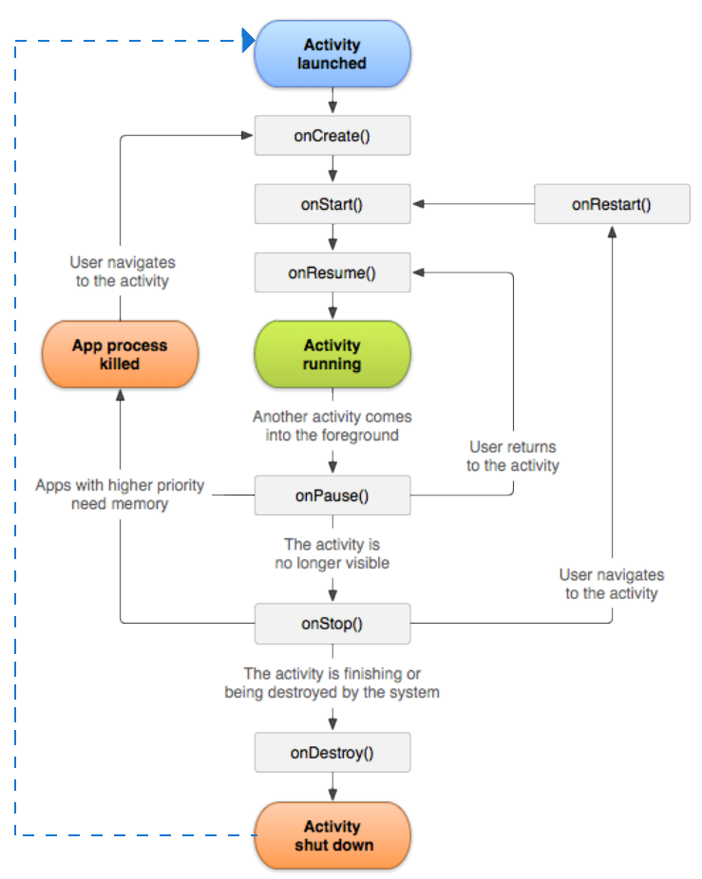
Activity
Life Cycle
Notes:
We make a class that inherits from Activity that controls the views in the page of the app.
Framework starts the activity.
As the user interacts with our app, by bringing it to the top of the stack or going away from our app it calls methods in our activity class.
Since our class inherits from the Activity class we know what methods are going to be called and we override them with the logic for our activity. So when we get an onStart method call from the framework we know 'onStart' means the user can see our app! Let's make sure they are still connected to the GPS.
Destroyed does not mean garbage collected. Created does not mean instantiated.
Blue Arrow Flipping Phone Means Destroyed.
All these methods are called on the UI thread.

Slide 16
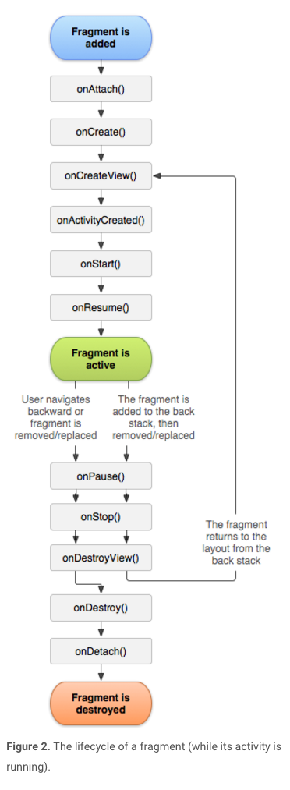
Fragment Life Cycle
Fragment's Callback Methods are a Response to Activity State
Notes:
All these methods are called on the UI thread.
Fragments are added or committed to Activities

Slide 17
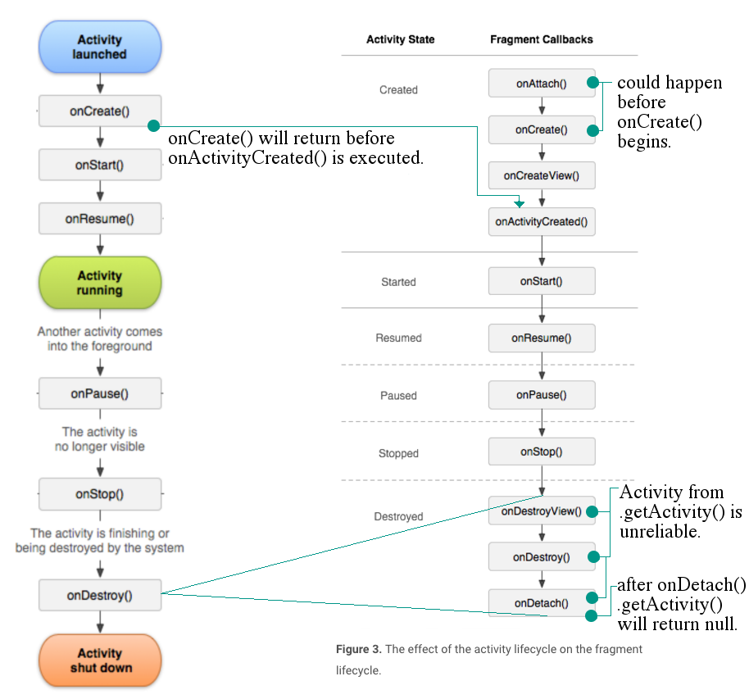
Activity and Fragment Life Cycles Together

Slide 18
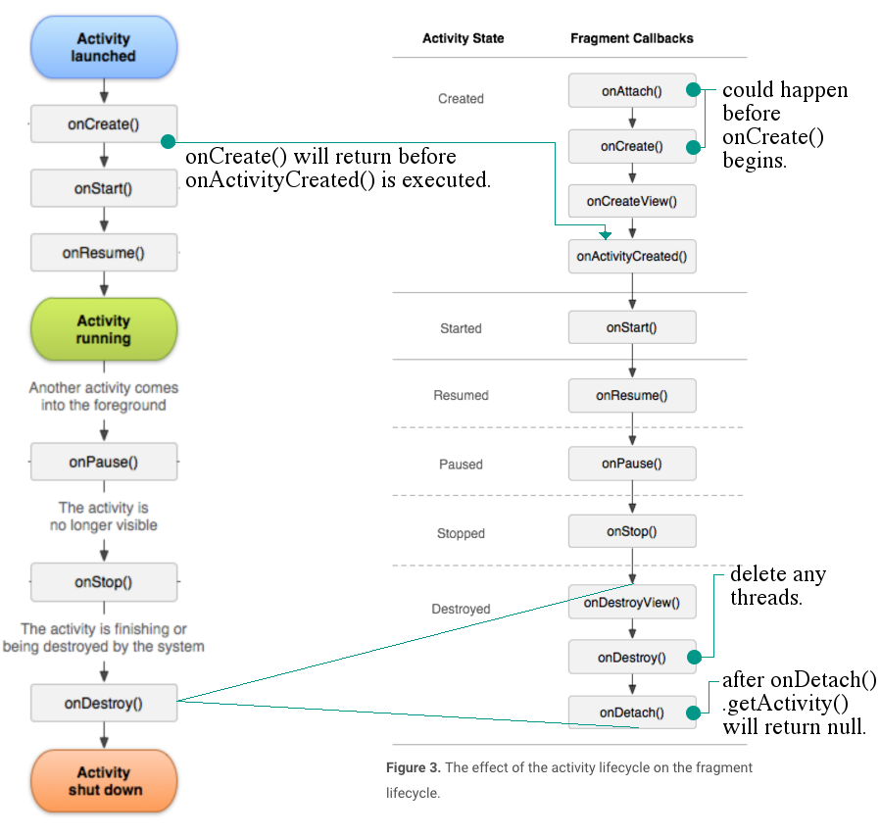
Retained Fragments
Second Time Around

Slide 19
Resources
FragmentRetainInstance by Dianne Hackborn
<sdk_root>/APIDemos/app/src/main/java/com/example/android/apis/app/FragmentRetainInstance.java.
or
https://android.googlesource.com/platform/development/+/master/samples/ApiDemos/src/com/example/android/apis/app
Develop>API Guides>App Components>Activities
https://developer.android.com/guide/components/activities.html
Develop>Training>Managing the Activity Lifecycle
https://developer.android.com/training/basics/activity-lifecycle/index.html

Slide 20
Resources
FragmentRetainInstance
<sdk_root>/APIDemos/app/src/main/java/com/example/android/apis/app/FragmentRetainInstance.java.
or https://android.googlesource.com/platform/development/+/master/samples/ApiDemos/src/com/example/android/apis
Develop>API Guides>App Components>Activities
https://developer.android.com/guide/components/activities.html
Develop>Training>Getting Started>Managing the Activity Lifecycle
https://developer.android.com/training/basics/activity-lifecycle/index.html

