Slide 1
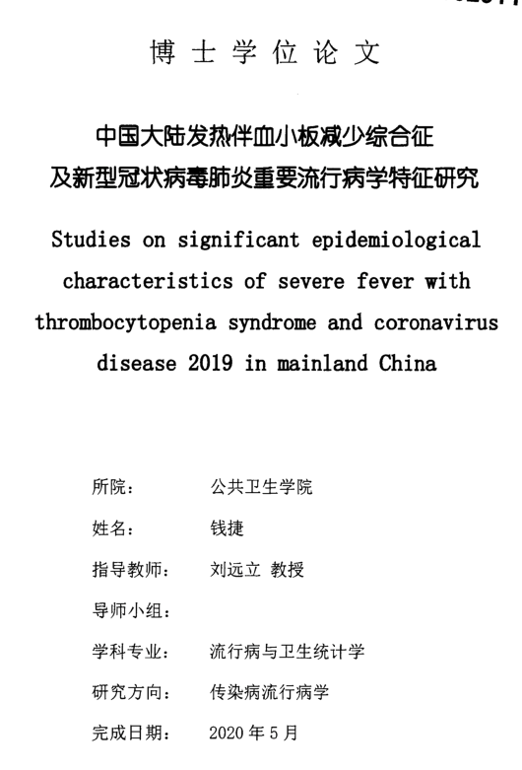
PhD dissertation
Study on important epidemiological characteristics of fever with thrombocytopenia syndrome and novel coronavirus pneumonia in mainland China
Studies on significant epidemiological characteristics of severe fever with thrombocytopenia syndrome and coronavirus disease 2019 in mainland China
Institute:
School of Public Health
Name: Qian Jie
mentor: Professor Liu Yuanli
Mentor Group:
major:
Epidemiology and Biostatistics
research direction:
Infectious Disease Epidemiology
Completion Date:
May 2020

Slide 2
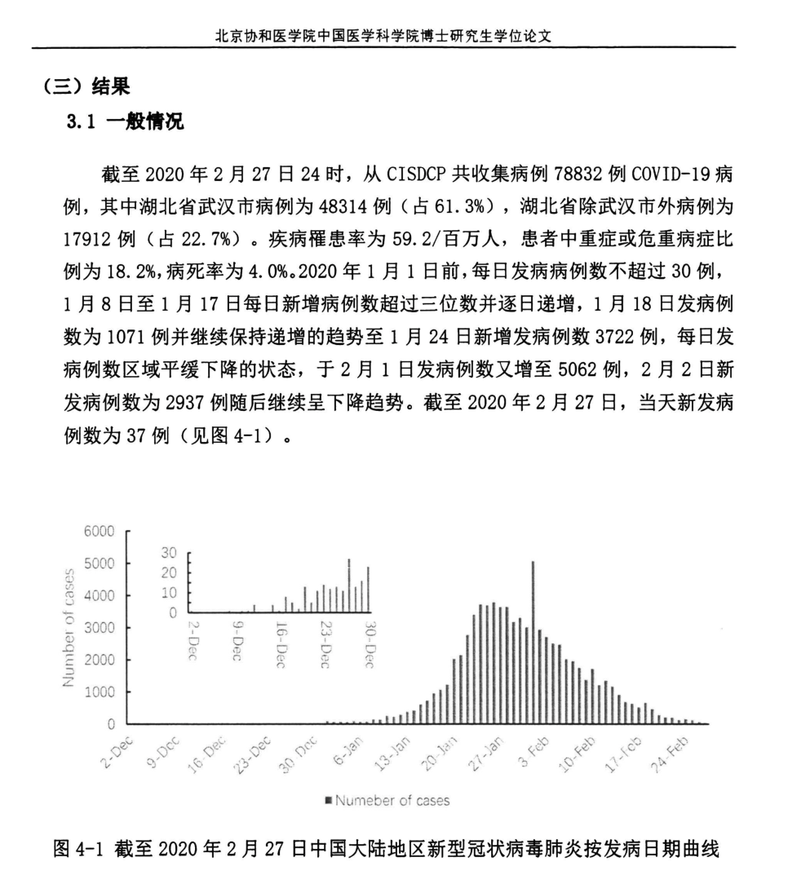
Dissertation for Ph.D. Candidates of Peking Union Medical College Chinese Academy of Medical Sciences
(3) Results
3.1 General situation
As of 24:00 on February 27, 2020, a total of 78,832 COVID-19 cases were collected from CISDCP, including 48,314 cases (61.3%) in Wuhan City, Hubei Province, and 17,912 cases (accounting for 22.7%) in Hubei Province except Wuhan City. %). The disease attack rate was 59.2 per million people, the proportion of patients with severe or critical illness was 18.2%, and the case fatality rate was 4.0%. Before January 1, 2020, the number of daily cases did not exceed 30, and from January 8 to January 17, the number of new cases exceeded three digits and increased day by day, and the number of cases on January 18 was 1071 And continued to maintain an increasing trend until the number of new cases on January 24 was 3722, and the number of daily cases was in a state of gradual decline. On February 1, the number of cases increased to 5062 cases. The number of cases stood at 2937 and then continued the downward trend. As of February 27, 2020, the number of new cases on that day was 37 (see Figure 4-1).
Figure 4-1 As of February 27, 2020, the new type of coronavirus pneumonia in mainland China according to the date of onset

