Slide 1
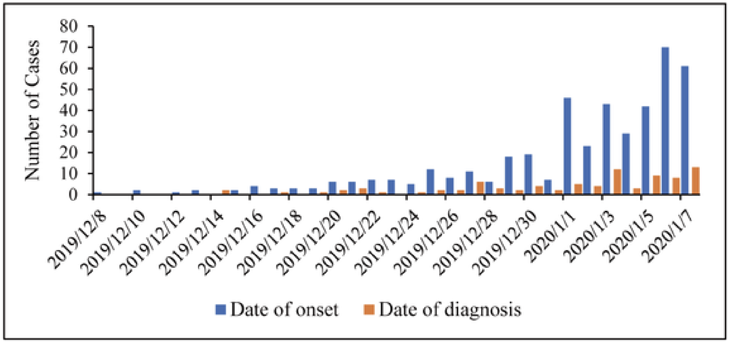
Confirmed cases

Slide 2
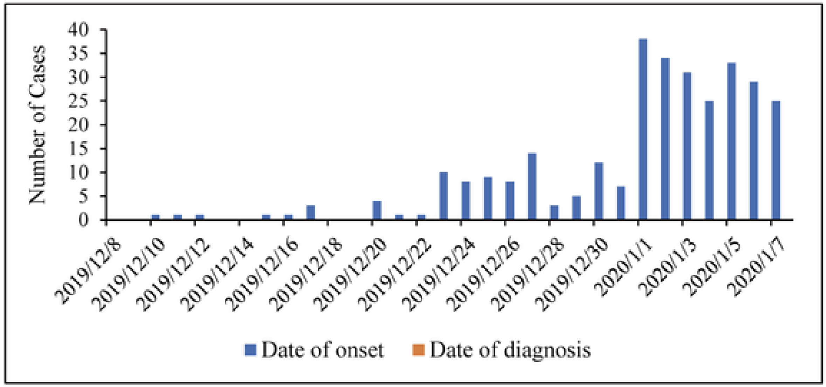
Clinically diagnosed cases

