Slide 1
Blackwell Electronics Co. customer transaction data ANALYSIS
April 6, 2020
Team Members:
Charlene Avery
Faisal Lodhi
James Ricciardi
Christy Thian

Slide 2
Objective
This presentation will walk through the analysis of online and in-store customer data provided by Blackwell Electronics. A key goal is to understand how online sales impact overall revenue.
We will use various data analytical methods in order to better understand the customer and their purchasing tendencies, such as:
Relationship between Spending and region
Relationship between number of items purchased and amount spent
Predict age using demographic data
Predict purchase method based on customer data

Slide 3
Data Dictionary
Overview of the Data: Data was provided by Blackwell Electronic Co. following the opening of their eCommerce website last year.
Quality Assessment: One duplicate data, no missing data, or evidence of inaccurate data were found
Actions Taken: Age was separated into 4 buckets for simplicity and increased model accuracy:
18-24
25-49
50-65
66-85
Attribute | Definition
In-Store | Online vs In-store
Age | Age of Customer
Items | Number of Items Purchased per Transaction
Amount | Dollar Amount of Total Purchase
Region | Regions divided into areas (1, 2, 3, 4)

Slide 4
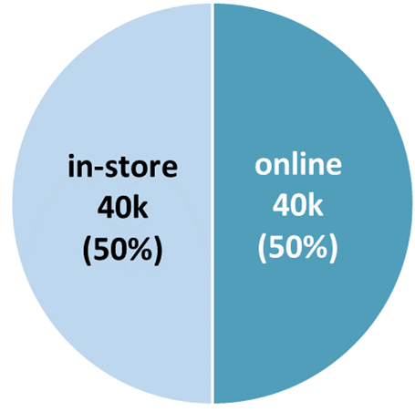
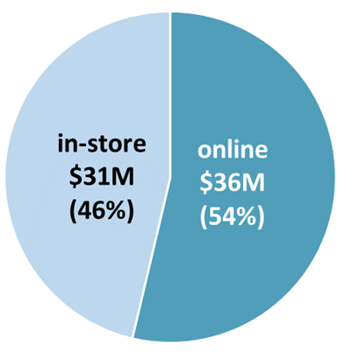
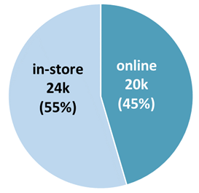
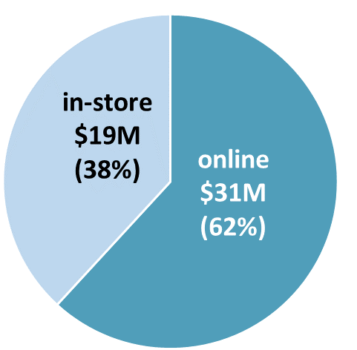
ONLINE vs. in-store BIG PICTURE
Change
All Regions
Number of Transactions
Sale Amount
Findings
Total Sales is $67M with 80k transactions
40k transactions each for online and in-store
54% of sales ($36M) generated by online
Regions 3 & 4
Total Revenue is $50M (75% of all regions)
45% of Regions 3 & 4 are online transactions
Online revenue generated $31M, almost the same as in-store revenue generated from all regions.
Recommendations:
Target online marketing advertisement to increase revenue, especially on Regions 3 and 4
Regions 3&4
Number of Transactions
Sale Amount
Summary

Slide 5
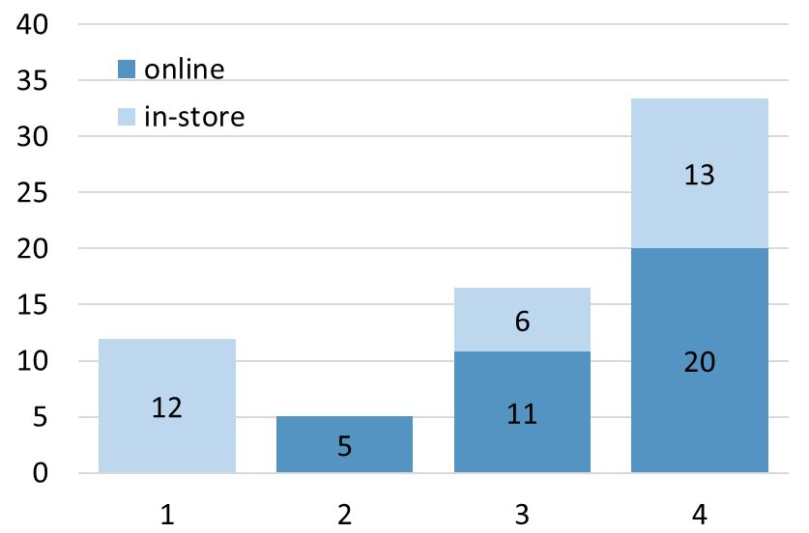
Relationship between Spending and REGION
Change
Sale Amount by Region
Findings
Region 4 has the highest total Sales ($33M), generating 50% of total revenue.
Region 2 has the lowest sales amount ($5M), and notably is the only region without a physical store
Online spending is suppressed when physical store is not present
Recommendations:
Allow online purchases in Region 1 to increase revenue
Ensure that online shoppers have access to physical stores to showcase products
Amount ($)
Region
Summary

Slide 6
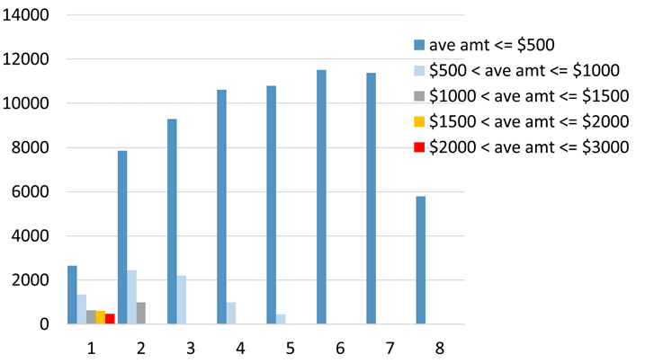
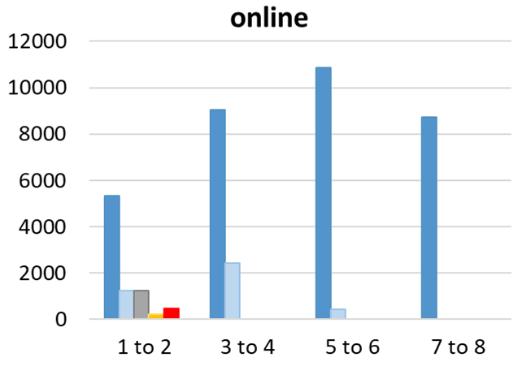
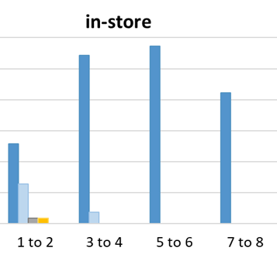
Relationship between number of items purchased and amount spent
Number of Transactions by Average Item Cost
Findings
All sale transactions seemed to be capped at 8 items.
No customers purchase more than two items when the average item cost is greater than $1000.
Customers tend to purchase less items as the price of the item increases.
Sales is limited by the overall amount in the transaction, not the number of items.
Large purchases (>$2000) are exclusively online
Recommendations:
Increase the allowable number of items purchased
Increase the upper limit of transaction amount
Number of Transactions
items
Online vs in-store
Number of Transactions
items
items

Slide 7
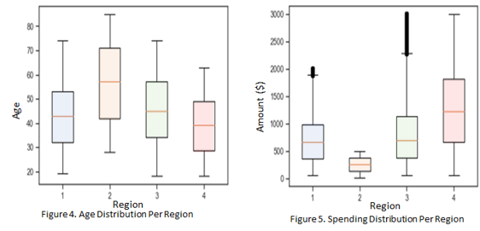
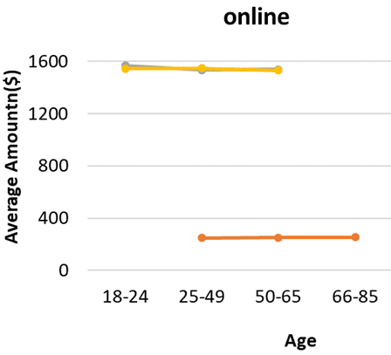
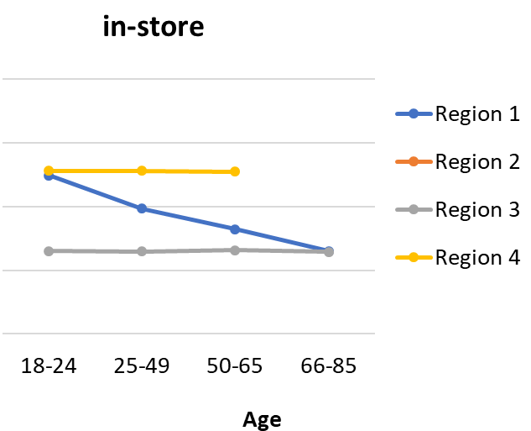
Comparing age to other variables
Age /Amount of Each Region
Findings
Region 2 was the only region with customers over 74 years old
Different regions have different age ranges that likely affect sales
Purchase amount helps identify younger customers (ie. customers over 65 years old did not make purchases over $1000)
Specific age is difficult to predict, but with proper division of age into key groups we got decent results (55% accuracy)
Recommendations:
Compare actual region demographics to our customer demographics to see which demographics we are successfully marketing to
Region
Amount by Age
Average Amount ($)

Slide 8
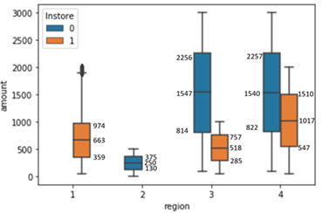
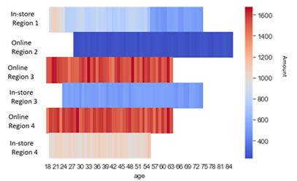
Identifying Online shoppers
indy
Purchase Method vs. Region
Online
In-store
Findings
Region 1 is in-store only, the spending decreases as the age bracket increases
Region 2 is online only, the spending is < $500, has customers older than 75
A wide range of purchases were made online, including expensive (>$2,000) purchases compared to in-store
Purchase method can be predicted with 89% accuracy
Recommendations:
Identifying gender and product categories could assist with online marketing ads (e.g. who exactly is purchasing TV’s and computers)
Offer free shipping for in-store purchases, to assist customers bring their heavy expensive items home.
Amount Spent in Each Region

Slide 9
conclusion
Number of items does not have a strong correlation with any of the other variables examined
Region 1 would benefit nicely from having online presence with it’s desirable demographics
Customers are likely examining expensive items (TVs, etc.) in the store and buying them online.
Older shoppers are more active online, but purchase less per transaction (and do not purchase large-ticket items)

Slide 10
Follow-up
Further analysis recommendations:
Compare actual demographics to customer demographics (to see which groups we are effectively marketing to)
Add additional information to future studies (e.g. gender) would increase information gained as well as improve our ability to predict customers’ behavior.
Advance the analysis to include nation-wide online spending would help locate additional store opportunities

