Slide 1
Depth Cameras, Demystified
Tutorial at the
2018 Summer School on
Multimodal Interaction
in Augmented and Virtual Reality
by Jun.-Prof. Dr. Florian Echtler
<florian.echtler@uni-weimar.de>

Slide 2
About me
@floemuc & https://floe.butterbrot.org/
„Postdoctoral Hacker and Research Hobbyist“
Co-Author of libfreenect{2} open-source drivers for Kinect 1 & 2 depth cameras
https://github.com/OpenKinect/libfreenect2
https://doi.org/10.5281/zenodo.50641

Slide 3
Plan for today
09:00 ~ 10:00 – Tutoral: depth camera basics
10:00 ~ 10:15 – short break
10:15 ~ 11:30 – Hands-on depth cam hacking (Build Your Own RANSAC)

Slide 4
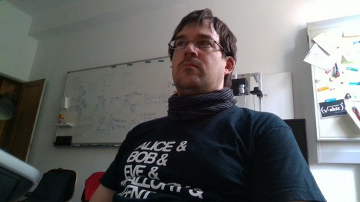
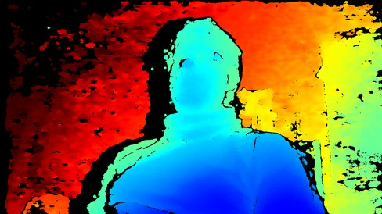
What are depth cameras?
„Regular“ camera: color values for each pixel
Depth camera: distance values for each pixel (usually visualized with color map)

Slide 5
Classes of DCs
Geometry-based
  Stereo vision
  Structured light
Time-of-Flight/ToF

Slide 6
Geometry-based DCs
Fundamental principle:
  Create two „views“ of scene
  Match scene points between views
  Determine 2 angles for each scene point
  Trigonometry happens
  Receive distance

Slide 7
Geometry-based DCs
Viewpoint 1
Object
Viewpoint 2

Slide 8
Geometry: Stereo Matching
Method 1: two images of scene
  → stereo matching of corresponding pixels
  → ideally only needed on horizontal scanline
  Examples: Occipital Structure Sensor, Intel Realsense D4xx

Slide 9
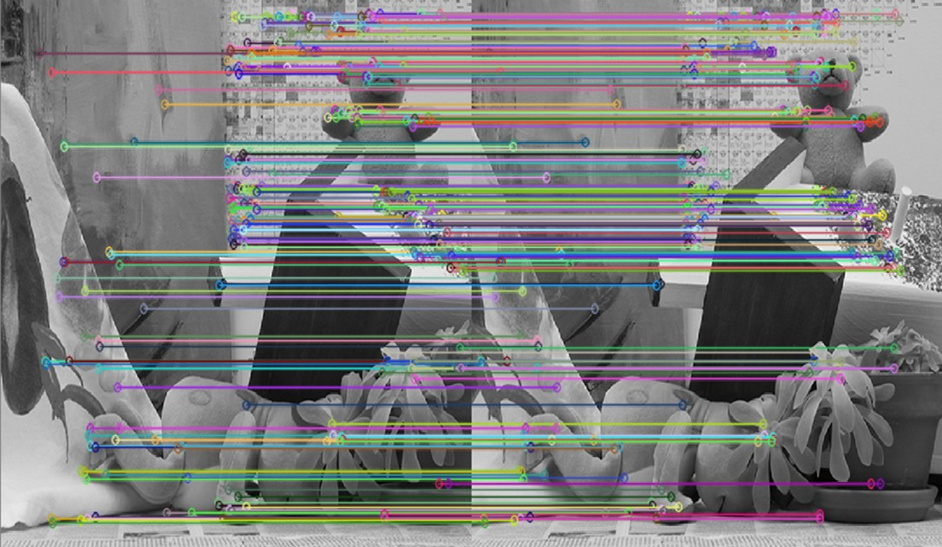
Geometry: Stereo Matching
Image Source (FU): https://www.mtbs3d.com/phpbb/viewtopic.php?f=138&t=18055

Slide 10
Geometry: Stereo Matching
Advantages:
  Close to human vision system
  Can work outdoors, even in sunlight
  Only uses plain cameras (* with sync)

Slide 11
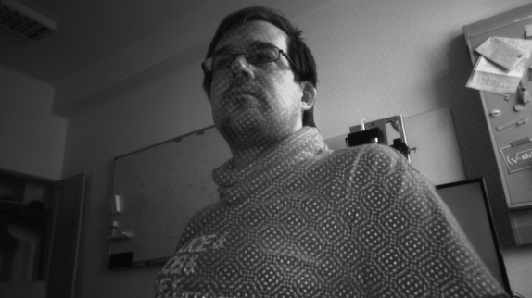
Geometry: Stereo Matching
Drawbacks:
  Problems with featureless areas (white wall)
  Mitigation: additional IR pattern projector

Slide 12
Geometry-based DCs
Method 2: one image of scene + known lighting
  → identify pixel correspondences via IR pattern
  Replaces one camera with light source
  2 sub-methods (down the rabbit hole… :-)

Slide 13
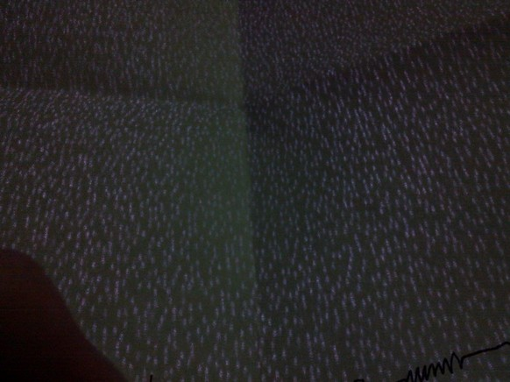
Geometry: Speckle Pattern
Method 2.1: speckle pattern = random dots
  Random, but previously known pattern
  „Patches“ of pattern can be matched → depth res. lower than image res.
  Example: Kinect v1

Slide 14
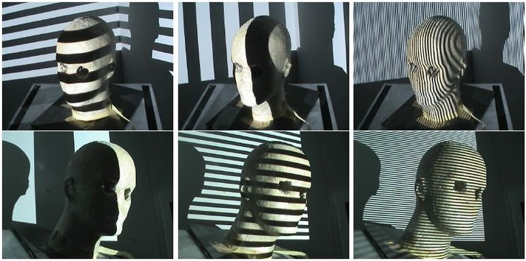
Geometry: Stripe Pattern
Method 2.2: Gray code = alternating stripes
  Encodes binary ID for each pixel
  Requires high frame rate or static scene (why?)
  Requires IR projector
  Example: Realsense SR300 (~ 300 FPS)
Image Source (FU): http://www.sci.utah.edu/~gerig/.../CS6320-CV-S2012-StructuredLight-II.pdf

Slide 15
Time-of-Flight/ToF DCs
Fundamental principle:
  Emit (infrared) flash
  Measure time until reflected light arrives
  (very simple) Math happens
  Receive distance
Example: Kinect v2

Slide 16
Time-of-Flight DCs
Emitter/Flash
Object
Camera/Sensor

Slide 17
Time-of-Flight DCs
Problem: c ~ 300 000 000 m/s :-O (~ 671 mil. mph ;-)
Common ToF depth resolution ~ 1 mm
→ time difference ~ 3 x 10⁻¹² s (3 picoseconds!)
→ would require counter at ~ 300 GHz per pixel
HOW?

Slide 18
Time-of-Flight DCs
Solution: measure phase difference (not time)
  Create clock signal with freq. f which modulates …
    a) IR emitter („flash“)
    b) sensitivity of light sensor
  Result is phase difference
  Calculation with c and f gives distance

Slide 19
Time-of-Flight DCs
Requires specialized image sensor
  Two “accumulators” per pixel (not just one)
  Clock input switches between acc. A and B
Kinect v2: result is three measurements per pixel at phase shift 0°, 120° and 240°

Slide 20
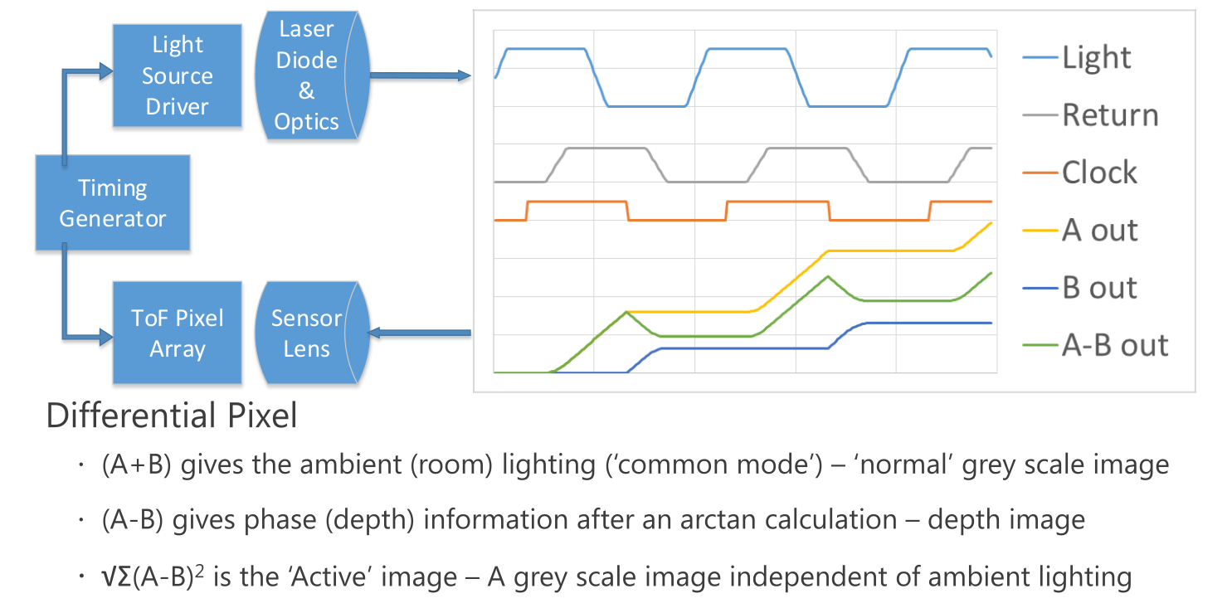
Time-of-Flight DCs
Image Source (FU): https://www.hotchips.org/wp-content/uploads/hc_archives/hc25/HC25.10-SoC1-epub/HC25.26.121-fixed-%20XB1%2020130826gnn.pdf

Slide 21
Time-of-Flight DCs
Tradeoff between precision and range
  High frequency → better precision, but quicker “wraparound”
  E.g. Kinect v2 @ 80 MHz: wavelength = 3.75 m
  Range from 0 to 3.75 m maps to depth resolution of sensor (11 bit for Kv2)

Slide 22
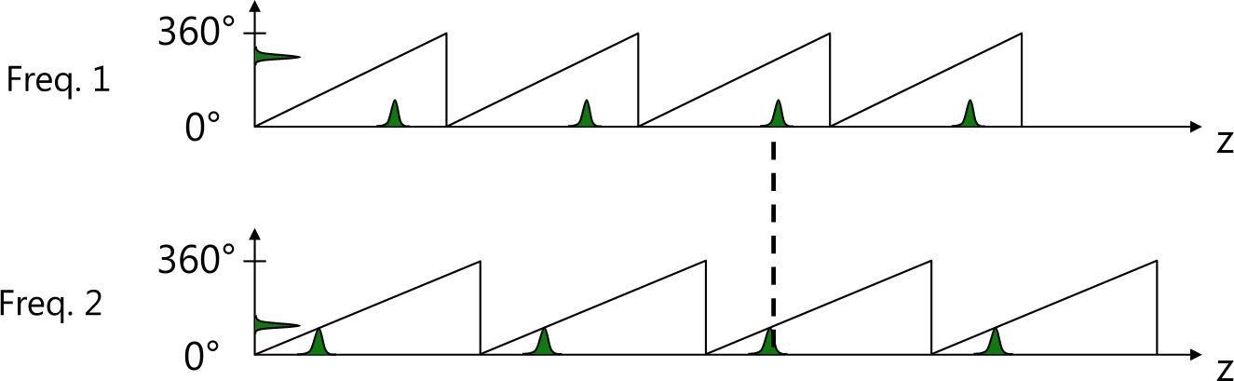
Time-of-Flight DCs
Solution: switch between multiple frequencies
  Kinect v2: 16 MHz, 80 MHz, 120 MHz
  Resolve ambiguity using second/third freq.
Image Source (FU): https://www.hotchips.org/wp-content/uploads/hc_archives/hc25/HC25.10-SoC1-epub/HC25.26.121-fixed-%20XB1%2020130826gnn.pdf

Slide 23
Depth-Color Alignment
most depth cameras also have a “plain” color cam
Problem: how to find corresponding color value for each depth pixel (or vice versa)?
Requires intrinsic and extrinsic camera parameters (?)
  Intrinsic: field of view, distortion, focal length, …
  Extrinsic: translation, rotation w.r.t. origin

Slide 24
Depth-Color Alignment
Alignment process:
  “Deproject” depth pixels into metric space (needs intrinsic parameters of depth cam)
  Translate depth pixels to color camera origin (needs extrinsic parameters of depth cam)
  Cast ray in metric space through color pixel (needs intrinsic parameters of color cam)
  Find (closest) intersection

Slide 25
Depth-Color Alignment
color camera
Object
?
depth sensor

Slide 26
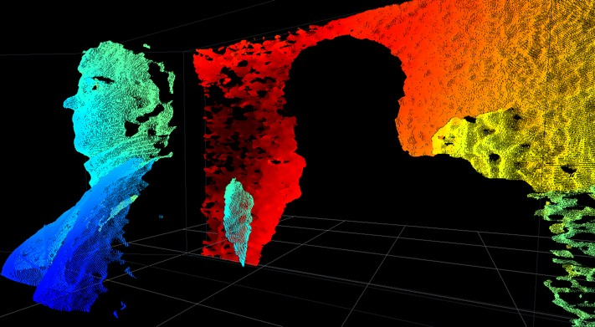
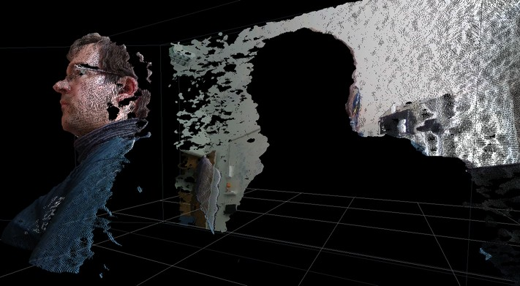
Point Clouds
Each depth pixel → 3D point (x, y, z)
Plus color → (x, y, z, r, g, b)

Slide 27
Question
Why the shadow on the left side of the body?

Slide 28
Summary
One size does not fit all (as always)
  Lighting? (e.g. sunlight – very hard)
  Texture? (e.g. flat featureless walls)
  Absorption? (e.g. some fabrics)
  Reflections? (nearly impossible ATM)

Slide 29
RANSAC
RANSAC = RANdom SAmple Consensus
  Goal: fit a model to noisy data
  Model: e.g. plane, line, …
  Data: e.g. point cloud

Slide 30
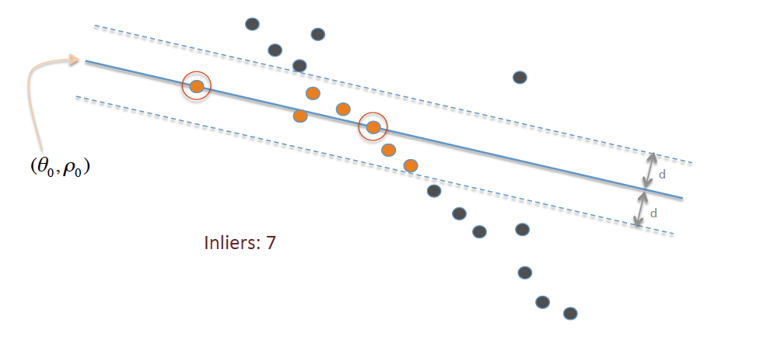
RANSAC
Step 1: randomly choose minimum # of data points required for model (e.g. 2 for line)
Step 2: count data points which are inliers (i.e. “close enough” to the model)
Too few inliers → step 1
Otherwise: refine model using inliers (optional)
Image Source (CC): https://commons.wikimedia.org/w/index.php?curid=37017886

Slide 31
Demo Time!
See https://github.com/floe/surface-streams
and https://www.youtube.com/watch?v=Qe1BROtGyzI

Slide 32
Your turn!
Pick a depth camera from the pile
Install the respective SDK
Adapt the sample code to measure average deviation from plane
Find a plane
Profit!

