Slide 1
Mobile Information Systems
Lecture 11: Case Studies
June 21st, 2017

Slide 2
Case studies
Inside the Amazon Dash button
Moving object databases
  Queries for moving objects
  Modelling of dynamic attributes
Synchronization (Dropbox & Co.)
  CAP theorem
  Rsync algorithm

Slide 3
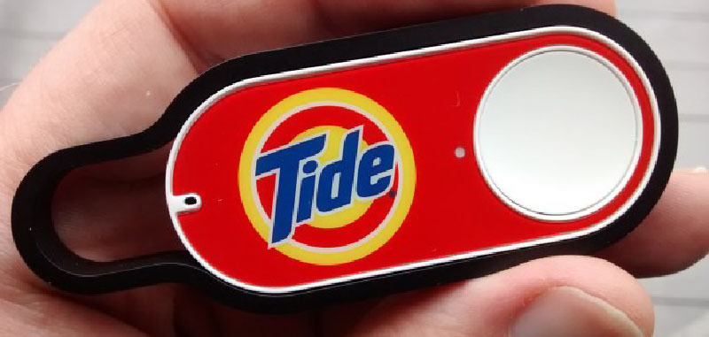
Inside the Amazon Dash Button (1)
Image source (FU): https://hackaday.com/2015/05/12/inside-the-amazon-dash-button/
Amazon Dash Button: prototypical IoT device
Single button for ordering a single product

Slide 4
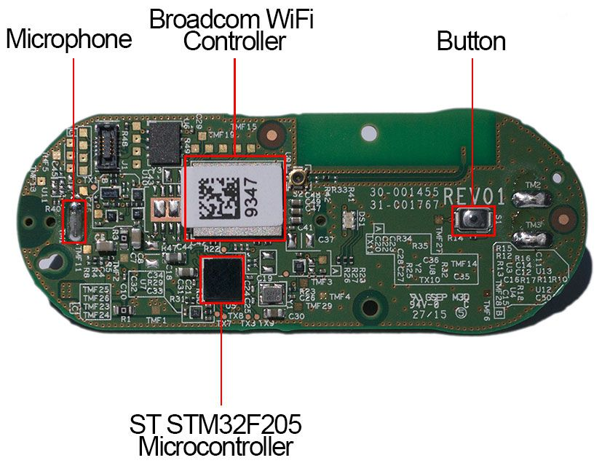
Inside the Amazon Dash Button (2)
Image source (FU): https://www.cnet.com/news/appliance-science-how-the-amazon-dash-button-works/
Contents:
  Microcontroller (reprogrammable)
  Board antenna
  Battery (non- rechargeable?)
  WiFi module
  Button (duh)
  Microphone (why?)
Antenna

Slide 5
Inside the Amazon Dash Button (3)
Chicken-and-egg problem for IoT devices:
  Configuration via WiFi
  No regular UI available
→ how to setup WiFi (network, password etc.)?
Possible solutions:
  Temporary local hotspot
  Side-channel configuration

Slide 6
Inside the Amazon Dash Button (4)
Approach 1: local hotspot (Android)
  Dash creates own network hotspot
  Mobile device connects, configures WiFi
  Dash closes hotspot, connects to WiFi as client
Approach 2: side-channel (iOS)
  iOS app sends configuration via ultrasound
  Dash button listens for specific sound patterns
  Extracts configuration, connects to WiFi as client

Slide 7
Location awareness/dependence
Location-dependent queries return results based on their location, but the location is not part of the queries
  Where is the next taxi?
  Give me a route to my hotel!
Location-aware queries contain explicit location information
  What’s the name of the castle in Potsdam?

Slide 8
Moving object queries
Which restaurant is reachable within 30 min.?
When will I arrive at the Marktplatz?
How many ambulances are placed within a radius of 10 km?
Show a warning if the distance between two airplanes will be less than 500 meters in the next 10 minutes!
Which UPS driver will be closest to Bauhausstraße 11 at 17:10?

Slide 9
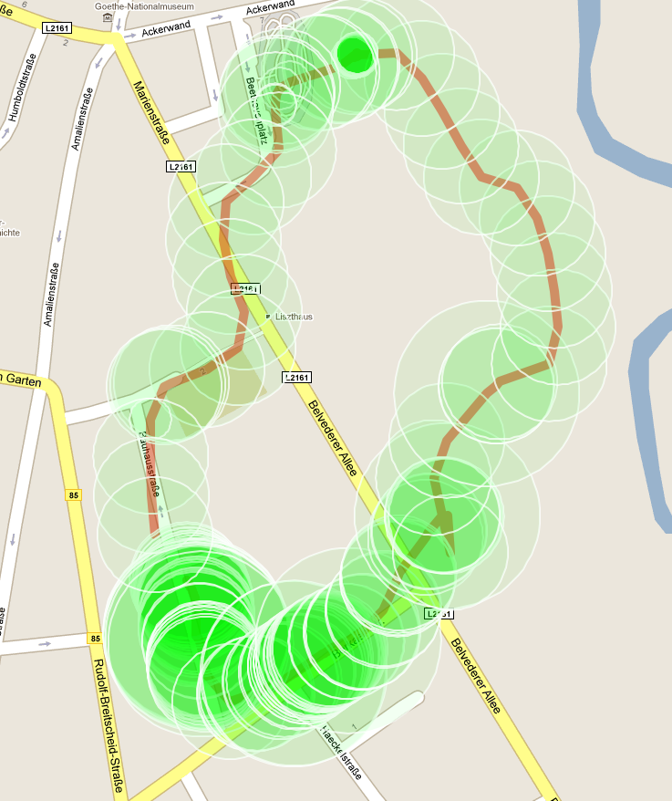
Moving object queries (2)
Image source (FU): © 2015 GeoBasis-DE/BKG (© 2009) Google
Performing a query may or may not depend on the location of the querying device
Query is related to the current, a past or a future location of an object
Space and time might be correlated or independent
Location information has vary- ing degree of uncertainty
Objects are (mostly) assumed as point-like (no dimensions)

Slide 10
Issues with “traditional” DBMS
Value is valid until it is changed
Movement requires permanent updating
  “Expensive” updates
  High network traffic
  Uncertainty
Typically no history
No possibility to forecast future locations

Slide 11
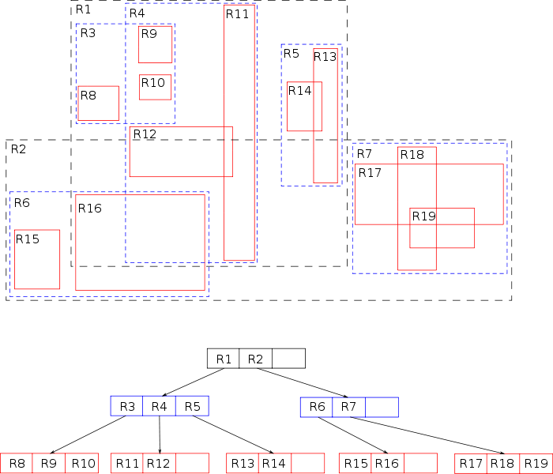
Issues regarding indices
Image source (PD): https://en.wikipedia.org/wiki/R-tree#/media/File:R-tree.svg
Possibly large number of moving objects
Efficient access required
  Index over location information
Spatial index: R-tree
  Each node is a rectangle covering all nodes beneath
  Updates expensive → ill suited to moving objects

Slide 12
Issues regarding query languages
Queries with spatial and temporal conditions:
  Spatial-temporal range query: “objects that overlap with polygon P within next 3 minutes”
  Spatial-temporal join query: “find airplanes that will have a distance less than 1000 m and return the regarding time point”
Traditional query languages like SQL are not (well) suited
  Extensions for spatial/temporal aspects exist, but not optimized for moving objects

Slide 13
Issues regarding uncertainty
Implications for queries:
  2 different results
    Objects that certainly fulfil the condition
    Objects that possibly fulfil the condition
  Or per object: possibility that a condition is fulfilled
Questions:
  When does uncertainty become more expensive than updates?
  How can a DBMS „tell“ how uncertain a piece of information can be at most?

Slide 14
Location model for moving objects
Traditional:
  Stored value is valid until it is explicitly changed
MOD (moving object databases):
  Explicit updates unacceptable
  Object might be temporarily disconnected
Solution
  Location (and other attributes) are represented as function over time

Slide 15
Dynamic attributes
Dynamic attribute A consists of 3 sub-attribs:
  updateValue, updateTime, function f(t)
Value v of A:
  t = updateTime: v = updateValue
  t = updateTime + t0: v = updateValue + f(t0)
Explicit update of updateValue and/or f(t):
  updateTime = timestamp of last change

Slide 16
Dynamic attributes (2)
Queries for same attribute at t1 and t2 may differ, even without intermediate updates
Queries about past possible
  Needs log of prior updates
  Storage space?
Queries about future possible
  Prediction based on current function f
  Changes to f will change query result (e.g. airplanes: deviation from flight plan?)

Slide 17
Location attributes
Location of a moving object:
  2 (or 3) dynamic attributes L.x, L.y, (L.z)
  f(t) = updateValue + (t – updateTime) * velocity
Suitable for objects with straight movement (airplanes, ships at sea)
  Many updates for objects that follow a route (e.g. street) and frequently change their direction
  Each turn requires an update of the function sub-attribute

Slide 18
Location attributes (2)
Better handling of road-based routes
Location attribute with 4 sub-attributes:
  updateValue – current index on route
  updateTime – time point of last update
  route – list of route points
  speed – scalar speed
f(t) = route[updateValue + (t – updateTime) * speed]
  Requires interpolation for long straight segments

Slide 19
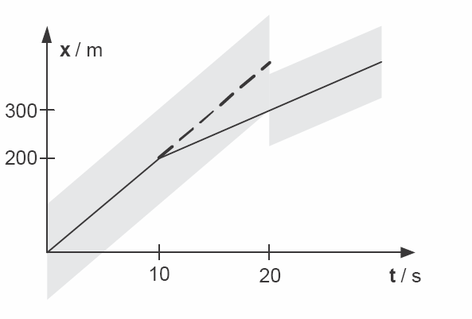
Uncertainty and inaccuracy
Source (FU): Mobile Datenbanken, Höpfner et al., dpunkt.verlag
Position information is inaccurate
Objects do not move exactly along the projected route but update only if …
  Inaccuracy is above threshold
  Time interval expires
From the view point of a query: correctness of result is uncertain

Slide 20
Spatial Indices
Frequent queries for dynamic attributes
  Range queries → index on attributes required
„Normal“ spatial index is not applicable
  High update frequency
Division of the problem in two sub-problems
  Suitable geometric representation of dynamic attributes
    Time as an additional space dimension
  Efficient access via index structures
    Classical spatial indexes

Slide 21
Time-value-representation
Spatial dimensions + time as additional dimension
E.g.: x-axis time, y-axis value:
  Object: path of movement (location as function over time)
  Query: line
Result: Objects that intersect the query line
  Pro: efficient query processing
  Con: expensive update handling

Slide 22
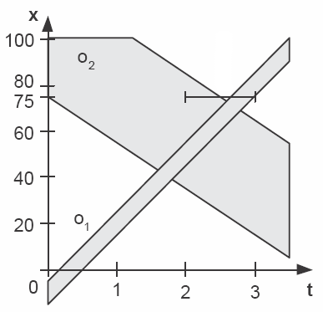
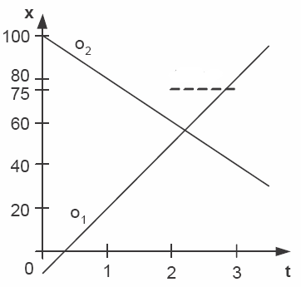
Time-value-representation
Source (FU): Mobile Datenbanken, Höpfner et al., dpunkt.verlag
Query
Query

Slide 23
Functional representation
f(t) = a - v*t
  a: dimension (x,y,z)
  v: gradient
Representation of dynamic attributes as points A × V
Pro: Easy update handling
Con: Complex query processing

Slide 24
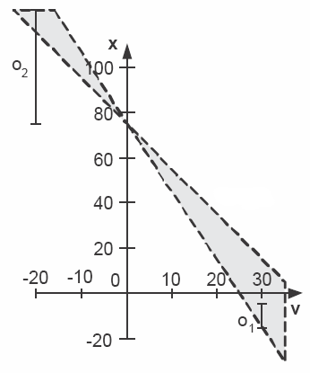
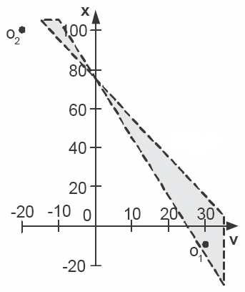
Functional representation
Source (FU): Mobile Datenbanken, Höpfner et al., dpunkt.verlag
Query

Slide 25
Synchronization
Several issues for Dropbox, OwnCloud & Co.:
Problem: intermittent connectivity
  Transfers may be interrupted
  Updates may happen while offline
Problem: bandwidth on mobile (still) limited
  Impossible to just copy GBs of data
  Adaptive synchronization required

Slide 26
Background: CAP theorem
Source (FU): http://www.infoq.com/articles/cap-twelve-years-later-how-the-rules-have-changed
“The CAP theorem states that any networked shared-data system can have at most two of three desirable properties:
consistency (C) equivalent to having a single up-to-date copy of the data;
high availability (A) of that data (for updates);
tolerance to network partitions (P).”
Note: network partitions = disjoint, unconnected sub-networks (single, disconnected device is its own network partition!)

Slide 27
CAP theorem ↔ Dropbox?
CAP theorem → 3 options: CA, AP, PC
  Which combination applies to Dropbox etc.? (AP)
  How is the missing feature handled?
Examples for other combinations?
  CA – Example: “classic” cluster database (MySQL, PostgreSQL, Oracle, …) → whole DB is offline when connections within cluster fail
  CP – Examples: some distributed databases (not as widely used) → e.g. disable “minority” partitions

Slide 28
Synchronization: rsync algorithm
Source (FU): https://rsync.samba.org/tech_report/node2.html
rsync = Unix tool, created 1996 by A. Tridgell
Goal: synchronize two similar files
  Designed for slow communication links
  Core idea: split file into fixed-size blocks, calculate checksum for each block
    Send checksums to synchronization partner
    Decide which blocks to transmit
1
2
3
...
...
n-2
n-1
n
c₁
c₂
c₃
...
...
c_{n-2}
c_{n-1}
c_{n}

Slide 29
Rsync algorithm (2)
Source (FU): https://rsync.samba.org/tech_report/node3.html
Works fine if blocks stay in place
Problem: what if offsets differ?
Inserted data (red) → all following c_{i} change
Solution: rolling checksum
1
2
3
...
...
n-2
n-1
n
Node A
1
2
3
...
...
n-2
n-1
n
Node B

Slide 30
Rsync algorithm (3)
Source (FU): https://rsync.samba.org/tech_report/node3.html
Rolling checksum: can be computed for every possible block offset in one pass
  “Sliding window” approach (cf. signal processing)
  Blocksize s, values v, checksum c, offset i
  Simplified: c(i) = ( c(i-1) - v[i-1] + v[i+s] ) mod M
c(i)
i-1
i
i+1
...
...
i+s-1
i+s
v
c(i-1)

Slide 31
Rsync algorithm (4)
Source (FU): https://rsync.samba.org/tech_report/node3.html
During calculation of rolling checksum:
  Search checksum list received from sync partner
    Note: list only contains only 1 checksum per block
    Fast search using hash table possible
  If match found: verify with strong checksum (MD5)
    If match verified: current block exists on both sides
    If no match: block needs to be transmitted
Rsync algorithm is widely used (Dropbox!)
Also suitable for backups etc. → space-saving

Slide 32
Synchronization: issues?
Rsync algorithm requires stable connection
  What if device temporarily offline?
  What if 2 nodes make changes while offline?
→ (Merge) conflicts
  Resolved using 3-way merge algorithm
  Problem: only applicable to unstructured files, e.g. source code, plain text
Change 1
Base
Merged
Change 2

Slide 33

The End

