Slide 1
Mobile Information Systems
Lecture 06: Context
© 2015-24 Dr. Florian Echtler
Bauhaus-Universität Weimar
Aalborg University
This work is licensed under a Creative Commons Attribution-NonCommercial-ShareAlike 4.0 International License.

Slide 2
Key issue: context (recap)
Unpredictable usage context
Different viewpoints:
  Environment (motion/noise/brightness)
  Geometric (position/location)
  Social context (acceptable behaviour, snooping)
  Activity context (what the user is doing)
    Physical/virtual activities
  Device context (what the device can do)
Context recognition

Slide 3
Context: device
Wildly varying capabilities
  Screen size: 1” (smartwatch) – 12” (large tablet)
  Connection: speed (EDGE – LTE), price, …
  Memory, energy supply, CPU power, sensors, …
→ Information adaptation?
  Server-side or device-side
  Static or dynamic

Slide 4
Device – server-side adaptation
“Browser switches” (static)
  server checks HTTP headers delivered by browser:
    User-Agent: Mozilla/5.0 (X11; Ubuntu; Linux x86_64; rv:30.0) Gecko/20100101 Firefox/30.0
    Accept: text/html,application/xhtml+xml, application/xml;q=0.9,*/*;q=0.8
    Accept-Language: en-gb,en;q=0.5
    Accept-Encoding: gzip, deflate
  select primary representation based on User-Agent
  select compression, language etc. based on Accept
Requires multiple versions of content (or at least multiple layouts for dynamic content)

Slide 5
Device – server-side adaptation (2)
Syntactic transformations (dynamic)
Does not consider content/semantics and other aspects of context
  HTML → WML gateways (outdated)
  “Compilation“ via XML+XSLT
  Compression proxy, e.g. using Opera Mobile
  Content management systems

Slide 6
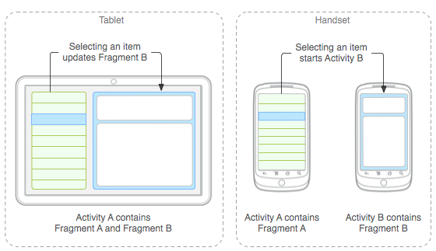
Device – device-side adaptation
Image source (FU): https://developer.android.com/guide/components/fragments.html
Dynamic layout, e.g. for …
  Web pages: using CSS3 “flex boxes”
  Apps: using Android fragments

Slide 7
Device – resource substitution
Adaptation via resource substitution
  Perhaps: reduction of the data quality necessary
Substitute →→ for … | CPU | Communication | Memory
CPU |  | Migration of compu-tations to the server/ uncompressed data | Caching and reuse of temporary results
Communication | Local execution of calculations/ compression |  | Local data storage
Memory | Data compression and compact data structures | Data management on the server only

Slide 8

Context: recognition (recap)
Image source (FU): http://www.gettyimages.com/gi-resources/ub/unfinishedbusiness/index.html
Example: automatic meeting detection
→ Disable audible notifications, send all calls to voicemail
Problem: what if it fails?
  False positive: user misses important call
  False negative: phone plays embarrassing ringtone in meeting
Must be very, very accurate to earn user trust

Slide 9
Context: recognition (2)
Aspects of context (ordered by complexity):
  Device (e.g. screen size & resolution)
  Virtual activities (e.g. using foreground task)
  Position (e.g. using GPS)
  Location (e.g. using geocoding)
  Environment (e.g. using light sensor/mic)
  Physical activities (e.g. using accelerometer)
  Social (e.g. using ???)

Slide 10
Context recognition – sensors
Hardware sensors (typical)
  Microphone (obviously :-)
  Touch screen (see lecture 4)
  Motion sensor (IMU, see lecture 4)
  Position sensor (GPS/GLONASS, see lecture 2)
  Proximity sensor
    Turns screen off when phone on ear
  Brightness sensor
    Controls screen brightness

Slide 11
Context recognition – sensors (2)
Hardware sensors (less common)
  Camera (e.g. as heartbeat sensor)
  Eye tracker (see lecture 5)
  Fingerprint sensor (see lecture 5)
  Temperature sensor
    Often built into battery – why?
  Pressure sensor
    Helps GPS with height measurement

Slide 12
Context recognition – sensors (3)
Software sensors → aggregate/convert/ interpret data from hardware sensors
  Location sensor
    GPS + WiFi + cell location
  Orientation sensor
    Filtered IMU data
  “Attention” sensor
    Processed eye tracker data
  “Network sensor”
    WiFi/IP address/cell information

Slide 13
Context recognition – sensors (4)
Issues when using sensors:
  Power consumption
    Significant impact on runtime
    Device can get uncomfortably warm
    Mitigation:
      adjusting sample rate
      turn off sensors when not needed
  CPU load
    When using multiple data streams at high frequency (e.g. camera + IMU + GPS) → even powerful multi-core CPUs can get high load → higher power consumption

Slide 14
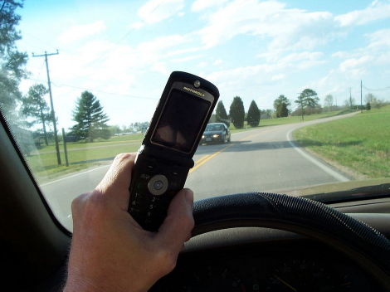
Context recognition scenario
Image source (CC): https://en.wikipedia.org/.../File:Cell_phone_use_while_driving.jpg
Car driver scenario →
How would you recognize this context?
  GPS motion > ~ 20 km/h
  On/near road
  Constant vibrations
  Unimanual usage
Consequences?

Slide 15
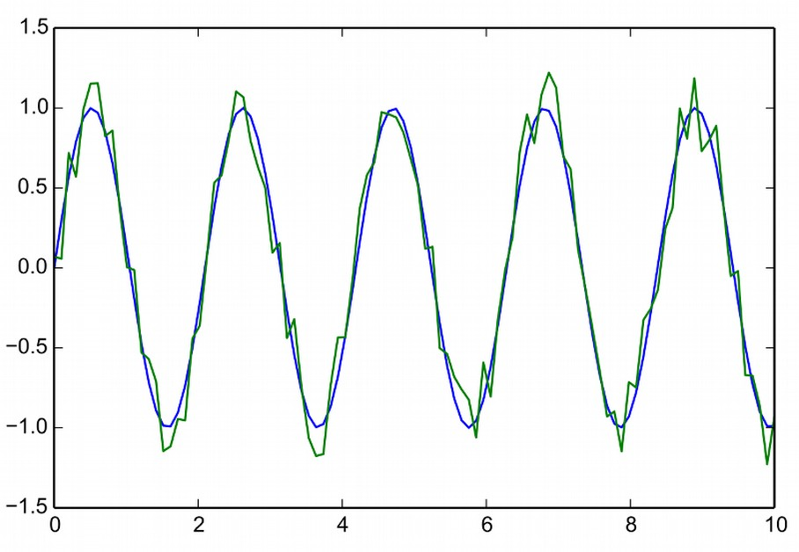
Side track: signal processing
Basic time series (blue)
  X axis = time (evenly spaced)
  Y axis = values/ measurements/ samples
Data almost always noisy (green)

Slide 16
Side track: signal processing (2)
Noisy data – two types of noise:
  Process noise: physically present in the measured process, e.g. hand tremor
  Measurement noise: occurs in sensor/equipment, e.g. thermal noise
Both unwanted → filter out
  Magnitude of noise sometimes important
However: both part of hidden state

Slide 17
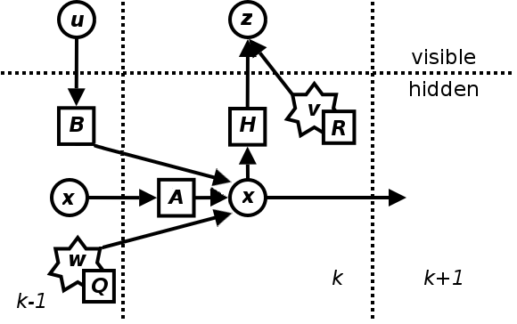
Side track: signal processing (3)
Noise model (from Kalman filter):
  X = “true” system state, A = transfer function
  U = control vector, B = control function
  W = process noise
  Measurement …
    Function H
    Noise V
    Result Z
  “Timeslice” k

Slide 18
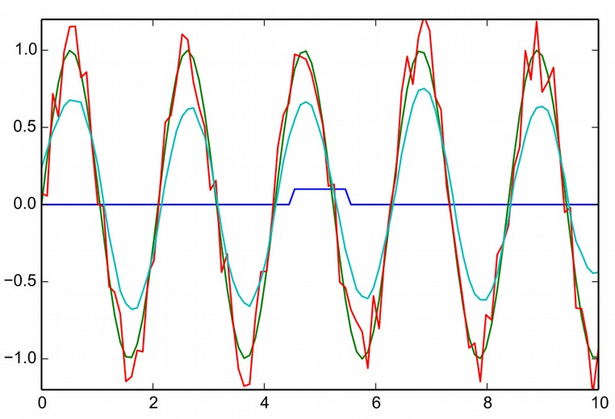
Side track: signal processing (4)
Filter kernels (blue)
  2nd function multiplied “on top” of time series (red)
  Sum of products = new function (cyan)
  E.g. square kernel → moving average
Convolution
  Point-wise multipli- cation of 2 functions

Slide 19
Side track: signal processing (5)
Characterizing signals
  Simple approach: mean & standard deviation
  Mean = average over certain time window
  Standard deviation (aka standard error) ~ average difference from mean value
Very different signals can have very similar values for mean & standard deviation!

Slide 20
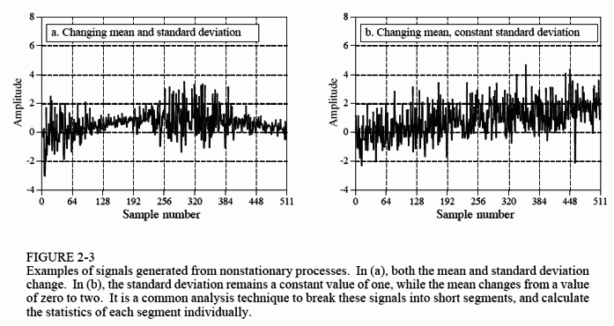
Side track: signal processing (6)
Further reading: DSP Guide (chapters 1-9) http://www.dspguide.com/pdfbook.htm

Slide 21
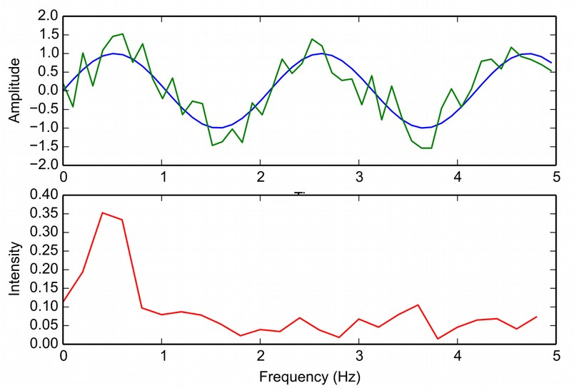
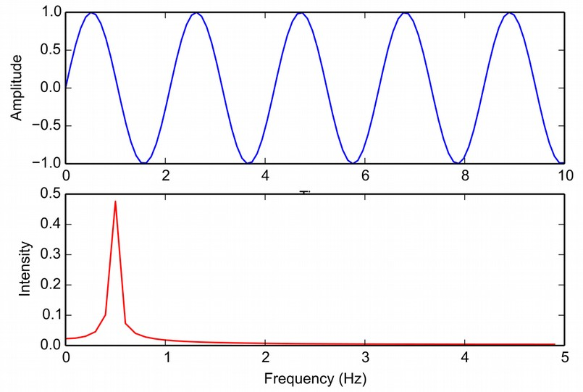
Side track: signal processing (7)
Fourier transformation (DFT, FFT)
  Time series (amplitude domain) can be represented as sum of sin/cos functions (frequency domain)
  Transformed data is new function, can be convoluted, filtered, etc. again
  Analysis of certain aspects easier than on original function

Slide 22
Context: implications
Available/permitted attention level (“channel bandwidth”)
  Audiovisual attention
  Input speed/precision
  Timespan for interaction
Available/permitted operations
  Bimanual operation not possible?
  Unobtrusive operation required?
  Legal restrictions?

Slide 23
Context: implications (2)
Possible reactions?
  E.g. disable phone while driving?
  E.g. enlarge buttons while walking?
  E.g. dim screen while in a crowd?
→ exceptions always possible & required
→ even more difficult to recognize!

Slide 24
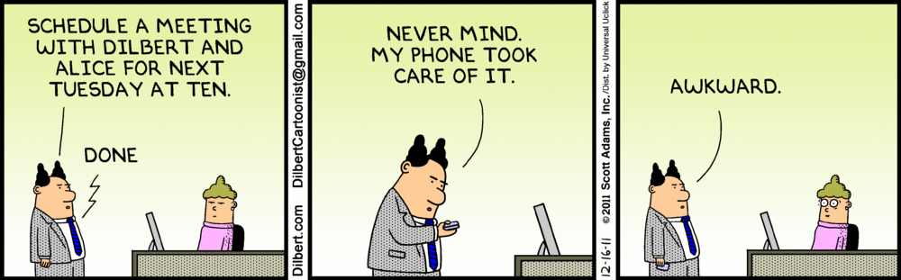
The End

