Slide 1
Mobile Information Systems
Lecture 11: Case Studies
© 2015-23 Dr. Florian Echtler
Bauhaus-Universität Weimar
Aalborg University
This work is licensed under a Creative Commons Attribution-NonCommercial-ShareAlike 4.0 International License.

Slide 2
Case studies
Inside the Amazon Dash button
Tweaks without root access
COVID-19 Contact Tracing
Apple AirTags & “Find My”
Mobile Card Emulation
Computational Photography

Slide 3
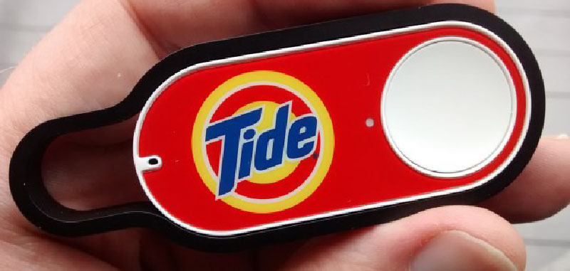
Inside the Amazon Dash Button (1)
Image source (FU): https://hackaday.com/2015/05/12/inside-the-amazon-dash-button/
Amazon Dash Button: prototypical IoT device
Single button for ordering a single product

Slide 4
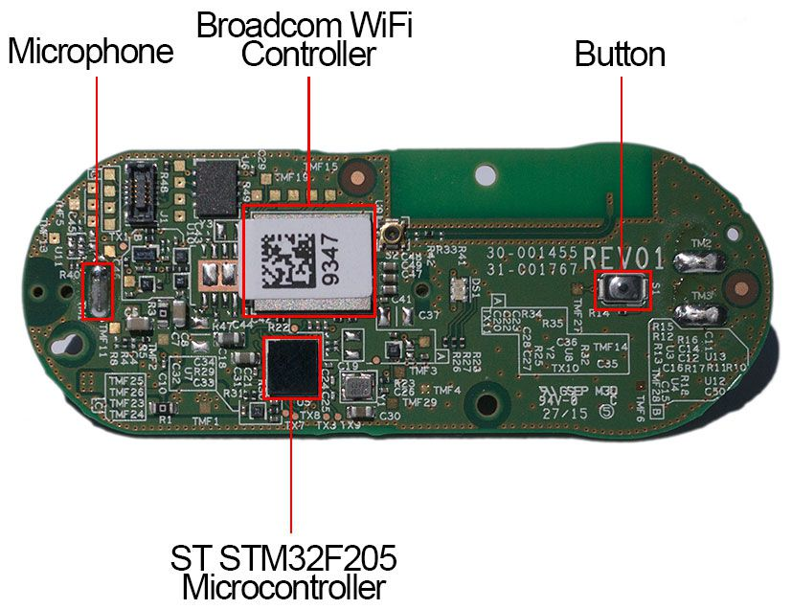
Inside the Amazon Dash Button (2)
Image source (FU): https://www.cnet.com/news/appliance-science-how-the-amazon-dash-button-works/
Contents:
  Microcontroller (reprogrammable)
  Board antenna
  WiFi module
  Button (duh)
  Microphone (why?)
  Battery (non-rechargeable)
Antenna

Slide 5
Inside the Amazon Dash Button (3)
Chicken-and-egg problem for IoT devices:
  Configuration via WiFi
  No regular UI available
→ how to setup WiFi (network, password etc.)?
Possible solutions:
  Temporary local hotspot
  Side-channel configuration

Slide 6
Inside the Amazon Dash Button (4)
Approach 1: local hotspot (Android)
  Dash creates own network hotspot
  Mobile device connects, configures WiFi
  Dash closes hotspot, connects to WiFi as client
Approach 2: side-channel (iOS)
  iOS app sends configuration via ultrasound
  Dash button listens for specific sound patterns
  Extracts configuration, connects to WiFi as client
[Approach 3: misuse of WiFi layer 2 frames, “ProbMe”]

Slide 7
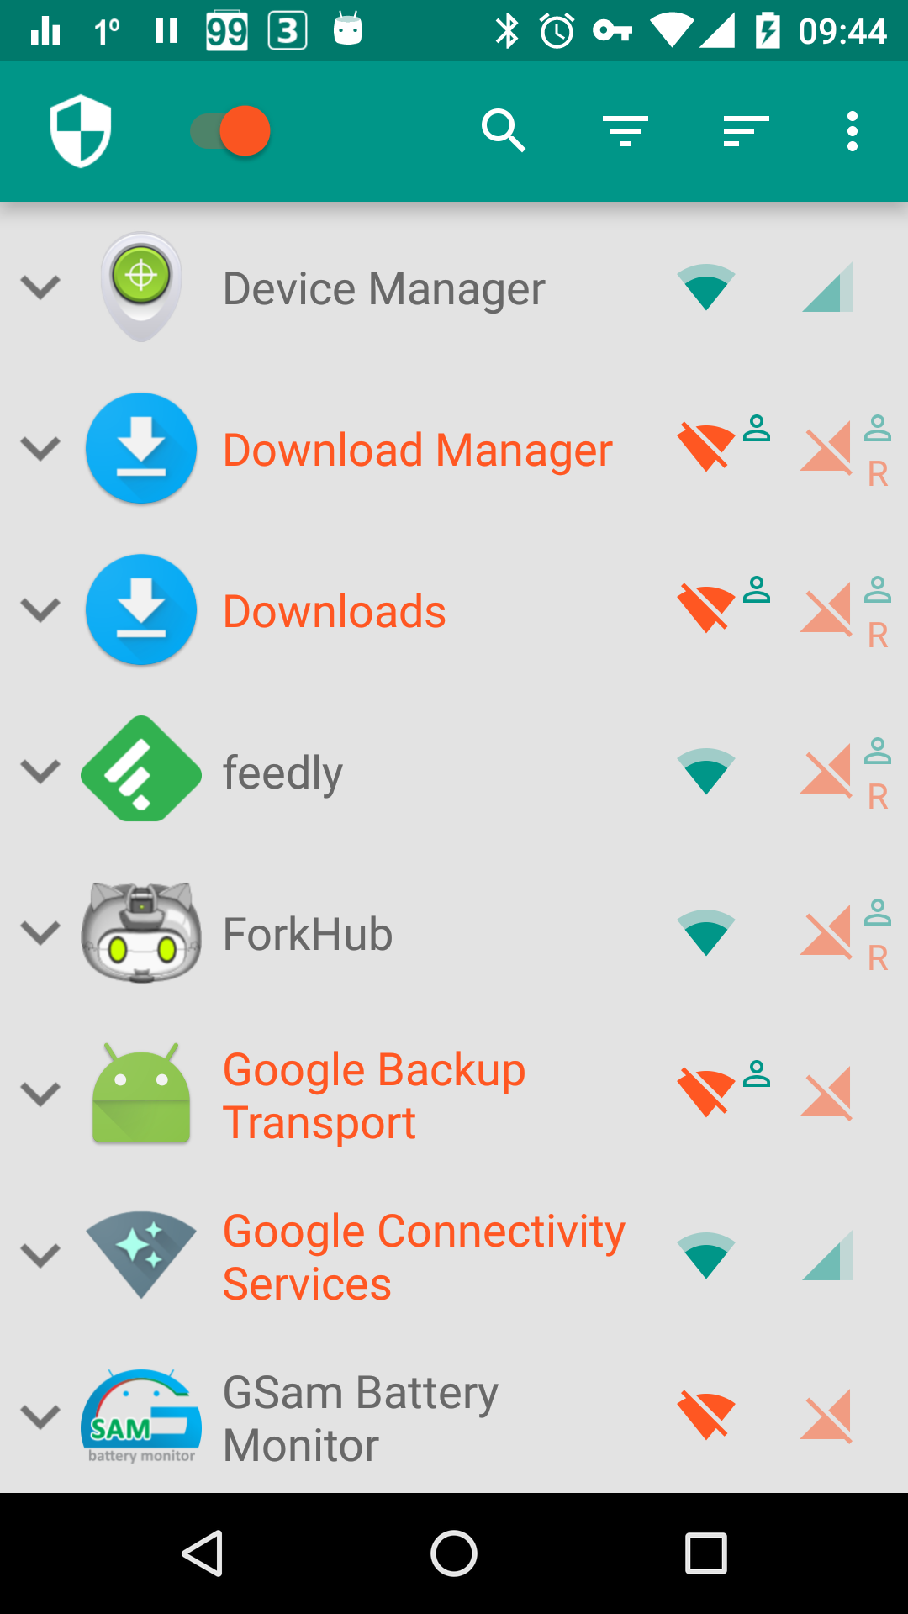
Tweaks without root access (1)
Image source (FU): https://www.netguard.me/
Netguard: User-Level Network Filter
  Android blocks root-level access to network (unless device is rooted)
  Loophole: VPN apps allowed at user level
  Can be (ab-)used for network filtering
  Helpful for blocking ads/trackers

Slide 8
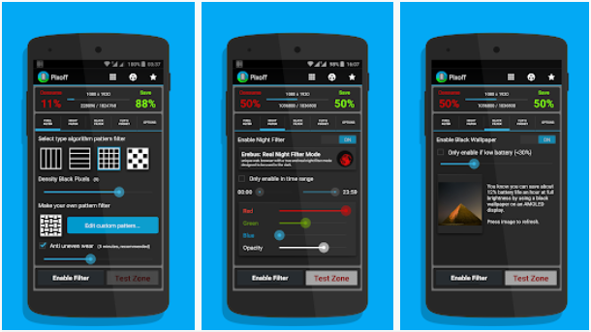
Tweaks without root access (2)
Image source (FU): https://play.google.com/store/apps/details?id=com.urysoft.pixelfilter
PixOff: AMOLED Battery Saver
  Selectively turn off individual pixels
  Doesn’t work for LCD screens (why?)
  Various patterns, depending on user pref.
  Currently not available in Play Store?

Slide 9
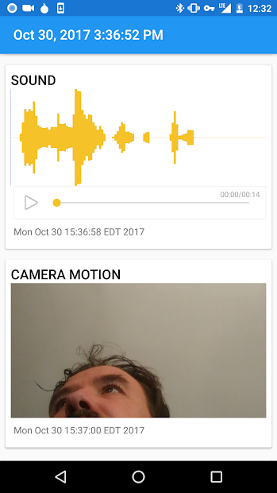
Tweaks without root access (3)
Image source (FU): https://play.google.com/store/apps/details?id=org.havenapp.main&hl=en
Secondary use for old devices
  Kiosk mode apps
    Lock device to single app, e.g. music player, web browser
    Useful to create “appliances”
  Room surveillance
    Use camera, microphone, IMU to watch for intruders
    Example: Haven (open-source) →

Slide 10
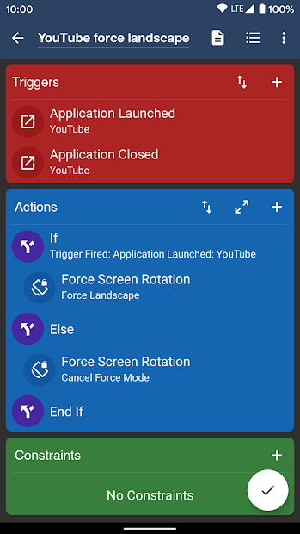
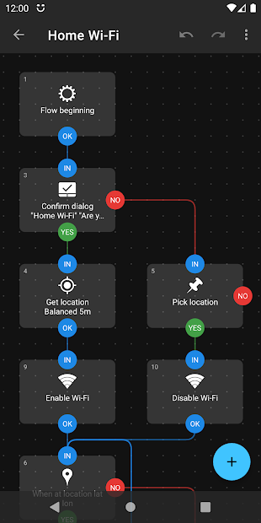
Tweaks without root access (4)
Image source (FU): https://play.google.com/...com.arlosoft.macrodroid, https://play.google.com/...com.llamalab.automate
Macro/automation tools
  e.g. MacroDroid (l), Automate (r)
  Sometimes approaching full- blown development environment
  Usability issues?
  Possible to e.g. accidentally lock yourself out of your own device

Slide 11
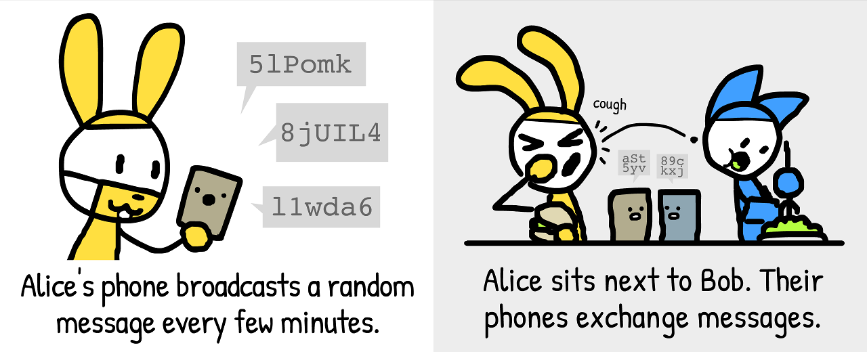
COVID-19 Contact Tracing (1)
Image source (PD): https://ncase.me/contact-tracing/

Slide 12
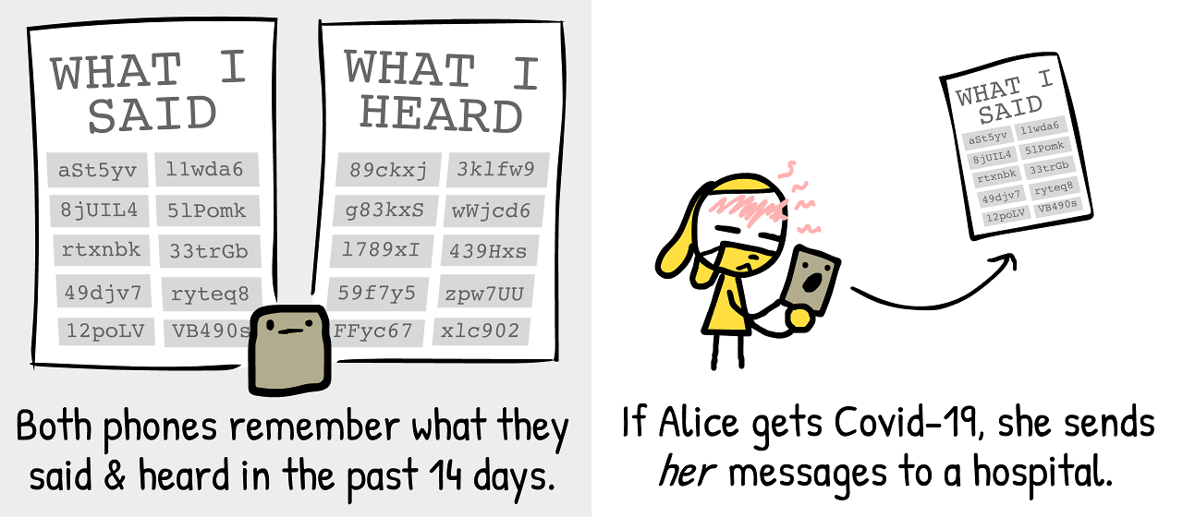
COVID-19 Contact Tracing (2)
Image source (PD): https://ncase.me/contact-tracing/

Slide 13
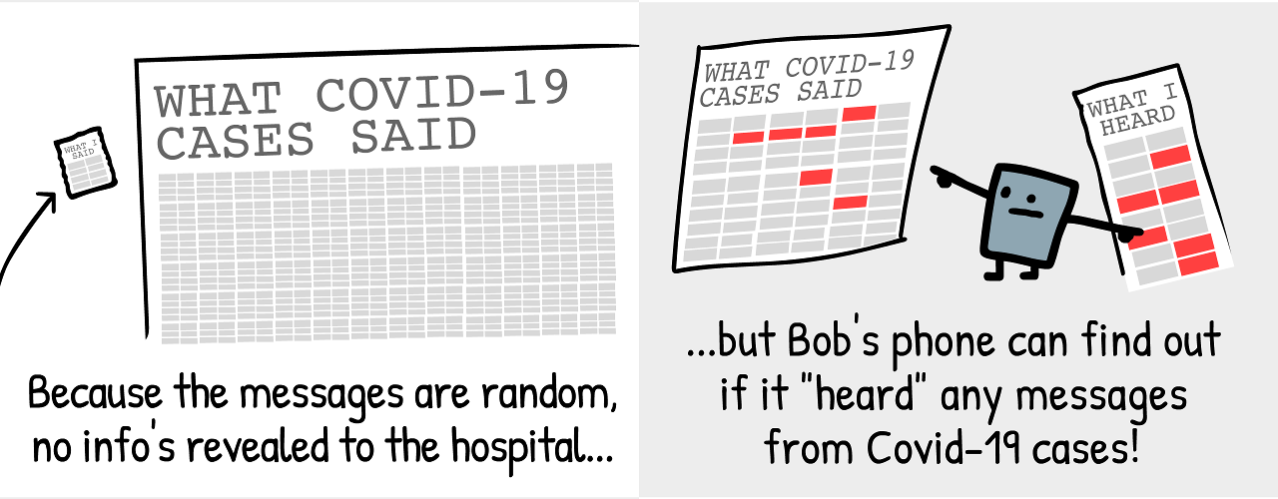
COVID-19 Contact Tracing (3)
Image source (PD): https://ncase.me/contact-tracing/

Slide 14
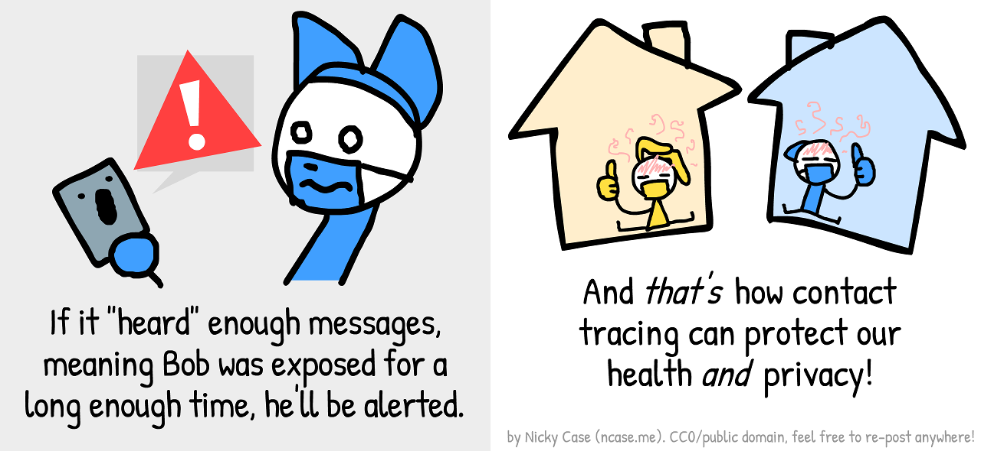
COVID-19 Contact Tracing (4)
Image source (PD): https://ncase.me/contact-tracing/

Slide 15
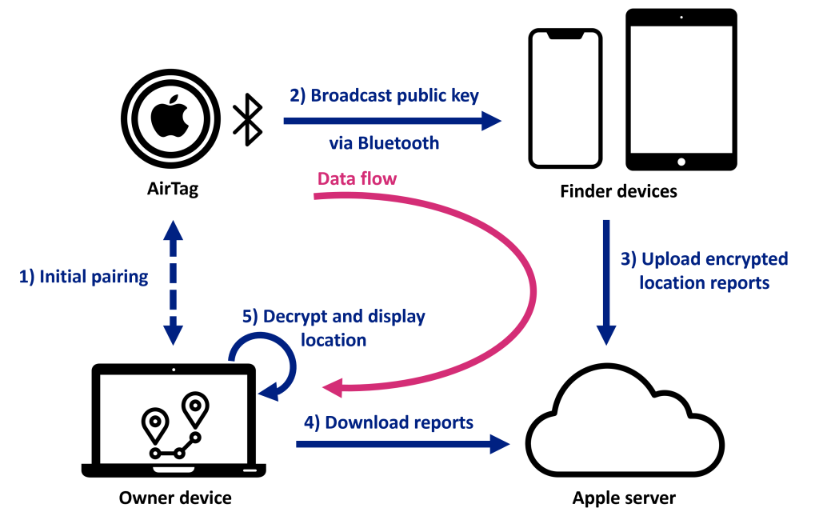
Apple AirTags & “Find My”
Image source (FU): https://makezine.com/projects/find-my-diy-airtag-tracker/

Slide 16
Apple AirTags & “Find My” (2)
Standard process using Bluetooth Low Energy
  Initial setup of public-private keypair
  AirTag broadcasts public key
  Other devices: upload own location, encrypted with public key
  Private key can be used to download and decrypt GPS location
iPhone 11+: Ultra Wide Band (UWB) for last-meter localization
Android devices: can use NFC to identify AirTag on contact

Slide 17
Apple AirTags & “Find My” (3)
3 different wireless technologies in one device:
  BTLE for broadcasting public key (& audio notifications)
  NFC for direct-touch identification & pairing
  UWB for last-meter localization
Issues with AirTags:
  Not a large issue: owner privacy (thanks to public-key crypto)
  Big issue: stalking & theft
  iPhones (try to) detect unknown AirTags moving with you
  Android needs custom app

Slide 18
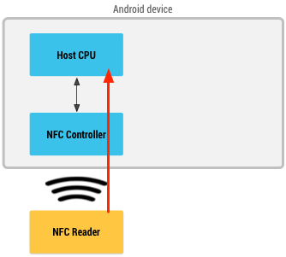
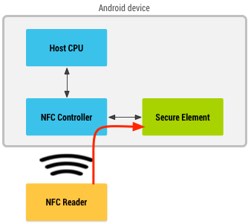
Mobile Card Emulation (1)
HCE
Image source (FU): https://developer.android.com/guide/.../hce
Two modes: Host Card Emulation (top), Secure Element Mode (bottom)
HCE: less secure, as malware can interfere with payment process
SEM: harder to implement, as extra security chip required (e.g. Apple Pay)
Google Pay: issues with carrier support (restricted SIM card access)
SEM
part of SIM card or NFC reader

Slide 19
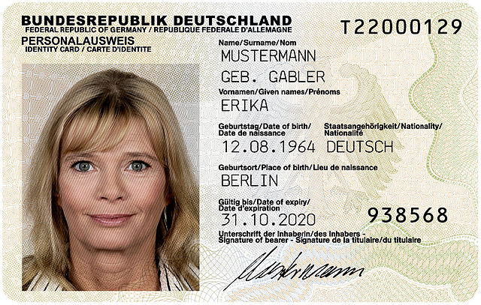
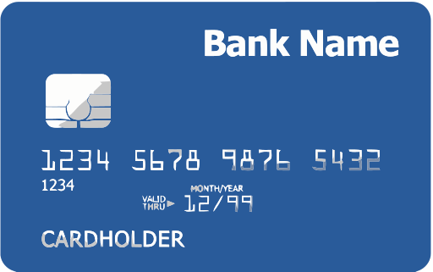
Mobile Card Emulation (2)
Image source (CC): https://commons.wikimedia.org/..., https://commons.wikimedia.org/...
Usage scenarios
  Mobile payment: credit card
  Identification: national ID card
Pass-through to websites possible
  Multiple components involved: website, card issuer, certificate authority, browser, secure element, helper app, …
  Difficult to debug & secure properly

Slide 20

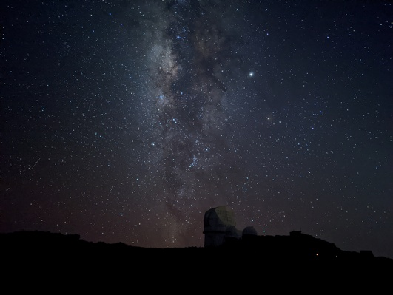
Computational Photography
Image sources: (CC) Marco Verch, (FU) Florian Kainz
Improve camera performance beyond physical limits, e.g.
  artificial “bokeh” effect → (usually only feasible with DSLR & large aperture)
  “Night Sight” on Pixel 4 → (usually only feasible with tripod & long exposure)

Slide 21
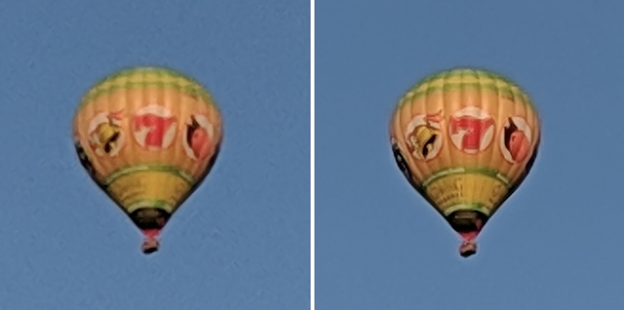

Computational Photography (2)
Image source (FU): https://ai.googleblog.com/2018/10/see-better-and-further-with-super-res.html
Example: Superresolution/ Superzoom
  Take burst of several images in quick succession (< 1 s)
  Merge into final image with 2-3x resolution/zoom of sensor

Slide 22
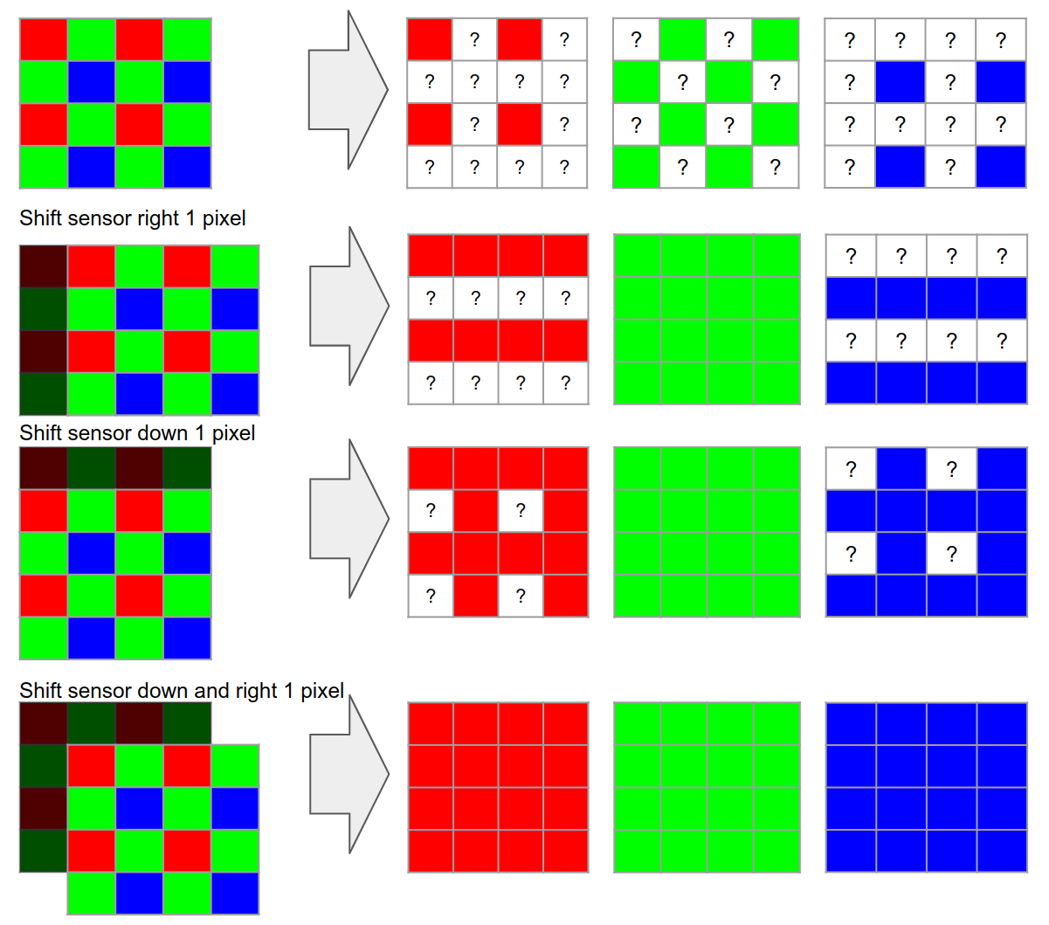
Computational Photography (3)
Image source (FU): https://ai.googleblog.com/2018/10/see-better-and-further-with-super-res.html
Approach:
  Use minimal shifts between images to improve details
  E.g. hand tremor, measured with IMU (or artificial motion of OIS)
  Takes adv. of Bayer pattern
Challenges
  Moving objects
  Image sensor noise
  Unpredictable motion

Slide 23
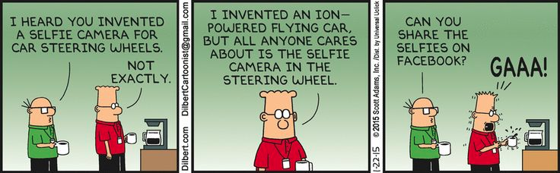
The End

