Slide 1
Mobile Information Systems
Lecture 10: Android Internals
© 2015-20 Dr. Florian Echtler
Bauhaus-Universität Weimar
<florian.echtler@uni-weimar.de>
This work is licensed under a Creative Commons Attribution-NonCommercial-ShareAlike 4.0 International License.

Slide 2
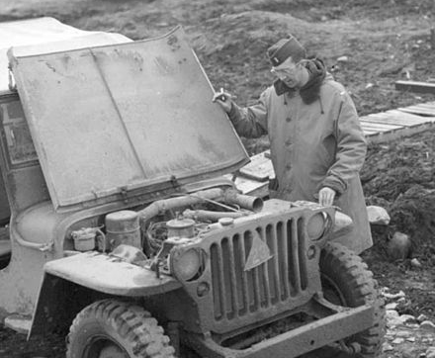
A look under the hood
Image source (PD): https://commons.wikimedia.org/...old_jeep_from_world_war_two.jpg

Slide 3
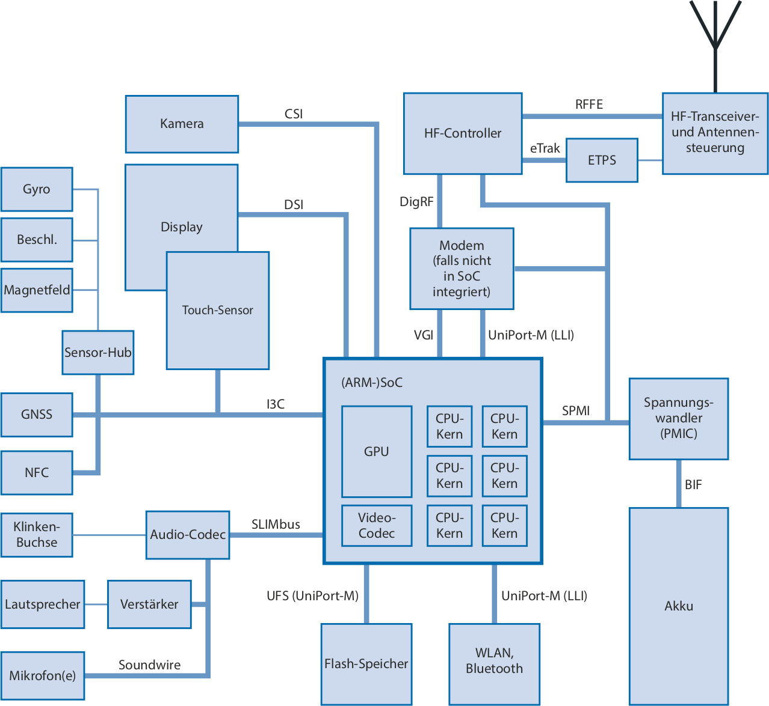
MIPI Hardware Interfaces
Image source (FU): https://shop.heise.de/katalog/ct-14-2020
Camera
MIPI = Mobile Industry Processor Interface
Multiple internal buses:
  Highspeed: CSI, DSI, Uniport
  Low-speed: I²C, I³C, SPMI, BIF, SLIMbus
(Mostly) abstracted away through kernel/ HAL
and antenna
control
Acc.
(unless part
of SoC)
Magnetic
I²C/I³C
Voltage
Converter
core
core
core
core
Headph.
Jack
core
core
Speaker
Amplifier
Battery
Mic(s)
Flash
Memory

Slide 4
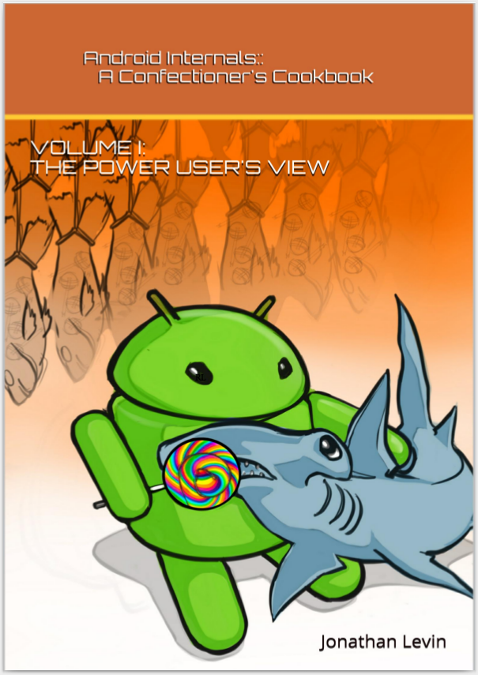
Book recommendation
Image source (PD): http://newandroidbook.com/AIvI-M-RL1.pdf
“Android Internals: A Confectioner’s Cookbook” by Jonathan Levin
http://newandroidbook.com/
Older edition freely available (up to Marshmallow PR1)

Slide 5
Android Internals (1)
Android storage partitions (generic)
  [a|h]boot → bootloader (fastboot)
  boot → Linux kernel + intital ramdisk (initrd)
  recovery → Linux kernel + minimal toolset
  system → main Android system
  userdata → user data storage (possibly encrypted)
  cache → temporary storage
… plus many vendor-specific extensions
Note: SD card mounted as storage extension for userdata

Slide 6
Android Internals (2)
[a|h]boot
(Bootloader)
recovery
(minimal Linux)
boot
(Linux kernel)
userdata
(apps + user data)
system
(Android +
Dalvik/ART)
cache (temp data)

Slide 7
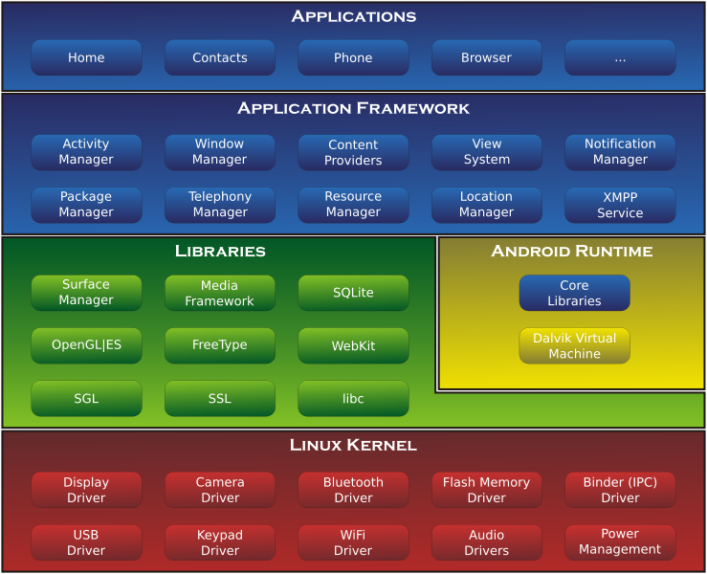
Android Internals (3)
Image source (CC): https://commons.wikimedia.org/wiki/File:Android-System-Architecture.svg
Java
C(++)

Slide 8
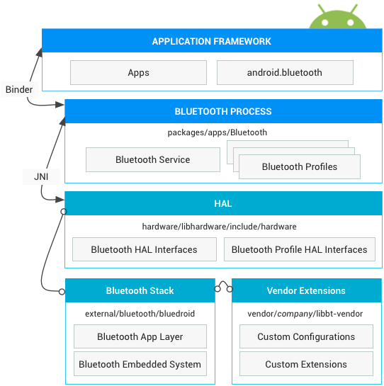
Example: Bluetooth stack
Image source (FU): https://source.android.com/devices/bluetooth.html
Java
C(++)

Slide 9
Linux kernel
Android = Linux?
  Uses new IPC = Inter-Process Communication:
  Binder (in addition to sockets, shared mem, …)
  Part of official kernel since February 2015
Closed hardware drivers
  HW vendors want to keep their secrets
  Only binary drivers, no source code → difficult to replace/modify kernel
  Conflict with GPL (often leads to legal battles, see e.g. https://blog.sebastian-schmid.de/.../xiaomi-gpl-violation.html)

Slide 10
Linux tools on Android
Can get a standard shell with adb shell
Standard(-ish) tools available: ps, top, grep …
Many static binaries work (why?)
Other Android-specific tools, e.g.:
  monkeyrunner → generates random touch/keypress events for UI testing
  app_process → allows scripts to interact with Dalvik/Java components, e.g. start activity

Slide 11
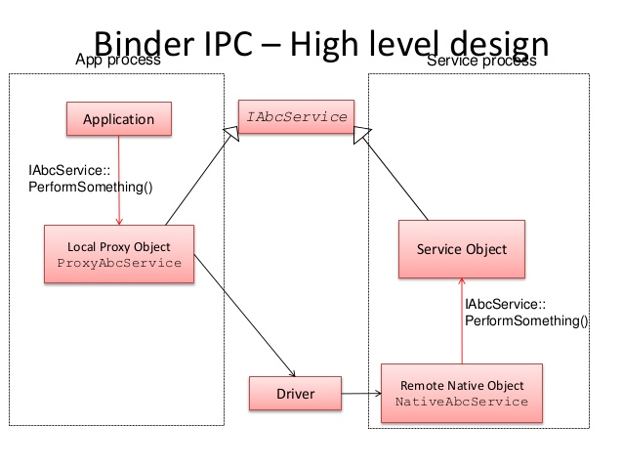
Binder IPC
Image source (FU): http://www.slideshare.net/pchethan/android-binder-ipc-implementation
Provides RPC = Remote Procedure Call
Communication apps ↔ services
Synchronous or asynchronous modes
Service
App

Slide 12
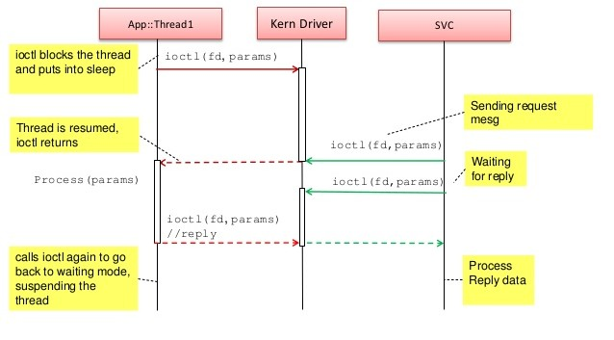
Android Binder
Image source (FU): http://www.slideshare.net/pchethan/android-binder-ipc-implementation
Asynchronous mode: caller sleeps until request serviced

Slide 13
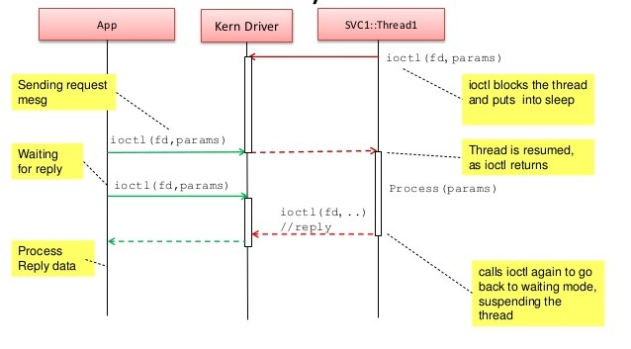
Android Binder
Image source (FU): http://www.slideshare.net/pchethan/android-binder-ipc-implementation
Synchronous mode: service sleeps until request made

Slide 14
libc vs. Bionic
libc = Standard C Library
  Used on most Unix-like systems
  Provides basic C functions, e.g. printf, strlen, …
Bionic: Google-specific replacement for libc
  BSD license instead of (L)GPL
  Smaller & faster
  Limited C++ support (no exception handling, STL needs to be linked separately)

Slide 15
Java VM
Original design goal:
  Support multiple CPU archs (arm*, mips, x86) …
  … with identical app binaries (no rebuild etc.)
→ Requires virtual machine (VM)
  Java already provides most features
  Machine-independent bytecode
  Bad reputation for high resource usage
→ Own adaptation of Java VM: Dalvik
  (named after Norwegian fishing village!?)

Slide 16
Stack-based vs. register-based
Stack-based VM:
  Very simple compiler (part of many grad courses)
  Needs lots of RAM accesses (many push/pop ops)
Register-based VM:
  Generally easier to optimize for low-end hardware (e.g. store intermediate values in CPU registers)
  Less RAM accesses required
  Drawback: compiler more complex

Slide 17
Dalvik & ART (1)
Dalvik VM default up to 4.4
  Register machine instead of stack machine
  Better speed & resource usage
  JIT = Just-In-Time compiler (since 2.2)
  Performance-critical sections converted to native
ART default from 5.0
  AOT = Ahead-Of-Time compiler
  Creates native Linux ELF executables at install time
  Tradeoff: storage space ↔ execution speed

Slide 18
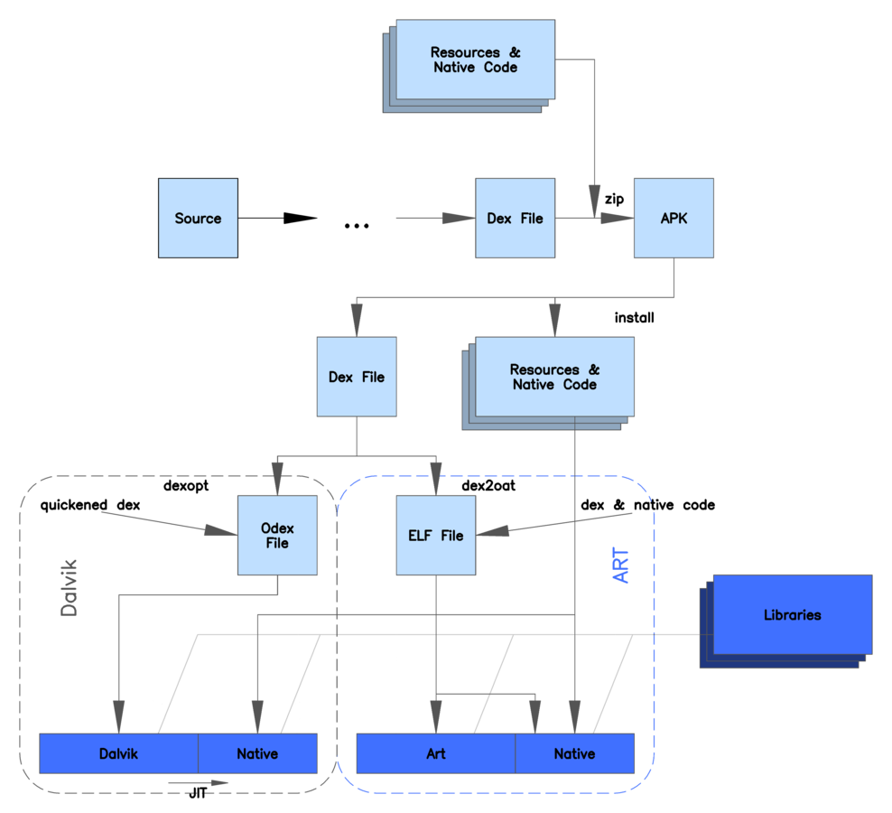
Dalvik & ART (2)
Image source (PD): https://en.wikipedia.org/wiki/Android_Runtime#/media/File:ART_view.png
Development
Deployment

Slide 19
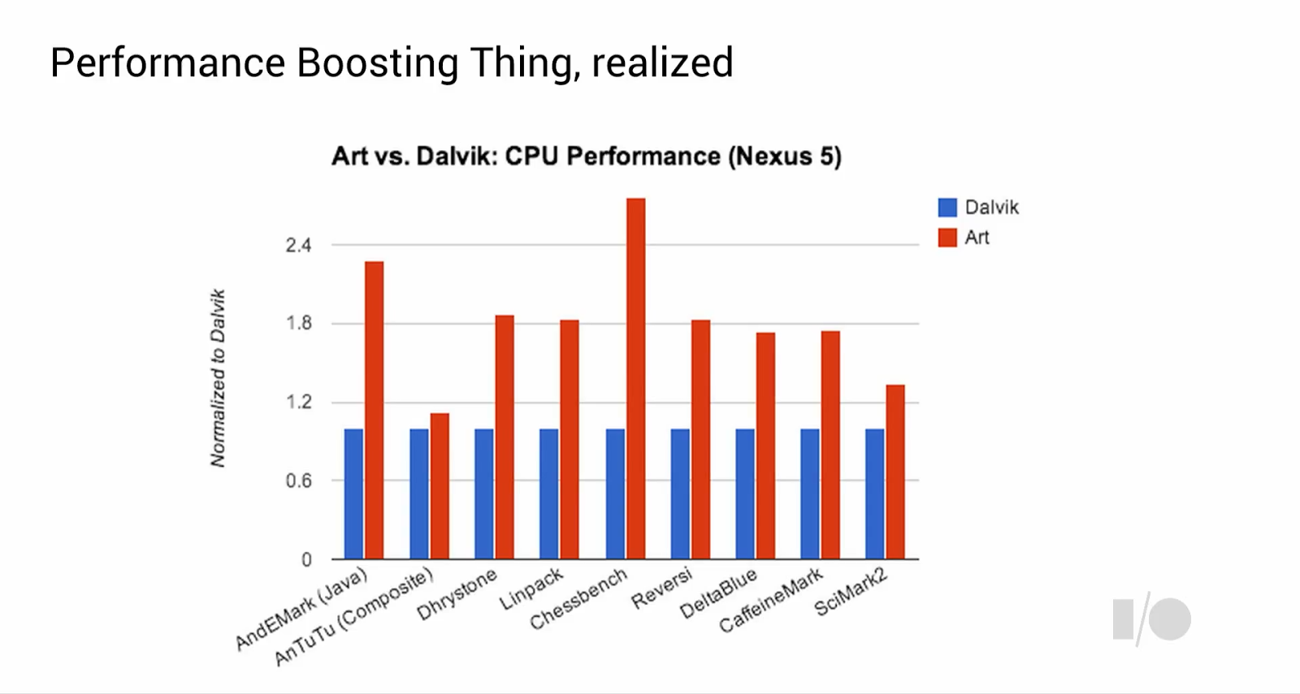
Dalvik & ART (3)
Image source (FU): http://anandtech.com/show/8231/a-closer-look-at-android-runtime-art-in-android-l/

Slide 20
APK & DEX
Compilation process:
  Java source (.java) → javac → Java class (.class)
  Since Android Studio 3.0: also Kotlin (.kt) source
  Class files → dx → Dalvik Executable (.dex)
    converts bytecode (Java VM → Dalvik VM)
    removes duplicate data (e.g. strings)
  DEX files + resources (e.g. images) → zip → APK
On device: JIT/AOT compilation to native code
  Question: why on device and not at compile time?

Slide 21
SDK & NDK
Android SDK: Java components & interfaces
Android NDK = Native Development Kit
  C++ compiler and libraries
  Used for performance-critical code (less important with ART)
  Can be used for system & shell tools
  Can be used to include existing C(++) libraries

Slide 22
Security measures/caveats (1)
On Linux level:
  Separation of privileges: separate user IDs for each app, service etc.
  Minimum amount of permissions for each ID (nearly none by default)
  Exception: UID 0 - “root”, omnipotent, only very few processes by default
  Additional restrictions through Linux Capabilities (fine-grained permissions) and SELinux policies

Slide 23
Security measures/caveats (2)
On Java level:
  Dalvik checks APK signature on installation
  App process has no permissions/capabilities
  All system services accessed through binder
  Services check <uses-permission> tags

Slide 24
Security measures/caveats (3)
“Rooting” a device: getting access to UID 0 (“root”) as regular user
  Allows to modify system components, access restricted information
  Unlocked bootloader → patched boot partition
  Sometimes uses existing, unpatched security holes
  May open up new, additional security issues

Slide 25
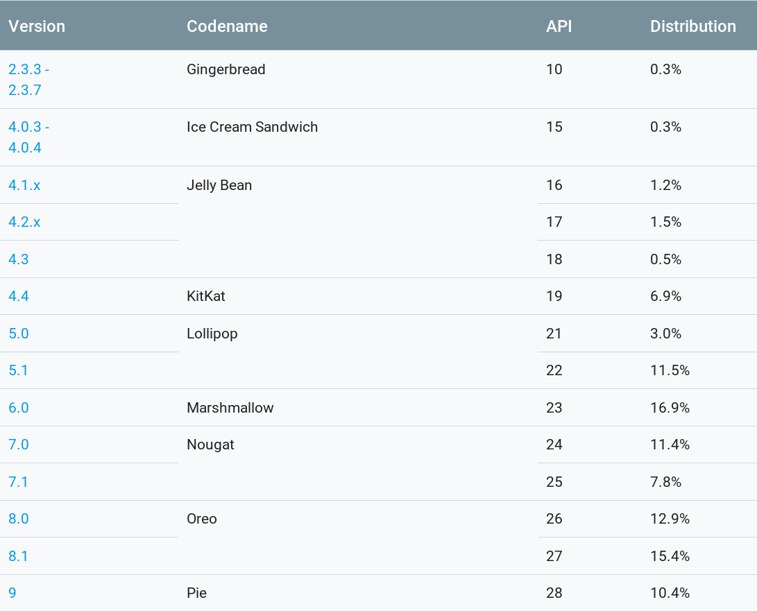
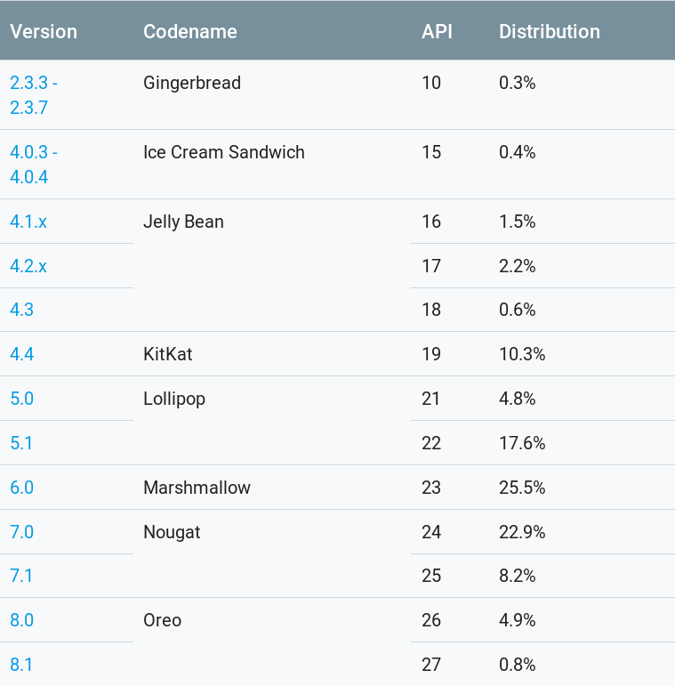
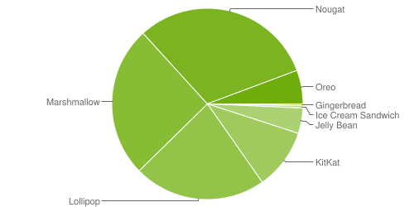
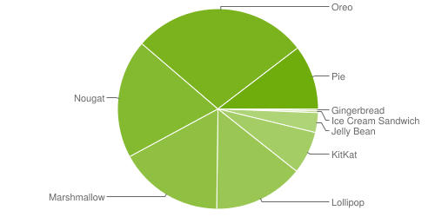
Apps & services (1)
Image source (FU): https://developer.android.com/about/dashboards/index.html, data 19-05-01 – 19-05-07
Problem: fragmentation due to sloppy vendor updates
→ move more services out of core OS (cf. Project Treble)
Data source: play store access from May 2019

Slide 26
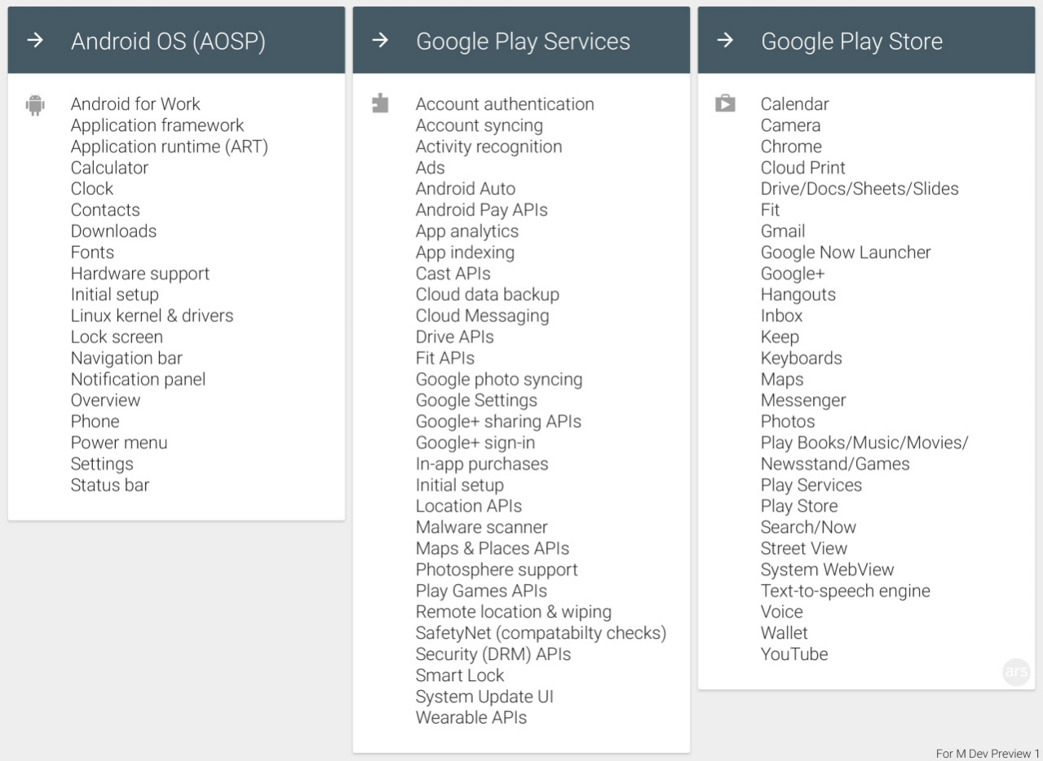
Apps & services (2)
Image source (FU): http://arstechnica.com/...play-services-data-backup-and-more/
Recent example:
COVID-19 Exposure
Notification API

Slide 27
HTML5 vs. native apps (1)
HTML5
  No installation required, just URL (QR code, NFC)
  Possible to also target iOS, desktops, …
  Additional layer of indirection (WebView/browser) → less performance (in general)
  Note: modern ARM CPUs have dedicated Javascript instructions
  Hardware access difficult or impossible (but improving, e.g. camera access in Javascript possible)
  Browser compatibility issues (Firefox ↔ Chrome ↔ WebKit) → Return of the Evil Browser Switch

Slide 28
HTML5 vs. native apps (2)
“Native”
  Generally faster (although very hard to quantify)
  Better access to hardware (sensors, camera, …)
  Payment services provided by app store
  Requires installation from app store or APK file
  In Android context: still means Java/Kotlin (+JIT/AOT)
Summary: many different trade-offs (again)
  Simple cross-platform apps → HTML5
  Performance, hardware access needed → native

Slide 29
Decompiling & reverse-engineering
Often necessary to look into existing apps …
  … for security research
  … for reverse engineering
Two major options available: dex2jar & jd-gui, jadx (relatively new, but all-in-one solution)
Create somewhat readable Java source code
Counter measure: Proguard
  Obfuscates & compresses source code
  Variable/method names converted to a...z, aa, ab, ...

Slide 30

RE case study: txtr Beagle
Image source (FU): http://de.txtr.com/beagle/
Announced as “10 € e-reader”, company broke
Very simple device: e-ink display, battery, flash storage, Bluetooth + small CPU
Books converted to images + transferred via Android app
Goal: reverse-engineer Bluetooth protocol
→ decompile Android app
→ protocol now open source (see https://github.com/schierla/jbeagle )

Slide 31
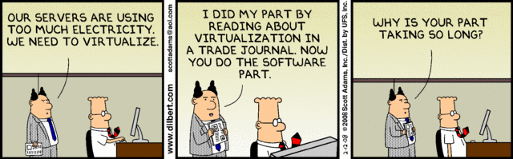
The End

