Slide 1
Mobile Information Systems
Lecture 07: Privacy & Security
May 20th, 2015

Slide 2
Key issue: security/privacy (recap)
Huge amounts of private & personal data on mobile devices
  Contact information, messages & e-mails
  Visited websites, pictures
  PIN/TAN codes
Many people want access to that data
  Google, Facebook, Microsoft (for selling ads)
  NSA, GCHQ, BND etc. (for catching criminals)
  Hackers (for stealing/extorting your money)

Slide 3

Problem 1: (lack of) encryption
No pervasive encryption on mobile devices
  Strong opposition from government snoopers (up to demanding “key escrow”)
  Device encryption
    Protects flash memory with user-derived key
    When missing: lost/found devices often trivial to access
  Data encryption
    Data in transit often unencrypted
    Can be intercepted/modified

Slide 4

Problem 2: cloud services
Widespread voluntary use of cloud services
  Google, Facebook, Dropbox, Whatsapp, Amazon, …
  Main reasons:
    Substitution of online resources for on-device resources
    Social components, communication, sharing
  Requires trusting at least one, usually several 3rd parties (outsourcing)
  Mostly without proper end-to-end encryption (cf. 1) → data freely accessible to cloud providers

Slide 5

Problem 3: (lack of) data protection
Private data not protected “by default”
  Outdated legal framework
  Not strictly enforced by mobile OS
  No fine-granular access control
→ access to contact list, messages, location, … possible for nosy/ malicious apps
Even if data itself encrypted, metadata often still readable (cf. WhatsApp)

Slide 6

Problem 4: intransparency
Many components outside user control
  Baseband module (own CPU, RAM, OS)
  Device OS (e.g. iOS, many Android devices)
No independent review possible
  Bugs, security holes and/or backdoors may exist
  Android is supposedly open-source …
  … but many exceptions (Google apps, vendor modifications, …)

Slide 7
Attacks on mobile devices
In increasing (arbitrary) order of severity:
  Re-use/sale of personal data
  Snooping, ”shoulder surfing”
  Nosy apps, spyware, malware
  Network-based attacks (WiFi sniffer, IMSI catcher)
  Physical device access/theft

Slide 8
Attacks: re-use/sale of personal data
Most cloud providers have …
  Full access to uploaded data
  ToS which allow them secondary use
Additional problems:
  Providers acquired by other companies → new ToS
  Other cloud users (e.g. photo tagging)
Alternatives: personal cloud, e.g. OwnCloud?

Slide 9
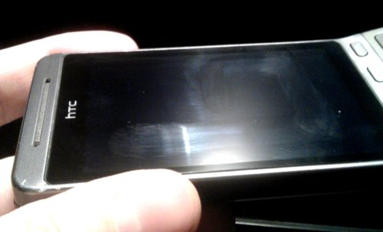
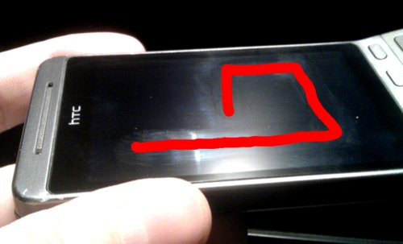
Attacks: ”shoulder surfing”
Image source (FU): https://f0rki.at/current-state-of-android-physical-security.html
“Unlock patterns” & short PINs easy to spot
“Smudge attacks”
  Fingers always leave small grease traces
  Traces can be used to infer patterns/PINs

Slide 10
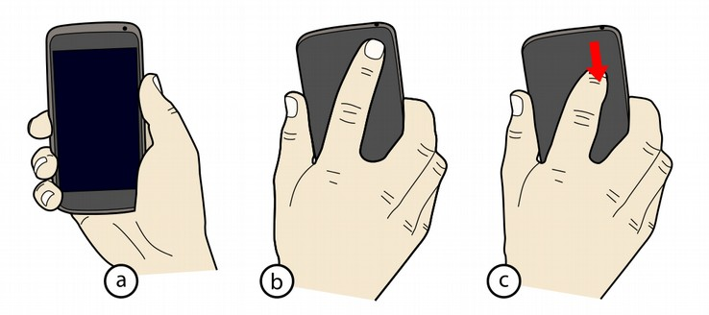
Attacks: ”shoulder surfing” (2)
Image source (FU): https://dl.acm.org/citation.cfm?id=2481330
Possible methods of defense:
  “Back-of-device authentication” (De Luca et al., CHI 2013) (requires extra sensor on back side)
  Combination of PIN input with eye tracking, grasp sensing, …
  Randomization of number layout (drawbacks?)

Slide 11
Attacks: spyware & malware
Definition: malicious software which tries to intercept information or mis-use resources
  In mobile context: mostly infostealers (spyware)
  Less available resources (CPU/bandwidth) than on desktop/laptop computers
  Secondary goal: resistence against removal
Android = main target for malware
  ~ 80% market share
  Relaxed security model
  Slow/sloppy review process in app stores

Slide 12
Android security model
Based on Linux security model
Each app has own “account” (UID)
  No direct access to other apps' data/files
  Only via OS-provided interfaces (permissions)
Problems:
  Permissions can only be approved as a whole
  Exact implications often unclear for user
    E.g. messaging app requires contact data & internet access (obvious for messaging service)
    Can also be used to “exfiltrate” whole address book

Slide 13
Attacks: spyware & malware (2)
Most Android malware are trojans
  Provide some legitimate service/function
  Hide illicit activities in background
Dedicated malware relatively rare
  E.g. ZeuS (Windows) + ZitMo (ZeuS-in-the-Mobile)
  Zeus on PC prompts user to connect mobile device, installs mobile malware component
  Zeus intercepts banking website credentials, ZitMo intercepts SMS with TAN
→ full access to bank account!

Slide 14
Attacks: spyware & malware (3)
Can (sometimes) be analyzed in sandbox
  Android emulator with additional logging (syscalls, network traffic, …)
  Simulated user input to trigger malicious behaviour
“Arms race”:
  Malware tries to identify sandbox environment
  Sandbox tries to look as realistic as possible
  E.g. IMEI check, vibration → accelerometer, sound → microphone, waiting for specific user input …

Slide 15
Attacks: network-based attacks
WLAN (802.11x) – passive sniffing attacks
  Unencrypted (many hotels)
  WEP (outdated & thoroughly broken)
  WPA(2) – pre-shared key & handshake must be known (key often public, handshake can be forced)
  WPA2 Enterprise (e.g. eduroam) – currently assumed to be secure (but can you trust every eduroam AP?)
→ use separate VPN on top of WLAN

Slide 16
Attacks: network-based attacks (2)
WWAN
  Identifying information
    IMSI (Int. Mobile Subscriber ID) = SIM card
    IMEI (Int. Mobile Equipment ID) = baseband module
  Location monitoring
    Cell-based location always available in backend
    Uses SS7 (Signalling System 7) backend network

Slide 17
Attacks: network-based attacks (3)
Signalling System 7 (SS7)
  Ancient protocol suite (since ~ 1975), used for …
    call setup, billing etc. between carriers
    carrier-internal configuration (roaming between MSCs)
  Many bugs & security issues
  Accessible to “rogue operators” - allows …
    re-routing of calls and messages
    tracking cell-based location of IMSI/IMEI
    disabling call encryption
  SMS re-routing recently used for bank fraud (mobile TANs intercepted)

Slide 18
Attacks: network-based attacks (4)
WWAN - call/data monitoring
  Uses IMSI catcher = “fake base station”
  Mobile devices must authenticate to base stations, but not vice versa → anybody can operate a BTS!
  Strong signal when close to target → phone switches to IMSI catcher
  IMSI catcher can downgrade/disable encryption
  Data forwarded to regular network, but decrypted/recorded beforehand
  Possible using open-source tools (OpenBTS)

Slide 19

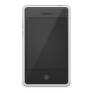
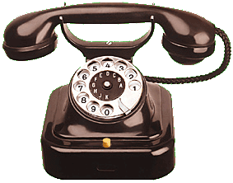
Attacks: network-based attacks (5)
IMSI catcher: classic “MITM” (man-in-the-middle) attack
Base
Station
(BTS)
Backend
network
IMSI
Catcher
Base
Station
(BTS)
Backend
network
wireless interface
encrypted
unencrypted

Slide 20
Attacks: physical device access
Security rule-of-thumb (“evil maid”):
  Once attacker has physical access, you've lost.
  Last line of defense: very strong encryption (public-key cryptosystem, 1000s of bits key length)
Problem: key management - impossible to type/remember 1000s of key bits
  Alternative 1: key needs to be derived from/ protected by smaller number of bits → use KDF
  Alternative 2: key needs to be stored in a separate security device, e.g. smartcard (such as SIM card)

Slide 21
Attacks: physical device access (2)
KDF = Key Derivation Function
  Protection against brute-force attacks
  Complex function, 1000s of iterations
  KDF should not take more than ~ 1 second on mobile device for fast unlock → problems?
PIN
random # of
iterations
+
KDF
Key
Salt
(random)
All green components are publicly known.

Slide 22
Attacks: physical device access (3)
Software-only KDF: no mitigation against offline attacks with high-end computers
  Alternative: “Secure Enclave” (iPhone) with internally-stored hardware key
  Wipes HW key after # of wrong tries
PIN
random # of
iterations
+
KDF
Key
Hardware
Key
All green components are publicly known.

Slide 23
Attacks: physical device access (4)
Alternative key storage: smart card
  Small dedicated computer (CPU, RAM, ROM)
  Common example: SIM card
    However: (currently) not used to store device keys, only WWAN network/baseband keys
  Features:
    Irrevocable wipe after n wrong PINs
    Tamper-proof: e.g. light sensor → triggers chip wipe
    Attacks usually require advanced knowledge of internals, sometimes via an electron microscope

Slide 24
Android startup process
fastboot
(Bootloader)
Accessed via key combination or USB command; unlocked bootloader allows re-flashing of all other components
recovery
(minimal Linux)
boot
(Linux kernel)
Accessed via key combination, bootloader or USB command; recovery allows re-flashing of all other components (initially only with updates signed by vendor)
data
(apps + user data)
system
(Android +
Dalvik VM)
Rooted system allows modification of all other components

Slide 25
Attack scenarios on found device
Device is locked and/or PIN protected (note: device PIN != SIM card PIN)
  Bootloader unlocked
    Flash & boot custom recovery image
    Create backup of data partition
    Analyze offline → PIN protection useless (see KDF)
  Bootloader locked
    Simply unlock bootloader? → will erase data partition
    Attempt to re-flash recovery anyway (bugs in BL?)
    Ultimate solution: direct hardware access to flash chips
    “Cold-Boot”: cool down RAM, reboot, read out remains

Slide 26
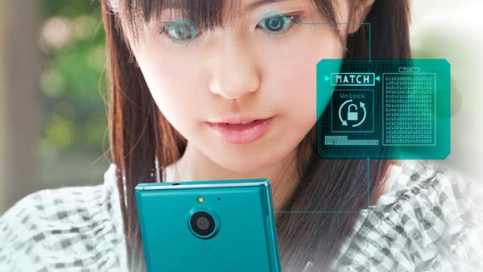
Encryption done right?
Image source (FU): http://www.heise.de/.../Android-Smartphone-mit-Iris-Scanner-2650067.html
PIN > 4 digits → user acceptance sinks rapidly
Two-factor authentication = something you know (e.g. PIN) + something you own
  Biometric: face, fingerprint, iris pattern, …
  Hardware: wireless token, chipcard, …
Communication
  Always use secure channels (e.g. HTTPS)
  Very difficult to account for all failure modes

Slide 27
Cloud services done right?
Peer-to-peer approaches
  E.g. Tor, Bittorrent, Bitcoin
  Problem: discovery of mobile peers, multi-hop routing → high network load
End-to-end encryption
  Some 3rd party tools: e.g. Boxcryptor, Truecrypt
  Damages business model of many cloud providers
  Zero-knowledge computing → computations on encrypted data without intermediate decryption

Slide 28
Data protection done right?
Fine-granular access management
  Current state: take it or leave it
  App permissions can only be approved or denied as a whole
  Slightly better on iOS: individual decisions possible
  Most apps will simply not work if access denied
Possible solution: fake personal data
  E.g. provide plausible-looking randomly generated contacts instead of real ones
  Apps shouldn't be able to tell the difference

Slide 29

Transparency done right?
Image source (FU): http://www.replicant.us/
Replicant: Android derivative
  Contains only open-source components
    No Google apps, services & store
    Several hardware drivers missing
    Baseband still inaccessible
OsmocomBB
  Fully open-source UMTS baseband implementation
  Only runs on some Motorola dumbphones
OpenMoko: open hard-/software smartphone
  Full schematics & source code available

Slide 30
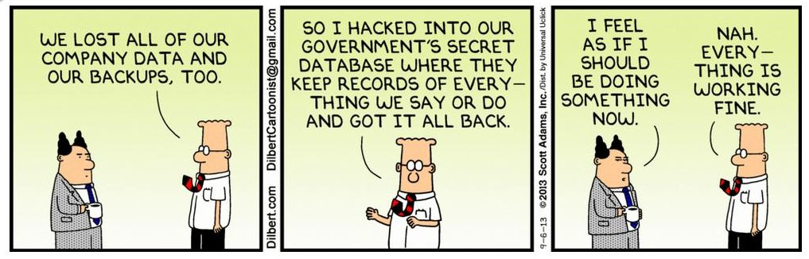
The End

