Slide 1
Mobile Information Systems
Lecture 08: UbiComp & IoT
© 2015-23 Dr. Florian Echtler
Bauhaus-Universität Weimar
Aalborg University
This work is licensed under a Creative Commons Attribution-NonCommercial-ShareAlike 4.0 International License.

Slide 2
Ubiquitous Computing
Source (FU): Mark Weiser, “The Computer for the 21st Century”, 1991
Mark Weiser, 1991: “The most profound technologies are those that disappear. They weave themselves into the fabric of everyday life until they are indistinguishable from it.”
Proposes 3 device classes:
  Tabs: wearable centimetre sized devices
  Pads: hand-held decimetre-sized devices
  Boards: metre sized interactive display devices.
→ Original vision has already (mostly) arrived.

Slide 3
Ubiquitous Computing (2)
… or has it?
  Ubiquitous computing not just about devices …
  … but also about interaction (or lack thereof)
Also {calm | ambient | pervasive} computing → implies less/no manual setup effort
Ever tried to use more than one Bluetooth device at once?
→ Not quite there yet after all.

Slide 4
“Internet of Things” (IoT)
Mostly a (widely/over-used) marketing term
Core idea: put connectivity everywhere
Basic concept similar to UbiComp:
  Less focus on personal/interactive devices
  More focus on “smart things” & sensor networks
  E.g. light bulb, fridge, trash can, water meter…
  Also: “Industry 4.0”, “Factory of the Future”

Slide 5
“Internet of Things” (IoT) (2)
Stated goals:
  Automate mundane, everyday tasks
  Increase energy/resource efficiency
  “Smarter” logistics, e.g. in factories
Other goals:
  Sell more wireless sensor modules?
  Gather more data about consumers?
  E.g. wireless power meter → possible to infer movie being currently watched! (How?)

Slide 6
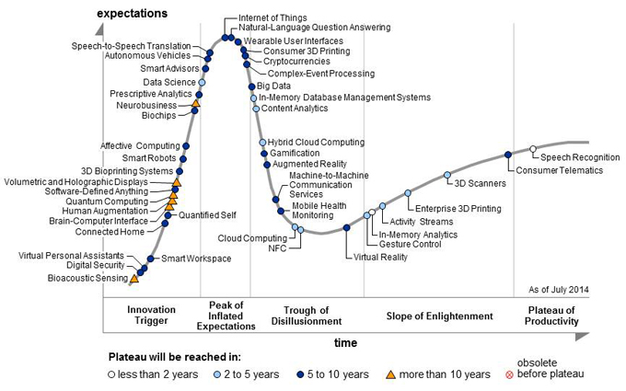
UbiComp/IoT Hype Cycle
Image source (FU): https://www.gartner.com/newsroom/id/2819918

Slide 7
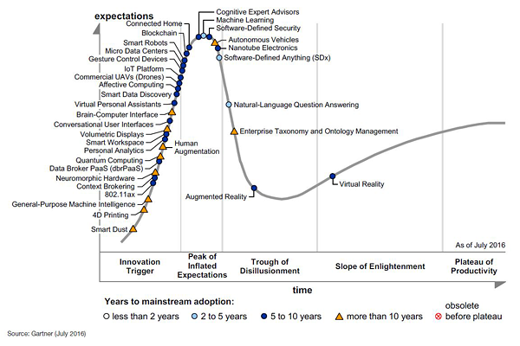
UbiComp/IoT Hype Cycle
Image source (FU): https://www.gartner.com/newsroom/id/3412017

Slide 8
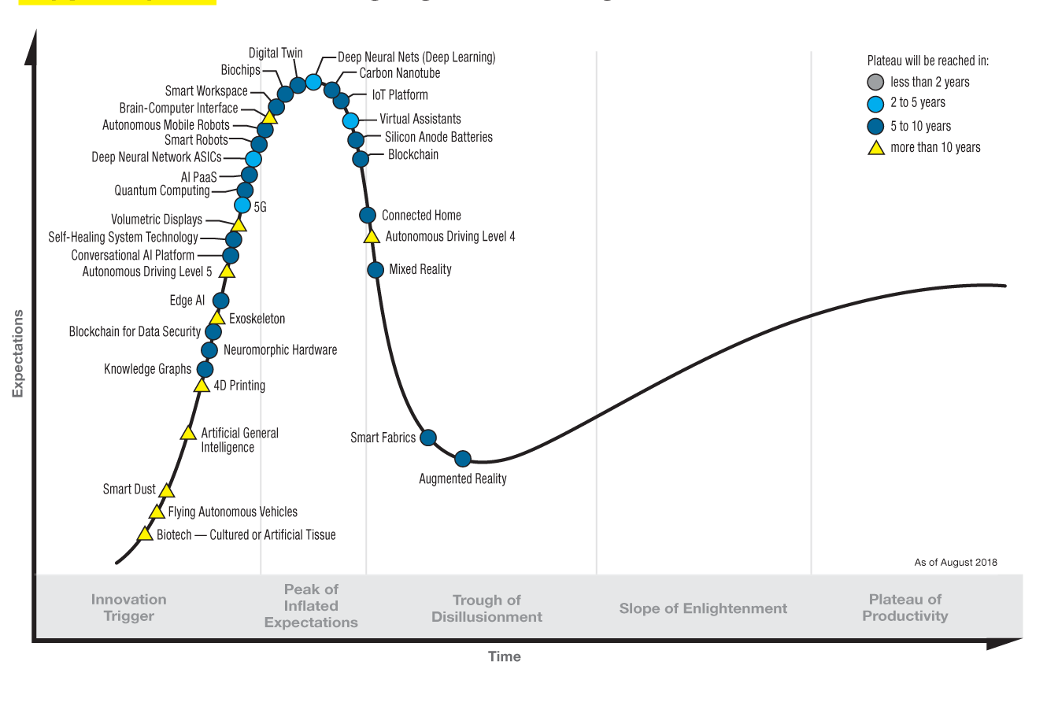
UbiComp/IoT Hype Cycle
Image source (FU): https://www.gartner.com/.../5-trends-emerge-in-gartner-hype-cycle-...2018/

Slide 9
Big issues for UbiComp/IoT?
Power/energy supply?
  Imagine changing batteries across 1000s of sensors/ ”smart things”... → energy harvesting?
Interaction concepts?
  People already struggle with synchronizing two devices → how to manage huge networks?
Privacy & security?
  Even more massive amounts of private data that requires adequate protection
Standards (or lack thereof)

Slide 10
UbiComp/IoT Technologies
Wearables & interaction concepts
Sensor & mesh networks
Personal area networks (BTLE, NFC)

Slide 11
Wearables & interaction concepts
“Wearable” = any body-worn, hands-free device
  Smartwatches, fitness trackers
  Smart glasses, e.g. Google Glass
  Headsets/headphones?
Require new interaction concepts
  E.g. small screen or no screen at all
  → use swipe/shake gestures
  → use voice commands

Slide 12
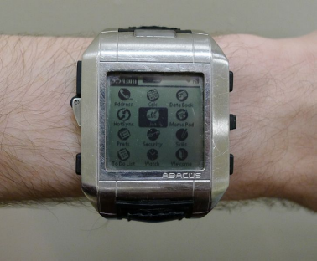
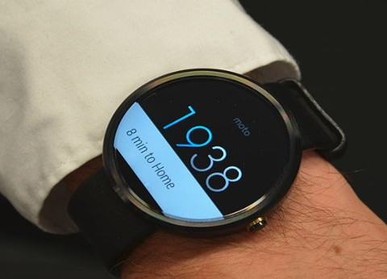
Smartwatches (1)
Image sources (GFDL): https://en.wikipedia.org/.../Fossil_Wrist_PDA, (PD): https://en.wikipedia.org/.../Moto360
Not a new concept, exists since late 1990s
Recent popularity due to …
  Companion device for smartphone → less complex hardware & power supply
  Better/more sensors, e.g. motion, heart rate, …
  Improved screens (e.g. round LCDs)
Problems:
  Battery lifetime
  Size

Slide 13
Smartwatches (2)
Hardware
  Surprisingly powerful (1 GHz quad-core, 4 GB ROM)
  Bluetooth LE + (sometimes) WiFi
Software
  Android Wear (Android derivative)
  Various proprietary OS (iOS, Tizen, …)
  Native notification & app support:
    iOS device + Apple Watch
    Android device + Android Wear

Slide 14
Smartwatches (3)
New interaction concepts:
  Rough swipes, motion gestures (no pinch-zoom :-)
  Interaction with smartphone: e.g. trace in-air gestures after touch lifted
Usage scenarios:
  Notifications & quick responses
  Data logging (body state/movement/sleep)
  … other ideas … ?

Slide 15

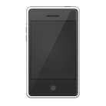



Sensor & mesh networks (1)
Image source (CC): http://tango.freedesktop.org/
“Regular” networks: star/tree topology
  Central hubs for each segment (wired or wireless)
Problems for sensors & IoT devices
  Low transmission power → short range
  Would require (many) additional hubs/gateways?
Other networks,
Internet

Slide 16
Sensor & mesh networks (2)
Image source (CC): http://tango.freedesktop.org/
Alternative: mesh networks
  Each device also acts as hub/relay
  Data is forwarded across several “hops”
  Topology can change dynamically
Other networks,
Internet

Slide 17
Sensor & mesh networks (3)
Main forwarding strategies:
  Flooding, re-broadcasting (problems?)
  Routing – on-demand: e.g. Ad hoc On-Demand Distance Vector (AODV)
  Routing – pro-active, e.g. Optimized Link State Routing (OLSR), B.A.T.M.A.N. (cf. Freifunk network)
Current implementations:
  ZigBee (IEEE 802.15.4)
  Bluetooth LE (since 5.1)
  WiFi-based (Freifunk)

Slide 18
Sensor & mesh networks (4)
Alternative: LPWAN (Low Power WAN)
  Relatively long range (1-10 km)
  Very low bandwidth (< 50 kBit/s)
  Also uses ISM bands
Current standards: LoRaWAN, Weightless, WiFi HaLow, …
Not (yet) widely used
Intended for smart meters, street lamps, etc.

Slide 19
Personal Area Network (WPAN)
Originally IrDA, later Bluetooth (see lecture 3)
Goal: communication with personal peripherals
Disadvantages:
  High power draw (on par with WiFi/cellular)
  Complex setup procedures (pairing, PIN codes etc.)
Alternative: Bluetooth Low Energy (BLE/BTLE), aka Bluetooth Smart
  Also available for medium-area mesh networks

Slide 20

Bluetooth Low Energy (1)
Image source (FU): http://www.bluetooth.com/Pages/Bluetooth-Brand.aspx (Logo)
Little in common with “classic” Bluetooth
  Same frequency band (2.4 GHz ISM)
  Similar modulation → no hardware change
  Much smaller/less complex protocol stack
  Part of Bluetooth specification v4.0
Optimized for simple battery-powered sensors
  Goal: months or years of battery lifetime
  Maximum data rate 1 Mbit/sec

Slide 21
Bluetooth Low Energy (2)
2 major roles: central or peripheral
  Peripherals can …
    Broadcast to all central devices
    Unicast to one specific central device
  Centrals can …
    Open connections to peripherals
    Be notified about value changes
OS support (mobile):
  Central role supported since Android 4.3, iOS 5
  Peripheral since Android 5.0 (not all devices), iOS 6

Slide 22
Bluetooth Low Energy (3)
“Complexity” classes for peripherals:
  Beacons (pure static broadcasts)
    E.g. iBeacon: simply broadcasts own UUID
    Additional data possible on request
  Sensors (broad-/unicast with sensor data)
    Multiple profiles: heart rate, activity, temperature, …
    Notification support to avoid constant polling
  Bidirectional communication
    Not primarily designed for synchronous comm.
    Mostly for setting sensor parameters etc.

Slide 23
Bluetooth Low Energy (4)
Power consumption
  Highly dependent on advertising interval
  nRF51822 SoC, CR2032 button cell, 1 s interval → estimate ~ 1 year of lifetime
  Power management becomes very important
  Modern SoCs have multiple peripherals that can be powered down individually

Slide 24
BTLE Profiles/Protocols (1)
GAP = Generic Advertising Profile
  Up to 31 bytes advertisement broadcast
  Up to 31 extra bytes on request by central
GATT = Generic Attribute Profiles
  Only available to one central at a time
  1+ services, containing 1+ characteristics each
  Each s/c identified by global 16-bit UUID
  Publish/subscribe model
    Value change notifications, no constant data stream
    Less “on” time for radio module → power savings

Slide 25
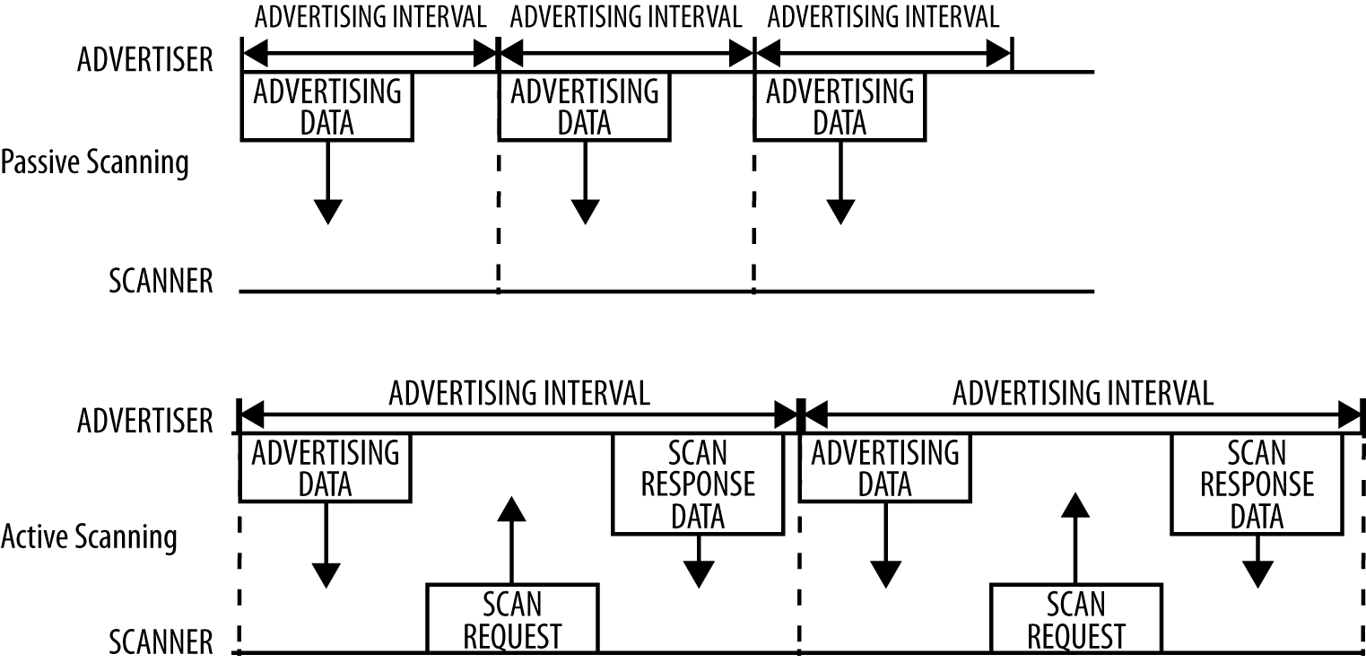
BTLE Profiles/Protocols (2)
Image source (FU): Townsend et al., Getting Started with Bluetooth Low Energy, O'Reilly Media
GAP: Generic Access Profile
  Advertising, discovery, connection establishment

Slide 26
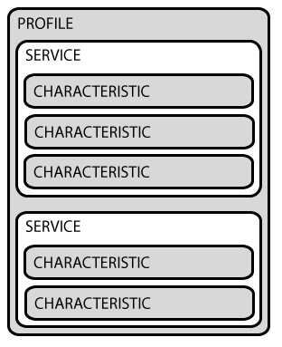
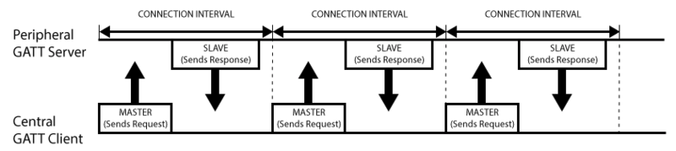
BTLE Profiles/Protocols (3)
Image source (FU): https://learn.adafruit.com/introduction-to-bluetooth-low-energy/gatt
GATT: Generic Attribute Profile
  Main transport for “live” data
  Extension of GAP
  Profiles, services + characteristics (each with unique UUID)
  Publish-subscribe model

Slide 27

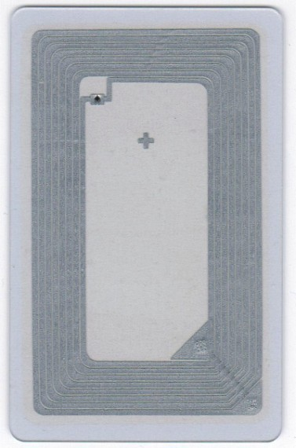
Near Field Communication (NFC)
Image sources (FU): http://nfc-forum.org/ (Logo), (CC) own image
Very simple devices, price down to ~ 0.30 €
  Various form factors: sticker, token, card, glass capsule (implantable/injectable), …
  Contain small IC + antenna coil
Subclass of RFID (radio freq. ID)
Power for tag provided by reader device through magnetic field
Communication through EM field modulation (bi-directional!)
IC
Coil

Slide 28
Near Field Communication (NFC)
Image sources (FU): http://nfc-forum.org/ (Logo)
Characteristics:
  13.56 MHz band, ~ 400 kBit/sec
  Range ~ 2 cm with standard antenna
  Storage: 137 byte – 80 kByte
Variants:
  Simple storage devices (cf. NDEF standard)
  Smart cards with crypto functions (e.g. Mifare)
  Java cards (user-programmable in Java)
  Card emulation (device mimics card/token)

Slide 29
Near Field Communication (NFC)
Image sources (FU): http://nfc-forum.org/ (Logo)
Usage scenarios
  URLs/contact data, e.g. in poster/business card
  Security & access control (Thoska)
  Mobile payment (some credit cards, Apple Pay)
  Passports (lots of sensitive information)
  Device-to-device (Android Beam)
Directed antenna can increase range to ~1 m → personal data stolen without direct contact

Slide 30
NFC Security
Image sources (FU): http://nfc-forum.org/ (Logo)
Public tags:
  should be write-protected (but often are not)
  E.g. overwrite with malicious URL?
Security measures
  Simple/low-level:
    Read and/or write keys for each data block
    Can often be brute-forced or sniffed
  Complex/high-level:
    Dedicated crypto “apps” in NFC chip
    Similar security concept to SIM card

Slide 31
UbiComp/IoT issue: energy supply
Possible solution: energy harvesting?
Many possible sources
  Sunlight/environment light
  Vibration & sound
  Temperature differences
  EM radiation (e.g. power lines, TV stations)
Drawbacks:
  Low efficiency (few 10-100 mW)
  Energy storage (e.g. during night?)

Slide 32
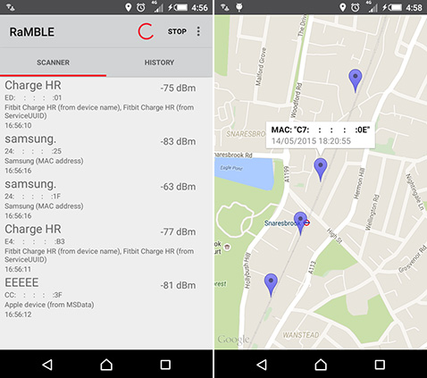
UbiComp/IoT issue: privacy
Image sources (FU): http://www.net-security.org/secworld.php?id=18422
Bluetooth LE devices: often broadcast-based
  Implies public availability → enables tracking
  Often leaks additional private data, e.g. pulse
  MAC address could be random, but often isn't
Classic tradeoff: security/ privacy ↔ ease of setup

Slide 33
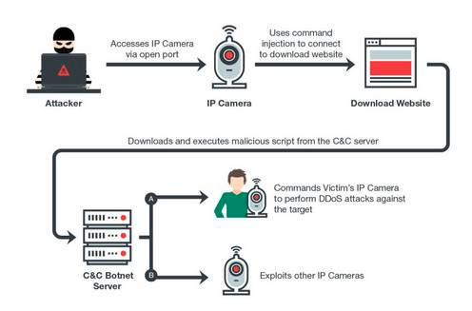
UbiComp/IoT issue: security
Image source (FU): https://www.theregister.co.uk/2017/05/10/persirai_iot_botnet/
Mobile phones: bad situation regarding patches, security updates etc.
IoT devices: even worse
Customer often won’t even notice, so why bother?
Problem: insecure devices on Internet → can be used as part of a botnet, execute DDOS attacks

Slide 34

UbiComp/IoT issue: standards
Image sources (CC): https://xkcd.com/927/
Current state: ~ 1 standard per manufacturer → e.g. light bulb A won't talk to control app B
  Common ground: sometimes IP
  Mostly: wild mixture (HTTP, MQTT, Zigbee, …)
Recent approach: URIBeacon/Physical Web
  Every “smart thing” broadcasts an URL
  Access/control via common web tools
  Problem: mapping?

Slide 35
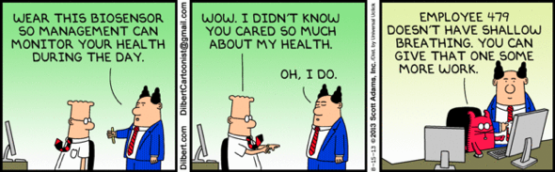
The End

