Slide 1
Mobile Information Systems
Lecture 09: Augmented Reality
June 3rd, 2015

Slide 2
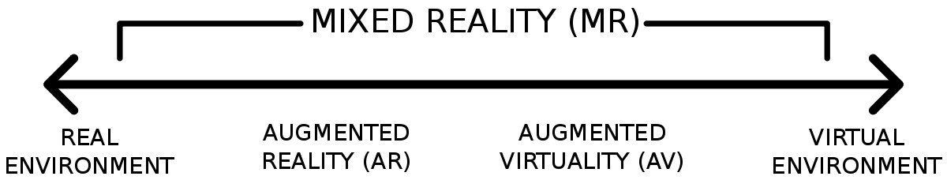
Augmented Reality (AR)
Image source (CC): https://en.wikipedia.org/wiki/Mixed_reality#/media/File:Reality-Virtuality_Continuum.svg
Part of the “Virtuality Continuum” (see below)
  Milgram & Kishino, “A Taxonomy of Mixed Reality Visual Displays”, 1994
Subclass of mixed reality
  Roughly categorized by ratio between real and virtual content

Slide 3
Augmented Reality (AR) (2)
Definition/characteristics
  R. Azuma, “A Survey of Augmented Reality”, 1997
    Mix of real-world and virtual visual information
    Information can be interacted with in real-time
    Real & virtual elements spatially aligned in 3D
→ Requirements:
  Visual input (real world) & output (virtual)
  User input & fast graphics (to enable interaction)
  6D head tracking (for spatial alignment)

Slide 4
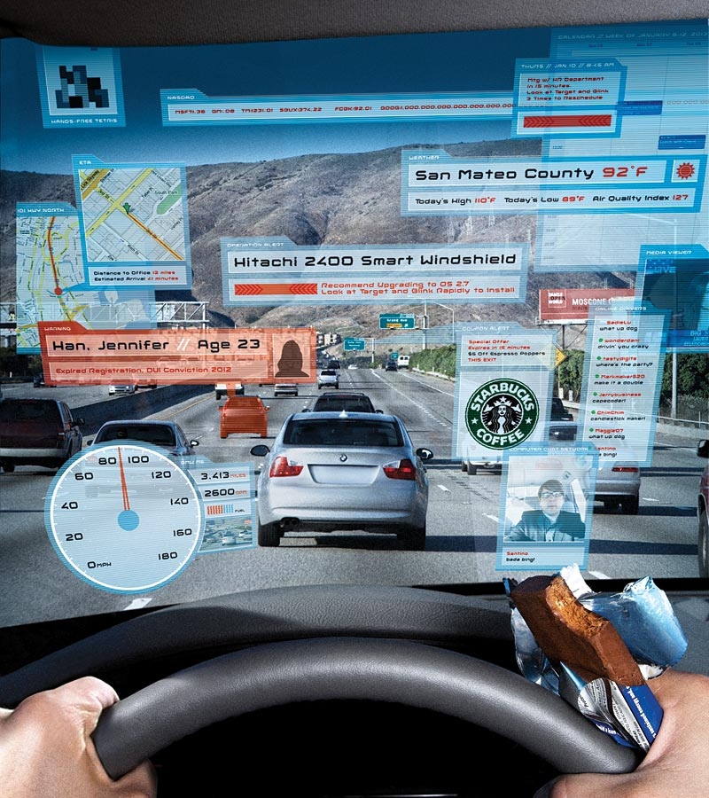
Is this AR?
Image source (FU): http://archive.wired.com/culture/culturereviews/ magazine/16-01/found
(apart from the fact that there can be too much of a good thing)

Slide 5
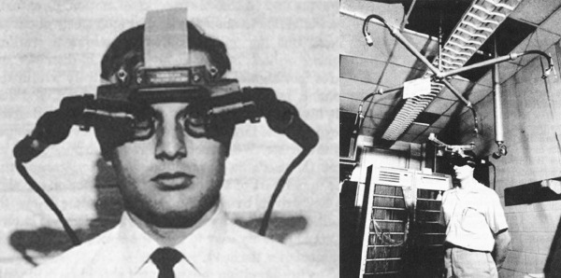
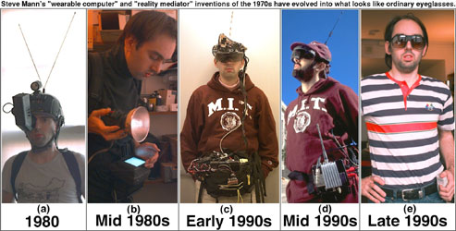
AR: History & Pioneers
Image source (FU): https://louislau91.files.wordpress.com/2013/06/sword_of_damocles.jpeg
Image source (FU): http://eyetap.org/research/wearables/wearcomp/wearables.html
1901: first mention of idea in novel (“The Master Key” by L. Frank Baum)
1968: first head-mounted display (HMD) (“The Sword of Damocles” by Ian Sutherland)
1980: first wearable HMD by Steve Mann

Slide 6
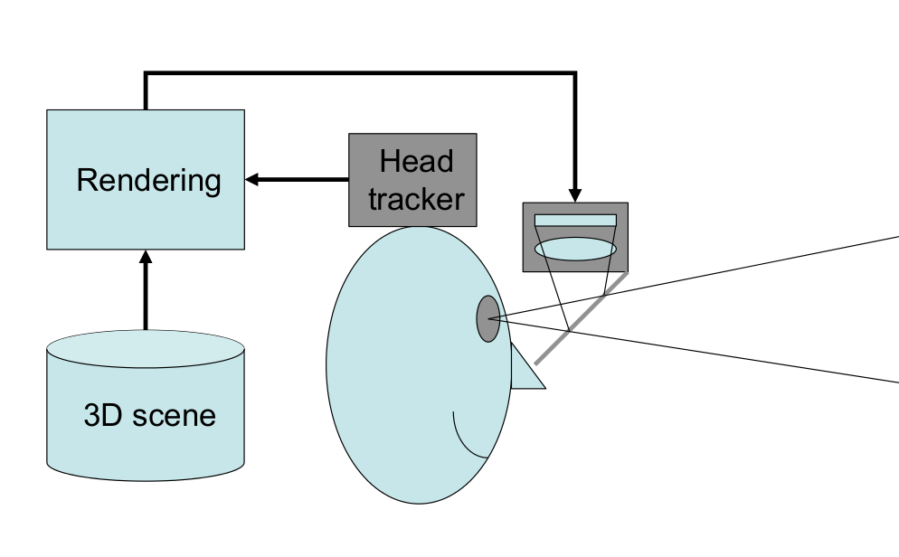
HMD: optical see-through (1)
Image source (FU): LMU Lecture by J. Wagner

Slide 7
HMD: optical see-through (2)
Use “beam combiner” + focus optics to overlay display image over real-world view
Pro:
  Direct view of real world
  Eye can focus at different distances
Contra:
  (Mostly) not able to “cover” objects (problem with 3D occlusion, i.e. real object behind virtual one)
  Lag/alignment issues real ↔ virtual more obvious

Slide 8
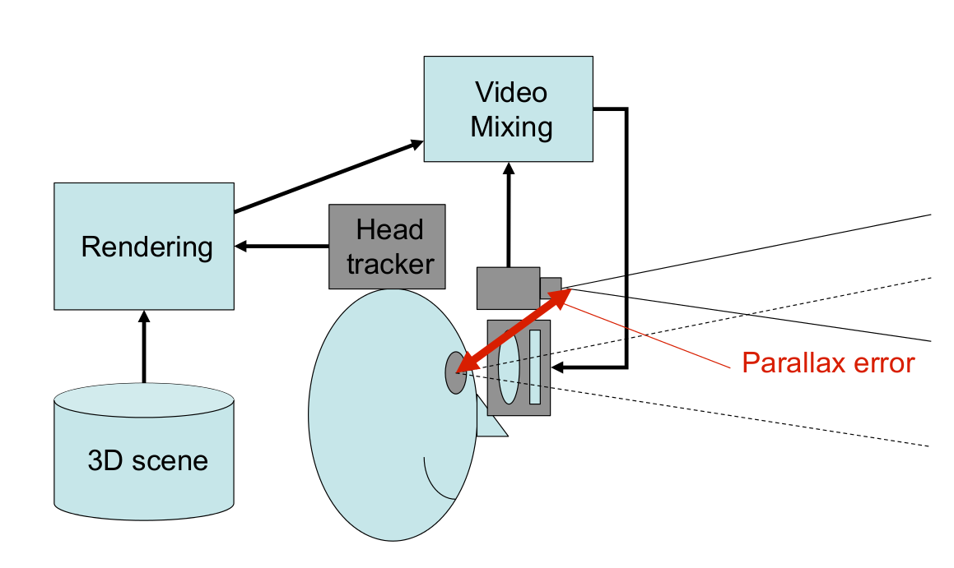
HMD: video see-through (1)
Image source (FU): LMU Lecture by J. Wagner

Slide 9
HMD: video see-through (2)
Similar to VR displays (cf. lecture 5) + camera
Pro:
  Possible to use camera image for tracking → less lag, better alignment real ↔ virtual
  Real objects can be hidden/substituted
Contra:
  Parallax error camera ↔ display
  Similar problems to VR displays (motion sickness)
  Single focus distance

Slide 10
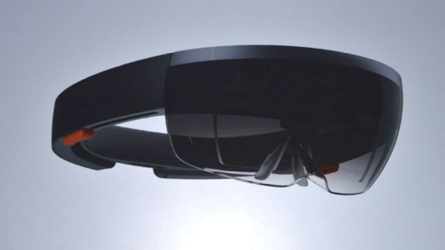
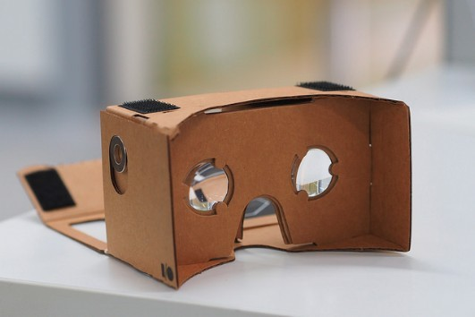
Commercial HMDs for AR
Image source (CC): https://www.flickr.com/photos/jiff01/15867880743/
Image source (CC): https://www.flickr.com/photos/othree/14519574116
Optical see-through:
  Google Glass (not AR!)
  Microsoft Hololens →
  Epson Moverio
Video see-through:
  Smartphone goggles
    Google Cardboard →
    Samsung Gear VR (+ sensors)
  Oculus Rift + add-on cameras

Slide 11
Issues with HMDs
Brightness (esp. for outdoor/sunlit context)
Field of view (FOV)
  Human FOV nearly 180°, many HMDs only ~ 20°
Weight/comfort (can induce headaches)
Lag between …
  real and virtual content
  head and image movement
Safety – what if video see-through fails while you're crossing the street?

Slide 12
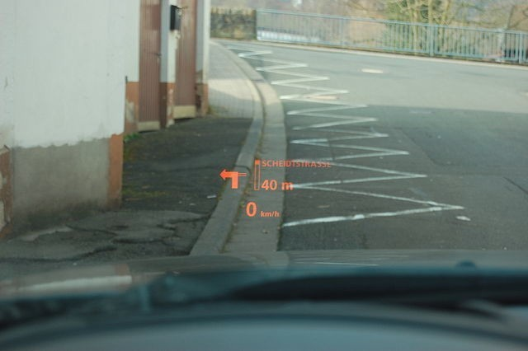
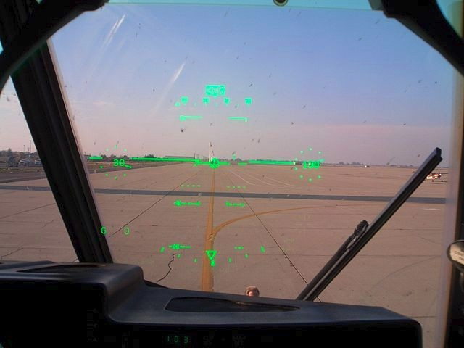
Heads-up displays (HUDs)
Image source (CC): https://en.wikipedia.org/wiki/Head-up_display#/media/File:E60hud.JPG
Image source (CC): https://en.wikipedia.org/.../File:C-130J_Co_Pilot%27s_Head-up_display.jpg
Mostly used in vehicles (car, airplane)
  Navigational information, speed, horizon etc.
  Not always spatially aligned (cf. left image)
  Uses beam combiner (windshield) + 2D display

Slide 13
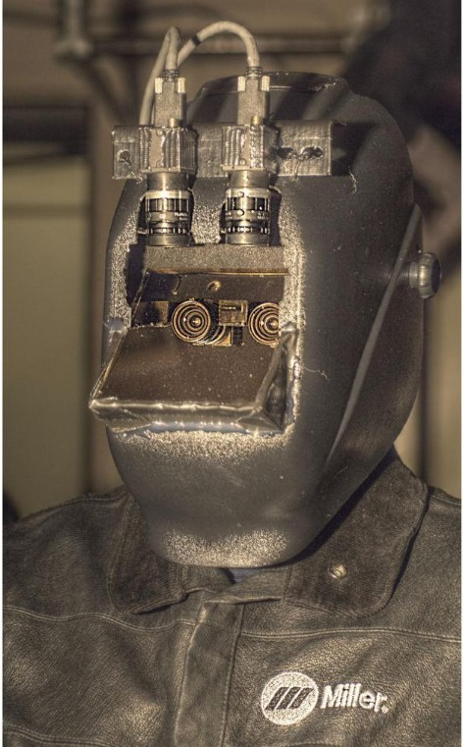
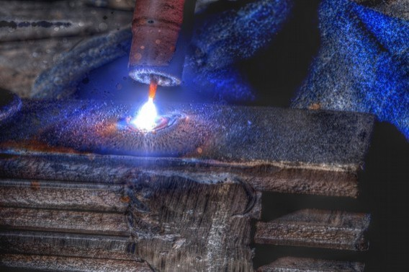
Augmented Diminished Reality?
Image source (FU): http://wearcam.org/mannventions-password-stefanosmannaz13/mannglas.htm
Not adding, but removing real-world content?
  Any plausible scenario?
→ HDR welding mask/goggles
  Filters out welding arc
  Other details remain visible

Slide 14
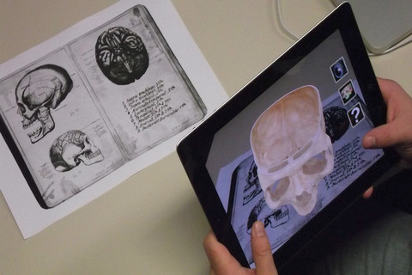
Mobile devices as AR displays
Image source (CC): https://en.wikipedia.org/.../File:App_iSkull,_an_augmented_human_skull.jpg
Uses “window into virtual world” metaphor
Usually no 3D display
  Except with tricks like Google Cardboard
  Parallax issues
Primary problem: location/tracking

Slide 15
AR: tracking & localization
Fundamental requirement for AR: stable & reliable head/view tracking
Multiple different approaches:
  GPS + IMU
  Vision-based
    Stereo/depth cameras
    SLAM algorithms

Slide 16
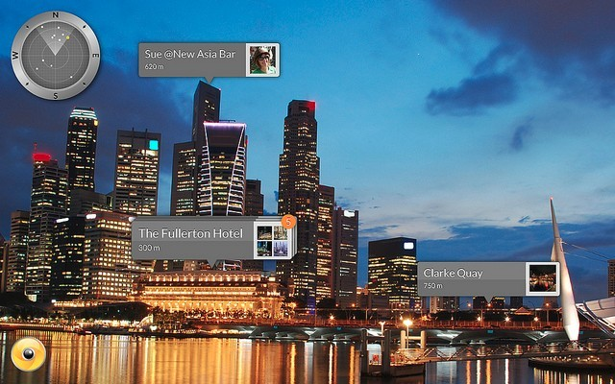
Tracking: GPS + IMU
Image source (CC): https://www.flickr.com/photos/wikitude/8280995004/
Sensor fusion for 6D pose (geo coordinates)
  3D position from GPS, 3D orientation from IMU
  (Relatively) low accuracy & position
  Requires additional environment information
Best suited for large- scale applications, e.g. buildings
Examples: Layar, Wikitude Browser

Slide 17
Tracking: vision-based
Primary goal (again): retrieve 6D pose
  Secondary goal: create environment map
  Enables interaction with environment
… using specialized hardware:
  Stereo cameras/depth cameras
  Google Project Tango (tablet with depth cam)
… for common devices (single RGB cam):
  Marker-based (fiducial/image)
  SLAM algorithms

Slide 18
Tracking: vision – stereo/depth
Core idea: each pixel provides color + distance
Stereo cameras: 2 cams mounted in parallel
  Replicate (part of) human depth perception
  Find stereo correspondences between 2 images
  Use camera/lens geometry to calculate distance
Depth cameras: single camera + emitter
  ToF – Time-of-flight: measure travel time of IR flash
  Structured light: shift in projected light pattern
Both methods require extra hardware!

Slide 19
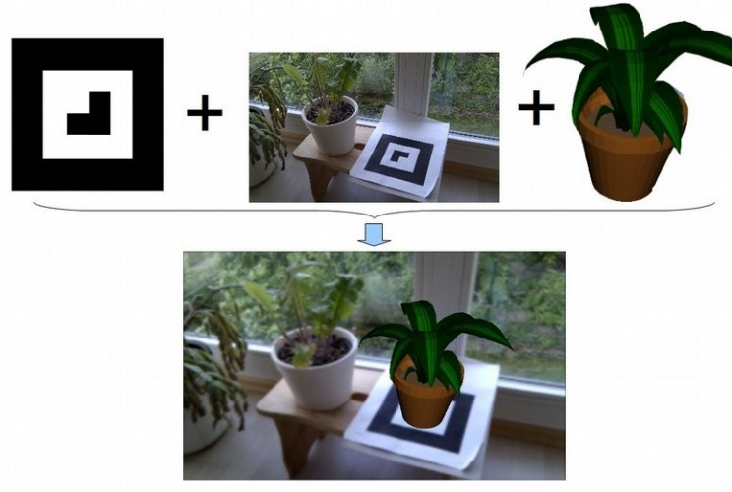
Tracking: vision – marker-based
Image source (FU): https://code.google.com/p/andar/
Image source (CC): https://en.wikipedia.org/.../File:App_iSkull,_an_augmented_human_skull.jpg
Core idea: use pre-defined markers/targets
  “Fiducials”: printed black-and-white patterns
  Image targets: use (flat) real-world objects
System detects pose relative to target

Slide 20
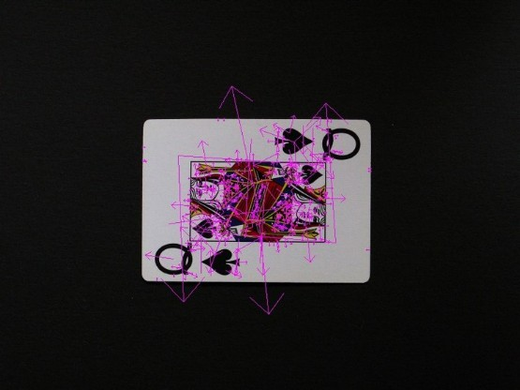
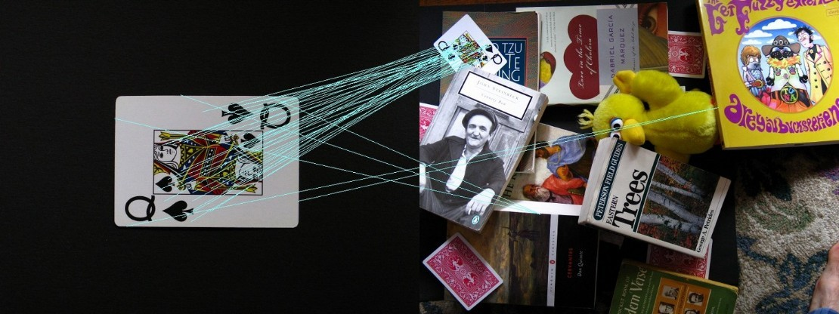
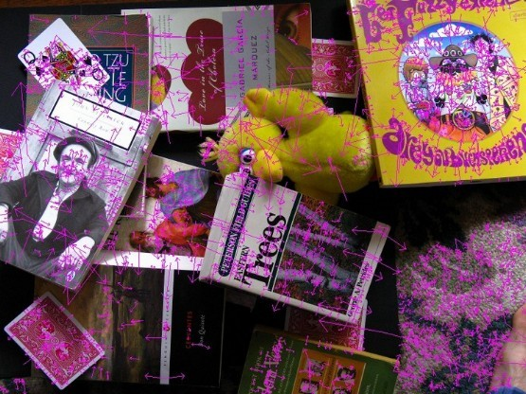
Marker-based tracking: SIFT & Co.
Image source (FU): https://robwhess.github.io/opensift/
SIFT = Scale Invariant Feature Transform
  Detects key points in images
  Describes them independent of size, rotation, …
  Descriptors can be matches across images → calculate geometric transformation

Slide 21
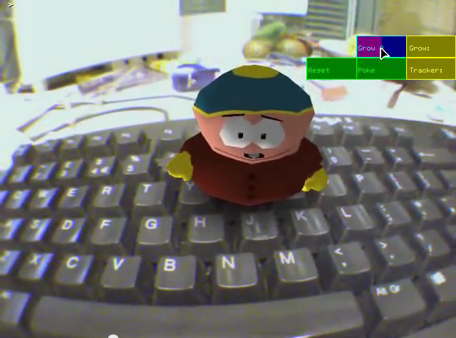
Tracking: vision – SLAM
Image source (FU): https://www.youtube.com/watch?v=F3s3M0mokNc
Simultaneous Localisation & Mapping
  Creates 3D environment map + 6D camera pose
  Requires only single camera
  Works on almost any device
  Creates stereo corres- pondences from motion
Requires significant processing power
  Possible on most recent smartphones

Slide 22
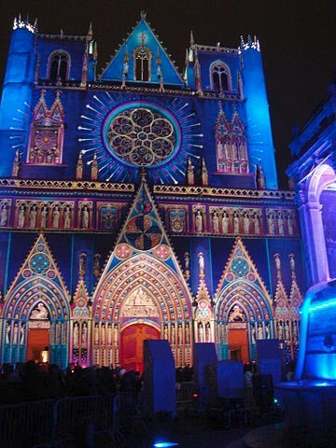
Spatial AR/Projection Mapping
Image source (CC): https://en.wikipedia.org/.../File:Cath._St_Jean_%282%29.JPG
Video source (FU): https://www.youtube.com/watch?v=KBx4RGoB6XI
Project augmentations directly onto real world
  Mostly static projector/camera setups until now
    E.g. for buildings, cars, other large objects
  Pico projectors → mobile use?
    Big problem (again): brightness vs. power supply
    Secondary issue: focus distance → laser projectors?
    Requires …
      accurate environment maps
      object tracking

Slide 23
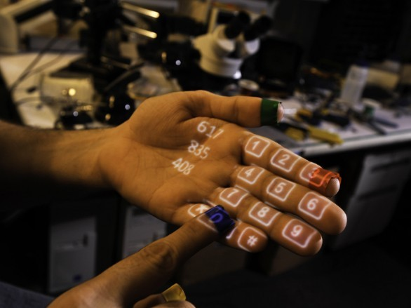
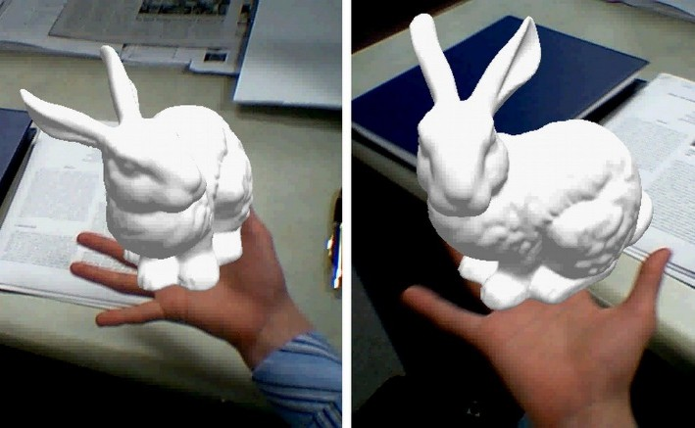
Interaction with AR
Image source (FU): http://www.pranavmistry.com/projects/sixthsense/
Image source (FU): http://ilab.cs.ucsb.edu/projects/taehee/HandyAR/
Touch screen, e.g. “Touch Projector”, Wikitude
  Not feasible with HMDs, only for handheld use
Individually tracked tools (e.g. Wiimote, gloves)
Optical recognition/tracking of hands

Slide 24
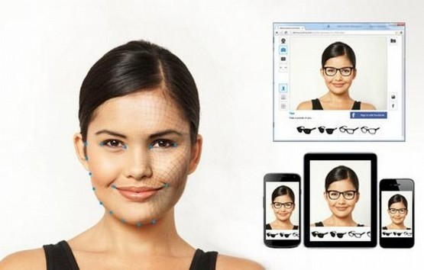
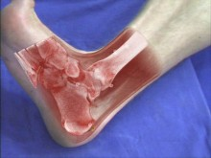
AR applications
Image source (FU): http://www.trylive.com/
Image source (FU): http://campar.in.tum.de/Chair/ResearchIssueMedAR
AR: still waiting for the “killer app”
  Advertisements →
    Ikea catalogue, fashion
  Military (sadly)
    Jet cockpits, weapon sights
  Medical →
  Education (e.g. iSkull, slide 17)
  Gaming (mostly casual games)
  Navigation (only prototypes)

Slide 25
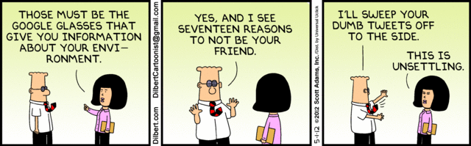
The End

