Slide 1
Mobile Information Systems
Lecture 02 – Big Issues
April 13th, 2016

Slide 2
Key issues of MIS (recap)
Limited power supply
Limited storage
Wireless communication channels
Limited/different I/O capabilities
Unpredictable usage context
Privacy & Security

Slide 3
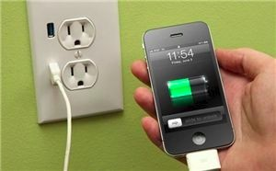
Key issue: power (1)
Image source (CC): https://www.flickr.com/photos/intelfreepress/10190082395/
Limited power supply
  Tradeoff: capacity ↔ size/weight/portability
  Energy consumption becomes important
Two possible solutions:
  Increase energy ↔ size/weight ratio
    Requires chemistry & physics knowledge
    Out of scope for this course :-)
  Decrease energy consumption
    Requires CS/EE knowledge
    In scope for this course

Slide 4
Key issue: power (2)
Biggest energy consumers (highest first):
  Display backlight
  Wireless modules (4G, 3G, WiFi, Bluetooth)
  GPS receiver, camera
  Sensors (touchscreen, accelerometer/IMU, …)
Energy-saving approaches:
  Whenever possible, disable unused subdevices
  Alternative: use lower polling frequency
  Look for possible tradeoffs, e.g. move computation-intensive tasks to cloud service

Slide 5
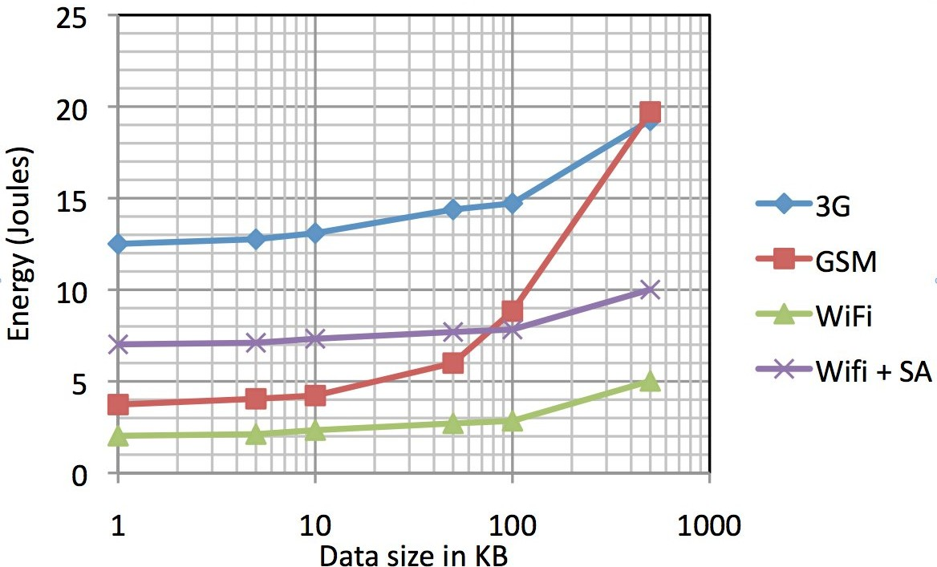
Energy demand of wireless transfers
Image source (FU): http://people.cs.umass.edu/~arun/papers/TailEnder.pdf
4G (est.)
(Scanning +
Association)

Slide 6
Key issue: storage (1)
Limited storage
  Standard is ~ 8 GB in entry-level smartphones
  Data (partially) stored in „cloud“ services
  Requires network connection for access
  Tradeoff: bandwidth ↔ storage
Reason: flash memory – why?
  Many related tradeoffs: price ↔ volume ↔ capacity ↔ power consumption

Slide 7
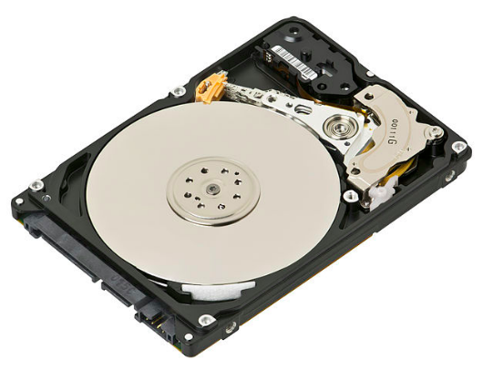
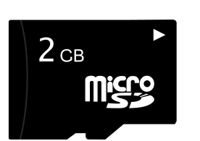
Key issue: storage (2)
Image source (CC): https://en.wikipedia.org/wiki/Hard_disk_drive#/media/File:Laptop-hard-drive-exposed.jpg
 | Hard disk | Flash memory
Price (2017) | ~ 25 € / TB | ~ 250 € / TB
Density | ~ 0.04 GB/mm³ | ~ 0.7 GB/mm³
Power consumption | ~ 1 W (idle), 2-3 W (operation) | ~ 0.1 W (idle), 1-2W (operation)
Typical capacity | ~ 4 TB | ~ 256 GB

Slide 8
Power/storage: summary
Primary tradeoff: size/weight ↔ capacity
Secondary tradeoffs:
  Power: conserve power, turn off consumers
  Storage: “outsourcing” to cloud service
    Increased traffic due to cloud communication may increase power consumption!

Slide 9
Key issue: wireless
Wireless communication
  Unpredictable availability & throughput
  Tradeoff: bandwidth ↔ energy consumption
  Media size growing faster than bandwidth (4K)
  Abrupt quality-of-service changes
  Round-trip-time (RTT) may be too high for interactive applications

Slide 10
Wireless basics
Basics of signal theory
Signal transmission & interference
Classification of wireless networks
ISO/OSI model, TCP/IP stack

Slide 11
Wireless basics: signal transmission
Transmitter
Cell
Transmission
region
Distance
Recognition
region
Interference
region

Slide 12
Wireless basics: signal theory (1)
Communication with electromagnetic waves
  Frequency ~ 0.5 – 5 GHz → no line-of-sight required
Channel capacity/throughput depends on:
  Channel bandwidth
    Given in MHz (e.g. 60 MHz for common UMTS bands)
    Limited by hardware/cost as well as regulations
  Modulation method
    Encodes data on the carrier wave (“center frequency”)
    Analog (AM/FM, known from radio) or digital (usually QAM, quadrature amplitude modulation)

Slide 13
Wireless basics: signal theory (1)
“white space”
Bandwidth
(whole band)
UMTS Band 1
(Americas)
PCS A-F
Uplink
PCS A-F
Downlink
Band
UMTS Band 2
(EMEA, Asia)
IMT
Uplink
IMT
Downlink
MHz
1800
1900
2000
2100
2200
Bandwidth
(channel)
Channel 1
…
Channel 2
Channel n
Channel n
Center frequency

Slide 14
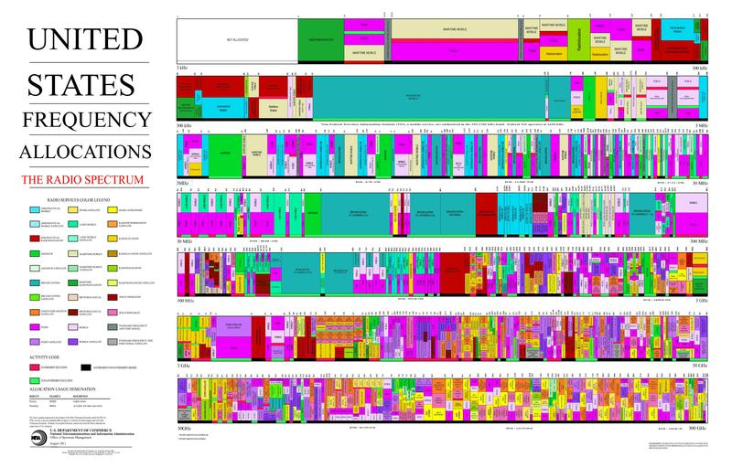
US Frequency Allocation Chart 2011
Image source (PD): https://en.wikipedia.org/...The_Radio_Spectrum.pdf

Slide 15
Wireless basics: signal theory (2)
Channel capacity/throughput (continued):
  Channel sharing (time/frequency slots)
    Multiple simultaneous transmissions on same frequency will cause interference (sometimes also on adjacent channels)
    Arbitration scheme required, either time-domain (round-robin) or frequency-domain (sub-channels)
  Signal-to-noise ratio (SNR) at receiver
    Signal: energy of the data I want to receive
    Noise: energy of everything else (thermal noise, other transmitters, cosmic radiation, …)

Slide 16
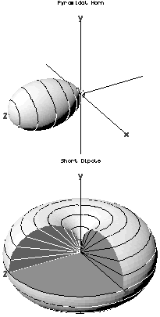
Wireless basics: antennas
Image source (PD): https://en.wikipedia.org/wiki/Radiation_pattern#/media/File:Radiation-patterns-v.png
Antennas: multiple characteristics
  Gain (~ efficiency)
  Radiation pattern (horn/dipole →)
Ideal omnidirectional antenna:
  Does not exist in reality
  Can be “simulated” through multiple real antennas
Antenna selection can help improve SNR

Slide 17
Wireless basics: negative effects (1)
Refraction
  Varying densities of the transmission media disrupt/redirect electromagnetic (EM) waves
Reflection
  Material smooth in the same size range as the EM wavelength (cf. RADAR dish, microwave oven door)
Absorption
  EM energy is absorbed by matter
Diffraction
  EM waves bend around small obstacles

Slide 18
Wireless basics: negative effects (2)
Interference
  Multiple transmitters on the same frequency band/ channel or reflections of a single transmitter
  Can lead to crosstalk and areas without signal
Multipath scattering
  Multiple different transmission paths between sender and receiver
  Can be used as advantage by MIMO systems with multiple antennas

Slide 19
Wireless basics: classification (1)
Wireless local area networks (WLAN)
  Replacement for wired LAN (e.g. Ethernet)
  802.11x protocol family (currently x = a/g/n/ac)
  up to ~ 800 Mbit/s (in theory), 20-50 m indoor range
Wireless personal area networks (WPAN)
  Short-range communication between peripherals
  2-10 m range, ~ 3 Mbit/s, Bluetooth protocol family
WiGig (802.11ad)
  WLAN in 60 GHz band → very high data rate (up to DisplayPort), but needs line-of-sight, low range

Slide 20
Wireless basics: classification (2)
Cellular networks (WWAN, … wide area …)
  Terrain-based – 2G (GSM), 3G (UMTS), 4G (LTE)
  Satellite-based – Globalstar, Iridium
  Asymmetric bandwidth allocation (mostly downstream, to device)
Mesh networks
  No central access point, peer-to-peer network
  Used for low-power sensors, “Freifunk” networks
  Can be based on WLAN, Bluetooth, Zigbee, …

Slide 21
Wireless basics: ISM bands
ISM = Industrial/Scientific/Medical
  Bands designated for unlicensed use, commonly 434 MHz/915 MHz (US/EMEA), 2.45 GHz, 5.8 GHz
Any equipment may transmit on these bands:
  Microwave ovens (commonly 2.4 GHz)
  Industrial processes (e.g. plastic welding)
  Tumor treatment (also with microwaves)
Also allowed for communications devices
  E.g. WLAN & Bluetooth in 2.45 GHz band, must be able to deal with ISM device interference

Slide 22
Wireless basics: ISO/OSI model
Device A
Device B
Application
Application
Presentation
Presentation
Session
Session
Transport
Transport
Network
Network
Data Link
Data Link
Physical
Physical

Slide 23
Wireless basics: TCP/IP stack
Application
Layer
SSH
HTTP
SMTP
RTSP,
SIP
DNS
Transport Layer Security (TLS, f.k.a. SSL)
Transport
Layer
Transmission Control
Protocol (TCP)
User Datagram
Protocol (UDP)
Internet
Layer
Internet Protocol (IP),
Internet Control Message Protocol (ICMP)
Link
Layer
WLAN
Blue-
tooth
2/3/4G
Ether-
net
DSL,
Cable

Slide 24
Recap: network stack protocols
Layered protocols → nested data packets
Packets consist of header + payload
Payload of protocol 1 = packet of protocol 2
PHY
LLC
IP
TCP
TLS
HTTP
actual payload data

Slide 25
Wireless: summary
Many physical issues (refraction, absorption, antenna geometry, power limits …)
Wireless spectrum is highly contested
  Many sources of interference
  Limited bandwidth available
Complex interleaved HW/SW stack

Slide 26
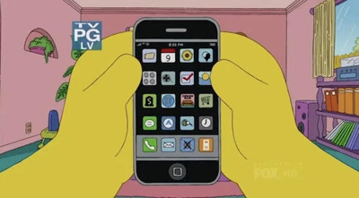
Key issue: I/O
Image source (FU): The Simpsons (S21E11), Fox Broadcasting Company
Different I/O capabilities
  Small screens, often no physical keyboard
  Text entry/precision work much slower (“Fat finger problem”)
  Less room for displaying data (cf. InfoVis)
  Use other channels …
    For input: touch, gestures, motion, camera, location, …
    For output: vibration, sound, speech, notification LED, …
  Tradeoff: size/weight ↔ I/O features?

Slide 27
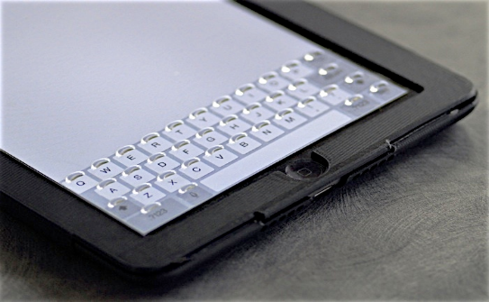
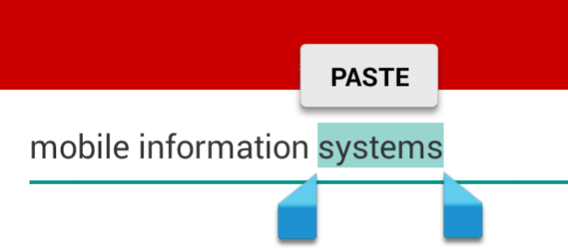
I/O issues: touch (1)
Image source (FU): http://tactustechnology.com/wp-content/uploads/2014/08/White-Paper-New-Tagged-PDF.pdf
No haptic feedback (unlike keyboards)
  “Phorm” overlay by Tactus
Occlusion
  Hand/fingers covers part of display
  Choose suitable screen layout in advance
Precision
  finger hits multiple pixels at once & covers target
  Use handles, menus with offset

Slide 28
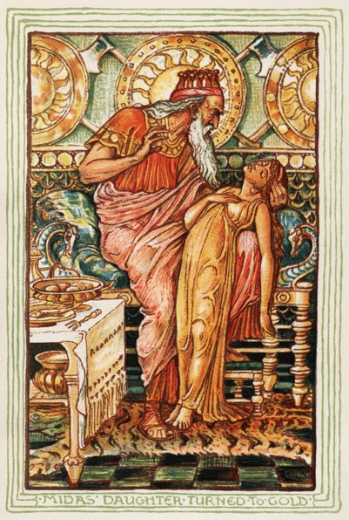
I/O issues: touch (2)
Image source (PD): https://en.wikipedia.org/wiki/Midas#/media/File:Midas_gold2.jpg
No “hover” state (unlike mouse)
  Every touch immediately triggers an action
  “Midas Touch Problem”
    Everything touched turns to gold
    Problems with food, relatives etc.
  Also in eye-tracking
  (Partial) solution: wait with action until touch lifted off

Slide 29
I/O issues: gestures
Discoverability
  How do I know which gestures are available?
  Even more difficult for complex gestures
“Natural” interaction
  What's a natural gesture?
  Strong personal & cultural preferences
No standards
  E.g. tap-and-hold, swipe, double tap can have very different meanings depending on app/OS
  Exception: pinch-zoom

Slide 30
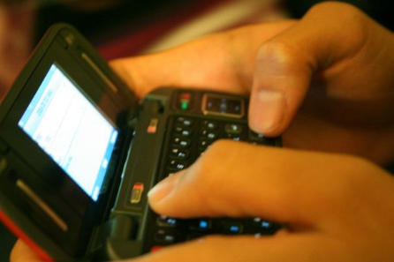
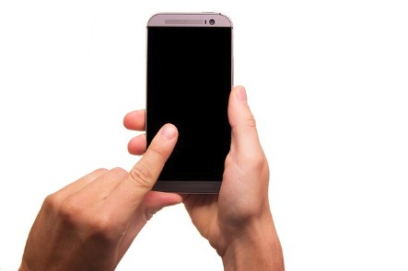
I/O issues: bimanual interaction
Image source (CC): https://en.wikipedia.org/wiki/Text_messaging#/media/File:Texting.jpg
Symmetric
  Both hands have same role, e.g. typing with both thumbs
Asymmetric
  Hands have different roles, e.g. one hand holds device, other hand types
Often not possible:
  One hand may be required for other tasks
  Thumb-only usage sometimes difficult

Slide 31
I/O issues: speech
Speech input
  Mostly used for hands-free dialing (in car)
  Siri, Cortana, Google Now: more complex speech recognition offloaded to cloud service
  Apparently not widely used (have you ever seen someone talk to Siri like in the commercial?)
Speech output
  Mostly used for car navigation
  Again, not widely used otherwise
Cultural differences (e.g. US vs. Europe)?

Slide 32
I/O issues: motion
Motion as output
  Mostly vibration alerts (binary channel)
  Moving/shape-changing phones exist as concepts (cf. http://www.fabianhemmert.com/projects)
Motion as input
  Accelerometer, inertial measurement unit (IMU)
  Can only sense relative position, not absolute
  Needs combination with GPS, marker tracking, …
  Sensitive to interference (magnetic fields)
  Use secondary device, e.g. smartwatch?

Slide 33
I/O issues: vision
Vision as input (camera)
  Input of barcodes/QR codes, text recognition (OCR), 3D structure reconstruction (SLAM)
  Computer vision needs to deal with wildly different lighting conditions (indoor/outdoor)
Vision as output: display
  Size/resolution: very high information density, suitable information visualization required
  Brightness/contrast: readable in sunlight?
Combination: augmented reality

Slide 34
I/O issues: other channels
Bio sensors
  Fingerprint, heart rate, skin conductivity
  Privacy issues?
Miscellaneous
  Back-of-device touch sensors
  Notification LEDs and sounds
  Location sensors (GPS etc.)
  Buttons
Spoilt for choice? Too “exotic” for user?

Slide 35
I/O: summary
Wide variety of very different I/O channels
  Primary: touch input, visual output
  Secondary: motion, camera, audio, …
Not necessarily limited by size, other tradeoffs (e.g. features ↔ learning curve)

Slide 36
Key issue: context
Unpredictable usage context
  Environment
  Location/position
  Social context
  Activity context
  Context recognition?

Slide 37
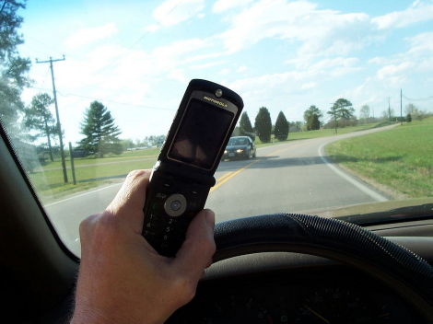
Context: environment
Image source (CC): https://en.wikipedia.org/.../File:Cell_phone_use_while_driving.jpg
Motion
  User moving on her/his own
  User being moved (bus, car)?
Sound
  Noisy or quiet?
  Should remain quiet (concert)?
Light
  Bright or dark?
  Should remain dark (movie theatre)?

Slide 38
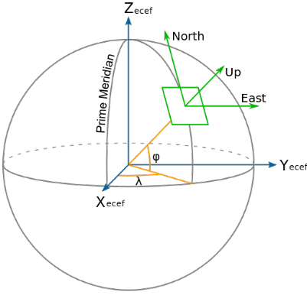
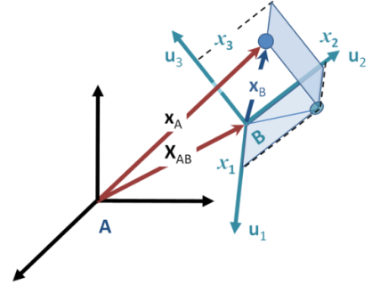
Context: geometric
Image source (CC): ECEF_ENU_Longitude_Latitude_relationships.svg, Moving_coordinate_system.PNG
Geographic context
  Moves with the user
  Absolute location (~ 3DOF)
  Use GPS/compass
User/device context
  Moves relative to the user
  Relative location/orientation (6DOF)
  Often more difficult to determine
  Higher precision required?

Slide 39
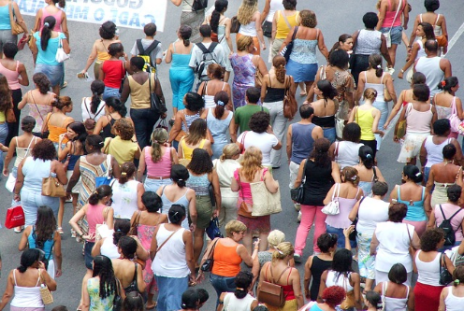
Context: social
Image source (CC0): http://pixabay.com/p-193357/?no_redirect
Expected user base?
  “Techies”, grannies, “normal” users, …
Acceptable behaviour?
  Depends on location: subway car or church?
  Talking loudly, taking pictures, …
Privacy
  “Shoulder surfers” snooping on passwords
  Temporary sharing with other persons (e.g. map)

Slide 40
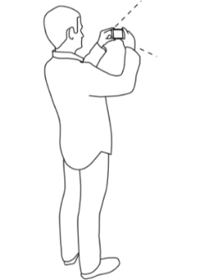
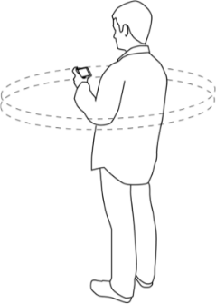
Context: activities
Image source (FU): LMU lecture by J. Wagner
Physical activities of the user
  Walking, standing, sitting at a table, …
  Influences available precision & attention
“Virtual” activities
  Taking pictures, looking at maps, using social networks, reading website, …
  Quick access to related activities
Seamless context switching?
  Continuing activities in different context, e.g. on desktop computer?

Slide 41

Context: recognition
Image source (FU): http://www.gettyimages.com/gi-resources/ub/unfinishedbusiness/index.html
Example: automatic meeting detection
→ Disable audible notifications, send all calls to voicemail
Problem: what if it fails?
  False positive: user misses important call
  False negative: phone plays embarrassing ringtone in meeting
Must be very, very accurate to earn user trust

Slide 42
Key issue: security/privacy (1)
Huge amounts of private & personal data on mobile devices
  Contact information, messages & e-mails
  Visited websites, pictures
  PIN/TAN codes
Many people want access to that data
  Google, Facebook, Microsoft (for selling ads)
  NSA, GCHQ, BND etc. (for catching criminals)
  Hackers (for stealing/extorting your money)

Slide 43
Key issue: security/privacy (2)
Problem 1: no pervasive encryption
  Strong opposition from government snoopers (up to demanding “key escrow”, cf. WhatsApp)
  Lost/found phones often trivial to access
Problem 2: voluntary use of cloud services
  Reasons discussed earlier (storage, processing)
  Requires trusting at least one, usually several 3rd parties (outsourcing)

Slide 44
Context: summary
Very broad range of possible usage contexts
  Consequently, automatic classification is hard
  Influence on possible/allowed user actions
Related issues: safety, privacy, security

Slide 45
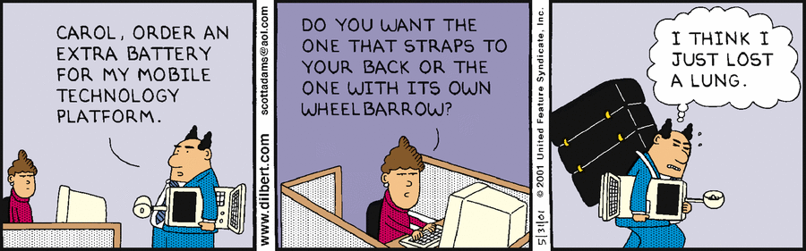
The End

