Slide 1
Mobile Information Systems
Lecture 03:
Location & Networks
April 21st, 2016

Slide 2
Networks: Overview
Basics (continued)
  Multiplexing, multiple access methods
Examples
  Bluetooth (WPAN)
  802.11x WiFi (WLAN)
  GSM/UMTS/LTE (WWAN)

Slide 3
Networks: multiplexing
RF spectrum is a precious shared resource (see US frequency allocation chart)
Allocated band has to be shared among many different transmitters without interference → requires multiple access method

Slide 4
Networks: multiple access (1)
Time-division multiple access (TDMA)
  Static: “timeslots”
    One single transmitter active per slot
    Requires clock synchronization in advance
  Dynamic: carrier-sense multiple access/collision avoidance (CSMA/CD)
    Listen if channel idle, then transmit (carrier sense)
    (Optional) Request to send/clear to send (RTS/CTS) → “hidden node problem” (X ↔ Ap ↔ Y)
    Transmit and wait for acknowledgement (collision detection during transmission almost impossible)

Slide 5
Networks: “hidden node problem”
Nodes X and Y can communicate with AP
X/Y cannot receive each others’ transmissions
If both transmit simultaneously:
→ Collision/Interference
→ AP receives garbage
Solution: Nodes “request
to send”, AP gives “clear
to send” (drawback?)
Y
X
AP

Slide 6
Networks: multiple access (2)
Frequency-division multiple access (FDMA)
  Simplest case: one frequency slot per transmission → receiver must be able to cover multiple slots
  Complex variant: OFDMA (orthogonal …) in 4G
    Simultaneous transmission of multiple low-bandwidth signals on “orthogonal” sub-channels
  WDMA (wavelength …) → different light colours in optical fibre

Slide 7
Networks: multiple access (3)
Code-division multiple access (CDMA)
  Spread-spectrum method: uses wider spectrum than required for actual signal bandwidth
  Multiple different modulation codes → allow separation of signals on same carrier
    Frequency-hopping spread spectrum (FHSS) → code is pseudo-random sub-channel sequence
    Direct-sequence spread spectrum (DSSS) → code is high-rate pseudo-random bit sequence

Slide 8
Networks: multiple access (4)
frequency
CDMA
FDMA
T6
T6
T6
T7
T8
T9
T5
T4
T4
T1
T2
T3
T1
T2
T3
…
time
TDMA
Assumption: transmitters T1 – T9, all using same signal bandwidth

Slide 9
Networks: summary
Wireless networks need multiple access method
  Timeslot-based: TDMA
  Frequency-based: FDMA
  Encoding-based: CDMA
Mostly on lowest two levels of ISO/OSI model

Slide 10
Standards: ISO/OSI model
(8)
User
7
Application
Bluetooth
6
Presentation
UMTS (3G)
5
Session
4
Transport
3
Network
2
Data Link
WiFi (802.11x)
1
Physical

Slide 11

Standards: (1)
Wireless personal area network (WPAN)
Complex protocol stack across all layers
Current specification (v4.0): ~ 2300 pages (!)
Air interface:
  2.4 GHz ISM band, up to 3 Mbit/s data rate
  80 channels á 1 MHz (or 40 * 2 MHz)
  Adaptive frequency hopping (AFH), also known as frequency-hopping spread spectrum (FHSS)

Slide 12
Standards: (2)
Two incompatible sub-specifications:
  “Classic” Bluetooth
    Used by headsets, mice, keyboards, …
  Bluetooth Low Energy (BTLE/BLE)
    Used by sensors, wearables, …
Devices can support one or both standards
  Most mobiles & laptops since ~ 2011 support both

Slide 13
Standards: (3)
7
Audio
vCal/vCard
Network
Management
6
OBEX
PPP/BNEP
SDP
Con-
trol
5
RFCOMM
4
Audio
Link manager
3
Link management
2
Baseband
1
Radio

Slide 14

Standards: (1)
Wireless local area network
Based on 802.11x standards family
Also in 2.4 and 5 GHz ISM band
  Interference with Bluetooth possible
  Minimized with BT/WiFi integrated transceivers
  WiFi can be used as high-speed data link layer for Bluetooth connections
Data rates of up to ~ 780 MBit (in theory), in real-world scenarios up to ~ 100 MBit

Slide 15
Standards: (2)
Only 2 lowest ISO/OSI layers
  Physical layer: modulation & channel access
    CSMA/CA, DSSS or OFDM, depending on sub-standard, optionally + MIMO
  Data link layer: management, e.g.
    Announcement of SSID (Service Set ID = network name)
    Roaming between access points
    Encryption/authentication
Many well-separated sub-standards → easier to implement than Bluetooth

Slide 16
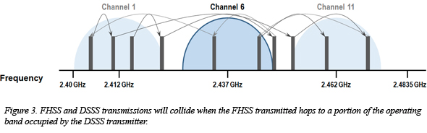
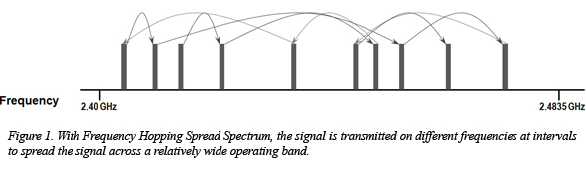
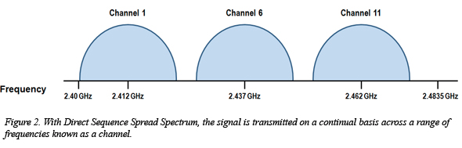
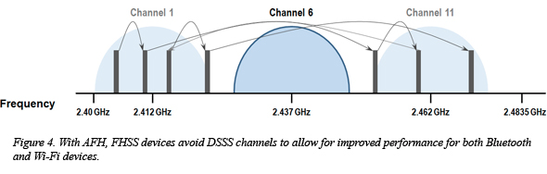
Standards: vs.
Source (FU): http://www.ecnmag.com/article/2012/03/wi-fi-and-bluetooth-coexistence
Same frequency band (2.4 GHz)
Different modulation scheme (DSSS vs. FHSS)

Slide 17
Standards: 1,2,3,4,5G
Wireless wide area networks
History: one generation every ~ 10 years
  1G – “C-Netz” (1985 – 2000): analog, FDMA, 9.6 kBit
  2G – GSM (1991 – now): digital, TDMA, ~ 200 kBit
    2015: phase-out beginning in some countries
  3G – UMTS (1998 – now): digital, CDMA, ~ 20 MBit
    Hybrid circuit-switched and packet-switched network
  4G – LTE (2009 – now): digital, OFDMA, ~ 300 MBit
    Purely IP-based, backend network less complex
  5G – plannning phase (2020 - ?)

Slide 18
Standards: UMTS
Current de-facto WWAN standard
Slowly being supplemented by LTE
Very complex hybrid between:
  circuit-switched (~ old telephone network)
  packet-switched (~ IP-based network)
Most functionality/complexity hidden from user
  Encapsulated in “baseband” module
  Separate firmware/OS, processor, memory
  Security/privacy issues? Nobody knows…

Slide 19




Standards: UMTS network schema
Base Station
Subsystem
UMTS devices
Core Network
Administration
Radio Cell 1
Bridge to
other
networks
Conventional
Telephone network
connection
Radio Cell 2
Radio Cell 3
Various
Location
Registers
Home
Location
Register
Base Station
Controller
Signa-
lization
Antenna
Speech
Node B
RNC
Mobile
Switching
Center
MSC
SCP
SOG
BG
Base
Transceiver
Station (BTS,
Base Station)
Radio
Network
Controller
Visitors
Location
Register
ILR
AUC
EIR
SMSC
Service
Control
Point
Service
Order
Gateway
Billing
Gateway
Speech or data channel
Data channels
SGSN
GGSN
Internet

Slide 20
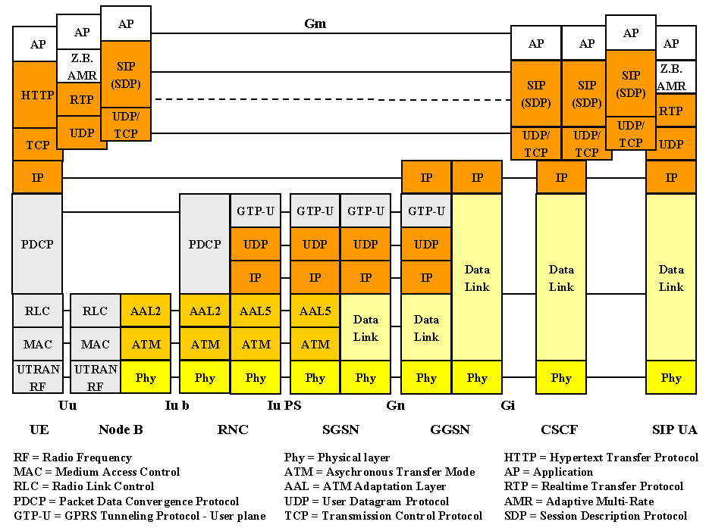
Standards: UMTS protocol stack
Source (FU): http://www.e-technik.org/aufsaetze_vortraege/aufsaetze/trick_itg_mobilfunk_6_03.pdf
Accessible
to user/
mobile OS
Hidden in
“baseband”
module

Slide 21
Standards: Summary
Big “families” of wireless standards
  WPAN: Bluetooth (all 7 ISO/OSI layers → complex)
  WLAN: 802.11x (only lowest 2 layers)
  WWAN: UMTS & LTE (also highly complex)
Sometimes overlap/interference between different sub-standards

Slide 22
Location: Overview
Objects & usage scenarios
Classes of location information
Location determination
  Satellite-based
  Network-based

Slide 23
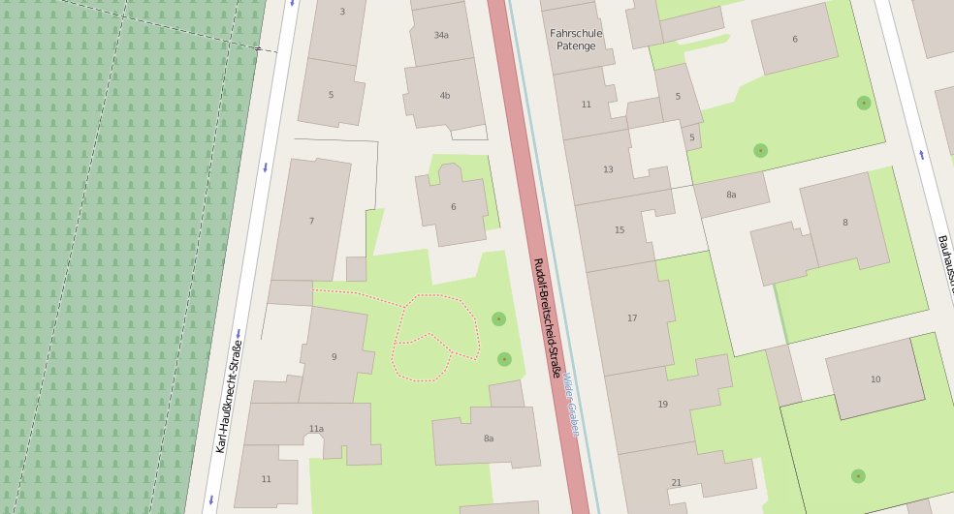

Where am I?
Image source (ODbL): http://www.openstreetmap.org/export#map=19/50.97309/11.32747

Slide 24
Location: Objects & Usage
I want to know the location of …
  myself (i.e. my own mobile device)
  a static object (e.g. a building, a network server)
  a moving object (e.g. vehicle, other mobile device)
  some combination of the above
I need it for …
  location-based services (e.g. nearest restaurants)
  data delivery (network route to device)
  navigation (physical route to target)

Slide 25
Location: Classes (1)
Geographic (latitude, longitude) – given in:
  Degrees, hours, minutes, seconds (outdated)
  Fraction of degrees (N 50.972921, W 11.326795)
Topological (street address)
  Many levels of detail possible
  Europe, Germany, Weimar, Karl-Haußknecht-Str. 7
Cell-based (ID of network cell)
  MAC address & SSID of WLAN access point
  ID number of current cell tower

Slide 26
Location: Classes (2)
Mapping between classes:
  Topological → geographic: “geocoding”
    E.g. map view: finding coordinates for street address
    Usually graph database augmented with coordinates
  Geographic → topological: “reverse geocoding”
    “What address am I currently at?”
    Requires “spatial index” on database → other lecture
  Cell ID → geographic/topological
    Needs separate DB containing coordinates/addresses for access points & cell towers

Slide 27
Location: Methods
Several types of “location providers” available in modern mobile devices
Tradeoff: Accuracy ↔ battery consumption
Method | Pro | Contra
Satellites | + Very accurate (~ 1 m) | - Works only outside - High power draw
WLAN cells | + Lower power draw | - less accurate (~ 10 m)
Cell towers | + No (additional) power draw | - quite inaccurate (~ 100 – 1000 m)

Slide 28
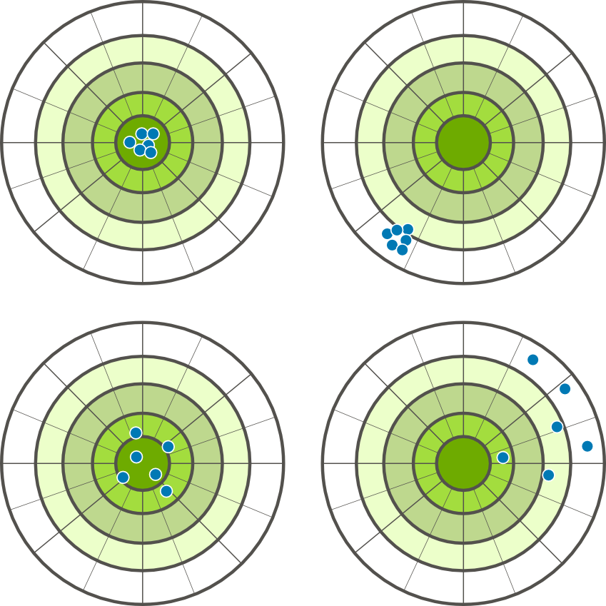
Location: Terminology
Precision and accuracy
High accuracy
Low accuracy (systematic error)
High precision
Low precision (reproduction error)

Slide 29
Location: GPS (satellite-based)
3 major satellite-based location systems:
  GPS (USA), GLONASS (RU), Galileo (EU)
Following slides refer to GPS
  Based on signal time-of-flight (TOF)
  Very similar concepts for GLONASS/Galileo
Most modern mobile devices support at least GPS & GLONASS (Galileo not yet completed)

Slide 30


Location: GPS, simplified
Measure signal runtime
Calculate distance to satellite
Intersect resulting circles (spheres)
0.05sec
A
0.04sec

Slide 31
Location: GPS, simplified (2)
Problem: imprecise receiver clock
0.055sec
0.05sec
0.045sec
A
0.04sec
B

Slide 32
Location: GPS, simplified (3)
Solution: use more satellites
0.055sec
0.05sec
0.045sec
0.04sec
0.035sec
0.03sec

Slide 33
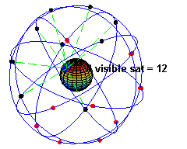
Location: GPS – facts
Image source (PD): https://en.wikipedia.org/wiki/Global_Positioning_System#/media/File:ConstellationGPS.gif
32 satellites in operation, altitude ~ 20 000 km
Equipped with high-precision atomic clocks (relativity!)
At least 4 visible satellites required for position fix, usually 8 – 9 for any given point
Position calculated using time difference of arrival (TDOA) instead of time of arrival (TOA) → no precision clock in receiver required

Slide 34
Location: GPS – facts (2)
Signal characteristics:
  Coarse/Acquisition (C/A) and Precision (P) code
  Frequency bands 1575.42 MHz & 1227.60 MHz, effective bitrate 50 bits/second
  Very low signal-to-noise-ratio (SNR) due to distance
Contents of signal data:
  Satellite clock & orbital data (“ephemeris”), required for position calculation
  Constellation data (“almanac”), used to quickly “lock” onto satellite signal + improve precision

Slide 35
Location: GPS – extensions
“Assisted” GPS (aGPS)
  Almanac can be “side-loaded” via data connection
  Improves time to first fix (TTFF) & precision
Differential GPS
  Add one or more stationary receivers
  Use known position offset to improve accuracy of moving receivers

Slide 36
Location: GPS pro & contra
Advantages
  High accuracy, available all over the world
  (Mostly) independent of external factors (weather)
Disadvantages
  Direct „line of sight“ to the satellites required
  Cold start can be very slow (several minutes)
  Running the system is expensive → ultimately still under military control, speed/altitude restrictions
  Civilian access can be degraded/turned off at any time (“Selective Availability” error until 2000)

Slide 37
Location: GPS - summary
Based on TDOA measurements to satellites
Very precise, but high power draw & line-of-sight required
Under military control; Precision code not available to civilians

Slide 38
Location: cell-based
Basic idea:
  Determine unique IDs of available network cells
    WLAN: MAC address & SSID (network name)
    WWAN: cell tower ID number
  Use database to lookup coordinates of cells
Depends on:
  Database availability & quality
  Cell size & shape
  Signal quality

Slide 39
Location: cell-based – structure
Cell shape: circular (theory), hexagonal (planning), irregular (reality)
Neighbouring cells use different frequencies to minimize interference
Some cell overlap inevitable
Cell sizes:
  WiFi: 10 m – 100 m
  3G (UMTS): 100 m – 5 km
  2G (GSM): 100 m – 35 km
F1
F2
F3
F1
F4
F1
F3
F2

Slide 40
Location: cell-based – parameters
Commonly used:
  Currently used/logged-in cell
  Cell sector (mostly for GSM/UMTS)
  Other available cells
Rarely used (why?):
  Signal strength
  Angle of arrival
  Time difference, round-trip time

Slide 41
Location: cell-based – example
Image source (ODbL): http://www.openstreetmap.org/export#map=19/50.97309/11.32747
Cell 1

Slide 42
Location: cell-based – example
Image source (ODbL): http://www.openstreetmap.org/export#map=19/50.97309/11.32747
Cell 1
Cell 2

Slide 43
Location: cell-based – example
Image source (ODbL): http://www.openstreetmap.org/export#map=19/50.97309/11.32747
Cell 1
Cell 2

Slide 44
Location: cell-based – issues
~ 99% of queries use Google location database
  access is logged → used to improve DB, but raises privacy issues
  Alternatives (less coverage & accuracy):
    OpenCellID
    Mozilla Location DB
Not available when offline, cell DB too large
WLAN cells can move/change quickly → frequent updates required

Slide 45
Location: cell-based - Summary
Less precise than GPS, but less power draw
Quality depends mostly on …
  Cell size & shape
  Database coverage & access
Privacy issues?

Slide 46
Location & networks?
Network location: used to route calls or data
Not the same as physical location, but correlated (very similar to cell-based location)
Examples:
  ID of target cell (i.e. cell tower)
  IP address of WLAN router/access point
Problem: network location needs to be found for other devices in order to contact them
Broadcast/multicast far too inefficient

Slide 47
Location registers in UMTS (1)
Each network has one or more home location registers (HLR)
  Devices are statically assigned to one HLR, based on phone number or purchase location
  Current location is stored as target VLR
Each mobile switching center (MSC) for a region has a visitor location register (VLR)
  Stores information on devices currently registered with this MSC
  Location is stored as currently used cell

Slide 48
Location registers in UMTS (2)
Base Station
Subsystem
UMTS devices
Core Network
Administration
Radio Cell 1
Bridge to
other
networks
Conventional
Telephone network
connection
Radio Cell 2
Radio Cell 3
Various
Location
Registers
Home
Location
Register
Base Station
Controller
Signa-
lization
Antenna
Speech
Node B
RNC
Mobile
Switching
Center
MSC
SCP
SOG
BG
Base
Transceiver
Station (BTS,
Base Station)
Radio
Network
Controller
Visitors
Location
Register
ILR
AUC
EIR
SMSC
Service
Control
Point
Service
Order
Gateway
Billing
Gateway
Speech or data channel
Data channels
SGSN
GGSN
Internet

Slide 49
Location registers in UMTS (3)
Connection request:
  First, attempt to look up target in VLR (e.g. in same city)
  If target not found, contact HLR
Goal: reduce load on HLRs
  Many connection requests within same area → queries can be answered by VLR
  Updates in HLR only required when roaming to different MSC, other updates locally in VLR

Slide 50
Network: mobile IP communication
Problem: IP relies on (mostly) static routes
IP address has two purposes:
  Host identification
  Routing/location information
Mobile devices can move to different subnets → ID stays same, location changes
Not a big problem for WLANs (… local area …)
… but for WWANs (impossible to put all devices into same subnet)

Slide 51
Network: mobile IP communication
F, G, I → G
* → D
F
A
B
E
F → F
I,H → I
* → E
A, B → A
* → D
D
H, I → H
* → E
G
C
H
I
Target: F

Slide 52
Network: mobile IP communication
Solution: assign static care-of address
  Separates identity from routing information
Care-of address is …
  A valid IP address with static routing
  Assigned to a stationary router
  Used to communicate with mobile device
Router acts as proxy
  forwards data within the core network
  e.g. using information from VLR

Slide 53
Location & Networks: Summary
Network location != physical location
UMTS: uses various location registers
IP network address for identity and routing → Needs internal separation, care-of address

Slide 54
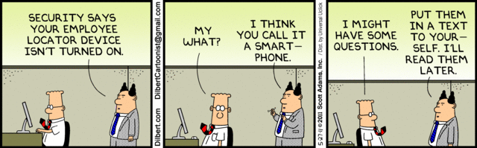
The End

Slide 55
Location: Questions
How can the system locate users/devices?
  Is permanent tracking a solution?
  … if not, what are the alternatives?
Solution depends on application profile:
  Are devices usually stationary, or are they moving constantly?
  How often is the location information used?

Slide 56
Basic solution
Degrees of freedom
Dev. | Cell
u | 13
v | 15
w | M
x | → B
y | → C
z | → C
A
D | C
u | 13
v | 15
w | M
D | C
x | → E
Introduction Dimensions Basic Solution Optimizations RW-Approaches
D | C
y | 7
z | 9
B
C
D
D | C
x | 2
D | C
y | 7
E
F
G
H
I
J
K
L
M
Access points
1
2
3
4
5
6
7
8
9
10
11
12
13
14
15
16
17
18
Mobile devices
x
y
z
u
v
w

Slide 57
Open Questions
Which nodes should store location information?
  Range: All / everywhere … Nothing
Which information should be stored?
  Path references vs. absolute addresses
How detailed should the stored information be?
  For communication: Access point
  For location-based services: more detailed location information
  Details vs. “Speed” - e.g. paging of device in multiple cells may be slow
Introduction Dimensions Basic Solution Optimizations RW-Approaches

Slide 58
Example – Search 1
Dev. | Cell
u | 13
v | 15
w | M
x | → B
y | → C
z | → C
y searches for z
Total: 3 queries
A
D | C
u | 13
v | 15
w | M
D | C
x | → E
Introduction Dimensions Basic Solution Optimizations RW-Approaches
D | C
y | 7
z | 9
B
C
D
D | C
x | 2
D | C
y | 7
E
F
G
H
I
J
K
L
M
Access points
1
2
3
4
5
6
7
8
9
10
11
12
13
14
15
16
17
18
Mobile devices
x
y
z
u
v
w

Slide 59
Example – Search 2
Dev. | Cell
u | 13
v | 15
w | M
x | → B
y | → C
z | → C
y searches for x
Total: 6 queries
A
D | C
u | 13
v | 15
w | M
D | C
x | → E
Introduction Dimensions Basic Solution Optimizations RW-Approaches
D | C
y | 7
z | 9
B
C
D
D | C
x | 2
D | C
y | 7
E
F
G
H
I
J
K
L
M
Access points
1
2
3
4
5
6
7
8
9
10
11
12
13
14
15
16
17
18
Mobile devices
x
y
z
u
v
w

Slide 60
Example – Search 3
Dev. | Cell
u | 13
v | 15
w | M
x | → B
y | → C
z | → C
y searches for w
Total: 4 queries + 2 page ops
A
D | C
u | 13
v | 15
w | M
D | C
x | → E
Introduction Dimensions Basic Solution Optimizations RW-Approaches
D | C
y | 7
z | 9
B
C
D
D | C
x | 2
D | C
y | 7
E
F
G
H
I
J
K
L
M
Access points
1
2
3
4
5
6
7
8
9
10
11
12
13
14
15
16
17
18
Mobile devices
x
y
z
u
v
w

Slide 61
Intermediate Conclusions (Search)
If inner nodes contain direct address information, a search has to look up all nodes up to the first shared (indirect) parent node.
If inner nodes contain forwarding information only, a search has to look up all nodes on the whole path.
Introduction Dimensions Basic Solution Optimizations RW-Approaches
Notes:
- First shared (indirect) parent node == lowest common ancestor

Slide 62
Example – Update 1
Dev. | Cell
u | 13
v | 15
w | M
x | → B
y | → C
z | → C
x moves from 2 to 3
Total: 2 DB updates
A
D | C
u | 13
v | 15
w | M
D | C
x | → F
Introduction Dimensions Basic Solution Optimizations RW-Approaches
D | C
y | 7
z | 9
B
C
D
D | C
x | 2
D | C
y | 7
E
F
G
H
I
J
K
L
M
Access points
1
2
3
4
5
6
7
8
9
10
11
12
13
14
15
16
17
18
Mobile devices
x → x
y
z
u
v
w

Slide 63
Example – Update 2
Dev. | Cell
u | 13
v | 15
w | M
x | → B
y | → C
z | → C
z moves from 9 to 8
Total: 2 DB updates
A
D | C
u | 13
v | 15
w | M
D | C
x | → F
Introduction Dimensions Basic Solution Optimizations RW-Approaches
D | C
y | 7
z | 8
B
D | C
y | 7
z | 8
C
D
D | C
E
F
G
H
I
J
K
L
M
Access points
1
2
3
4
5
6
7
8
9
10
11
12
13
14
15
16
17
18
Mobile devices
x
y
z ← z
u
v
w

Slide 64
Intermediate Conclusions (Update)
If inner nodes contain direct address information, an update has to change at most all nodes on the path from the old zone to the root node and from there to the new zone.
If inner nodes contain forwarding information only, an update has to change all nodes up to the first shared (indirect) parent node.
Introduction Dimensions Basic Solution Optimizations RW-Approaches
Notes:
- First shared (indirect) parent node == lowest common ancestor

Slide 65
Caching
Idea
  Keep location information locally after establishing a connection to a device.
Useful if CMR high, i.e. few movements relative to # of connection requests
Successful due to a typically existing spatial clustering of requests
  e.g. many phone calls made locally within a city
Introduction Dimensions Basic Solution Optimizations RW-Approaches

Slide 66
Caching – Costs
Lazy caching
  just store previous location and retry connection
  if connection fails, start regular search
  worthwhile if benefit of direct access is higher than costs in case of cache misses.
Eager Caching
  also update caches when device moves
  devices have to know about caches and update such information if moving
  → approach is not adequate for location information
Introduction Dimensions Basic Solution Optimizations RW-Approaches
Notes:
Lazy: first try cache, if device is not found, do new search – do not try to keep cache entries up to date
Eager: every movement of a device results in cache updates – expensive and scales badly

Slide 67
Caching issues
Cache replacement strategies
Pre-initialisation of caches
Introduction Dimensions Basic Solution Optimizations RW-Approaches

Slide 68
Replication
Replication of location information in the net:
  Reduces search effort
  Increases update effort (synchronization required)
Is adequate if many requests from zone j regard device x and x is not moving a lot (→ LCMR is high)
Introduction Dimensions Basic Solution Optimizations RW-Approaches

Slide 69
Replication issues
Available storage space in the location databases
Available computational power of the location DB machines
Again: Degrees of freedom
  Accuracy (current location, partition, …) → update freq.
  Hierarchy level (access speed, DB size)
Introduction Dimensions Basic Solution Optimizations RW-Approaches

