Slide 1
Mobile Information Systems
Lecture 04:
I/O on mobile devices (1/2)
© 2015-24 Dr. Florian Echtler
Bauhaus-Universität Weimar
Aalborg University
This work is licensed under a Creative Commons Attribution-NonCommercial-ShareAlike 4.0 International License.

Slide 2
I/O on mobile devices
Issues, revisited
  Today: Touch, gestures, motion
  Next week: Vision & other I/O channels
Solutions
  Common (commercial) approaches
  Research projects

Slide 3
I/O issues: touch (recap)
Preface: touchscreen technology
Issues:
  No haptic feedback (unlike keyboards)
  Occlusion – hand/fingers covers part of display
  Precision – user hits multiple pixels, covers target
  No “hover” state – “Midas touch problem”
  Reachability

Slide 4
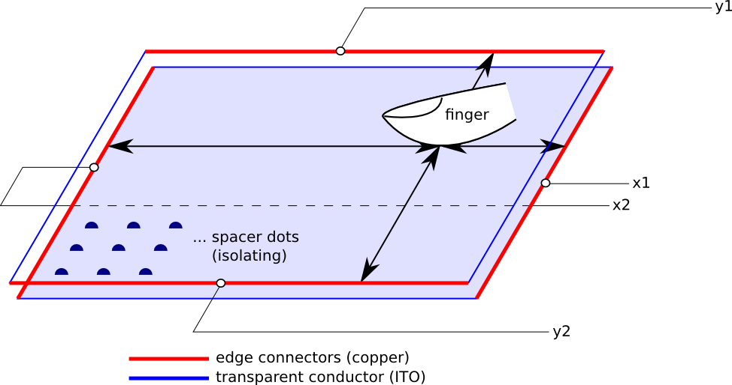
Touch – technology: resistive
Cheap, low-end technology (no multitouch)
  Two conductive layers separated by spacers
  Can be used with gloves, pens, …

Slide 5
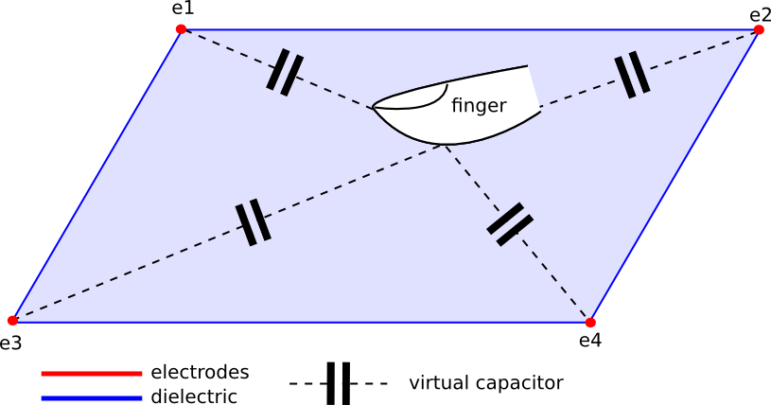
Touch – technology: capacitive (1)
Common in POS terminals etc. (no multitouch)
Robust, simple (but not usable with gloves)

Slide 6
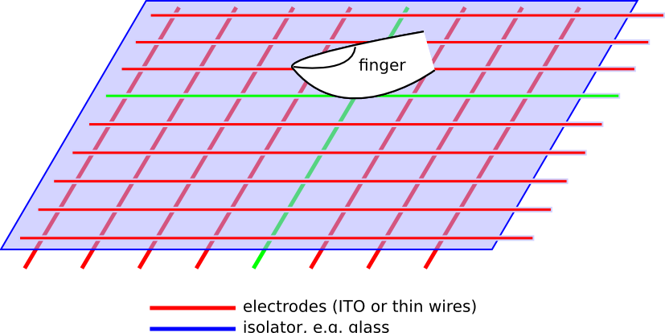
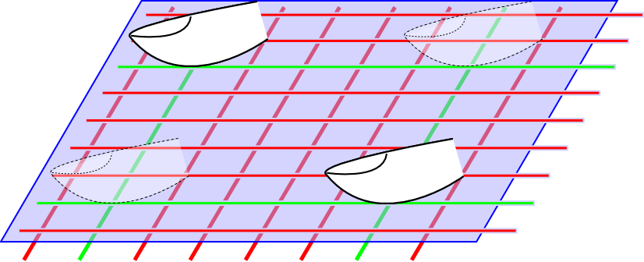
Touch – technology: capacitive (2)
“Projected capacitive” - two variants:
  Mutual capacitance: each row/column measured
  Self capacitance: each crossing measured indiv.

Slide 7
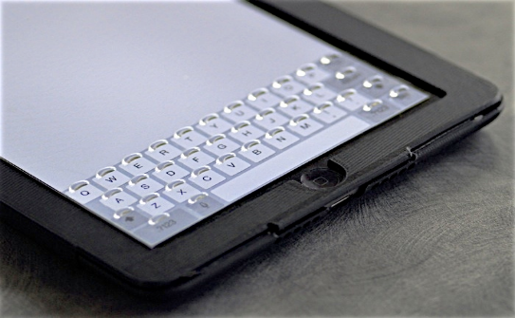
Touch – haptic feedback (1)
Image source (FU): http://tactustechnology.com/wp-content/uploads/2014/08/White-Paper-New-Tagged-PDF.pdf
“Phorm” overlay by Tactus
  Multiple layers of transparent foil
  Thin channels allow fluid to flow into “bubbles”
  All bubbles raise/lower simultaneously
  Prototype with fixed bubble arrangement → only usable with one single keyboard layout

Slide 8
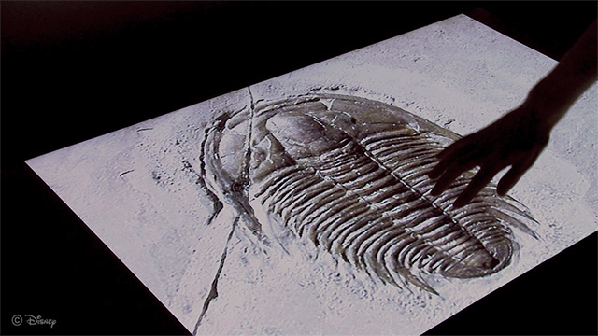
Touch – haptic feedback (2)
Image source (FU): https://dl.acm.org/citation.cfm?id=2502020
“Tactile Touch Screen” using electrovibration
  Static electric charge on whole screen, modulated relative to finger position
  Modifies friction screen ↔ finger
  Creates feeling of ridges & valleys
  Only single-touch
“Tactile Rendering of 3D Features on Touch Surfaces”, Kim et al., UIST 2013

Slide 9
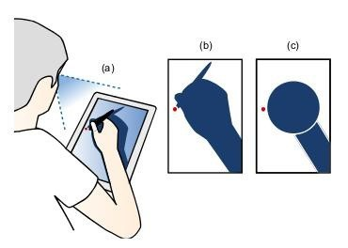
Touch – occlusion (1)
Image source (FU): http://dl.acm.org/citation.cfm?id=1518787
Create geometric model of user's hand/arm
Use model to rearrange pop-ups etc.
Rule of thumb: objects below/ right of touch point → higher chance of being overlooked
“Hand Occlusion with Tablet-sized Direct Pen Input”,
Vogel et al., CHI 2009

Slide 10
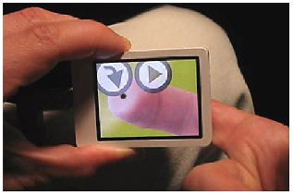
Touch – occlusion (2)
Image source (FU): http://dl.acm.org/citation.cfm?id=1518995
NanoTouch: back-of-device interaction
  Second touch-/clickpad on device backside
  “Virtual” finger shown on screen → illusion of “transparent” device
  Enables very small screens
“Back-of-device Interaction allows creating very small touch devices”, Baudisch et al., CHI 2009

Slide 11
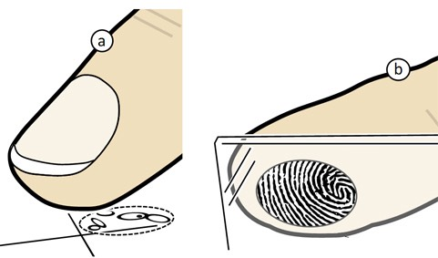
Touch – precision (1)
Image source (FU): http://dl.acm.org/citation.cfm?id=1753413
“Perceived Input Point Model”
  Different perception of touched point for different users and for different angles (a)
  Possible solution: use high-resolution sensor (b) to extract fingerprints → detect touch angle → improve accuracy
“The Generalized Perceived Input Point Model and How to Double Touch Accuracy by Extracting Fingerprints”, Holz et al., CHI 2010

Slide 12
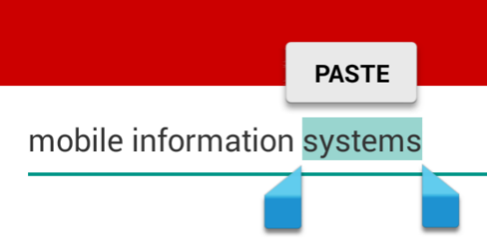
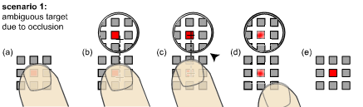
Touch – precision (2)
Right image source (FU): http://dl.acm.org/citation.cfm?id=1240727
“Offset Cursor”: introduces fixed distance between touch point and actual target (e.g. Android selection handles, left)
“Shift” - creates dynamic lens view over small targets (e.g. iOS text selection, right)
“Shift: A Technique for Operating Pen-Based Interfaces Using Touch”, Vogel et al., CHI 2007

Slide 13
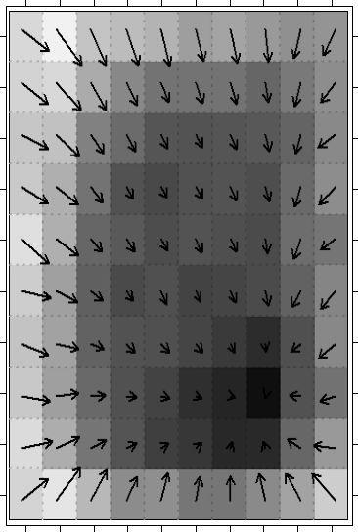
Touch – precision (3)
Image source (FU): https://dl.acm.org/citation.cfm?id=2037395
“100 000 000 Taps”
  Use mobile game to analyze high number of tap events
  Create average offset maps for individual phone models
  May still be context-specific
“100,000,000 taps: analysis and improvement of touch performance in the large”, Henze et al., MobileHCI 2011
Offset vectors for Samsung Galaxy S

Slide 14
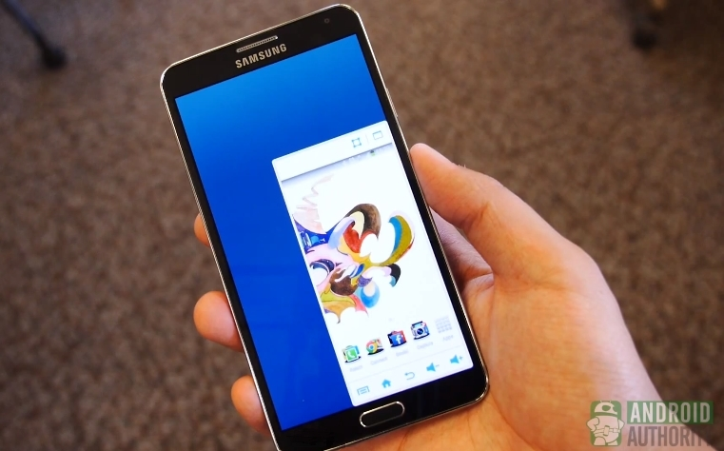
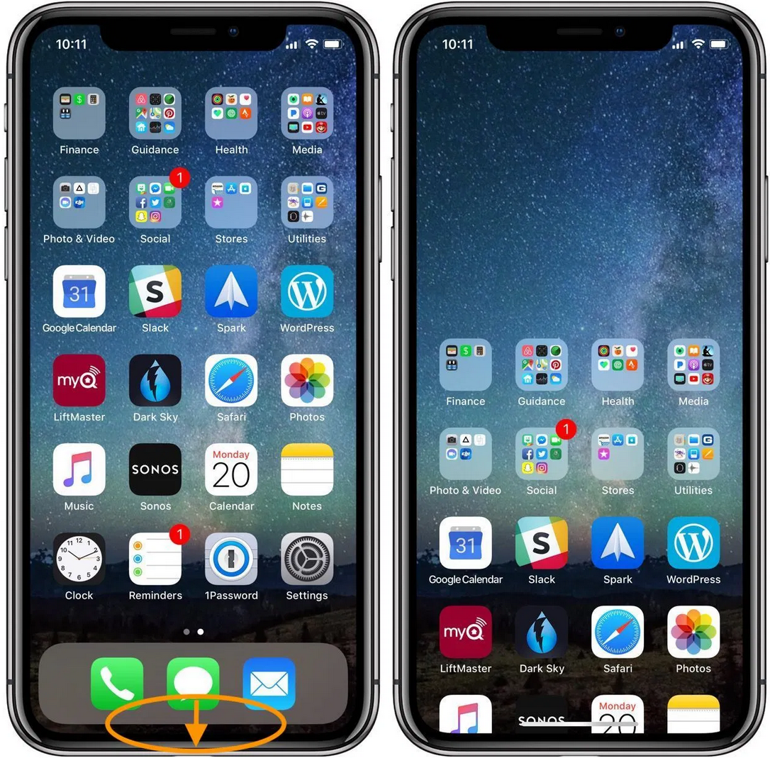
Touch – reachability?
Image source (FU): https://www.androidauthority.com/note-3-one-handed-operation-how-to-280458/
Problem for one-handed use
Affects precision and reach
Built-in “one-handed mode” (Android) or “reachability mode” (iOS)
Precision still worse (why?)
Android
iOS

Slide 15
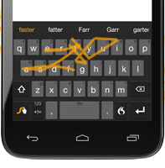
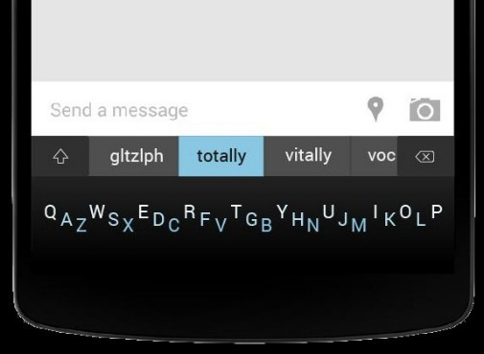
Touch – precision: keyboards
Image sources (FU): http://www.swype.com/, http://minuum.com/
Less precise than physical keyboards
→ word prediction (WP) helps:
  “classic” QWERTY + WP
  Swiping across letters + WP (Swype/Swiftkey, left)
  Single line of letters + WP (Minuum, right)

Slide 16
Touch – hover state (1)
No hover state → “Midas Touch Problem”
Also appears with some styli, eye tracking, …
Solved by “lift-off strategy”
  Touch down → screen starts giving feedback
  Touch moves → continuous feedback
  Touch up → action is triggered
Developed in 1988, used everywhere nowhttps://www.cs.umd.edu/hcil/touchscreens/

Slide 17
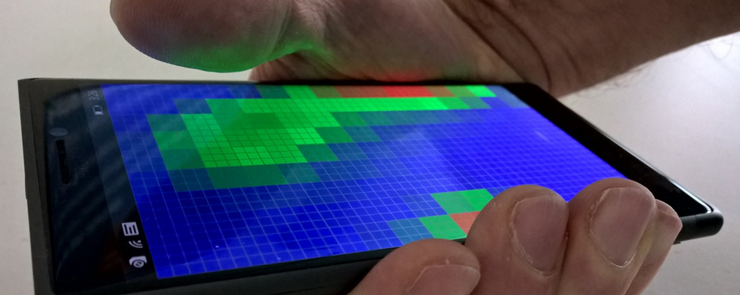
Touch – hover state (2)
Image source (FU): https://dl.acm.org/citation.cfm?doid=2858036.2858095
“Pre-Touch Sensing”
  Many capacitive screens can sense hover
  Usually filtered out by touchscreen controller
  Allows detection of hover, grip, touch force, ...
“Pre-Touch Sensing for Mobile Interaction”, Hinckley et al., CHI 2016

Slide 18
Touch: summary
Drawbacks ↔ Mouse:
  Less precision
  More occlusion
  No hover state (mostly)
  No haptic feedback
1:1 transfer of desktop UIs will almost certainly fail
Needs new strategies

Slide 19
I/O issues: gestures (recap)
Discoverability
  How do I know which gestures are available?
  Even more difficult for complex gestures
“Natural” interaction
  What's a natural gesture?
  Strong personal & cultural preferences
No standards
  E.g. swipe; long-press: very different meanings for each app/OS
  Exception: pinch-zoom

Slide 20
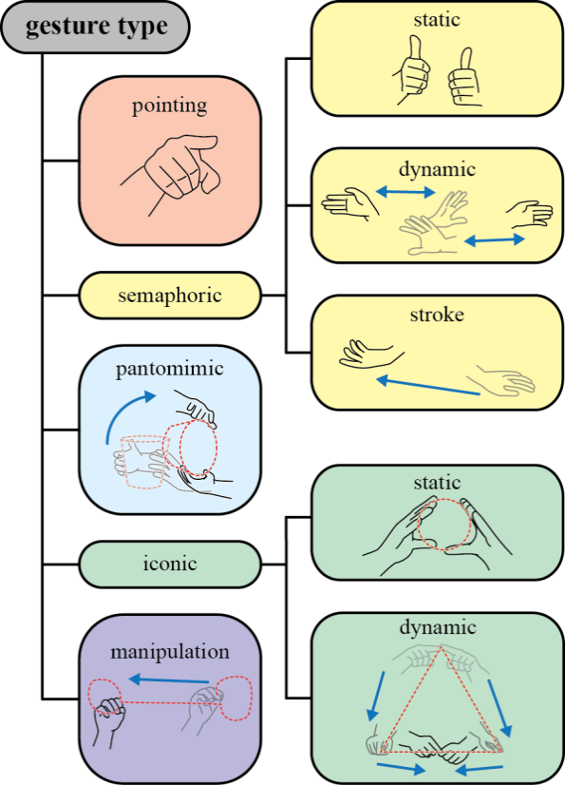
Gestures: what is a gesture?
Source (FU): http://research.microsoft.com/pubs/175454/GesturesTR-20121107-RoA.pdf
Taxonomy
  Pointing/”deictic”
  Semaphoric
    Gesticulation, sign language?
  Pantomimic
    Describes actions
  Iconic
    Conveys shapes
  Manipulation
    Implies physical link

Slide 21
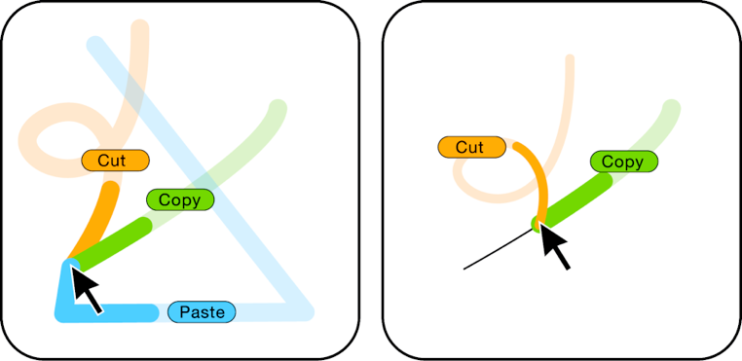
Gestures – discoverability (1)
Image source (FU): http://dl.acm.org/citation.cfm?id=1449724
Feedback
  Provides information after correct execution
  Helps with reinforcement learning
Feedforward
  Provides information before/during execution
  OctoPocus →
“OctoPocus: A Dynamic Guide for Learning Gesture-Based Command Sets”, Bau et al., UIST 2008

Slide 22
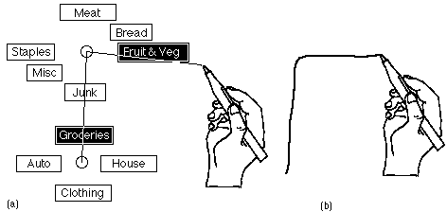
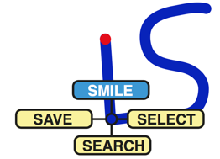
Gestures – discoverability (2)
Image sources (FU): http://dl.acm.org/citation.cfm?id=169426, http://dl.acm.org/citation.cfm?id=2481321
Marking Menus (Buxton)
  Display radial menu after short dwell time
  Multiple hierarchy levels
  Easy transition from novice to expert (without dwell time)
Augmented Letters (Roy)
  Start with first letter of command
  “Tail” selects subcommand

Slide 23
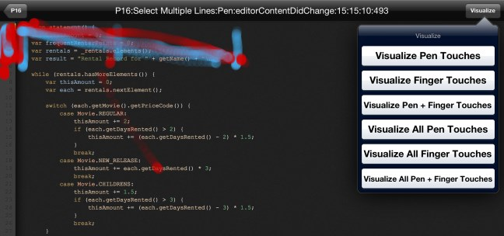
Gestures: what is “natural”?
Image sources (FU): http://dl.acm.org/citation.cfm?id=2480317
Elicitation studies
  Show intended effect/describe action first
  Users execute gesture which they consider most appropriate/best suited, gesture is recorded
  Often very little agreement, except simple actions
  Test: what gesture would you use to delete a line in a touchscreen-based code editor?
Visualization of gestures for “Select Multiple Lines”
RefactorPad: editing source code on touchscreens, Raab et al., EICS 2013

Slide 24
I/O issues: motion (recap)
Motion as input
  Motion of device: inertial measurement unit (IMU)
  Motion of user: EMG, camera-based approaches
Motion as output
  Mostly vibration alerts (binary channel)
    Extension: multiple vibration motors
  Moving/shape-changing phones
  Moving the user itself?

Slide 25
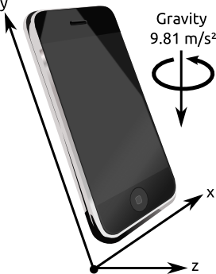
Motion input – device sensors (1)
IMU (Inertial Measurement Unit) contains:
  Accelerometer (3 axes/DOF*)
    Measures acceleration, including gravity (“down”)
    Cannot sense rotation around “gravity axis”
(*) DOF = Degrees Of Freedom

Slide 26
Motion input – device sensors (2)
IMU (Inertial Measurement Unit) contains:
  Magnetometer/compass (3 axes/DOF)
    Measures earth's magnetic field (“north”)
    Distorted by large metal objects, power lines etc.
  Gyroscope (3 axes/DOF)
    Measures rate-of-turn
    Compensates sudden magnetometer errors

Slide 27
Motion input – device sensors (3)
9 total measurements → sensor fusion algorithm → 3 DOF absolute orientation
Combine with position (GPS) → 6 DOF “pose”
IMU data can also be used to estimate position relative to some starting point
High power consumption for all 3 sensors → only accelerometer enabled by default, at low update rate (~ 1 measurement/sec.)

Slide 28
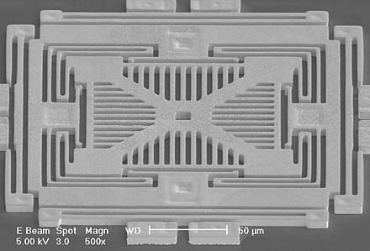
Motion input – MEMS (1)
Image source (FU): http://archives.sensorsmag.com/articles/1203/20/fig1.jpg
MEMS = Micro ElectroMechanical Systems
  Microscopic springs, weights, actuators etc. etched on silicon wafer
  Same manufacturing process as for regular ICs → directly integrated with read-out electronics
MEMS Accelerometer (electron microscopy)

Slide 29
Motion input – MEMS (2)
Example measurements:
  Force on spring-loaded weight → acceleration
    Spring “stiffness” limits senseable range
  Lateral force on vibrating weight → rotation
    No rotating elements, despite “gyroscope” name
  Hall effect current → magnetic field
    Highly sensitive to stray magnetic fields, even from on-device power supply

Slide 30
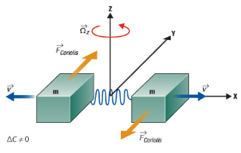
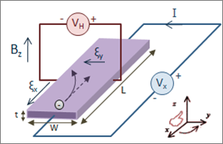
Motion input – MEMS (3)
Image source (FU): http://electroiq.com/blog/2010/11/introduction-to-mems-gyroscopes/
Image source (PD): https://en.wikipedia.org/wiki/Hall_effect
Vibrating Structure Gyroscope: measure lateral force F_{Coriolis} (= asymmetric displacement) on vibrating weights
Hall effect sensor: measure V_{H} induced by magnetic field B_{Z}
F_{C}
a
v
m
m
v
F_{C}

Slide 31
Motion input – MEMS calibration
See also: https://electronics.stackexchange.com/questions/22144/magnetometer-%E2%88%9E-shaped-calibration
Magnetic field strength of earth constant → independent of measurement angle
In reality: angle-dependent offset (aka “hard iron”/”soft iron” effects)
8-shaped movement used for calibration → cover as many different angles as possible → calculate offsets and compensate errors

Slide 32
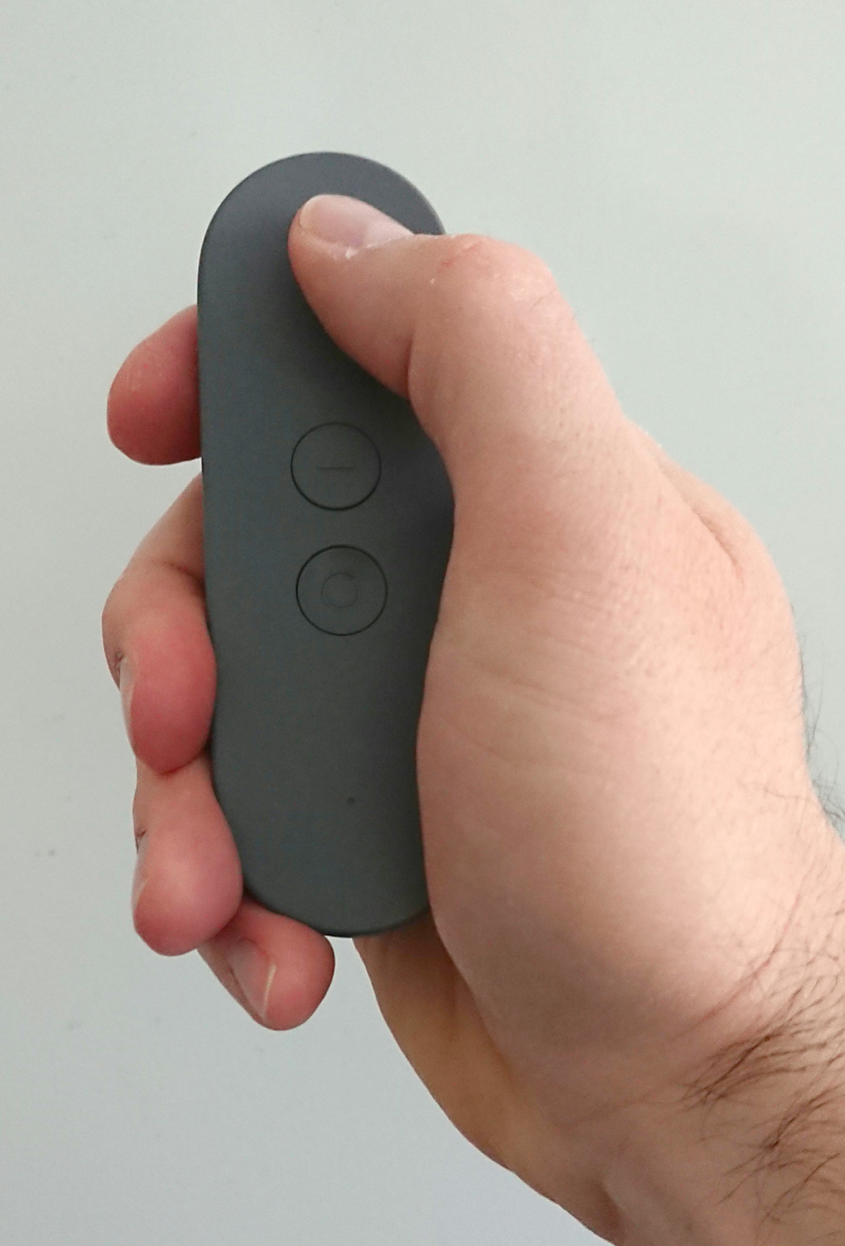
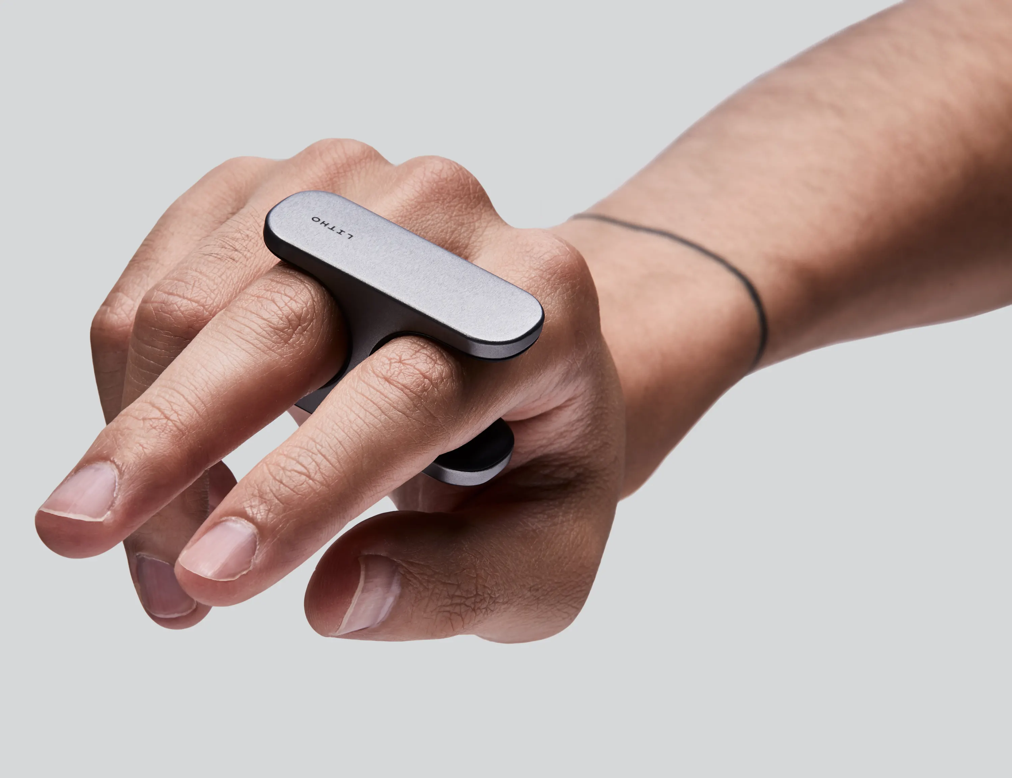
Motion input – add-on controllers
Image sources: (CC) own picture, (FU) https://www.litho.cc/
Many flavours, usually with buttons, touchpad, IMU, BTLE
e.g. Daydream controller (l), Litho (r), many clones

Slide 33
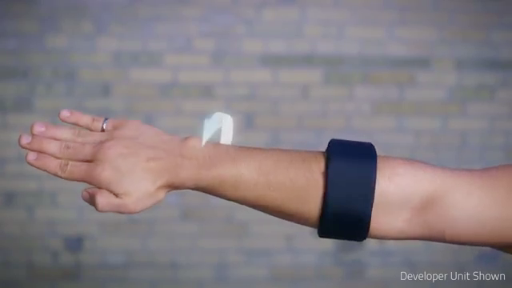
Motion input – muscle sensing
Image source (FU): https://www.thalmic.com/en/myo/
Myo: EMG (electromyography) device
Measures tiny electric currents created by muscle movement and tension
Data can be used to infer hand/arm gestures
Scenario: hands-free phone control

Slide 34
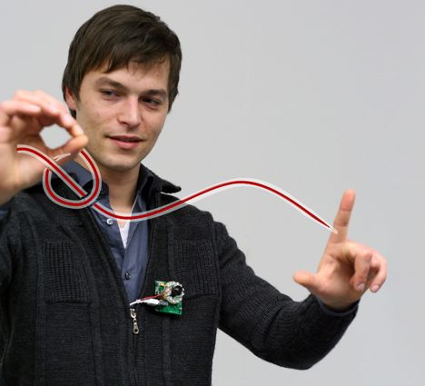
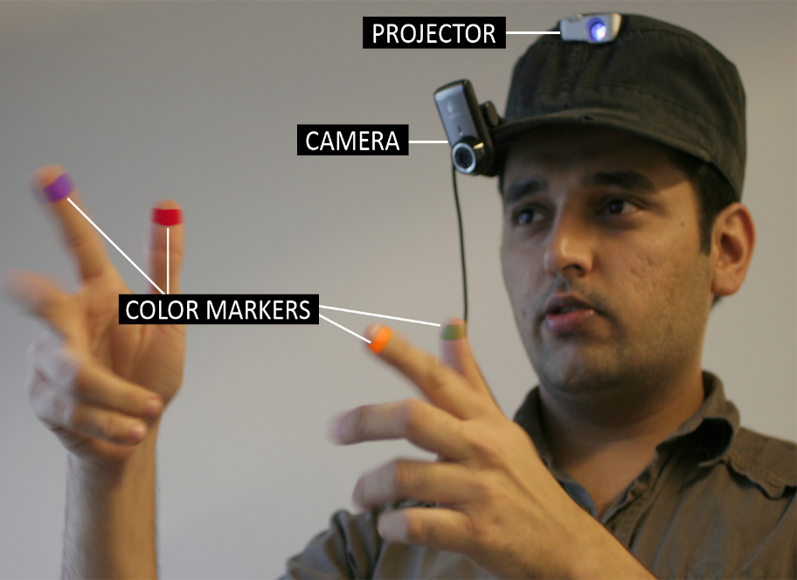
Motion input – free-air gestures
Image source (FU): http://dl.acm.org/citation.cfm?id=1866033, http://dl.acm.org/citation.cfm?id=1667160
Imaginary Interfaces (l) & SixthSense (r)
Both based on body-worn cameras

Slide 35
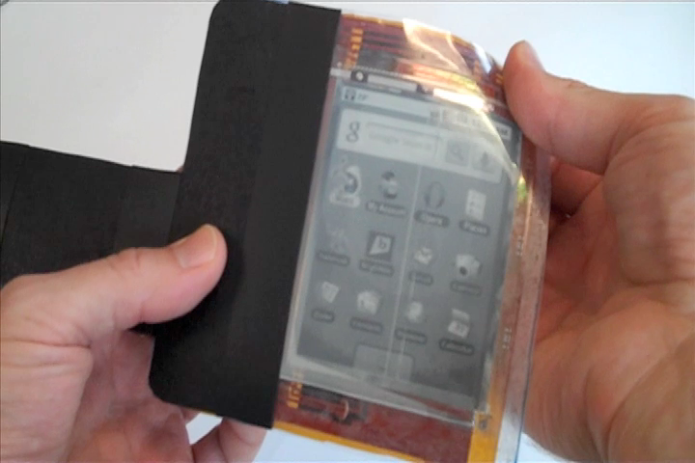
Motion input – deformation
Image source (FU): https://dl.acm.org/citation.cfm?id=1979136
PaperPhone: Bend Gestures in Mobile Devices
Borrows metaphors from physical paper
  Earmarking
  Flipping pages
  …
“PaperPhone: understanding the use of bend gestures in mobile devices with flexible electronic paper displays”, Lahey et al., CHI 2011

Slide 36
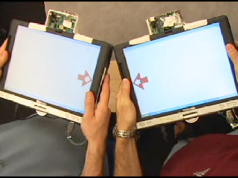
Motion input – bumping
Image source (FU): http://research.microsoft.com/en-us/um/people/kenh/papers/ubicomp03abstract.pdf
Bumping devices together creates connections/exchanges data
Also (was) available as a contacts app
How would you implement this?
“Bumping Objects Together as a Semantically Rich Way of Forming Connections between Ubiquitous Devices”, Hinckley et al., Ubicomp 2003

Slide 37
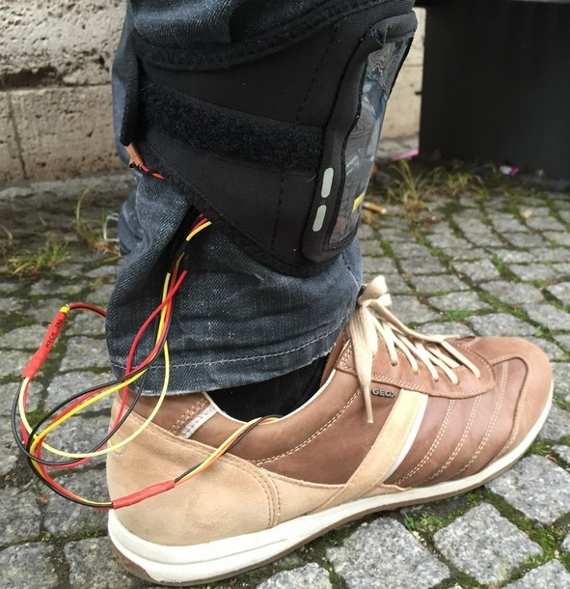
Motion output – “Shoe me the way”
Image source (FU): “Shoe me the Way”, M. Schirmer et al., MobileHCI 2015
Vibration output: only binary?
Can still encode numerical information
E.g. directions (left/right) → use multiple vibration sources as spatial cues
  In shoes
  On belt
  On vest
  ...

Slide 38
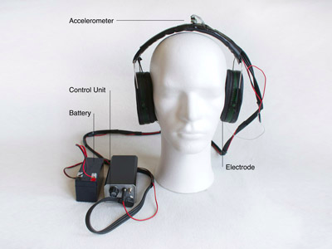
Motion output – user itself? (1)
Image source (FU): http://www.antalruhl.com/media_tech/gvs.htm
Galvanic Vestibular Stimulation (GVS)
  Low current stimulates inner ear
  Affects sense of balance
  Can (theoretically) be used for navigation and to compensate motion sickness in VR

Slide 39
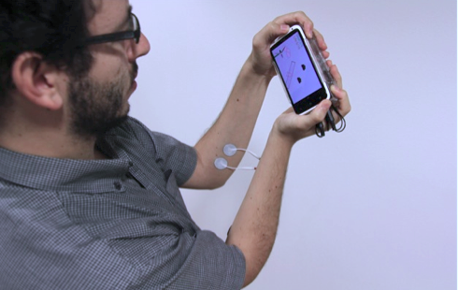
Motion output – user itself? (2)
Image source (FU): https://dl.acm.org/citation.cfm?id=2481355
Muscle-propelled Force Feedback
  Electrodes cause involuntary muscle movement
  Feels like force exerted by device on its own
Issues:
  Electrode attachment
  Safety considerations
“Muscle-propelled force feedback: bringing force feedback to mobile devices”, Lopes et al., CHI 2013

Slide 40
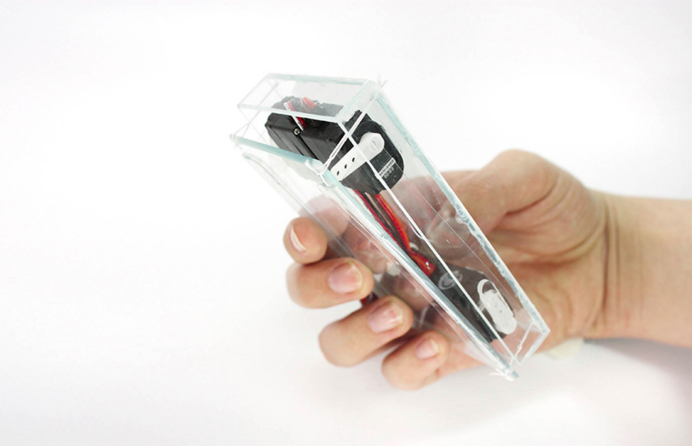
Motion output – “breathing phone”
Image source (CC): http://www.fabianhemmert.com/projects/shape-changing-mobiles
Change various parameters of mobile device
  Shape, thickness, center of gravity, …
Use them to convey “ambient information”
  E.g. slow, regular breathing → no missed calls, no new texts

Slide 41
Motion: summary
Motion input:
  Device motion sensed by 3-9 MEMS sensors
  User motion sensed via device or camera
Motion output:
  Mostly vibration in commercial devices
  Some weird/interesting research concepts

Slide 42
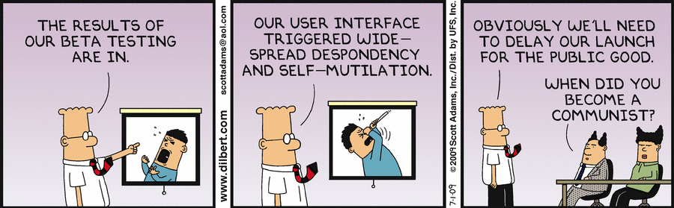
The End

