Slide 1
Mobile Information Systems
Lecture 01 – Introduction
& Technological Basics
April 4th, 2018

Slide 2
Prerequisites
Lecture: basic knowledge of …
  computer science theory
  software engineering & networking
Exercises:
  Programming experience (in Java or C++)
  Ability to solve problems on your own
  No prior Android experience required!
  Required (before Friday): Android Studio!

Slide 3
Why Android?
Most widely used mobile OS for the forseeable future (3-4 years at least)
Development possible on all major platforms (Windows, Linux and MacOS X)
Very flexible mobile OS, (mostly) open source
Low entry barrier for users and developers (cheap devices, software emulator)

Slide 4
Topics
Introduction & technological basics
  Device classification
  Device hardware & software
  Key features & issues

Slide 5
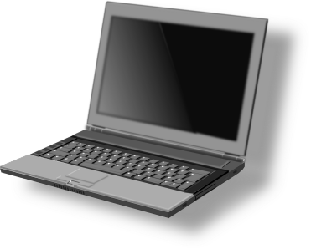
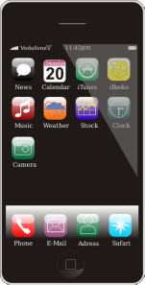
Classification: size (1)
Mobile computer (e.g. laptop)
  Capabilities similar to desktop computer
  Extensible (plug-in cards)
Handheld (e.g. tablet, mobile phone)
  Reduced capabilities (CPU, RAM, storage) compared to standard mobile computer
  Data often synchronized with a desktop PC or server (“cloud”)
On-board computer
  Specialized devices for time-critical control tasks

Slide 6
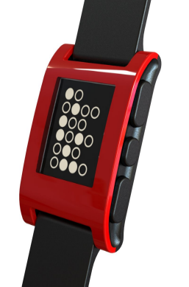
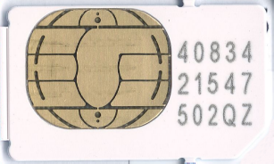
Classification: size (2)
Source (CC): http://ksimgs.s3.amazonaws.com/PebblePressPack1.zip
Wearables
  Worn on body: e.g. clothing, watch, ...
  Minimal manual interaction possible
Chip card (e.g. SIM)
  Special reader/adapter is required
  Chip can store data and is often programmable
NFC tags
  Similar to chip card, but wireless power & data transmission

Slide 7
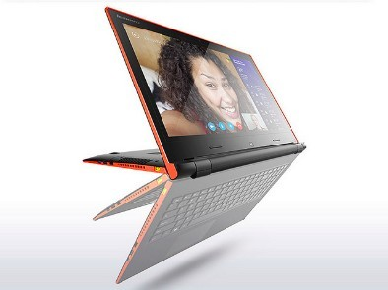
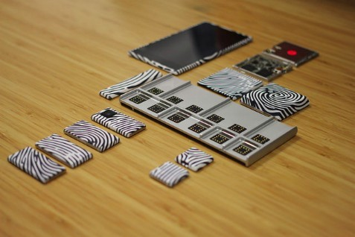
Classification is getting blurry
Source (CC): https://www.flickr.com/.../11741149766/, https://www.flickr.com/.../16129709460/
„Phablets“
  Large smartphones? Small tablets?
Convertibles
  Tablets with attach-/foldable keyboard, big CPU
„Project Ara“
  Smartphone platform: "spine" + extension modules
Smartwatches
  Some models have most smartphone features

Slide 8
Classification: purpose
Orthogonal to the size:
  General purpose device
    Installation & execution of various applications possible
    Needs a flexible operating system and well defined interfaces
  Special purpose devices
    Developed to run/support a certain application
    Mostly not programmable
    Specialized hardware

Slide 9
Classification: Examples
Category | GP-device | SP-device
Mobile standard computer | Notebook, convertible | e.g. for cartography, surveying and alignment, archaeology
On-board computer | - | e.g. in cars, airplanes or satellites
Handheld | Smartphones, tablets, PDAs | E-book reader, "dumbphone", pager, game console (e.g. PSP), calculator, car navigation
Wearable | Programmable wearables, e.g. smartwatches | Watch, medical devices (measuring pulse, etc.)
Chip card | Smart Card | SIM card, phone card, EC card with cash chip
Primary lecture topics

Slide 10
Classification: summary
Two major dimensions: size and purpose
Size: broad spectrum from ~ 1 mm to ~ 50 cm
Purpose: general or special (with overlap)

Slide 11
Hardware: Comparison (1)
Desktop & laptop PC:
  High-end multi-GHz CPU & GPU
    Modular design
    Significant power consumption
    Thermal design / heat issues
    (Mostly) x86/AMD64 architecture
  Few high-performance I/O channels
    Screen: at least Full HD (1920x1080) or beyond
    Keyboard & Mouse: up to 300 APM (actions per minute), see https://www.youtube.com/watch?v=YbpCLqryN-Q

Slide 12
Hardware: Comparison (2)
Mobile devices:
  Energy-efficient, lower-performance SOCs
    System-On-Chip with integrated CPU/GPU/bridge chips
    RAM/ROM usually still separate (why?)
    (Mostly) ARM architecture, many vendors
  many different low(er) performance I/O channels
    Touchscreen, camera, vibration, light sensor, accelerometer/IMU, GPS, proximity sensor, LED, …
    Why are 300 APM probably not possible with a touchscreen?

Slide 13
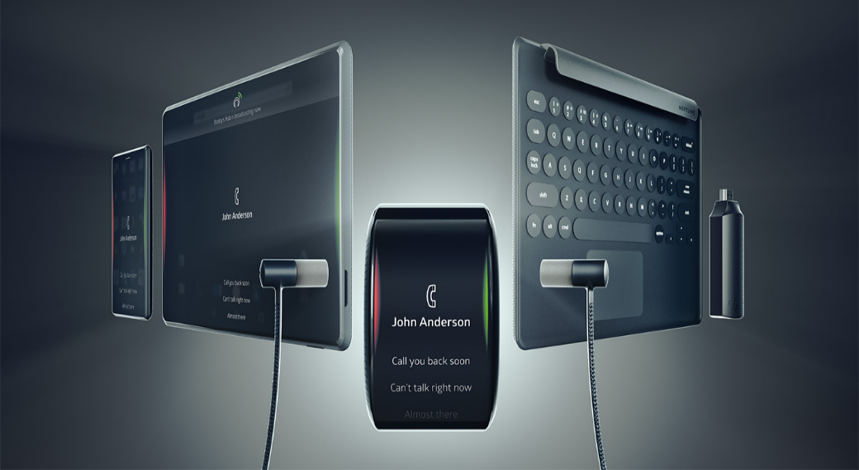
Hardware: Convergence?
Source (FU): https://www.indiegogo.com/projects/neptune-suite-one-hub-infinite-possibilities#gallery
Vision: only one device + accessories
  "Project Neptune” (IndieGogo)
  Powerful smartwatch + wireless screens

Slide 14
Operating Systems: Overview
2007/08: “Smartphone revolution”
Current state (2018): duopoly
  10 – 20 % market share (high-end): iOS
  80 – 90 % market share (whole spectrum): Android
Android took ~ 2 years to overtake and ~ 4 years to completely displace Symbian
Past challengers: Windows 10, Ubuntu Touch, Bada, Tizen, Firefox OS…
Usually centralized “app stores” for software

Slide 15
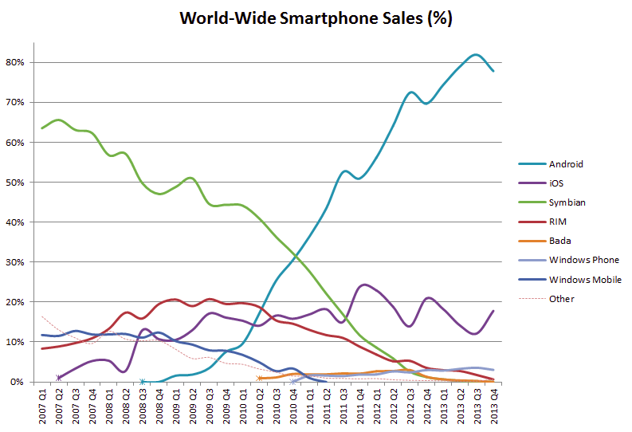
Operating Systems: Sales history
Image source (CC): https://commons.wikimedia.org/wiki/File:World_Wide_Smartphone_Sales_Share.png

Slide 16
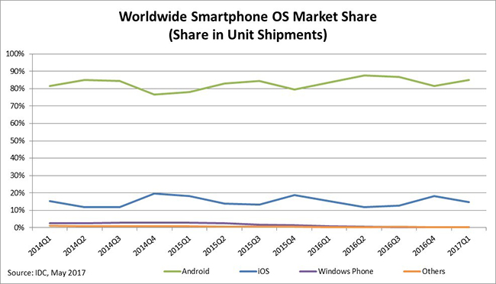
Operating Systems: Market share
Image source (FU): https://www.idc.com/promo/smartphone-market-share/os

Slide 17
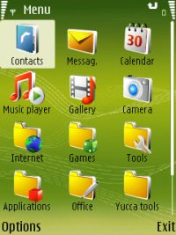
Operating Systems: Symbian
Image source (FU): https://en.wikipedia.org/wiki/Symbian#/media/File:S60_3rd_Edition_from_N73.jpg
Developed by Ericsson, Nokia, Motorola and Psion
Standard OS for nearly all smartphones until ~ 2009
(Mostly) dead after Nokia acquisition by Microsoft

Slide 18
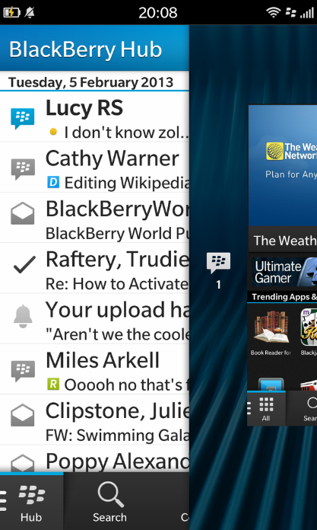
Operating Systems: Blackberry OS
Image source (FU): https://en.wikipedia.org/wiki/BlackBerry_10#/media/File:Blackberry_Hub.png
Developed by Research in Motion (RIM) since 1999
Proprietary, was popular in business context
Application development in Java
Can run Android apps
Negligible market share

Slide 19
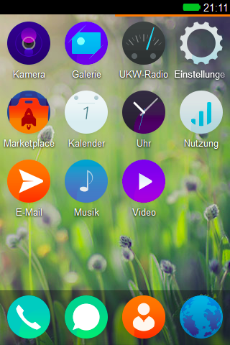
Operating Systems: Firefox OS
Image source (MPL): https://de.wikipedia.org/wiki/Firefox_OS#/media/File:Firefox_OS_1.4.png
OS based on Linux kernel
GUI based on HTML5, CSS, JavaScript
Very low cost, low resource requirements
Aimed at developing markets
Currently stalled/ discontinued

Slide 20
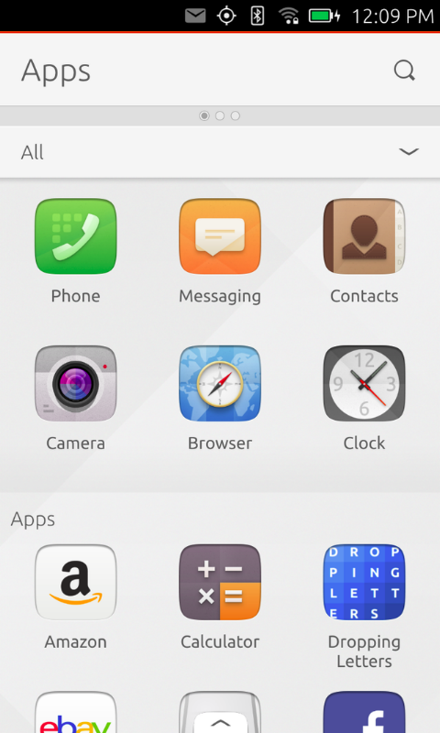
Operating Systems: Ubuntu Touch
Image source (CC): https://en.wikipedia.org/.../File:Ubuntu_Touch_2015-02-06_Apps_screen.png
Also based on Linux kernel
Early beta stage
Few devices available
Can be manually installed on some Android devices
“Unified” interface: convergence desktop ↔ mobile

Slide 21
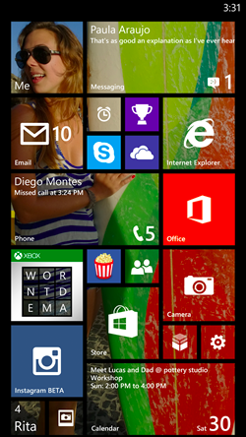
Operating Systems: Windows 10
Image source (FU): https://en.wikipedia.org/wiki/Windows_Phone#/media/File:WP8.1_Start_Screen.png
Successor of Windows CE/Windows Phone
Current version: Windows 10 Mobile
  New tile-based graphical user interface („Modern“/„Metro“)
  Partnership with Nokia
  (R.I.P. Symbian)
  Development with C#/.NET
  Support for dedicated mobile version has ended, merged into “regular” Windows 10

Slide 22
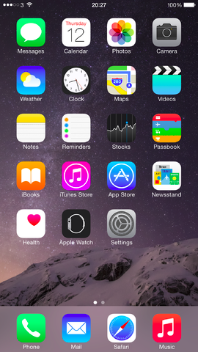
Operating Systems: iOS
Image source (FU): https://en.wikipedia.org/wiki/IOS#/media/File:IOS_8_Homescreen.png
Initially released as iPhone OS in 2007
Multitasking / background activities since iOS 4
Development using Objective C & (recently) Swift
Based on Darwin/BSD kernel

Slide 23
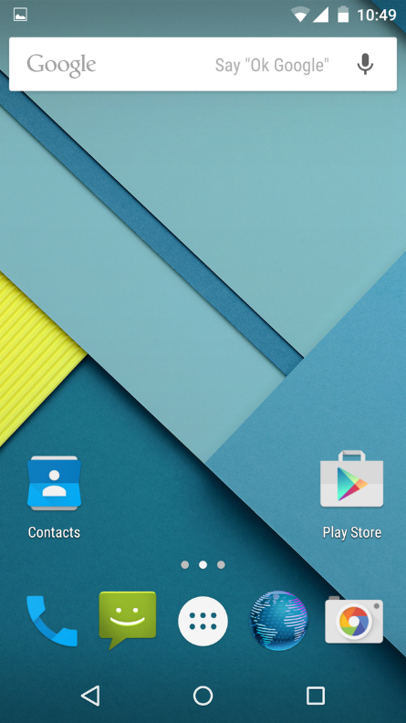
Operating Systems: Android
Image source (FU): https://en.wikipedia.org/.../File:Android_L_Develpment_Preview.png
Released by Google in 2008
(mostly) Open Source
  Based on Linux kernel
  Many derivatives, e.g. LineageOS
Development with Java
No „traditional“ JavaVM
  Dalvik Virtual Machine
http://www.android.com/

Slide 24
Hardware/Software: summary
Mobile hardware: more “monolithic” than regular PCs (why?)
  Side effect: tighter connection between hardware and OS, porting usually difficult (driver issues)
Mobile software: two major OS (Android/iOS), many small contenders
  Common aspect: centralized “app stores”
  Fragmentation issues (particularly for Android)

Slide 25
Key features of MIS
Accessing data at any time and everywhere
  „Intelligence Amplification“ (or at the very least, „factual knowledge amplification“)
Location-based services
  Possible compensation for I/O, bandwidth issues
  E.g. transmit only location-relevant data
Context-aware systems
  User may be in the car, at home, in a meeting, sleeping, talking, …

Slide 26
Key features: application examples
PIM (= Personal Information Management)
Mobile Internet access, information lookup
Mobile network access for “traveling salesmen” or engineers (VPN)
Navigation systems (advantages over „offline“ navigation?)
Package tracking (e.g. DHL or UPS)
Social networking with live location data
Augmented Reality (AR) (why not VR?)

Slide 27
Key issues of MIS
Most central aspect: mobile hardware
  Needs to be portable & lightweight
  No fixed location, moves with user
  Raises additional issues:
    Limited power supply
    Limited storage
    Wireless communication channels
    Limited/different I/O capabilities
    Unpredictable usage context
  Many potential tradeoffs

Slide 28
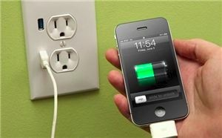
Key issues of MIS: power & storage
Image source (CC): https://www.flickr.com/photos/intelfreepress/10190082395/
Limited power supply
  Tradeoff: capacity ↔ size/weight/portability
  Energy consumption becomes important
Limited storage
  Data (partially) stored in „cloud“ services
  Requires network connection for access
  Tradeoff: bandwidth ↔ storage

Slide 29
Key issues of MIS: wireless
Wireless communication
  Coverage: area-wide vs. hotspot-based
  Available bandwidth
  Cost aspects
  Unpredictable availability
    Cell sharing (capacity)
    Shielding effects (zones without coverage)
  Moving device → static routing not possible
  Tradeoff: bandwidth ↔ energy consumption

Slide 30
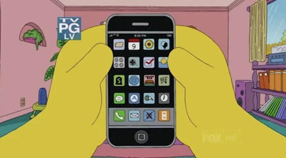
Key issues of MIS: I/O
Image source (FU): The Simpsons (S21E11), Fox Broadcasting Company
Different I/O capabilities
  Small screens, often no physical keyboard
  Text entry/precision work much slower
  “Fat finger problem”
  Use other channels …
    For input: motion, camera, location, …
    For output: vibration, sound, speech, …
  Tradeoff: size/weight ↔ I/O features?

Slide 31
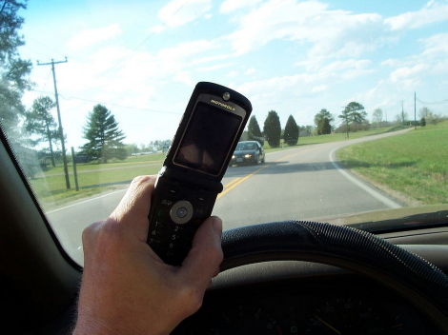
Key issues of MIS: context
Image source (CC): https://en.wikipedia.org/.../File:Cell_phone_use_while_driving.jpg
Unpredictable usage context – user can be ...
  Sitting
  Standing (no support)
  Walking (into things?)
  Lying on the sofa
  Driving in a car (shaking)
  Talking to other people (noisy)
  Some (sensible) combination of the above
  ... ?

Slide 32
Features & issues: summary
Main feature: mobile data access & processing
Main issue: mobility → leads to …
  Power & storage issues
  Connectivity issues
  I/O issues
  Context issues

Slide 33
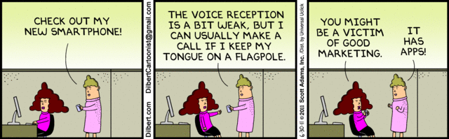
The End

