Slide 1
Mobile Information Systems
Lecture 09: Mixed Reality
© 2015-23 Dr. Florian Echtler
Bauhaus-Universität Weimar
Aalborg University
This work is licensed under a Creative Commons Attribution-NonCommercial-ShareAlike 4.0 International License.

Slide 2
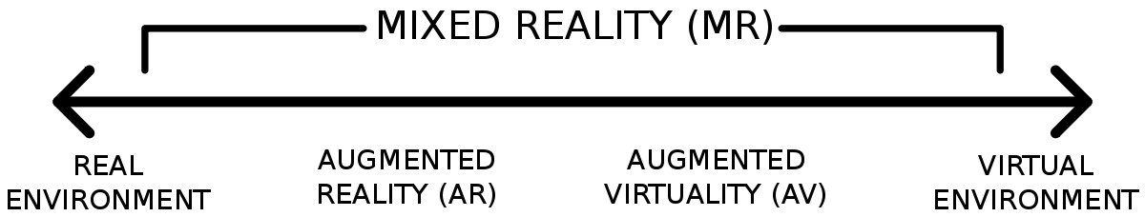
Augmented Reality (AR)
Image source (CC): https://en.wikipedia.org/wiki/Mixed_reality#/media/File:Reality-Virtuality_Continuum.svg
Part of the “Virtuality Continuum” (see below)
  Milgram & Kishino, “A Taxonomy of Mixed Reality Visual Displays”, 1994
Subclass of mixed reality
  Roughly categorized by ratio between real and virtual content

Slide 3
Augmented Reality (AR) (2)
Definition/characteristics
  R. Azuma, “A Survey of Augmented Reality”, 1997
    Mix of real-world and virtual visual information
    Information can be interacted with in real-time
    Real & virtual elements spatially aligned in 3D
→ Requirements:
  Visual input (real world) & output (virtual)
  User input & fast graphics (to enable interaction)
  6D head tracking (for spatial alignment)

Slide 4
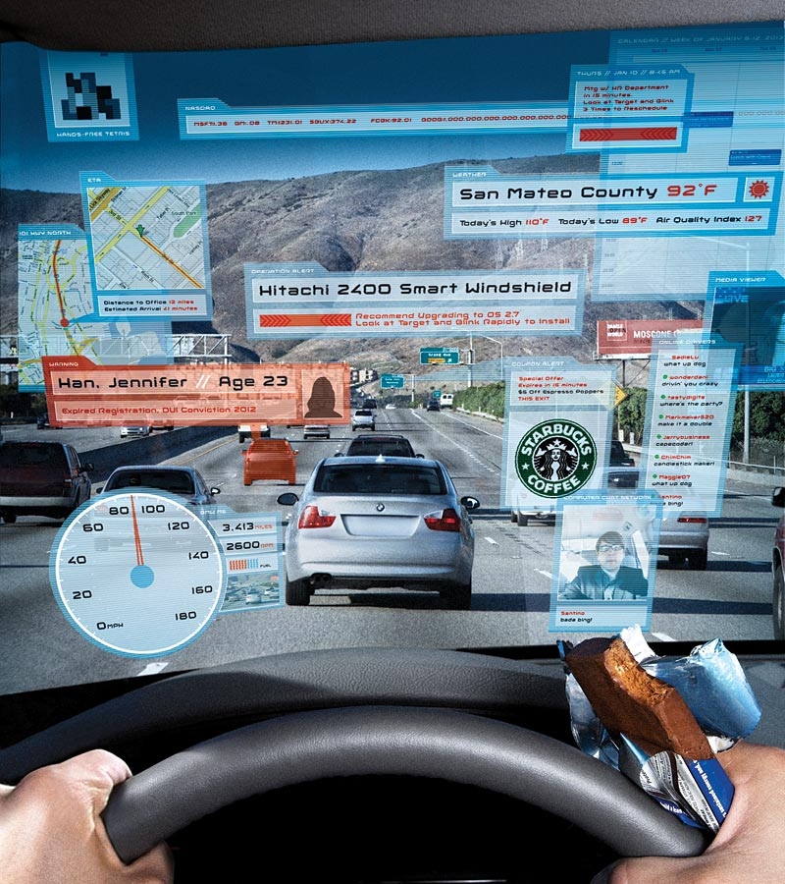
Is this AR?
Image source (FU): http://archive.wired.com/culture/culturereviews/ magazine/16-01/found
(apart from the fact that there can be too much of a good thing)

Slide 5
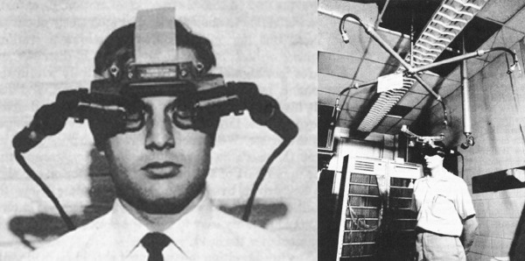
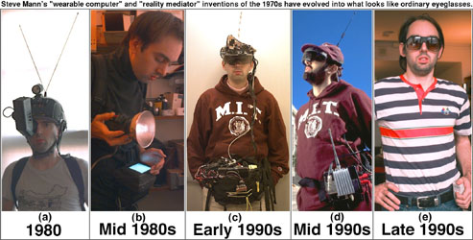
AR: History & Pioneers
Image sources (FU): https://louislau91.[...]/sword_of_damocles.jpeg, http://eyetap.org/[...]/wearables.html
1901: first mention of idea in novel (“The Master Key” by L. Frank Baum)
1968: first head-mounted display (HMD) (“The Sword of Damocles” by Ian Sutherland)
1980: first wearable HMD by Steve Mann

Slide 6
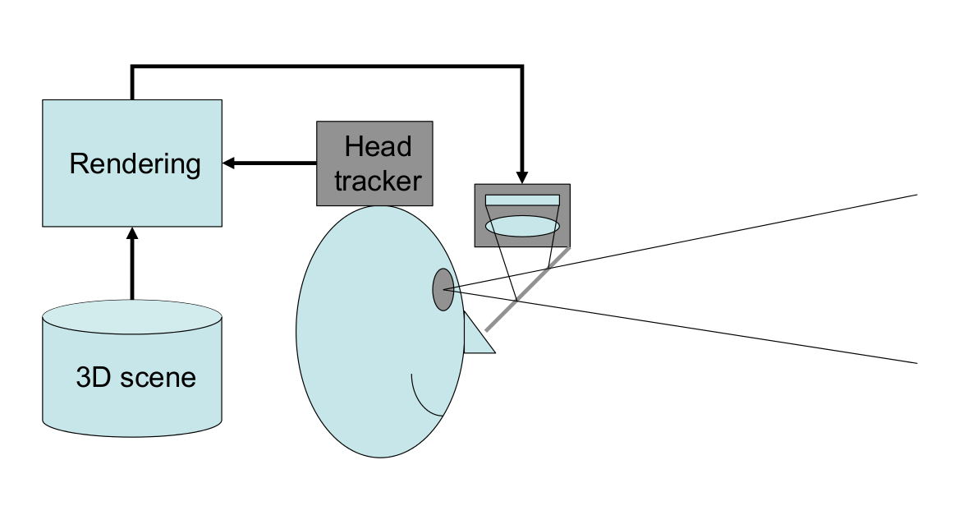
HMD: optical see-through (1)
Image source (FU): LMU Lecture by J. Wagner

Slide 7
HMD: optical see-through (2)
Use “beam combiner” + focus optics to overlay display image over real-world view
Pro:
  Direct view of real world
  Eye can focus at different distances
Contra:
  (Mostly) not able to “cover” objects (problem with 3D occlusion, i.e. real object behind virtual one)
  Lag/alignment issues reality ↔ virtual content more obvious

Slide 8
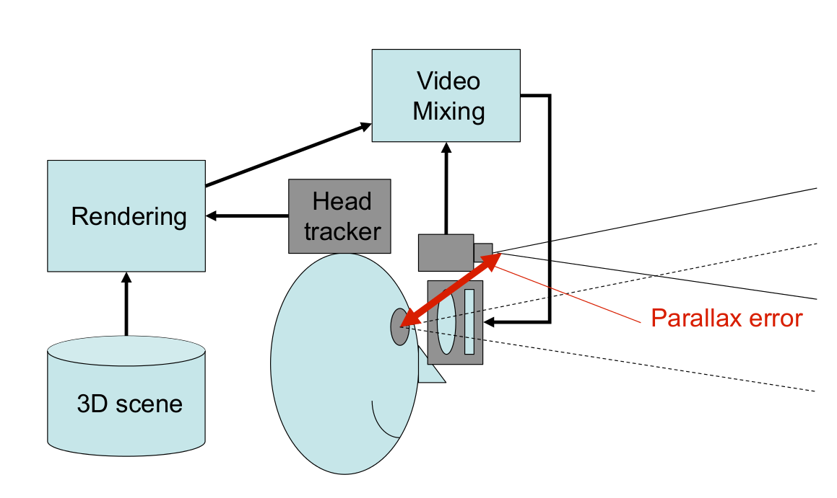
HMD: video see-through (1)
Image source (FU): LMU Lecture by J. Wagner

Slide 9
HMD: video see-through (2)
Similar to VR displays (cf. lecture 5) + camera
Pro:
  Possible to use camera image for tracking → less lag, better alignment real ↔virtual
  Real objects can be hidden/substituted
Contra:
  Parallax error camera ↔ display
  Similar problems to VR displays (motion sickness)
  Single focus distance

Slide 10
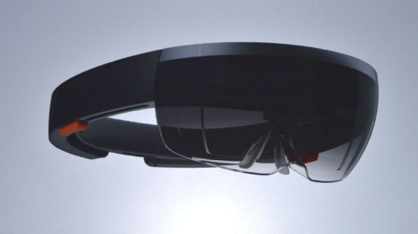
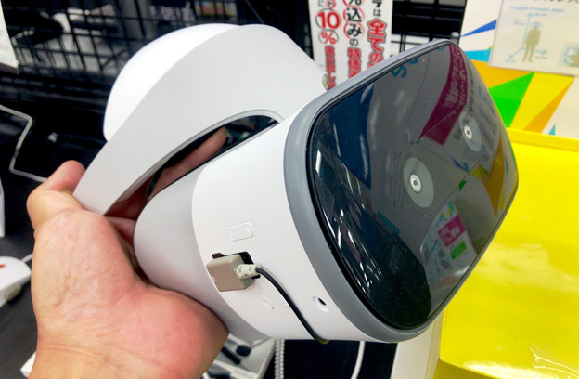
Commercial HMDs for AR
Image source (CC): https://www.flickr.com/photos/jiff01/15867880743/
Image source (CC): http://photozou.jp/photo/show/124201/256868351
Optical see-through:
  Google Glass, North Focals (not AR!)
  Microsoft Hololens →
  Magic Leap
Video see-through:
  Smartphone goggles (Google Cardboard, Samsung Gear VR)
  Meta Quest 3, Lenovo Mirage Solo →
  VR Headset + add-on cameras

Slide 11
Issues with HMDs
Brightness (esp. for outdoor/sunlit context)
Field of view (FOV)
  Human FOV nearly 180°, many HMDs only ~ 20°
Weight/comfort (can induce headaches)
Lag between …
  real and virtual content
  head and image movement
Safety – what if video see-through fails while you're crossing the street?

Slide 12
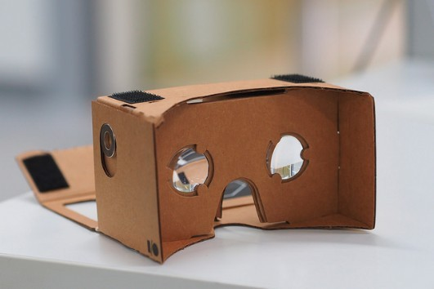
Issues with Cardboard & Co.
Image source (CC): https://www.flickr.com/photos/othree/14519574116
Only single camera on almost all devices → no 3D view for AR possible, “flat screen effect”
(Mostly) no positional tracking, only rotation → higher probability of motion sickness
Unpredictable device capabilities
Uncomfortable weight distribution
Touchscreen inaccessible

Slide 13
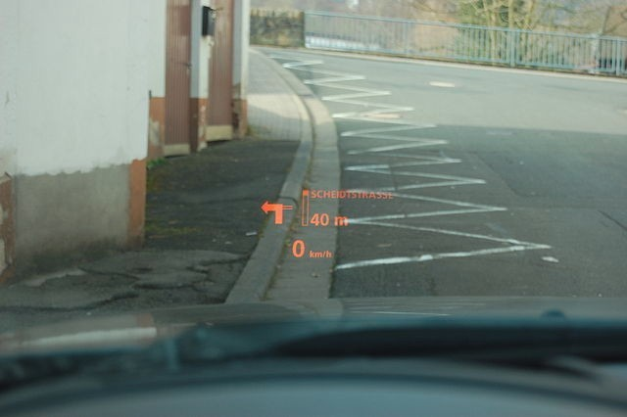
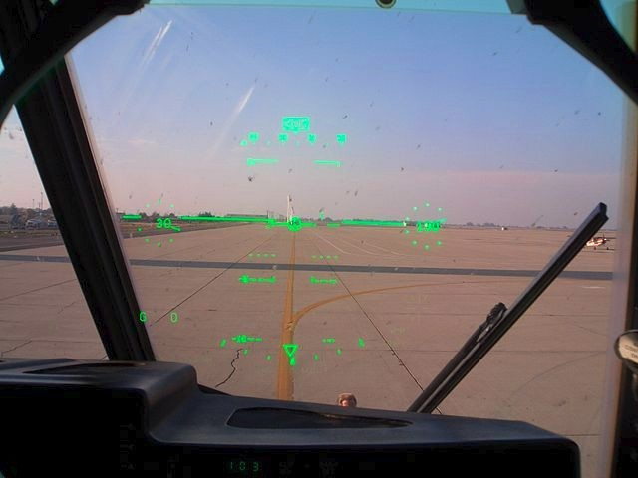
Heads-up displays (HUDs)
Image source (CC): https://en.wikipedia.org/wiki/Head-up_display#/media/File:E60hud.JPG
Image source (CC): https://en.wikipedia.org/.../File:C-130J_Co_Pilot%27s_Head-up_display.jpg
Mostly used in vehicles (car, airplane)
  Navigational information, speed, horizon etc.
  Not always spatially aligned (cf. left image)
  Uses beam combiner (windshield) + 2D display

Slide 14
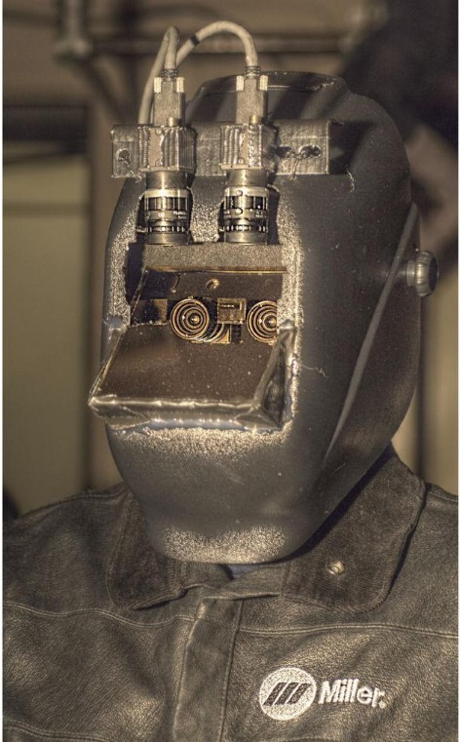
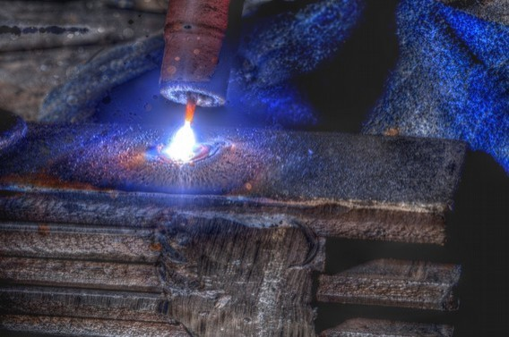
Augmented Diminished Reality?
Image source (FU): http://wearcam.org/mannventions-password-stefanosmannaz13/mannglas.htm
Not adding, but removing real-world content?
  Any plausible scenario?
→ HDR welding mask/goggles
  Filters out welding arc
  Other details remain visible

Slide 15
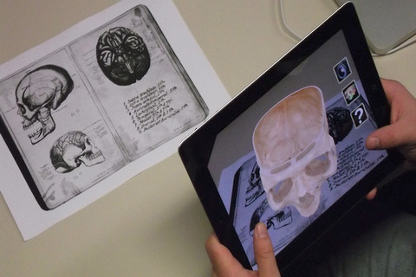
Mobile devices as AR displays
Image source (CC): https://en.wikipedia.org/.../File:App_iSkull,_an_augmented_human_skull.jpg
Uses “window into virtual world” metaphor
Usually no 3D display
  Except with tricks like Google Cardboard
  Parallax issues
Primary problem: location/tracking

Slide 16
AR: tracking & localization
Fundamental requirement for AR: stable & reliable head/view tracking
Multiple different approaches:
  GPS + IMU
  Vision-based
    Stereo/depth cameras
    SLAM algorithms

Slide 17

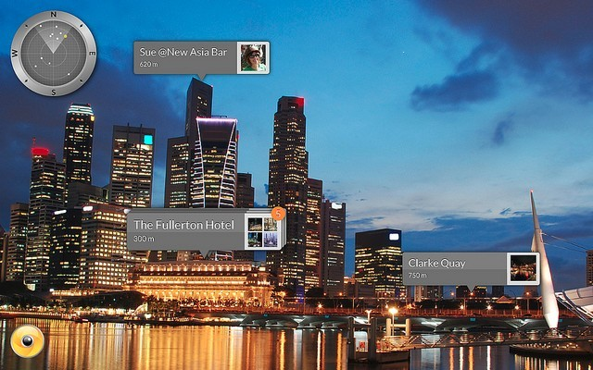
Tracking: GPS + IMU
Image source (CC): https://www.flickr.com/[...]/, https://www.flickr.com/[...]/27972275293
Sensor fusion for 6D pose (geo coordinates)
  3D position from GPS, 3D orientation from IMU
  (Relatively) low accuracy & position
  Requires additional environment information
Best suited for large- scale applications, e.g. buildings
Examples: Pokemon Go, Layar, Wikitude Browser

Slide 18
Tracking: vision-based
Primary goal (again): retrieve 6D pose
  Secondary goal: create environment map
  Enables interaction with environment
… using specialized hardware:
  Add-on stereo cameras/depth cameras
  iPad Pro (tablet with depth cam)
… for arbitrary devices (single RGB cam):
  Marker-based (fiducial/image)
  SLAM algorithms

Slide 19
Tracking: vision – stereo/depth
Core idea: each pixel provides color + distance
Stereo cameras: 2 cams mounted in parallel
  Replicate (part of) human depth perception
  Find stereo correspondences between 2 images
  Use camera/lens geometry to calculate distance
Depth cameras: single camera + emitter
  ToF – Time-of-flight: measure travel time of IR flash
  Structured light: shift in projected light pattern
Both methods require specialized hardware!

Slide 20
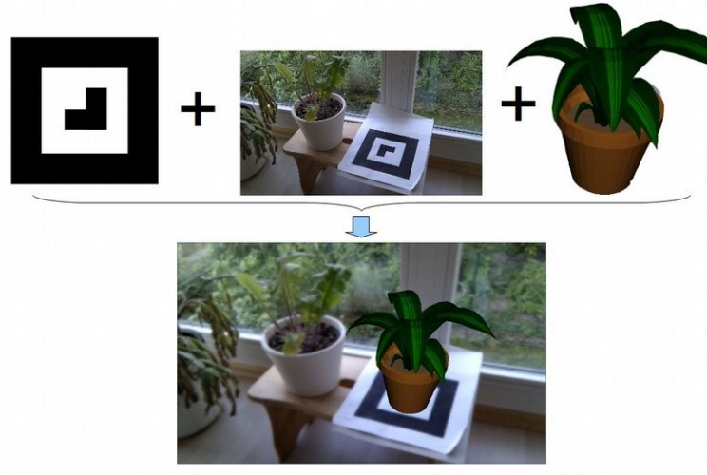
Tracking: vision – marker-based
Image source (FU): https://code.google.com/p/andar/
Image source (CC): https://en.wikipedia.org/.../File:App_iSkull,_an_augmented_human_skull.jpg
Core idea: use pre-defined markers/targets
  “Fiducials”: printed black-and-white patterns
  Image targets: use (flat) real-world objects
System detects pose relative to target

Slide 21
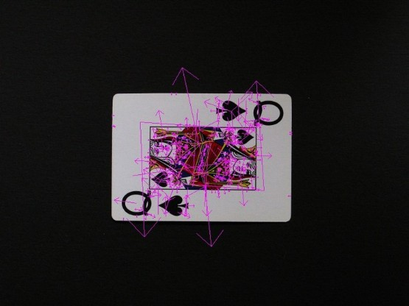
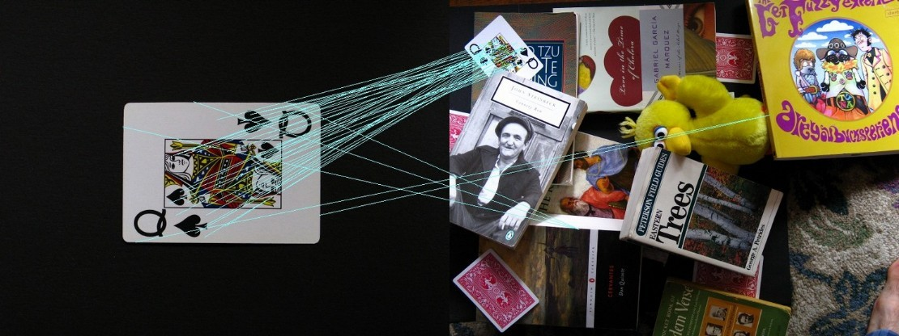
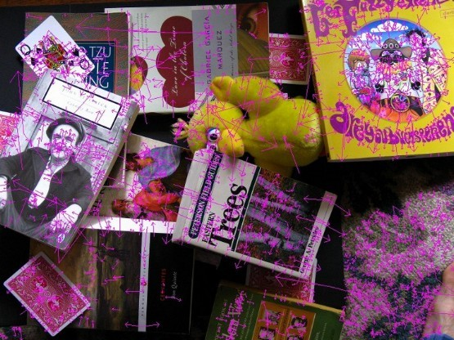
Marker-based tracking: SIFT & Co.
Image source (FU): https://robwhess.github.io/opensift/
SIFT = Scale Invariant Feature Transform
  Detects key points in images
  Describes them independent of size, rotation, …
  Descriptors can be matches across images → calculate geometric transformation

Slide 22
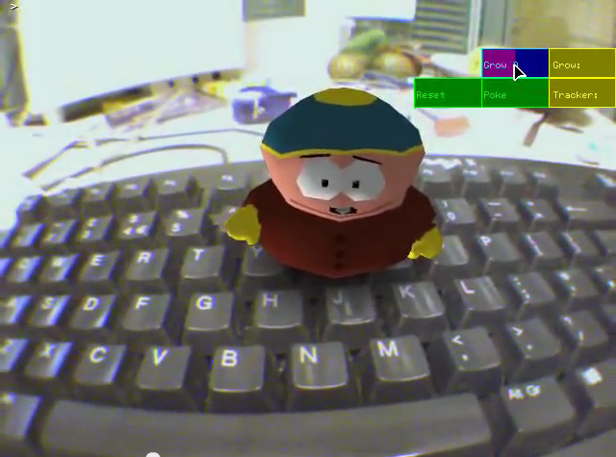
Tracking: vision – SLAM (1)
Image source (FU): https://www.youtube.com/watch?v=F3s3M0mokNc
Simultaneous Localisation & Mapping
  Creates 3D environment map + 6D camera pose
  Requires only single camera
  Works on almost any device
  Creates stereo corres- pondences from motion
  (Optionally) uses IMU data to determine motion magnitude

Slide 23
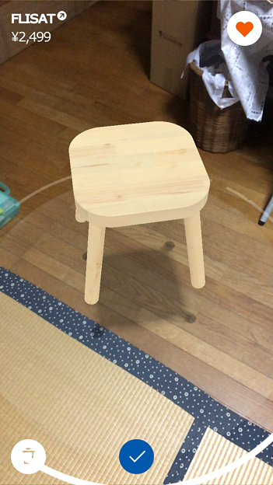
Tracking: vision – SLAM (2)
Image source (CC): http://photozou.jp/photo/show/124201/251690045
Map generation requires significant processing power
  Possible on most recent smartphones with ARKit/ARCore frameworks
  Needs calibration data for camera (distortion), IMU (alignment to camera)
  Includes plane detection (floor, tables, walls) for object placement + shadows
  Touchscreen-based interaction

Slide 24
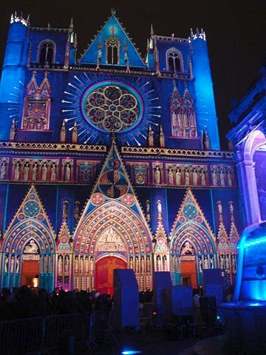
Spatial AR/Projection Mapping (1)
Image source (CC): https://en.wikipedia.org/.../File:Cath._St_Jean_%282%29.JPG
Video source (FU): https://www.youtube.com/watch?v=KBx4RGoB6XI
Project augmentations directly onto real world
  Mostly static projector/camera setups
    E.g. for buildings, cars, other large objects
  Pico projectors → mobile use?
    Big problem (again): brightness vs. power supply
    Other issue: focus distance → laser projectors?
    Requires …
      accurate environment maps
      object tracking

Slide 25
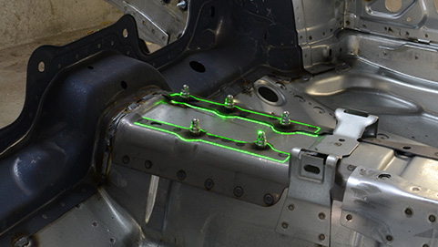
Spatial AR/Projection Mapping (2)
Image source (FU): https://www.extend3d.de/
Industrial usage scenario: project assembly instructions directly onto workpiece (“Werklicht” by Extend3D)
  Needs high brightness & focal depth (green outline) → laser projector required
  Workpiece geometry needs to be known in advance → target for visual tracking (similar to image targets)

Slide 26
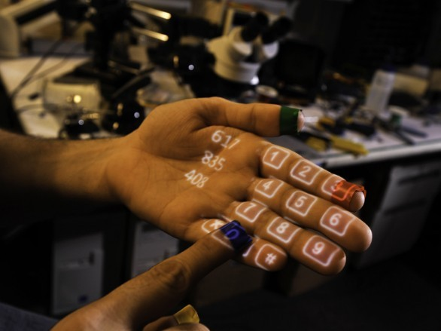
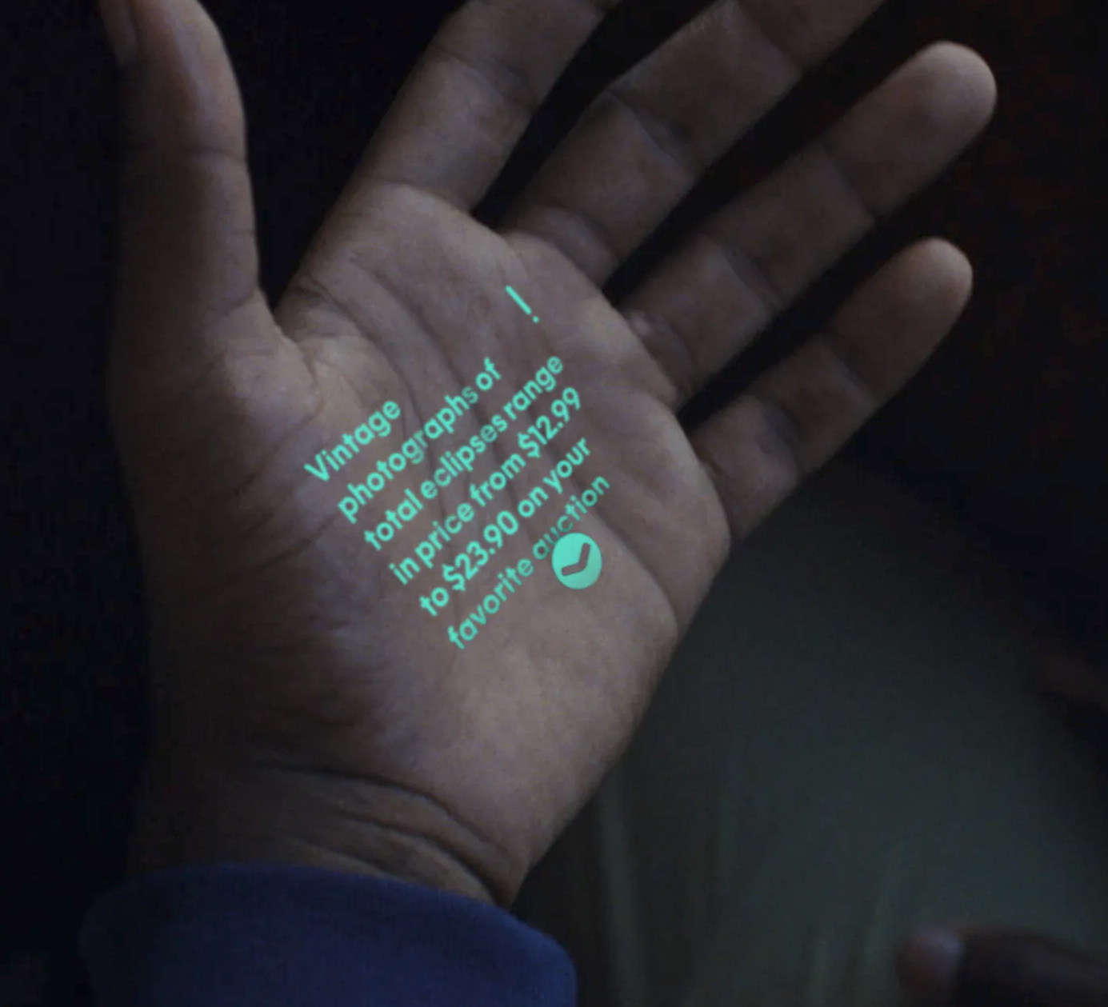
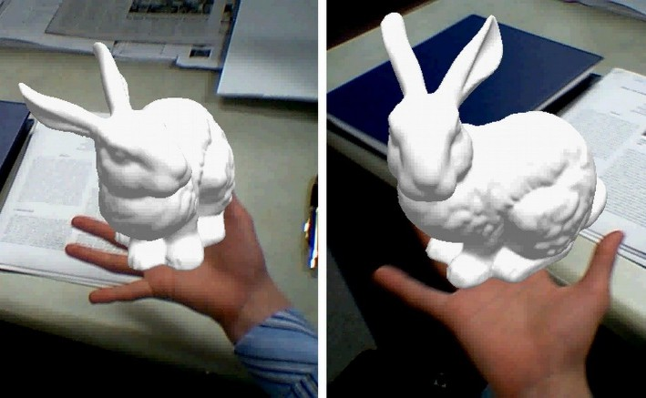
Interaction with AR
Image source (FU): http://www.pranavmistry.com/projects/sixthsense/
Image source (FU): http://ilab.cs.ucsb.edu/projects/taehee/HandyAR/
Touch screen, e.g. “Touch Projector”, AI Pin
  Not feasible with HMDs, only for handheld use
Individually tracked tools (e.g. Wiimote, gloves)
Optical recognition/tracking of hands

Slide 27
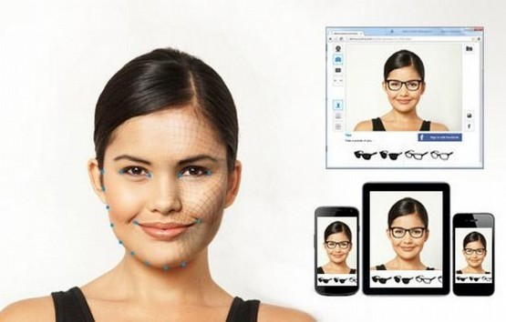
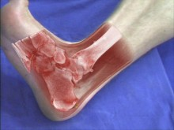
AR applications
Image source (FU): http://www.trylive.com/
Image source (FU): http://campar.in.tum.de/Chair/ResearchIssueMedAR
AR: still waiting for the “killer app”
  Advertisements (Ikea, fashion) →
  Military (sadly): cockpits, weapon sights
  Education (e.g. iSkull, slide 14)
  Repair & Maintenance (e.g. see video)
  Gaming (e.g. Ingress, Pokemon Go)
  Medical applications (X-ray vision) →
  Navigation (only prototypes)

Slide 28
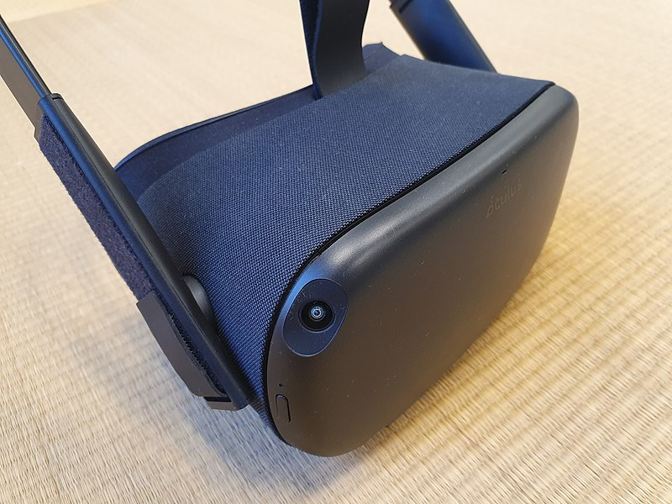
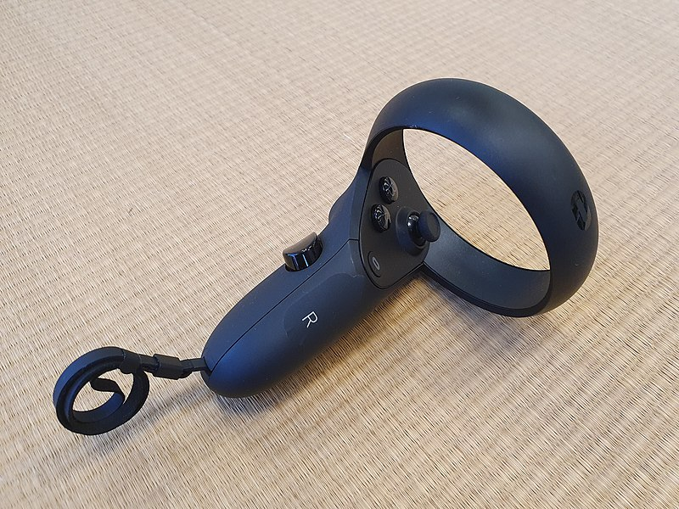
“Mobile” Virtual Reality?
Image source (CC): https://de.m.wikipedia.org/wiki/Datei:Oculus_Quest.jpeg
Image source (FU): https://de.m.wikipedia.org/wiki/Datei:Oculus_Touch_Hand_Controller_2.jpeg
Meta Quest 1-3: no cables (mobile HW)
4 low-res high-speed IR cameras
  Tracking of hand-held controllers
  “Room-scale” 6DoF tracking
No obstacle detection, only pre-defined safety boundaries → needs large space
Possible workaround: “redirected walking”
General research topic in VR: locomotion

Slide 29
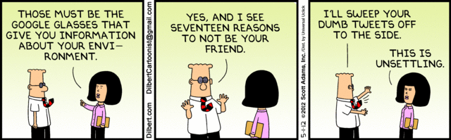
The End

