Slide 1
Software Engineering
Lecture 10 – Testing/CI
& Memory Layout
© 2015 Dr. Florian Echtler
Bauhaus University Weimar
<florian.echtler@uni-weimar.de>
This work is licensed under a Creative Commons Attribution-NonCommercial-ShareAlike 4.0 International License.

Slide 2
Testing (Recap)
Abstract: process test cases, check results
However: tests can only show presence of errors, not absence.
Outputs revealing
presence of defects
Input
test
cases
Output
test
results
I_{e}
O_{e}
Inputs causing
anomalous
behaviour
System

Slide 3
Testing (Recap 2)
Validation testing
  Show that software meets requirements
  Test cases modelled after typical use cases
Defect testing
  Obvious goal: find bugs/errors/design flaws!
  Test cases contain atypical/erroneous data

Slide 4
Testing: Variants
Testing is possible at many levels/stages
Development testing
  unit testing
  component testing
  system testing
Performance testing
User testing
Release testing

Slide 5
Development testing strategies (1)
Partition testing (defect testing)
  Determine equivalence partitions for input data
  Equivalent behaviour for all inputs from one partition
  Select test cases from each partition and at partition boundaries
  Related to path testing/code coverage (equivalent behaviour → same execution path), see lecture 7
  Usually requires some knowledge about internals, i.e. pure black-box testing difficult

Slide 6
Development testing strategies (2)
Guideline-based testing (defect testing)
Select test cases known to be error-prone
  NULL for pointers
  NaN, -0, inf for float/double values
  INT_MAX, -INT_MAX, 0 for integers
Sequences/arrays/vectors
  Sequences with 0 or 1 values
  Sequences with different lengths for each test
  Access first/middle/last element of sequence

Slide 7
Development testing strategies (3)
Example:
  Function which accepts 4-10 input values
  Each value is 3-digit integer >= 100
Partitions → see diagram
Guidelines:
  Also test with empty sequence/1 value
  Test with input values of 0/INT_MAX
0 1
3 4
7
10 11
n:
n < 4
4 <= n <= 10
n > 10
0 MAX
99 100
999 1000
v:
v < 100
v >= 100
v >= 1000

Slide 8
Performance/stress testing
Mainly relevant for back-end systems (servers, databases) – hybrid verification/defect test
Usually relies on required performance (e.g. transaction/second) and exceeds this limit
Goal: test failure behaviour
  soft fail: just fewer transactions than requested
  hard fail: system crash/data loss

Slide 9
Fuzzing
Intentionally flood the component with random/garbage input
  More data per time than during normal operation
  Malicious/garbage data values
Also possible for UIs, e.g. monkeyrunner on Android (generates random touch events)
Often used for security testing, i.e. to find exploitable bugs

Slide 10
User testing
Tests performed by end-users, not developers
Focus on user interface, not internals
  Paper prototypes (before any code is written), mockups (e.g. using HTML5/Flash)
  “Classic” usability study, think-aloud testing (invite testers to lab, observe usage)
  “In-the-wild” study → daily usage scenario + recording/logging of comments, interactions, …
  A/B testing: provide two different variants of UI to two groups of people, compare e.g. efficiency

Slide 11
Release testing
Final verification tests before delivery
Usually black-box testing, relying only on specification/requirements
Also called acceptance testing, may involve customers/users
In agile processes (no rigid requirements):
  Part of each cycle (e.g. Scrum)
  Performed by “product owner”
  Some documentation/”sign-off”recommended

Slide 12
Continuous Integration (1)
Source: https://en.wikipedia.org/wiki/Continuous_integration
CI: agile method, collection of “best practices”
Maintain a code repository
  Use branches sparingly
Automate the build
  A single command (e.g. “make”) should build everything
Make the build self-testing
  Tests should be integrated into build process

Slide 13
Continuous Integration (2)
Source: https://en.wikipedia.org/wiki/Continuous_integration
Often considered the most central part of CI:
Everyone commits to mainline every day
  Keeps number of conflicts low
Every commit to mainline should be built
  Should also be automated, e.g. with Jenkins, Travis-CI (integrated with Github), …

Slide 14
Continuous Integration (3)
Source: https://en.wikipedia.org/wiki/Continuous_integration
Keep the build fast
  Prerequisite for frequent re-builds
Test in a clone of the production environment
  e.g. test apps on real phone, not simulator
  Separate test env. can introduce new bugs
  Use scaled-down production environment
Make it easy to get the latest deliverables
  e.g. direct download access for customer

Slide 15
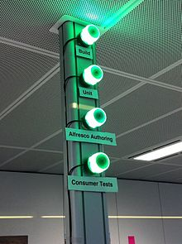
Continuous Integration (4)
Image source (CC): https://en.wikipedia.org/wiki/Build_light_indicator
Everyone can see results of latest build
  Build problems are fixed quickly
  Often shown by physical indicators (see image)
Automate deployment
  e.g. automated upload to app store/beta testers
  “Continuous Deployment”

Slide 16
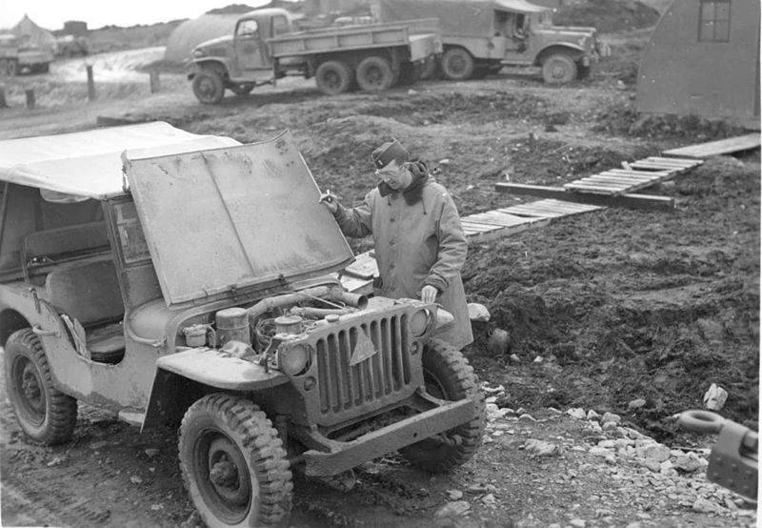
C++ memory layout: under the hood
Image source (PD): https://en.wikipedia.org/...old_jeep_from_world_war_two.jpg

Slide 17
C++ memory layout: under the hood
Source (FU): http://www.openrce.org/articles/files/jangrayhood.pdf
A* a →
class A {
public:
char c;
int i;
void foo();
};
A* a = new A();
a->foo(); // calls A::foo
memory adresses
A::c
<padding>
A::i
local
global
A::foo(A* this)
...

Slide 18
C++ memory layout: under the hood
Source (FU): http://www.openrce.org/articles/files/jangrayhood.pdf
B* b →
class A {
public:
char c;
int i;
void foo();
};
A* a = new A();
a->foo(); // calls A::foo
class B: public A {
public:
int i2;
void foo();
};
B* b = new B();
A* a2 = b;
b->foo(); // calls B::foo
a2->foo(); // calls A::foo
memory adresses
A::c
<padding>
A* a2
A::i
B::i2
local
global
A::foo(A* this)
...
B::foo(B* this)
...

Slide 19
C++ virtual funcs: under the hood
Source (FU): http://www.openrce.org/articles/files/jangrayhood.pdf
P* p →
class P {
public:
int p1;
virtual void bar();
};
P* p = new P();
p->bar(); // calls P::bar
memory adresses
P::virt_funcs
P::p1
local
global
&P::bar
P::bar(P* this)
...

Slide 20
C++ virtual funcs: under the hood
Source (FU): http://www.openrce.org/articles/files/jangrayhood.pdf
Q* q →
class P {
public:
int p1;
virtual void bar();
};
P* p = new P();
p->bar(); // calls P::bar
class Q: public P {
public:
int q1;
virtual void bar();
virtual void baz();
};
Q* q = new Q();
P* p2 = q;
q->bar(); // calls Q::bar
p2->bar(); // calls Q::bar
memory adresses
P::virt_funcs
P* p2
P::p1
Q::q1
local
global
&Q::bar
&Q::baz
Q::bar(Q* this)
...
...

Slide 21
Buffer Overflow (1)
top of stack
esp = 0x0019fee0
00 | 19 | ff | 28
00 | 40 | 10 | 48
Source (FU): http://arstechnica.com/security/...-the-buffer-overflow/
stack growth
memory addresses
void get_name() {
  char name[64];
  printf(“Your name? ”);
  std::gets(name);
  printf(“Hi, %s.”,name);
}
char name[64]
frame pointer
return address

Slide 22
Buffer Overflow (2)
top of stack
esp = 0x0019fee0
P | e | t | e
r | 00
00 | 19 | ff | 28
00 | 40 | 10 | 48
Source (FU): http://arstechnica.com/security/...-the-buffer-overflow/
stack growth
memory addresses
gets = “Get String”
Reads characters until newline
Does not check any other conditions → problems?
char name[64]
frame pointer
return address

Slide 23

Buffer Overflow (3)
top of stack
esp = 0x0019fee0
A | A | A | A
A | A | A | A
A | A | A | A
A | A | A | A
A | A | A | A
A | A | A | A
A | A | A | A
A | A | A | A
A | A | A | A
A | A | A | A
A | A | A | A
A | A | A | A
A | A | A | A
A | A | A | A
A | A | A | A
A | A | A | A
A | A | A | A
A | A | A | A
A | A | A | A
A | A | A | …
Source (FU): http://arstechnica.com/security/...-the-buffer-overflow/
stack growth
memory addresses
No size check!
→ return address overwritten
→ program crashes
Many similar, outdated C functions → listen to compiler warnings!
Other problems?
char name[64]
frame pointer
return address

Slide 24
Buffer Overflow (4)
top of stack
esp = 0x0019fee0
c | a | l | c
. | e | x | e
88 | 64 | 24 | c0
83 | ec | 48 | 89
e5 | 83 | ec | 54
89 | e3 | 6a | 54
53 | e8 | 42 | d1
b2 | 77 | c6 | 45
ac | 44 | 8d | 45
f0 | 50 | 53 | 52
52 | 52 | 52 | 52
52 | 55 | 52 | fe
4d | 34 | e8 | 49
0b | 84 | 77 | 66
81 | f4 | a4 | 01
56 | 66 | 81 | 34
24 | 78 | 04 | c3
00 | 19 | fe | e8
Source (FU): http://arstechnica.com/security/...-the-buffer-overflow/
stack growth
memory addresses
Return address can be overwritten with pointer to buffer itself
Possible to insert and execute arbitrary code!
Root cause of many historic security issues (e.g. Morris worm)
char name[64]
frame pointer
return address

Slide 25
Buffer Overflow (5)
top of stack
esp = 0x0019fee0
c | a | l | c
. | e | x | e
88 | 64 | 24 | c0
83 | ec | 48 | 89
e5 | 83 | ec | 54
89 | e3 | 6a | 54
53 | e8 | 42 | d1
b2 | 77 | c6 | 45
ac | 44 | 8d | 45
f0 | 50 | 53 | 52
52 | 52 | 52 | 52
52 | 55 | 52 | fe
4d | 34 | e8 | 49
0b | 84 | 77 | 66
81 | f4 | a4 | 01
56 | 66 | 81 | 34
24 | 78 | 04 | c3
00 | 19 | fe | e8
Source (FU): http://arstechnica.com/security/...-the-buffer-overflow/
stack growth
memory addresses
Modern OS contain multiple countermeasures
Possible mitigation strategies?
  Address layout randomization
  Stack “canary” values
  No-Execute-Bit (NX)
char name[64]
frame pointer
return address

Slide 26
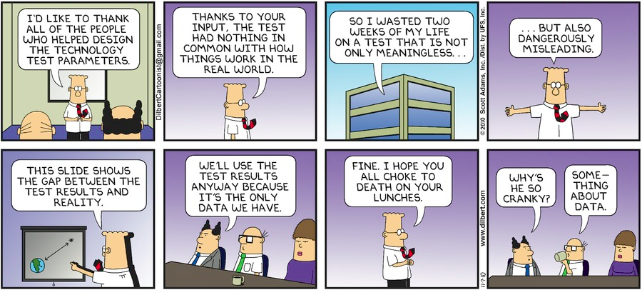
Questions/Comments?
Thanks for listening!

