Slide 1
Software Engineering
Lecture 05 – Agile Methods
© 2015-20 Dr. Florian Echtler
Bauhaus-Universität Weimar
<florian.echtler@uni-weimar.de>
This work is licensed under a Creative Commons Attribution-NonCommercial-ShareAlike 4.0 International License.

Slide 2
General problems with IT projects
Source (FU): McKinsey, 2012, http://www.mckinsey.com/...IT_projects_on_time_budget_and_value.ashx
On average, large IT projects (> $15 million):
  45 % over budget
  7 % over time
  56 % less value than predicted
17 % of large projects fail so spectacularly as to threaten company survival

Slide 3
Plan-driven methods: Problems
Emerged in 1960s from other engineering disciplines
Business cycles getting ever faster
  → requirements change quickly
  → plan-driven methods require rework
For small projects: massive overhead
  → often more management than development
→ starting in 1990s: shift to agile methods

Slide 4
The Agile Manifesto
Source (FU): Kent Beck et al., 2001, http://agilemanifesto.org/
“We are uncovering better ways of developing software by doing it and helping others do it. Through this work we have come to value:
Individuals and interactions over processes and tools
Working software over comprehensive documentation
Customer collaboration over contract negotiation
Responding to change over following a plan
That is, while there is value in the items on the right, we value the items on the left more.”

Slide 5
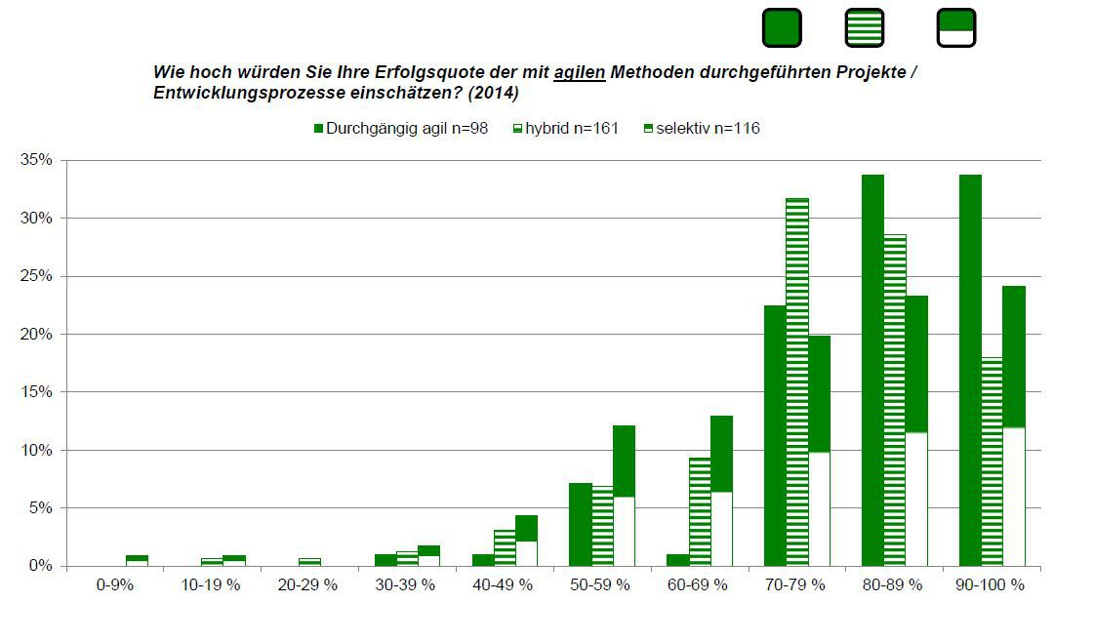
Popularity of agile methods
Image source (FU): Prof. Dr. Komus, HS Koblenz, Studie Status Quo Agile 2014
Estimate your success quota for projects conducted with agile methods:
agile
hybrid
selective

Slide 6
Key aspects of agile models
Interleaving of activities
  Specification, design and implementation interleaved/concurrent
Incremental development
  Regular releases with customer involvement
Prototyping tools
  e.g. user interfaces quickly built with visual editors

Slide 7
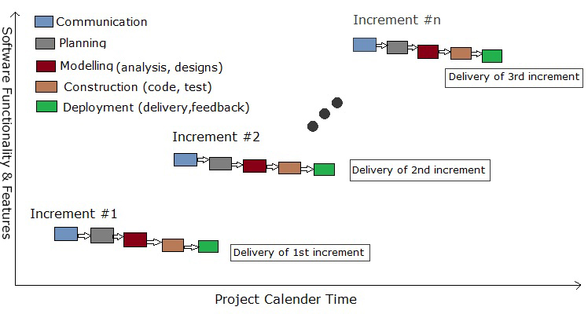
Incremental Development
Image source (CC): https://en.wikipedia.org/wiki/Incremental_build_model

Slide 8
Key agile principles
Customer involvement throughout the development process
Incremental delivery based on customer's priorities
People, not process: leave the development team to their own self-organizing ways
Embrace change: expect requirements to change from the start
Maintain simplicity by constant refactoring

Slide 9
Possible issues with agile methods
Strong commitment & background knowledge (also in IT) from customer required
Conflicting priorities from many stakeholders
Team members' personalities?
Cultural conflict with processes/contracts in large companies

Slide 10
Possible issues with agile (2)
Constant refactoring means extra work → often neglected under time pressure
Team members often change after each cycle → less stable environment
Maintenance more difficult due to lack of documentation/original team

Slide 11
Things to consider
Best for... | Agile | Plan-driven
Development team | small, co-located, highly skilled | large, distributed, lower (average) skill
System size | small, monolithic | large, distributed
Regulation compliance or formal analysis needed? | no | yes
System lifetime and iterations | short/many | long/few
Organization | small startup | large corporation

Slide 12
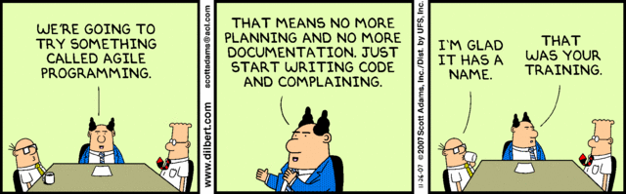
Agile Methods
Extreme Programming [Beck1999]
Scrum [Schwaber/Beedle2001]
Feature Driven Development [DeLuca1997] http://www.nebulon.com/
(Open) Kanban [Hurtado2013] http://agilelion.com/agile-kanban-cafe/open-kanban

Slide 13
Extreme Programming (XP)
Focused on development aspects
Key components:
  User stories define requirements
  Pair programming, test-first development
  Multiple new builds/versions per day
  All tests must pass before integration
  New releases delivered every ~ 2 weeks
  No delays, remove features if necessary

Slide 14
XP: Planning & Design
Incremental planning
  Requirements based on “user stories”
  Select stories for each release based on available time & priority
Simple design
  Only design for the current requirements
On-site customer
  Customer representative as full-time team member

Slide 15
XP: Planning & Design (2)
Conventional wisdom in SE: “design for change” → anticipating changes now saves time and effort later
XP perspective: changes cannot be reliably anticipated, leads to unnecessary effort for generalization
→ constant code improvement/refactoring

Slide 16
XP: User Stories
Source (FU): Sommerville, Software Engineering, Chapter 3
Sample user story: Prescribing medication
Kate is a doctor who wishes to prescribe medication for a patient attending a clinic. The patient record is already displayed on her computer, so she clicks on the medication field and can select “current medication”, “new medication” or “formulary”.
If she selects “current medication”, the system asks her to check the dose. If she wants to change the dose, she enters the new value and then confirms the prescription.
[…]
The system always checks that the dose is within the approved range. If it isn't, Kate is asked to change the dose.
After Kate has confirmed the prescription, it will be displayed for checking. She either clicks 'OK' or 'Change'. If she clicks 'OK', the prescription is recorded on the audit database. If she clicks on 'Change', she reenters the 'Prescribing Medication' process.

Slide 17
XP: User Stories (2)
Source (FU): Sommerville, Software Engineering, Chapter 3
User stories broken down into tasks
  Task 1: Change dose of prescribed drug [...]
  Task 2: Formulary selection [...]
  Task 3: Dose checking
  Dose checking is a safety precaution to check that the doctor has not prescribed a dangerously small or large dose.
  Using the formulary ID for the generic drug name, look up the formulary and retrieve the recommended maximum and minimum dose.
  Check the prescribed dose against the minimum and maximum. If outside the range, issue an error message saying that the dose is too high or too low. If within the range, enable the 'Confirm' button.

Slide 18
XP: Development
Pair programming
  Two people on one workstation
  Provides instant code review
Constant refactoring, e.g.
  Rename methods/classes with descriptive names
  Move long code section to separate method
Collective ownership
  All developers work on all system components
  No “islands of expertise”

Slide 19
XP: Development (2)
Test-first development
  Automated unit tests
  Written before the code itself
Continuous integration
  Task completed → integrate into whole system
  Whole build, all tests must still pass
Sustainable pace
  Significant overtime not acceptable
  Reduces code quality and long-term performance

Slide 20
XP: Testing
Incremental development
  → no clear/fixed specification
  → no external testing team possible
Tests created by developers before the code
  → implicitly defines interface & spec.
  → avoids test lag
Tests built on tasks from user stories
Customer involvement through test cases

Slide 21
XP: Testing - Example
Source (FU): Sommerville, Software Engineering, Chapter 3
Test: Dose Checking
  Input:
    A number in mg representing a single dose of the drug.
    A number representing the number of doses per day.
  Tests:
    Input where single dose is correct but freq. too high.
    Input where single dose is too high or too low.
    Input where single dose * freq. is too high or too low.
    Input where single dose * freq. is in permitted range.
  Output:
    OK or error message that dose is outside of safe range.

Slide 22
XP: Testing – possible issues
Code coverage
  Developers may skip certain test cases
  Refactoring can cause classes to be missed
“Incremental testing”
  Interaction between classes difficult to test
  Even 100% unit test coverage can't catch all bugs

Slide 23
XP: Pair Programming
Two developers on one workstation
  Supports collective ownership/responsibility, “egoless programming”
  Informal review process: each line of code is looked at by at least 2 persons
Total productivity comparable to 2 persons working alone: continuous discussion →
  Implicit knowledge sharing
  Fewer false starts/mistakes
However: depends on individual personality!

Slide 24
Scrum
Focused on management aspects
    Definition – British (informal), orig. from Rugby:
      a disorderly crowd of people or things. "there was quite a scrum of people at the bar"
Designed to enable management of iterative development processes (contradiction!)
3 phases:
  Outline – general objectives, architecture
  Sprint cycles – develop one release per cycle
  Project closure – wrap-up & documentation

Slide 25
Scrum
Assess
Select
Initial planning
and design
Project closure
Review
Develop
“Sprint cycle”

Slide 26
Scrum
Sprint cycle (~ 2 weeks = one release in XP)
  Assess product backlog (work to be done)
  Select features/functionality (with customer)
  Develop release (team isolation by Scrum master)
  Review and present to stakeholders

Slide 27
Scrum Master/Meetings
Facilitator – main tasks:
  Arrange daily stand-up meetings (~ 15 min.)
  Track backlog/work to be done
  Record decisions
  Communicate with customers/upper management
Daily meetings
  Everyone briefly describes progress/problems/ plan for the day
  Everyone knows about project state

Slide 28
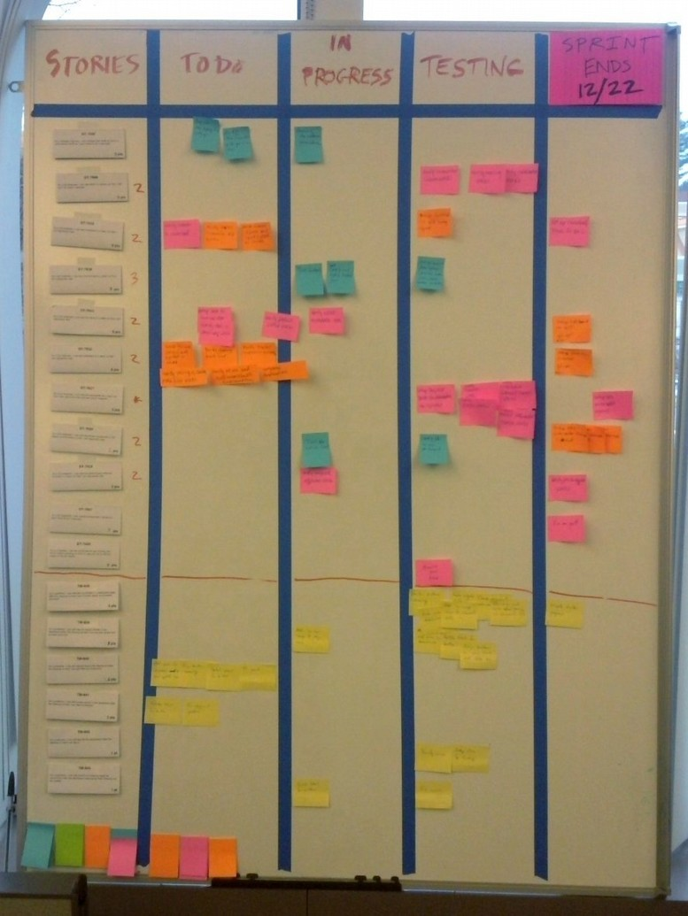
Scrum Board
Image source (CC): https://en.wikipedia.org/wiki/Scrum_%28software_development%29
Often used to track progress during sprint cycle
Categories: ToDo, In Progress, (Testing), Done

Slide 29
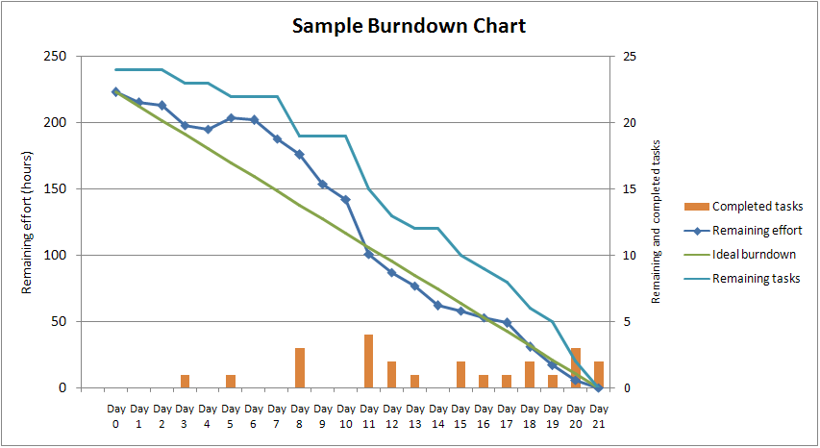
Scrum: Burn-down chart
Image source (CC): https://en.wikipedia.org/wiki/Scrum_%28software_development%29

Slide 30
Scaling agile methods up
Scaling up: agile methods for large systems
  Consist of separate, communicating subsystems
  Include/interact with other existing systems
  Have to follow regulations (e.g. aircraft)
  Long procurement/development/deployment time
  Multiple stakeholders

Slide 31
Scaling agile methods up (2)
Agile adaption requires …
  Multiple teams (too large for single small team)
  At least some up-front architecture design
  Communication mechanisms between teams (e.g. Wikis, video calls, group chat, … )
  More detailed documentation
  Continuous integration perhaps not possible due to build duration

Slide 32
Scaling agile methods out
Scaling out: agile methods in large companies
Needs to deal with …
  Reluctance in upper management
  Incompatible with bureaucratic procedures/regulations
  Wide range of skill levels in teams
  Cultural resistance

Slide 33
Summary
Both plan-driven and agile have merits
Textbook examples are unlikely to work in reality without adaptation
Remember: one size does not fit all.

Slide 34
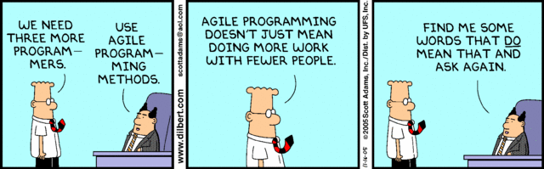
Questions/suggestions?

