Slide 1
Software Engineering
Lecture 01 – Introduction
© 2015-17 Dr. Florian Echtler
Bauhaus-Universität Weimar
<florian.echtler@uni-weimar.de>
This work is licensed under a Creative Commons Attribution-NonCommercial-ShareAlike 4.0 International License.

Slide 2
Do you know...
any programming language?
C ?
C++ ?
any revision control system?
SVN ?
git ?
UML ?
Agile development ?

Slide 3
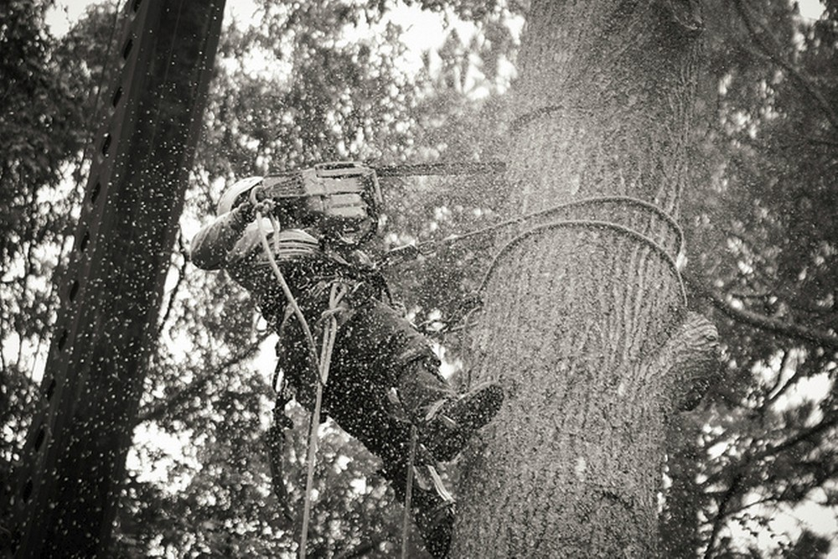
Why software engineering?
Image source (CC): https://www.flickr.com/photos/jacobavanzato/16152519186
Software development is (relatively) easy
(Unlike operating a chainsaw in the forest)

Slide 4
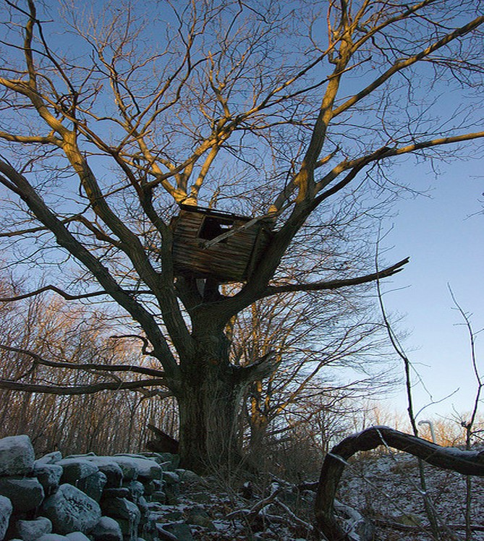
Why software engineering?
Image source (CC): https://www.flickr.com/photos/78044378@N00/364003706
A first prototype is usually finished quickly …

Slide 5

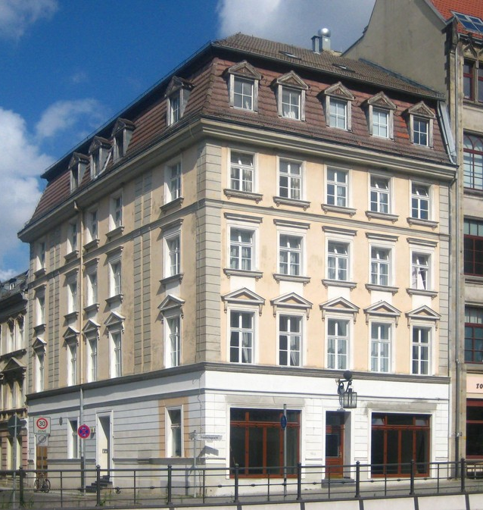
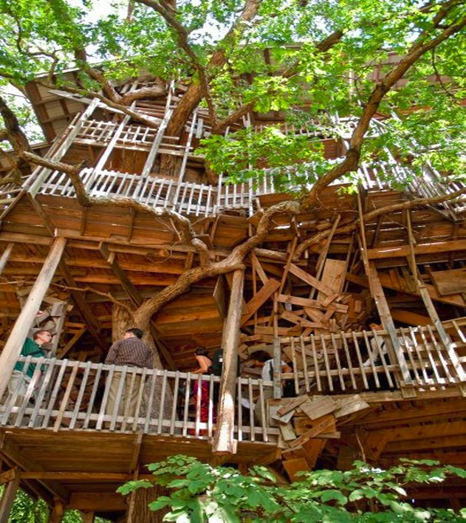
Why software engineering?
Image sources (CC): https://www.flickr.com/photos/10402746@N04/7165270428
https://commons.wikimedia.org/wiki/File:Berlin,_Mitte,_Kleine_Gertraudenstra%C3%9Fe_3,_Wohnhaus_01.jpg
… however, expanding that prototype is often much more difficult.

Slide 6
Why software engineering?
Create software that is …
  well-structured
  easy to maintain
  (re-)usable
  … and meets its requirements.
Provide a development process which is …
  predictable
  adaptable
  … and on time.

Slide 7
Topics (1)
Best practices
  revision control: SVN, git, …
  testing: unit tests, iterative development, …
  UML diagrams (refresh from Modelling class)
Development paradigms/process models
  “Classic”: Waterfall, RUP, Spiral, …
  “Agile”: Scrum, XP, …

Slide 8

Topics (2)
Design Patterns (in C++)
  simple patterns: e.g. Singleton
  complex patterns: e.g. Factory
Miscellaneous Topics
  Building & Debugging
  Requirements Engineering
  UI Patterns
  Open-source software

Slide 9
Lectures
Introduction
Best practices: RCS, testing, UML recap
“Classic” & “agile” development models (2 lectures)
Design Patterns (2 lectures)
Code Quality
Build Systems & Debugging
Requirements Engineering
Testing & Continuous Integration
Open Source Software
Exam Preparation

Slide 10
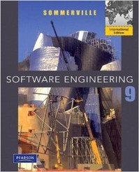

Companion Books
Ian Sommerville, “Software Engineering” (9th edition)
http://opac.ub.uni-weimar.de/DB=1/PPNSET?PPN=618878599
Erich Gamma et al., “Design Patterns”
http://opac.ub.uni-weimar.de/DB=1/PPNSET?PPN=520726987

Slide 11
Further reading
Fred P. Brooks, “The Mythical Man-Month” [1] (historic perspective on SE)
Eric S. Raymond, “The Cathedral and the Bazaar” [2] (open source development)
Kent Beck et al., “The Agile Manifesto” [3] (origins of agile development)
[1] http://opac.ub.uni-weimar.de/DB=1/PPNSET?PPN=352067705
[2] http://www.catb.org/esr/writings/cathedral-bazaar/
[3] http://agilemanifesto.org/

Slide 12
Great software failures
Software is everywhere
→ massive damage potential
Billions of $ lost
Hundreds of deaths & injures

Slide 13
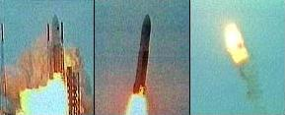
Ariane 5 Flight 501
Image source (FU): https://www.ima.umn.edu/~arnold/disasters/ariane.html
Left/center: liftoff (June 4th, 1996)
Right: self-destruct after 39 seconds
~ 500 million US-$ damage

Slide 14
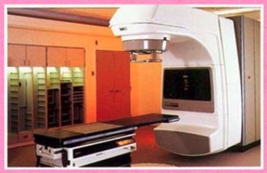
Therac-25
Image source (FU): http://cr4.globalspec.com/blogentry/19025/Failure-of-the-Therac-25-Medical-Linear-Accelerator
Radiation therapy machine for cancer patients
At least 6 accidents with massive radiation overdoses → death or serious injury

Slide 15
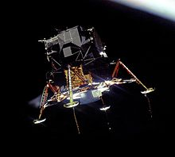
Apollo 11 PGNCS
Image source (PD): https://en.wikipedia.org/wiki/Apollo_11#Lunar_descent
During lunar descent:
Unexpected “executive overflow” alarms

Slide 16
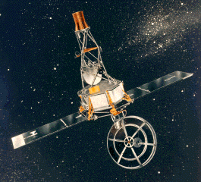
Mariner I
Image source (PD): http://nssdc.gsfc.nasa.gov/nmc/spacecraftDisplay.do?id=MARIN1
First US Venus probe
Rocket self-destructed shortly after launch

Slide 17
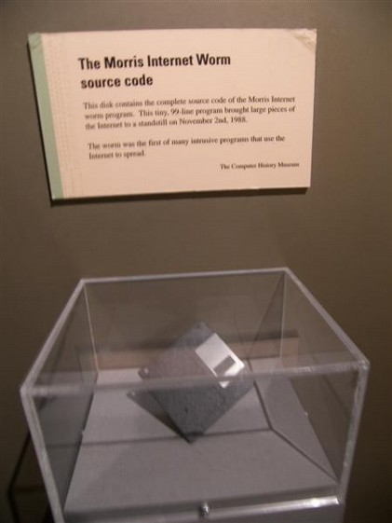
“Morris Worm”
Image source (CC): https://en.wikipedia.org/wiki/Morris_worm#/media/File:Morris_Worm.jpg
First “computer virus” - by accident
Designed as a research tool

Slide 18
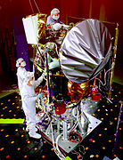
Mars Climate Orbiter
Image source (PD): https://en.wikipedia.org/wiki/Mars_Climate_Orbiter
Lost during Mars approach 1999
~ 330 million US-$ damage

Slide 19
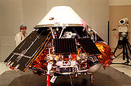
Mars Polar Lander
Image source (PD): https://en.wikipedia.org/wiki/Mars_Polar_Lander
Lost during Mars landing 1999
~ 330 million US-$ damage

Slide 20
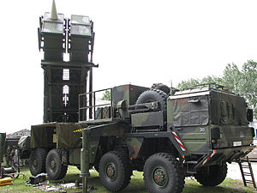
Patriot Missile Disaster
Image source (CC): https://en.wikipedia.org/wiki/MIM-104_Patriot
Error in guidance system
Resulted in 28 deaths during 1991 Gulf war

Slide 21

AT&T phone network crash
Image source (FU): http://www.att.com/gen/press-room?pid=6158&cat=46&u=484
AT&T network collapses on Jan 15th, 1990
11 h downtime, ~ 60 million US-$ damage

Slide 22
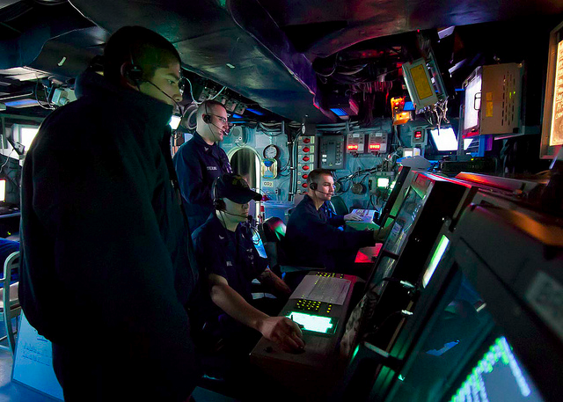
Los Angeles flight control crash
Image source (CC): https://www.flickr.com/photos/usnavy/7261361906/
Flight control at LAX crashes on Apr 30th, 2014
10 cancelled, 500 delayed flights

Slide 23
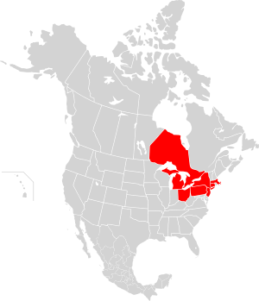
2003 Northeast blackout
Image source (CC): https://en.wikipedia.org/wiki/Northeast_blackout_of_2003
Over 2 days of power outages in US/Canada
~ 10 fatalities, 45 million people affected

Slide 24
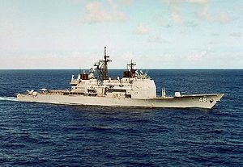
USS Yorktown
Image source (CC): https://en.wikipedia.org/wiki/USS_Yorktown_%28CG-48%29
Testbed for “Smart Ship” program
Ship-wide system crash on Sep 21, 1997 (including engines)

Slide 25
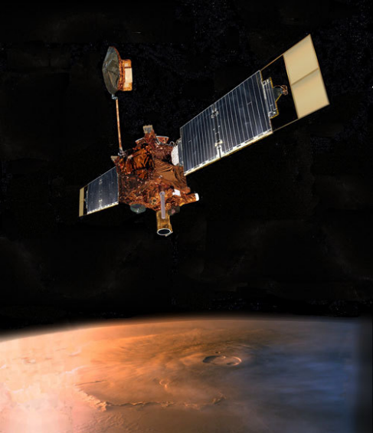
Mars Global Surveyor
Image source (CC): https://en.wikipedia.org/wiki/Mars_Global_Surveyor
Contact lost in 2006
End of successful 10-year mission

Slide 26

Toyota Acceleration Bug
Image source (FU): http://www.toyota-global.com/showroom/emblem/passion/
Causes “unintended acceleration”
May have caused up to 89 deaths

Slide 27
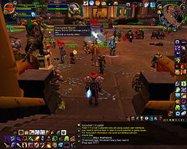
Corrupted Blood Incident
Image source (FU): https://en.wikipedia.org/wiki/File:WoW_Corrupted_Blood_Plague.jpg
Unintended virtual “plague” in WoW
Was later used by epidemiologists to study spread of diseases

Slide 28
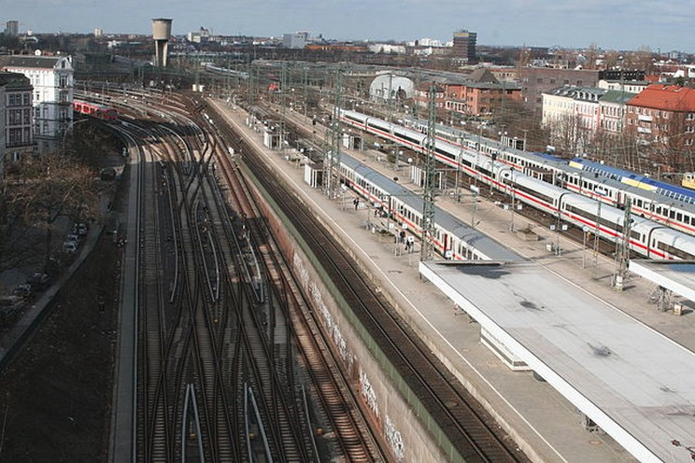
Hamburg-Altona Railway Switch
Image source (CC): https://en.wikipedia.org/.../media/File:Bahnhof_Hamburg_Altona.JPG
Computer “upgrade” of switch system
Result: whole railway station shut down for over 2 days, 100 000s of passengers affected

Slide 29
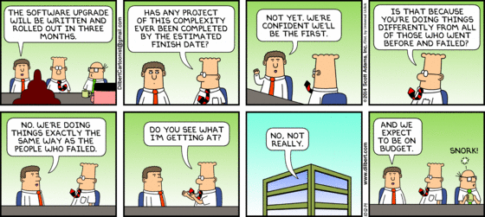
Questions/suggestions?

