Slide 1
Software Engineering
Lecture 09 – Build Process
© 2015-19 Dr. Florian Echtler
Bauhaus-Universität Weimar
<florian.echtler@uni-weimar.de>
This work is licensed under a Creative Commons Attribution-NonCommercial-ShareAlike 4.0 International License.

Slide 2
Today's topics
From code to binary
  Compilation
  Static & dynamic linking
Inside a Hello World program

Slide 3
Preface: Java vs. C(++)
Java Source
C(++) Source
compile time
Bytecode
Assembler Source
Java Virtual
Machine
Machine Code
Machine Code
runtime
Processor
Processor

Slide 4
Preface: from code to binary
What happens when you type
gcc -o helloworld helloworld.c ?
4 sub-stages:
  Preprocessing
  Compilation
  Assembly
  Linking (static/dynamic)

Slide 5
Preface: from code to binary (2)
C(++)
Source
*.c(pp)
Preproc.
C(++)
*.i
ASM
Source
*.s
Preprocessor
(cpp)
Compiler
(gcc)
Include
Files
*.h(pp)
Binary
Object
File *.o
(compile-time)
Linker (ldd)
Assembler
(gas)
Libraries
*.so/dll
Executable
(run-time)
Linker (ld.so)

Slide 6
Preface: from code to binary (3)
What happens when you type
javac HelloWorld.java?
2 sub-stages:
  Compilation & Assembly
  Linking (static/dynamic)

Slide 7
Preface: from code to binary (4)
Java
Source
*.java
JVM
Bytecode
*.class
Java
Archive
*.jar
Compiler
(javac)
Archiver
(jar)
Java Virtual
Machine (java)
Libraries
*.so/dll

Slide 8
Tasks of the linker
Combine multiple object files into binary
  Allows modularization
  Redundant code can be shared
Determine address space/memory layout
  Merge/relocate code blocks from separate objects
Resolve symbolic references
  References to library functions
  References to functions in other objects

Slide 9
Memory Layout (C)
Layout identical for each program (virtual memory)
  Text Segment: executable binary code, read-only
  Data Segment: global vars
  Stack: used for local variables & return addrs
  Heap: used for dynamic allocation (new()/free())
  Beware of memory leaks!
Stack
virtual memory addresses
(empty)
Heap
Data segment
Text segment

Slide 10
Memory Layout (Java)
Everything inside the JVM
  Global heap (shared)
  One stack per thread
  Fixed maximum size
  Method storage
JVM has Garbage Collector
  Deletes unused objects
  No memory leaks (in theory)
  Can impact performance
Stack
Heap
Method area

Slide 11
Linking (static & dynamic)
Static linking: linker tasks performed at compile time, results written to executable
  Good: no incompatibilities possible
  Bad: program size increases
Dynamic linking: linker tasks performed at run time, results loaded into memory
  Good: program can be kept smaller
  Bad: library version conflicts (“DLL hell”)

Slide 12
Linking (static & dynamic) (2)
Both steps usually combined:
  program objects linked statically
  libraries linked dynamically
Examining static linkage:
  C(++): objdump -xd object
  Java: javap -p -c -s classfile
Examining dynamic linkage
  C(++): ldd executable
  Java: not applicable (why?)

Slide 13
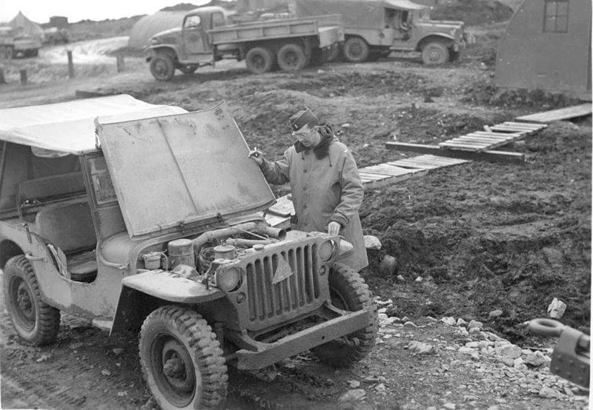
Hello world: under the hood
Image source (PD): https://en.wikipedia.org/...old_jeep_from_world_war_two.jpg

Slide 14
Hello world (C): under the hood
hello.c → hello.i
#include <stdio.h> → [content copy of stdio.h]
void hello() {
printf("Hello ");
}

Slide 15
Hello world (C): under the hood
hello.c/hello.i → hello.s
.section .rodata
.LC0:
.string "Hello "
.text
.globl hello
.type hello, @function
hello:
pushq %rbp
movq %rsp, %rbp
movl $.LC0, %edi
movl $0, %eax
call printf
popq %rbp
ret
global read-only data section with “label” .LC0
start of code section with global label “hello”
“setup” code
printf function call with label reference to .LC0
“cleanup” code

Slide 16
Hello world (C): under the hood
hello.c/hello.i → hello.s → hello.o
Disassembly of section .text:
0000000000000000 <hello>:
0: 55 push %rbp
1: 48 89 e5 mov %rsp,%rbp
4: bf 00 00 00 00 mov $0x0,%edi
5: R_X86_64_32 .rodata
9: b8 00 00 00 00 mov $0x0,%eax
e: e8 00 00 00 00 callq 13 <hello+0x13>
f: R_X86_64_PC32 printf-0x4
13: 5d pop %rbp
14: c3 retq
start address (not yet linked → zero)
Relocations (final addresses are not yet known, will be filled in by linker)

Slide 17
Hello world (C): under the hood
hello_world.dynamic (after linking)
Disassembly of section .text:
00000000004005a2 <hello>:
4005a2: 55 push %rbp
4005a3: 48 89 e5 mov %rsp,%rbp
4005a6: bf 54 06 40 00 mov $0x400654,%edi
4005ab: b8 00 00 00 00 mov $0x0,%eax
4005b0: e8 ab fe ff ff callq 400460 <printf@plt>
4005b5: 5d pop %rbp
4005b6: c3 retq
start address (determined by linker)
Former relocations (final addresses filled in by linker)

Slide 18
Hello world (Java): under the hood
HelloWorld.java
class HelloWorld {
public static void main(String args[]) {
System.out.println("Hello World!");
}
}

Slide 19
Hello world (Java): under the hood
HelloWorld.class
public static void main(java.lang.String[]);
descriptor: ([Ljava/lang/String;)V
Code:
0: getstatic #2 // get static class field // Field java/lang/System.out:Ljava/io/PrintStream;
3: ldc #3 // get string “Hello World!”
5: invokevirtual #4 // invoke virtual method // Method java/io/PrintStream.println:(Ljava/lang/String;)V
8: return
Reference to a PrintStream object from static field System.out
Invoke method println on PrintStream object with String object as parameter
Reference to a constant String object from local object pool

Slide 20
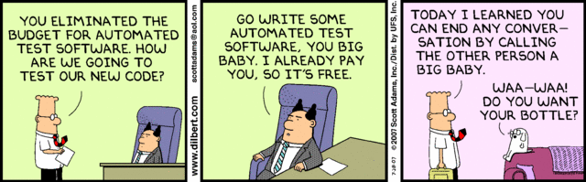
Questions/Comments?

