Slide 1
Software Engineering
Lecture 10 – Error
Handling & Debugging
© 2015-19 Dr. Florian Echtler
Bauhaus-Universität Weimar
<florian.echtler@uni-weimar.de>
This work is licensed under a Creative Commons Attribution-NonCommercial-ShareAlike 4.0 International License.

Slide 2
Error handling with Exceptions
Goal: better structure for error handling
Examples in C(++), but applicable to most other languages
Exceptions are thrown (error reporting) and caught (error handling)

Slide 3
Error handling in C
int process_files() {
input1 = fopen(“file1”, “r”);
if (input1 == NULL)
return errno;
input2 = fopen(“file2”, “r”);
if (input2 == NULL) {
fclose(input1);
return errno;
}
input3 = fopen(“file3”, “r”);
if (input3 == NULL) {
fclose(input1);
fclose(input2);
return errno;
}
// process files
[ … ]
return 0;
}
somewhat messy, requires lots of clean-up code
errors often indicated through return value
NULL for pointers
value < 0 for int, often stored in global variable errno

Slide 4
Error handling in C (2)
int process_files() {
input1 = fopen(“file1”, “r”);
if (input1 == NULL)
goto error_1;
input2 = fopen(“file2”, “r”);
if (input2 == NULL)
goto error_2;
input3 = fopen(“file3”, “r”);
if (input3 == NULL)
goto error_3;
// process files
[ … ]
return 0;
error_3: fclose(input2);
error_2: fclose(input1);
error_1: return errno;
}
Alternative method using goto
“Goto considered harmful” (E. Dijkstra, 1968)
Code using goto generally harder to read/understand
Possible exception as shown in example

Slide 5
Error handling in C++
int process_files() {
MyFile input1(“file1”, “r”);
if (!input1.valid())
return -1;
MyFile input2(“file2”, “r”);
if (!input2.valid())
return -1;
MyFile input3(“file3”, “r”);
If (!input3.valid())
return -1;
// process files
[ … ]
return 0;
}
Local objects destroyed at end of scope
No need for explicit clean-up if properly implemented in destructor
Difficult with non-local objects

Slide 6
Error handling in C++ (2)
void process_files() {
try {
std::ifstream input1(“file1”);
std::ifstream input2(“file2”);
std::ifstream input3(“file3”);
// process files
[ … ]
} catch (std::exception& e) {
// display error message
std::cout << e.what() << “\n”;
}
}
Solution: try/catch blocks for exceptions
Classes from std:: throw derivatives of std::exception
exception.what() provides short text description of error

Slide 7
Exceptions with throw/try/catch
try {
if (index < 0)
throw std::runtime_error(
“Index out of range” );
if (index > 10000)
throw -1;
}
// catch plain integer
catch (int e) {
std::cout << “Error #“;
std::cout << e << “\n”;
}
// catch base class
// of runtime_error
catch (std::exception& e) {
std::cout << e.what() << “\n”;
}
Multiple catch blocks for different types are possible
Rule (C++): “Throw by value, catch by reference”
Java: Throw anything derived from java.lang. Throwable (e.g. subclass of RuntimeException)

Slide 8
Exception propagation
void throw_something() {
// no try...catch here
throw std::runtime_error();
}
void caller() {
try {
throw_something();
}
// exception caught here
catch (std::exception& e) {
std::cout << e.what() << “\n”;
}
// “catch-all” for any type
catch (...) {
std::cout << “default
exception handler\n”;
}
}
Exceptions are propagated upwards until they are caught
Use “catch-all” clauses for any type that does not have a specific handler
Java catch-all: catch (Exception ex)

Slide 9
Debugging
The “basic” approach: printf() & friends
  Not very flexible, modifiable at compile-time only
  Mental “reverse-engineering” of program state
  Can slow program down (sometimes massively)
  Advantages?
The “smart” approach: debugger
  Stop program at arbitrary point
  Advance execution step-by-step
  View arbitrary variables/objects

Slide 10
Debugger commands
Exact command names differ between debuggers (gdb, VS, XCode, …), functionality remains same
Set Breakpoint
→ Execution stops at specified line or method
Set Watchpoint
→ Execution stops when variable is changed

Slide 11
Debugger commands (2)
Step → Execute a single line of code
  Step Into: enter any called functions
  Step Over: call functions as a whole and stop
Inspect/Watch Variable
→ Value of variable is shown while stepping
Run/Continue
→ Execute until breakpoint/watchpoint hit

Slide 12
Stack frames
Stack: dedicated memory for each thread
  keeps track of called functions and their local vars
  grows downward as opposed to heap (malloc, new)
Stack frame: local variables & return address of currently executed function
Debugger can switch to earlier stack frames, i.e. inspect caller's context
List of stack frames = call stack

Slide 13
Call stack
Minimal example with up to 3 stack frames, state when execution paused in line 2
1 int main() {
2 printf(“Hello!”);
3 func1();
4 printf(“Goodbye!”);
5 }
6 void func1() {
7 int i = 1;
8 func2(i);
9 i = 42;
10 }
11 void func2(int a) {
12 int b = a;
13 }
Start of stack:
Frame for main()

Slide 14
Call stack (2)
Minimal example with up to 3 stack frames, state when execution paused in line 7
1 int main() {
2 printf(“Hello!”);
3 func1();
4 printf(“Goodbye!”);
5 }
6 void func1() {
7 int i = 1;
8 func2(i);
9 i = 42;
10 }
11 void func2(int a) {
12 int b = a;
13 }
Start of stack:
Frame for main()
Frame for func1()
Return to main, line 4
Storage for int i

Slide 15
Call stack (3)
Minimal example with up to 3 stack frames, state when execution paused in line 12
1 int main() {
2 printf(“Hello!”);
3 func1();
4 printf(“Goodbye!”);
5 }
6 void func1() {
7 int i = 1;
8 func2(i);
9 i = 42;
10 }
11 void func2(int a) {
12 int b = a;
13 }
Start of stack:
Frame for main()
Frame for func1()
Return to main, line 4
Storage for int i
Frame for func2()
Return to func1, line 9
Storage for int b
Storage for int a

Slide 16
Debugging information
Debugger does not know names of functions, variables etc. → can only show memory addrs
“Human-readable” names must be compiled into executable, e.g. using -g flag (gcc/javac)
Binary grows larger, sometimes slower → usually not enabled for release builds

Slide 17
Buffer Overflow (1)
top of stack
esp = 0x0019fee0
00 | 19 | ff | 28
00 | 40 | 10 | 48
Source (FU): http://arstechnica.com/security/...-the-buffer-overflow/
stack growth
memory addresses
void get_name() {
  char name[64];
  printf(“Your name? ”);
  std::gets(name);
  printf(“Hi, %s.”,name);
}
char name[64]
frame pointer
return address

Slide 18
Buffer Overflow (2)
top of stack
esp = 0x0019fee0
P | e | t | e
r | 00
00 | 19 | ff | 28
00 | 40 | 10 | 48
Source (FU): http://arstechnica.com/security/...-the-buffer-overflow/
stack growth
memory addresses
gets = “Get String”
Reads characters until newline
Does not check any other conditions → problems?
char name[64]
frame pointer
return address

Slide 19

Buffer Overflow (3)
top of stack
esp = 0x0019fee0
A | A | A | A
A | A | A | A
A | A | A | A
A | A | A | A
A | A | A | A
A | A | A | A
A | A | A | A
A | A | A | A
A | A | A | A
A | A | A | A
A | A | A | A
A | A | A | A
A | A | A | A
A | A | A | A
A | A | A | A
A | A | A | A
A | A | A | A
A | A | A | A
A | A | A | A
A | A | A | …
Source (FU): http://arstechnica.com/security/...-the-buffer-overflow/
stack growth
memory addresses
No size check!
→ return address overwritten
→ program crashes
Many similar, outdated C functions → listen to compiler warnings!
Other problems?
char name[64]
frame pointer
return address

Slide 20
Buffer Overflow (4)
top of stack
esp = 0x0019fee0
c | a | l | c
. | e | x | e
88 | 64 | 24 | c0
83 | ec | 48 | 89
e5 | 83 | ec | 54
89 | e3 | 6a | 54
53 | e8 | 42 | d1
b2 | 77 | c6 | 45
ac | 44 | 8d | 45
f0 | 50 | 53 | 52
52 | 52 | 52 | 52
52 | 55 | 52 | fe
4d | 34 | e8 | 49
0b | 84 | 77 | 66
81 | f4 | a4 | 01
56 | 66 | 81 | 34
24 | 78 | 04 | c3
00 | 19 | fe | e8
Source (FU): http://arstechnica.com/security/...-the-buffer-overflow/
stack growth
memory addresses
Return address can be overwritten with pointer to buffer itself
Possible to insert and execute arbitrary code!
Root cause of many historic security issues (e.g. Morris worm)
char name[64]
frame pointer
return address

Slide 21
Buffer Overflow (5)
top of stack
esp = 0x0019fee0
c | a | l | c
. | e | x | e
88 | 64 | 24 | c0
83 | ec | 48 | 89
e5 | 83 | ec | 54
89 | e3 | 6a | 54
53 | e8 | 42 | d1
b2 | 77 | c6 | 45
ac | 44 | 8d | 45
f0 | 50 | 53 | 52
52 | 52 | 52 | 52
52 | 55 | 52 | fe
4d | 34 | e8 | 49
0b | 84 | 77 | 66
81 | f4 | a4 | 01
56 | 66 | 81 | 34
24 | 78 | 04 | c3
00 | 19 | fe | e8
Source (FU): http://arstechnica.com/security/...-the-buffer-overflow/
stack growth
memory addresses
Modern OS contain multiple countermeasures
Possible mitigation strategies?
  Address layout randomization
  Stack “canary” values
  No-Execute-Bit (NX)
char name[64]
frame pointer
return address

Slide 22

Questions/Comments?

Slide 23
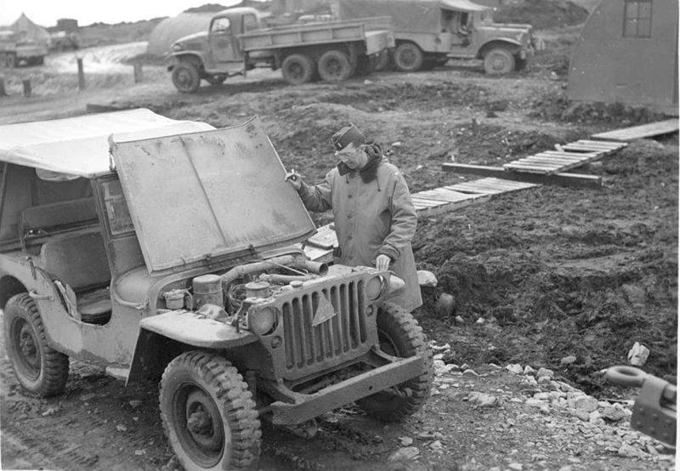
C++ memory layout: under the hood
Image source (PD): https://en.wikipedia.org/...old_jeep_from_world_war_two.jpg

Slide 24
C++ memory layout: under the hood
Source (FU): http://www.openrce.org/articles/files/jangrayhood.pdf
A* a →
class A {
public:
char c;
int i;
void foo();
};
A* a = new A();
a->foo(); // calls A::foo
memory adresses
A::c
<padding>
A::i
local
global
A::foo(A* this)
...

Slide 25
C++ memory layout: under the hood
Source (FU): http://www.openrce.org/articles/files/jangrayhood.pdf
B* b →
class A {
public:
char c;
int i;
void foo();
};
A* a = new A();
a->foo(); // calls A::foo
class B: public A {
public:
int i2;
void foo();
};
B* b = new B();
A* a2 = b;
b->foo(); // calls B::foo
a2->foo(); // calls A::foo
memory adresses
A::c
<padding>
A* a2
A::i
B::i2
local
global
A::foo(A* this)
...
B::foo(B* this)
...

Slide 26
C++ virtual funcs: under the hood
Source (FU): http://www.openrce.org/articles/files/jangrayhood.pdf
P* p →
class P {
public:
int p1;
virtual void bar();
};
P* p = new P();
p->bar(); // calls P::bar
memory adresses
P::virt_funcs
P::p1
local
global
&P::bar
P::bar(P* this)
...

Slide 27
C++ virtual funcs: under the hood
Source (FU): http://www.openrce.org/articles/files/jangrayhood.pdf
Q* q →
class P {
public:
int p1;
virtual void bar();
};
P* p = new P();
p->bar(); // calls P::bar
class Q: public P {
public:
int q1;
virtual void bar();
virtual void baz();
};
Q* q = new Q();
P* p2 = q;
q->bar(); // calls Q::bar
p2->bar(); // calls Q::bar
memory adresses
P::virt_funcs
P* p2
P::p1
Q::q1
local
global
&Q::bar
&Q::baz
Q::bar(Q* this)
...
...

