Slide 1
Software Engineering
Lecture 11 – Testing & Continuous Integration
© 2015-19 Dr. Florian Echtler
Bauhaus-Universität Weimar
<florian.echtler@uni-weimar.de>
This work is licensed under a Creative Commons Attribution-NonCommercial-ShareAlike 4.0 International License.

Slide 2
Testing (Recap)
Abstract: process test cases, check results
However: tests can only show presence of errors, not absence.
Outputs revealing
presence of defects
Input
test
cases
Output
test
results
I_{e}
O_{e}
Inputs causing
anomalous
behaviour
System

Slide 3
Testing (Recap 2)
Validation testing
  Show that software meets requirements
  Test cases modelled after typical use cases
Defect testing
  Obvious goal: find bugs/errors/design flaws!
  Test cases contain atypical/erroneous data

Slide 4
Testing: Variants
Testing is possible at many levels/stages
Development testing
  unit testing
  component testing
  system testing
Performance testing
User testing
Release testing

Slide 5
Development testing strategies (1)
Partition testing (defect testing)
  Determine equivalence partitions for input data
  Equivalent behaviour for all inputs from one partition
  Select test cases from each partition and at partition boundaries
  Related to path testing/code coverage (equivalent behaviour → same execution path), see lecture 8
  Usually requires some knowledge about internals, i.e. pure black-box testing difficult

Slide 6
Development testing strategies (2)
Guideline-based testing (defect testing)
Select test cases known to be error-prone
  NULL for pointers
  NaN, -0, inf for float/double values
  INT_MAX, -INT_MAX, 0 for integers
Sequences/arrays/vectors
  Sequences with 0 or 1 values
  Sequences with different lengths for each test
  Access first/middle/last element of sequence

Slide 7
Development testing strategies (3)
Example:
  Function which accepts 4-10 input values
  Each value is 3-digit integer >= 100
Partitions → see diagram
Guidelines:
  Also test with empty sequence/ single value
  Test with input values of 0/INT_MAX
0 1
3 4 5
7
9 10 11
n:
n < 4
4 <= n <= 10
n > 10
0 MAX
99 100
999 1000
v:
v < 100
v >= 100
v >= 1000

Slide 8
Performance/stress testing
Mainly relevant for back-end systems (servers, databases) – hybrid verification/defect test
Usually relies on required performance (e.g. transactions/second) and exceeds this limit
Goal: test failure behaviour
  soft fail: just fewer transactions than requested
  hard fail: system crash/data loss

Slide 9
Fuzzing
Intentionally flood the component with random/garbage input
  More data per time than during normal operation
  Malicious/garbage data values
Also possible for UIs, e.g. monkeyrunner on Android (generates random touch events)
Often used for security testing, i.e. to find exploitable bugs

Slide 10
User testing
Tests performed by end-users, not developers
Focus on user interface, not internals
  Paper prototypes (before any code is written), mockups (e.g. using HTML5/Flash)
  “Classic” usability study, think-aloud testing (invite testers to lab, observe usage)
  “In-the-wild” study → daily usage scenario + recording/logging of comments, interactions, …
  A/B testing: provide two different variants of UI to two groups of people, compare e.g. efficiency

Slide 11
Release testing
Final verification tests before delivery
Usually black-box testing, relying only on specification/requirements
Also called acceptance testing, may involve customers/users
In agile processes (no rigid requirements):
  Part of each cycle (e.g. Scrum)
  Performed by “product owner”
  Some documentation/”sign-off”recommended

Slide 12
Continuous Integration (1)
Source: https://en.wikipedia.org/wiki/Continuous_integration
CI: agile method, collection of “best practices”
Maintain a code repository
  Use branches sparingly
Automate the build
  A single command (e.g. “make”) should build everything
Make the build self-testing
  Tests should be integrated into build process

Slide 13
Continuous Integration (2)
Source: https://en.wikipedia.org/wiki/Continuous_integration
Often considered the most central part of CI:
Everyone commits to mainline every day
  Keeps number of conflicts low
Every commit to mainline should be built
  Should also be automated, e.g. with Jenkins, Travis-CI (integrated with Github), …

Slide 14
Continuous Integration (3)
Source: https://en.wikipedia.org/wiki/Continuous_integration
Keep the build fast
  Prerequisite for frequent re-builds
Test in a clone of the production environment
  e.g. test apps on real phone, not simulator
  Separate test env. can introduce new bugs
  Use scaled-down production environment
Make it easy to get the latest deliverables
  e.g. direct download access for customer

Slide 15
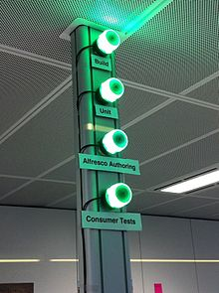
Continuous Integration (4)
Image source (CC): https://en.wikipedia.org/wiki/Build_light_indicator
Everyone can see results of latest build
  Build problems are fixed quickly
  Often shown by physical indicators (see image)
Automate deployment
  e.g. automated upload to app store/beta testers
  “Continuous Deployment”

Slide 16
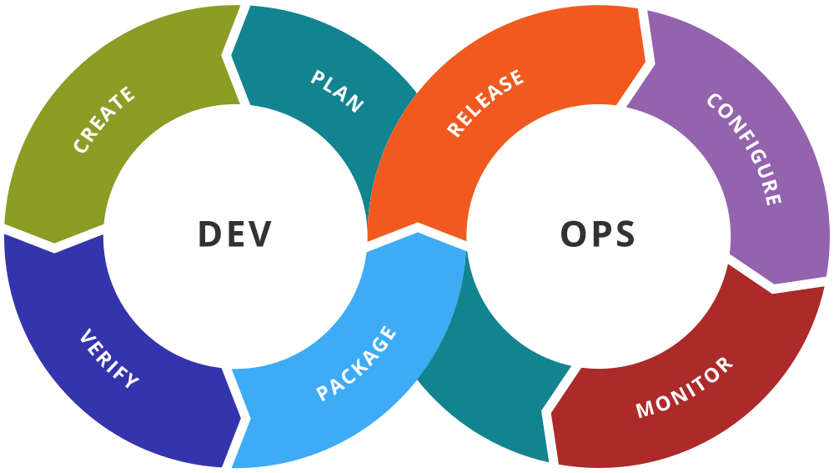
DevOps
Image source (CC): https://commons.wikimedia.org/wiki/File:Devops-toolchain.svg
“Development” + “Operations”
DEV side: very similar to, e.g., Scrum
OPS side: stronger focus on software maintenance
Heavy reliance on automation tools
Useful integration of expertise, or just a way to reduce personnel?

Slide 17
Build systems
Compile & link
  See lecture 9
Dependency resolution
  Internal: determine dependencies of objects, modules, source code etc. (often via timestamps)
  External: locate/install missing libraries, tools, headers etc.

Slide 18
Build systems (2)
Test management
  Run test suites after (each?) successful compilation
  Provide overview of succeeded/failed tests, test coverage
Install products – e.g. …
  Copy to suitable filesystem locations
  Create archives/packages
  Upload to app store

Slide 19
(Meta-)build systems: examples
Make
Autotools/CMake
Ant/Maven/Gradle
Eclipse/Xcode/Visual Studio

Slide 20
Make
Ancient in computing terms – created 1976
Somewhat obscure syntax (“Makefile”)
Only deals with internal dependencies
Can be extended using external tools/scripts

Slide 21
Autotools
Makefile generator
Widely used in open-source projects
Only available for Unix-like environments
Consists of multiple sub-tools (automake, autoconf, configure) which create a Makefile
Also deals with external dependencies
Very powerful, but also very obtuse

Slide 22
CMake
More modern replacement for autotools
Also generates Makefile or Visual Studio XML
Cross-platform (Windows, Linux, MacOS)
Mostly a standalone scripting language

Slide 23
SCons
Standalone build system
Based on Python → generic scripting possible
Automatic dependency analysis
Cross-platform (Windows, Linux, MacOS)

Slide 24
Ant/Maven/Gradle
Standalone build systems
Focused on Java projects
XML-based (Ant/Maven) or JSON-based (Gradle) project description files
Cross-platform (Windows, Linux, MacOS)
Often used for Android projects (esp. Gradle)

Slide 25
Eclipse/Xcode/Visual Studio
Integrated Development Environments (IDEs)
Build system, editor, RCS frontend, test manager, UML tools, …
Support multiple languages (usually at least Java/C++)
Typical examples of CASE tools (Computer Aided Software Engineering)

Slide 26
Build systems: Summary
Once again: one size does not fit all
Build system can add lots of complexity
Try to avoid “feature creep”
Most open-source projects focus on CMake (C, C++) or Ant/Maven (Java)

Slide 27
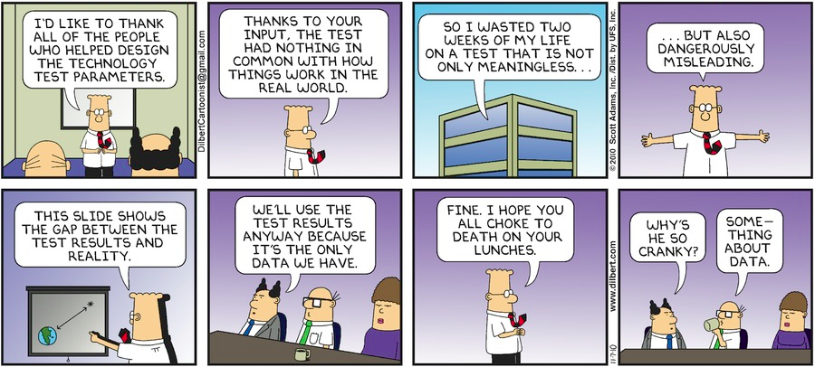
Questions/Comments?
Thanks for listening!

Slide 28
Make: mini HowTo
Commands read from Makefile
Makefile consists of rule blocks
First rule block is executed by default
For other rules/targets: make [target]

Slide 29
Makefile anatomy
# example Makefile rule block
target [target2] …: [prereq1] [prereq2] …
[TAB] command 1
[TAB][command 2]
…
Targets: what files will this rule build?
Prerequisites: what files does this rule need to work?
Commands: what does this rule do to build the targets?
  commands need TAB prefix
  command list aborts after any non-zero exit status

Slide 30
Makefile anatomy (2)
# example for predefined macros
hello: hello.o world.o
  echo “Target name:” $@
  echo “All prerequisites:” $^
  $(CC) -o $@ $^
  # → gcc -o hello hello.o world.o
# example for pattern rules → specify how to build any .o file from any .c file
%.o: %.c
  $(CC) $(CFLAGS) -o $@ -c $^

Slide 31
Makefile anatomy (3)
# example for internal macros & functions
C_FILES = $(wildcard *.c)
hello: $(patsubst %.c, %.o, $(C_FILES))
  $(CC) -o $@ $^
# example for “phony” targets which do not actually create a file, but act as scripts
clean:
  rm hello *.o
.PHONY: clean

