Slide 1
Software Engineering
Lecture 06 – Design Patterns:
Part 2
© 2015 Dr. Florian Echtler
Bauhaus University Weimar
<florian.echtler@uni-weimar.de>
This work is licensed under a Creative Commons Attribution-NonCommercial-ShareAlike 4.0 International License.

Slide 2
Today's topics
Design Patterns part 2:
  Structural patterns
  Behavioural patterns
UI patterns

Slide 3
Structural patterns
Used to compose/hide/modify objects
Rules-of-thumb:http://www.vincehuston.org/dp/structural_rules.html
Examples:
  Adapter/Facade/Proxy
  Composite
  Decorator

Slide 4
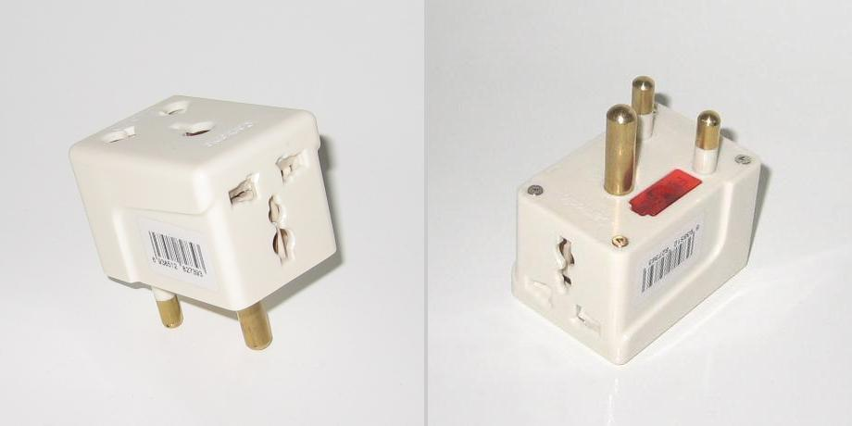
Adapter
Image source (PD): https://en.wikipedia.org/wiki/AC_power_plugs_and_sockets
Adapt existing class interface to alternative/ new interface
Real-world example: see below

Slide 5
Adapter: Code example
Source (FU): http://www.vincehuston.org/dp/adapter.html
class LegacyRectangle {
public:
void draw( int x, int y, int w, int h ) {
std::cout << "rectangle at (" << x << ',' << y
<< ") with width " << w << " and height " << h;
}
}
// adapter to new Shape interface
class Rectangle: public Shape {
public:
Rectangle() { adaptee = new LegacyRectangle(); }
void draw( int x1, int y1, int x2, int y2 ) {
adaptee.draw( min(x1,x2), min(y1,y2),
abs(x2-x1), abs(y2-y1) );
}
private:
LegacyRectangle adaptee;
}

Slide 6
Adapter: similar patterns
Facade – provide simplified external interface for complex, interrelated set of objects
Proxy – provide same interface with extra functionality:
  Placeholder for “expensive” objects
  Local representation for remote object
  Protective proxy: access control
  Caching/reference counting (e.g. smart pointer)

Slide 7
Composite
Useful for representation of tree structures
E.g. scene graph, GUI widgets, directories, …
Composite contains components which can be other composites
Component
virtual void traverse() = 0;
*
Leaf
Composite
void traverse() { … }
void traverse() { … }

Slide 8
Composite: Code example
Source (FU): http://www.vincehuston.org/dp/composite.html
class File: DirEntry {
public:
File( std::string name ): m_name(name) { }
void traverse() { std::cout << m_name << std::endl; }
}
class Directory: DirEntry {
public:
Directory( std::string name ): m_name(name), m_entries() { }
void add( DirEntry* obj ) { m_entries.push_back( obj ); }
void traverse() {
std::cout << m_name << ”:” << std::endl;
for (auto entry: m_entries) {
entry->traverse();
}
}
private:
std::list<DirEntry*> m_entries;
}
class DirEntry {
public:
virtual void traverse() = 0;
protected:
std::string m_name;
}

Slide 9
Decorator
Enables adding extra functionality on the fly
Important – decorators can be stacked:
Stream* decoratedStream = new GZIPStream( new ASCII7Stream( new FileStream("fileName.gz")));
Can't be used to modify the interface
Structure similar to Composite

Slide 10
Decorator
Coffee
virtual string ingredients() = 0;
BasicCoffee
CoffeeDecorator
string ingredients() {
return “Coffee”;
}
Coffee* m_base;
Milk
ExtraEspresso
Milk(Coffee* base) {
m_base = base;
}
string ingredients() {
return m_base->ingredients()
+ ”, with milk”;
}
ExtraEspresso(Coffee* base) {
m_base = base;
}
string ingredients() {
return m_base->ingredients()
+ ”, with extra Espresso”;
}

Slide 11
Decorator
Coffee* coffeeWithMilk = new Milk( new BasicCoffee() );
std::cout << coffeeWithMilk->ingredients() << std::endl;
→ Coffee, with milk
Coffee* doubleShotLatte = new ExtraEspresso(
new ExtraEspresso( coffeeWithMilk ));
std::cout << doubleShotLatte->ingredients() << std::endl;
→ Coffee, with milk, with extra Espresso, with extra Espresso

Slide 12
Behavioural patterns
Used to control/interact with objects
Rules-of-thumb: http://www.vincehuston.org/dp/behavioral_rules.html
Examples:
  Iterator
  Command
  Visitor
  Observer

Slide 13
Iterator
Goal: traverse a collection
Prominent implementation: STL containers
Decouples data structures from algorithms
Iterator object is returned from data structure
Iterator<Item>
Container<Item>
void first();
void next();
Item& current();
bool hasNext();
Iterator<Item>&
getIterator();

Slide 14
Command
Promotes method call to object
Command objects can be passed to other methods and invoked later
Command
Target
void execute();
Target m_target;
void func1(int);
void func2(int);
...

Slide 15
Command
Source (FU): http://www.vincehuston.org/dp/command.html
class Target {
public:
void func1( int param );
void func2( int param );
};
class Command {
public:
typedef void (Target::*Action)(int);
Command( Target* object, Action method, int param ):
m_object(object), m_method(method), m_param(param) { }
void execute() { (m_object->*m_method)(m_param); }
private:
Target* m_object;
Action m_method;
int m_param;
};
[...]
Command cmd( &my_target, &Target::func2, 123 );
cmd->execute();

Slide 16
Visitor
Visitor applies an operation to all objects of an element hierarchy (often recursively)
Complements the Composite pattern
Allows to add functionality to elements without changing elements themselves

Slide 17
Visitor
HTMLElement
virtual void accept
(Visitor* v) = 0;
Visitor
Visitor
virtual void visit
(DivElement* d);
virtual void visit
(SpanElement* s);
...
virtual void visit
(DivElement* d);
virtual void visit
(SpanElement* s);
...
DivElement
void accept(Visitor* v){
v->visit( this );
for (auto c: children)
c->accept( v );
}
RenderVisitor
...
SpanElement
void accept(Visitor* v){
v->visit( this );
...
}
PlaintextVisitor
...

Slide 18
Observer
Provides a way to notify dependent components if a central state changes
Often used to implement Model-View-Controller architecture

Slide 19
Observer
Source: http://www.vincehuston.org/dp/observer.html
Model
Visitor
View
void register(View*);
State getState();
void modify() {
for (auto v: views)
v->update();
}
virtual void visit
(DivElement* d);
virtual void visit
(SpanElement* s);
...
View(Model m) {
m.register(this);
}
virtual void
update() = 0;
GraphicalView
TabularView
void update();
void update();

Slide 20
“Mainloop” Pattern
Not object-oriented, common in many GUI/ graphics libraries
Library has internal mainloop
  void mainloop() {
    while (event = getNextEvent() && !quit)
      process(event);
  }
Problem: using multiple libraries?
Possible solution: expose getNextEvent + process, write own mainloop()

Slide 21

UI Patterns
Image source (FU): http://designinginterfaces.com/
Patterns can also be applied to GUIs
Don't involve code, but rather layout, colors, widgets, …
Book reference: “Designing Interfaces” by Jenifer Tidwell, O'Reilly Books

Slide 22
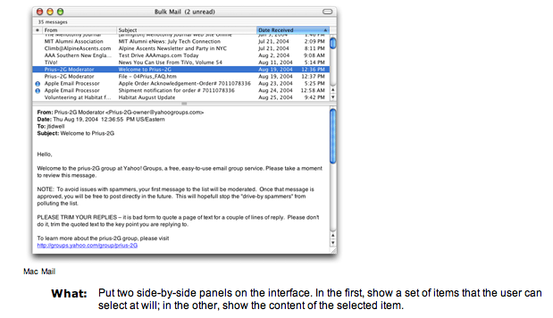
UI Patterns: Two-Panel Selector
Image source (FU): “Designing Interfaces”, Jennifer Tidwell

Slide 23
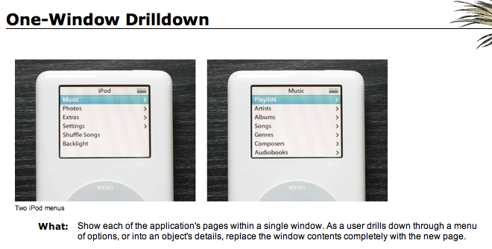
UI Patterns: One-Window Drilldown
Image source (FU): “Designing Interfaces”, Jennifer Tidwell
Alternative to Two-Panel Selector, useful for:
Limited display space
Infrequent usage (e.g. Ubuntu/MacOS settings panel)

Slide 24
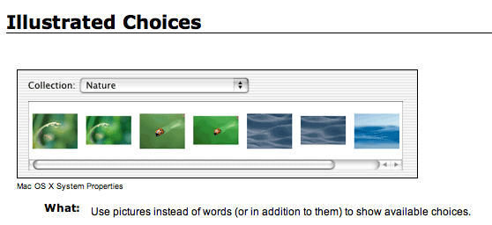
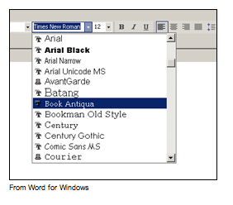
UI Patterns: Illustrated Choices
Image source (FU): “Designing Interfaces”, Jennifer Tidwell
What: use pictures instead of words (or in addition to them) to show available choices.

Slide 25
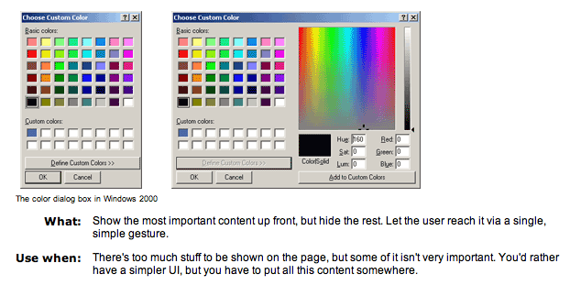
UI Patterns: Extras on Demand
Image source (FU): “Designing Interfaces”, Jennifer Tidwell

Slide 26
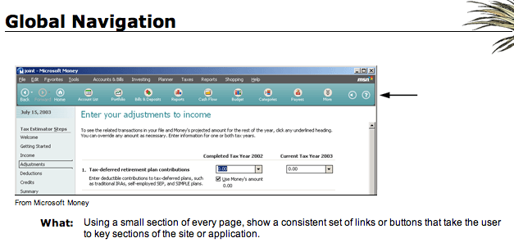
UI Patterns: Global Navigation
Image source (FU): “Designing Interfaces”, Jennifer Tidwell

Slide 27
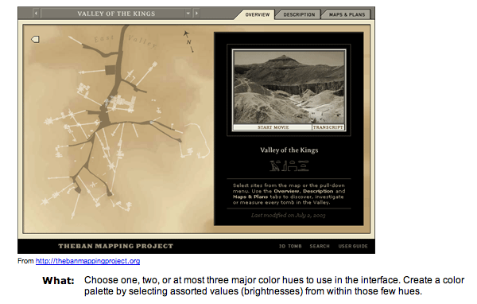
UI Patterns: Few Hues, Many Values
Image source (FU): “Designing Interfaces”, Jennifer Tidwell

Slide 28
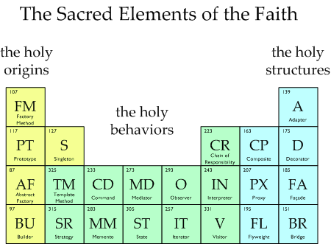
Questions/Comments?
Image source (FU): http://www.vincehuston.org/dp/

