Slide 1
Software Engineering
Lecture 02 – Best Practices
© 2015-18 Dr. Florian Echtler
Bauhaus-Universität Weimar
<florian.echtler@uni-weimar.de>
This work is licensed under a Creative Commons Attribution-NonCommercial-ShareAlike 4.0 International License.

Slide 2
Best Practices
UML/Modelling (Recap)
Revision Control
(Unit) Testing

Slide 3
UML/Modelling (Recap)
UML: Unified Modelling Language
Used for visualization of system design
ISO standard since 2000 (currently v2.5)
Multiple diagram types (14!)
  Structure diagrams
  Behaviour diagrams
(Sometimes) used to auto-generate code

Slide 4

UML Diagram Types
Tools
  Violet: http://alexdp.free.fr/violetumleditor/
  UMLet: http://www.umlet.com/
  ArgoUML: http://argouml.tigris.org/
5 most common diagram types [ES2007]:
  Structure: Class
  Behaviour: Sequence, Use case, State, Activity
Common to all diagram types: comments

Slide 5
Class Diagram (1)
Show properties of classes
  Methods, attributes, visibility, scope
template
parameter(s)
b: Boolean
+ = public
# = protected
- = private
class name
Window
+ size: Area
# visibility: Boolean = b
- window: Pointer
attributes
+ display()
+ show()
+ hide()
italic = abstract
underline = class scope
methods

Slide 6
Class Diagram (2)
Image source (CC): https://en.wikipedia.org/wiki/Class_diagram
Show relations between classes
  Inheritance, implementation, …
Inheritance (“is a”)
superclass
MoneyStorage
subclass
BankAccount
Wallet
Interface (“implements”)
Wallet
<<interface>>
IWallet
Owner

Slide 7
Class Diagram (3)
Image source (CC): https://en.wikipedia.org/wiki/Class_diagram
Show relations between classes
  Composition, Associations, Multiplicity, …
Composition (“contains”,
is destroyed with container)
Aggregation (“has”,
can exist separately)
Car
Motor
Pond
Duck
“1 Car contains 1-2 Motors”
“1 Pond has arbitrary # of Ducks”
NonProfit
Donor
“Every Donor gives to arbitrary # of NonProfits, each NonProfit has arbitrary # of Donors, and each Donation has an individual Amount.”
Donation
Amount:money

Slide 8

Use Case Diagram
Image source (CC): https://en.wikipedia.org/wiki/Use_Case_Diagram
Contains actors and actions
Useful for communication with customers
Mimics real world
Less focus on system internals

Slide 9

Sequence Diagram
Image source (CC): https://en.wikipedia.org/wiki/Sequence_diagram
Shows objects, lifelines and messages
Illustrates …
  runtime behavior
  object lifetimes
  (a)synchronous calls
download

Slide 10
State Diagram
Image source (CC): https://commons.wikimedia.org/wiki/File:UML_State_diagram.svg
Contains states and transistions
Transitions represent external events
Start transition shows initial state
Simulator stopped
Simulator running
Simulator paused
Retrieve log data
[Continue]

Slide 11
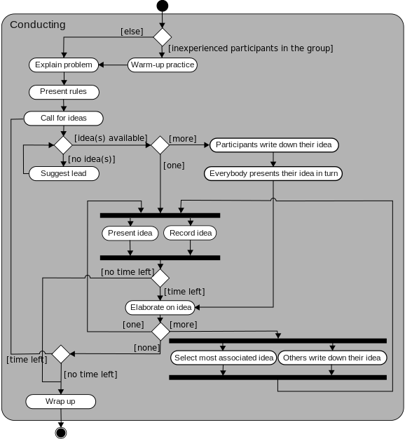
Activity Diagram
Image source (CC): https://en.wikipedia.org/wiki/Activity_diagram
Shows actions, decisions and concurrency (black bars)
Similar to flowchart

Slide 12
UML best practices
Use for communication/documentation
Try to keep diagrams small
Code generation can be helpful …
… but usually only for “boilerplate” code (class structure etc.)

Slide 13
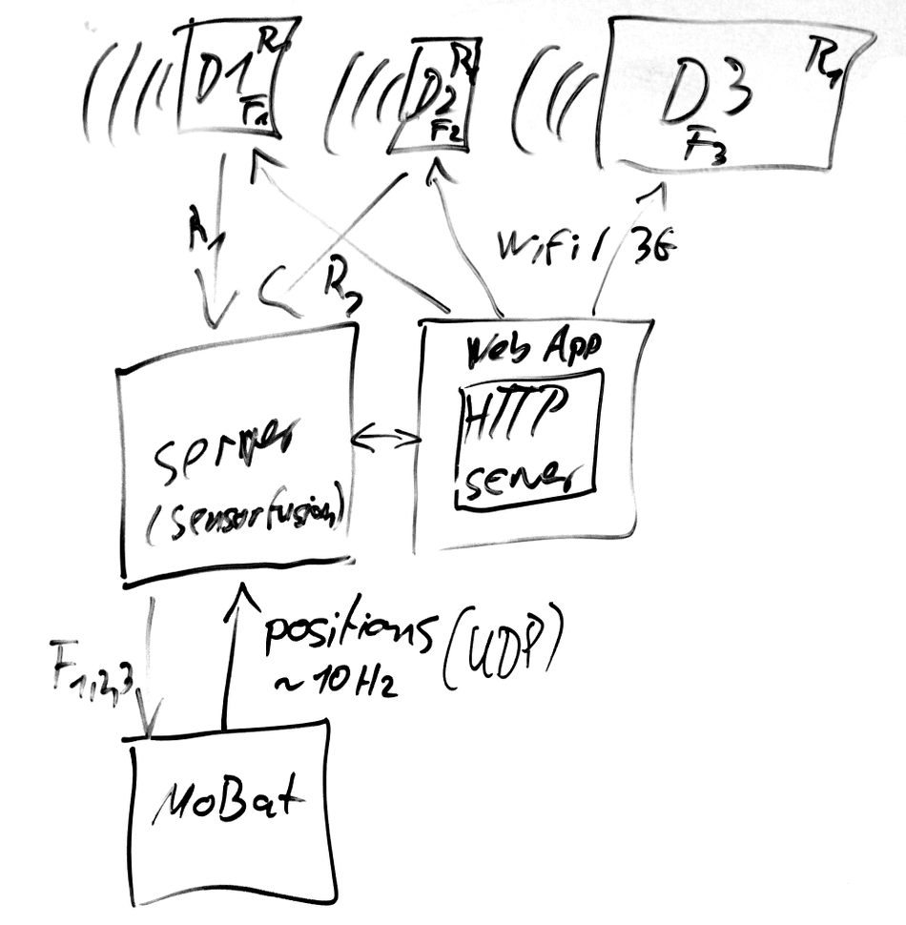
UML: alternatives?
If UML not strictly required: consider simpler “box-and-line” diagrams
Most whiteboard sketches fall into this category :-)

Slide 14
Revision Control
Also known as version or source code control
Revision control systems (RCS) maintain …
  a history of changes
  from multiple persons
  to a set of documents.
Mostly designed for plain-text documents (e.g. source code, LaTeX files, …)
Extensions for binary files (e.g. images) possible

Slide 15
Storing history in RCS (1)
Most RCS use numbered revisions
Initial state of the document set is revision 1,
First change is revision 2, second change ...
Important: not necessarily linear
Revisions can have multiple successors
→ overall structure is a tree (with exceptions)

Slide 16
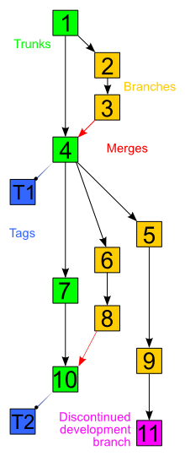
Storing history in RCS (2)
Time
Image source (CC): https://en.wikipedia.org/wiki/Revision_control
Trunk: main development history (often also called master)
Branch: e.g. development of extra features, bugfixes, …
Tags: “bookmarks”, e.g. releases
Merges: combination of 2 or more branches (break pure tree structure)

Slide 17
Storing history in RCS (3)
Time
Image source (CC): https://en.wikipedia.org/wiki/Revision_control
Merges: can lead to conflicts
e.g. what if change sets 6 and 7 edit the same file?
What if it's the same line?
→ may require manual intervention/rewriting

Slide 18
Common RCS terms
Repository (repo): storage for files + history (usually on a remote server)
Working copy: local copy of the files at a specific revision
Common examples: CVS, Subversion (SVN)
working
copy
repo-
sitory

Slide 19
Common RCS operations
checkout: create a local copy
commit: push a set of changes to the repository (atomic operation)
update: integrate new changes from repo into local copy (possibly requiring merge)
working
copy
repo-
sitory
commit
update

Slide 20
Distributed RCS
multiple interconnected repositories (peer-to-peer), no separate working copies
e.g. Bazaar (bzr), Mercurial, git
widely used in open-source context
repo
repo
repo
repo

Slide 21
DRCS operations
clone: create new, complete copy of repo
commit: save changes locally to history
push/pull: transfer to/from remote repo
“upstream”
repo
repo
“downstream”
clone
repo
repo
clone
push
pull

Slide 22
Other RCS ops: diff
diff: view highlighted set of changes
+/- represents added/removed lines
optionally also with changes per word
works best for text docs, e.g. source code
diff --git a/examples/protonect/src/libfreenect2.cpp b/examples/protonect/src/libfreenect2.cpp
index 2d4709b..42e2157 100644
--- a/examples/protonect/src/libfreenect2.cpp
+++ b/examples/protonect/src/libfreenect2.cpp
@@ -422,7 +422,8 @@ bool Freenect2DeviceImpl::open()
if(usb_control_.enablePowerStates() != UsbControl::Success) return false;
if(usb_control_.setVideoTransferFunctionState(UsbControl::Disabled) != UsbControl::Success) ...
- size_t max_iso_packet_size = libusb_get_max_iso_packet_size(usb_device_, 0x84);
+ int max_iso_packet_size;
+ if(usb_control_.getIrMaxIsoPacketSize(max_iso_packet_size) != UsbControl::Success) return false;
if(max_iso_packet_size < 0x8400)
{
...

Slide 23
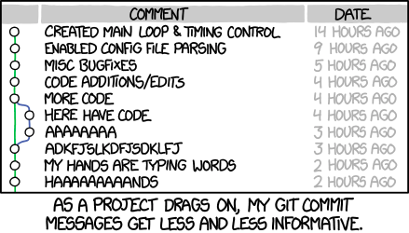
RCS best practices
Keep commits small
Only related changes in one commit
Use meaningful commit messages
Only commit valid code (at least compiles)
RCS is not a backup
Use graphical tools (e.g. tig, gitg)
https://xkcd.com/1296/

Slide 24
Testing
Abstract: process test cases, check results
However: tests can only show presence of errors, not absence.
Outputs revealing
presence of defects
Input
test
cases
Output
test
results
I_{e}
O_{e}
Inputs causing
anomalous
behaviour
System

Slide 25
Testing (2)
Validation testing
  Show that software meets requirements
  Test cases modelled after typical use cases
Defect testing
  Obvious goal: find bugs/errors/design flaws!
  Test cases contain atypical/erroneous data

Slide 26
Testing (3)
Testing is possible at many levels/stages
Development testing
  unit testing
  component testing
  system testing
Release testing
Performance testing
User testing

Slide 27
Development Testing
Performed iteratively during development
Mostly performed by developers themselves (“white-box testing”)
Independent test developers also possible (“black-box testing”)

Slide 28
Unit Testing
Core idea: test each unit of source code individually, e.g. each class
Goal: test all methods, attributes, states
Often requires mock objects/test harnesses to simulate missing system components
Testing all states may require internal knowledge of the class – problem with black box testing

Slide 29
Component/System Testing
Test building blocks consisting of multiple units/classes (or sub-blocks)
Focus on interface between sub-units
Possible types of interface error:
  Interface misuse, e.g. parameters in wrong order
  Interface misunderstanding – incorrect assumptions about behaviour of callee, e.g. passing unsorted array to binary search
  Timing errors – components operate at different speeds → out-of-date information is accessed
“mystery booleans”

Slide 30
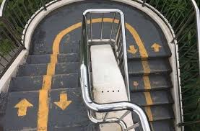
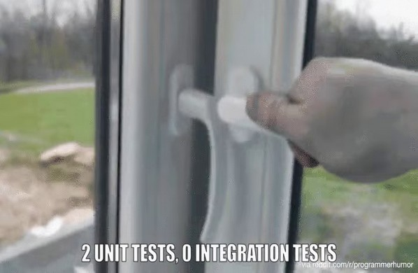
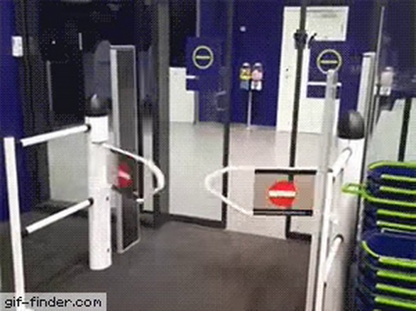

“2 Unit Tests, 0 Integration Tests”
Image source (FU): https://www.reddit.com/r/ProgrammerHumor

Slide 31
Testing automation
Tests should (usually) be automated
e.g. run tests directly after RCS commit
Test frameworks provide structural support
3 phases:
  Setup – initialize object/environment
  Call – execute method
  Assertion – check results
Often grouped in test suites

Slide 32
Testing: best practices
Use a test framework (JUnit, CPPUnit, …)
Automate your tests
Combine with RCS
  Commit/push hooks to trigger tests
  Bisection to find errors in large changesets
Use “extreme” test cases, e.g. NULL, NaN, -0, INT_MAX, empty set, …
If at all possible: write tests first!
scripts executed after
RCS operations

Slide 33
Testing: best practices (2)
Bisection: binary search in revision history
  Identify initial “good” and “bad” commit
  Test the one halfway between good and bad
  Repeat until only one commit left
Works best with small commits
Example: 4th test identifies commit with error
revision history
+
-
Test passes
1.
3.
4.
2.
Test fails
+
+
-
-

Slide 34
General best practices: Teamwork
Follow the coding style guide
  Use a tool like indent
Use team tools
  RCS
  Issue tracker
  Discussion forums
Never, ever send code by e-mail.
Never, ever share code via remote folders.

Slide 35
General best practices: Workflow
A common git workflow with Github:
  Pull recent changes from upstream repository.
  Check for new issues.
  Create and checkout a new branch.
  Fix an issue in this branch.
  Test and commit the branch locally.
  Push the new branch to your Github repository.
  Create a pull request for the master repository.

Slide 36
General best practices: Workflow
GitHub
linux
linux
owner: torvalds
owner: you
“upstream”
Your PC
linux

Slide 37
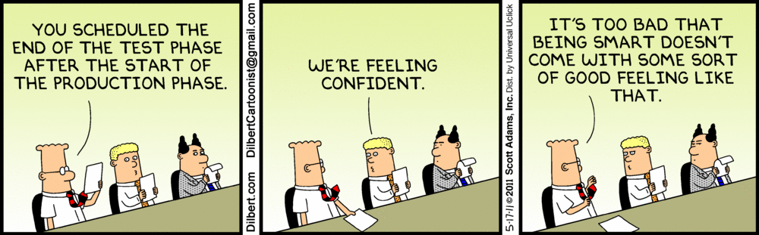
Questions/suggestions?

